Slide 1
Team: Luna R
Week 4
Xinghai Nian, Bingzhen Chen, Xiaoqian Yang

Slide 2
Flashcards to learn a foreign language
Description: A website where users can learn a foreign language using flashcards.
Users would need to register or sign in first before they can choose a language.
Then there are two modes:
1. Study Mode: using flashcards to study.
2. Quiz Mode: Multiple choices, true and false questions.
User score, score rank, time to take the quiz will be saved.

Slide 3

What we’ve accomplished:
Frontend: homepage and login/signup page are done.
Backend: flask routing, flash messages are done.
We will focus on the backend in the following week, to finish Milestone 2.
Milestone 2 | Frontend/backend development (home page, register, login) | week 4: 02/23/2023
Milestone 3 | Frontend/backend development (study mode design) | week 6: 03/09/2023
Milestone 4 | Frontend/backend development (quiz mode design) | week 8: 03/23/2023
Milestone 5 | Frontend/backend development (score board design) Test website, possibly deploy the website. | week 10: 4/15/2023

Slide 4
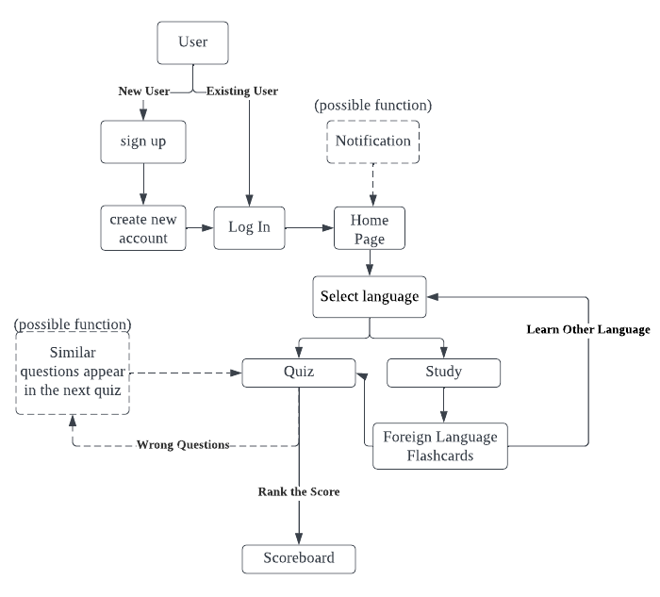
Minor change in Flowchart
Let users choose language before selecting Study Mode or Quiz Mode.

Slide 5
Updates on job assignments
Xinghai Nian: study mode design, quiz mode quiz question design
Bingzhen Chen: flashcards design, scoreboard design
Xiaoqian Yang: home page, sign in/up, log out, study mode/quiz mode choices page, user accounts, create a database, connect database to the website
We will function as a team.

