Slide 1
Team: Luna R
Week 8
Xinghai Nian, Bingzhen Chen, Xiaoqian Yang

Slide 2
Flashcards to learn a foreign language
Description: A website where users can learn a foreign language using flashcards.
Users would need to register or sign in first before they can choose a language.
Then there are two modes:
1. Study Mode: using flashcards to study.
2. Quiz Mode: Multiple choices, true and false questions.
User score, score rank, time to take the quiz will be saved.
Github: https://github.com/StacyYang/Flashcards-to-learn-a-foreign-language

Slide 3

What we’ve accomplished:
For administer account, we are able to create a administer account, and can list all user accounts, remove any account. And list quiz questions.
Milestone 2 | Frontend/backend development (home page, register, login) | week 4: 02/23/2023
Milestone 3 | Frontend/backend development (study mode design) | week 6: 03/09/2023
Milestone 4 | Frontend/backend development (quiz mode design) | week 8: 03/23/2023
Milestone 5 | Frontend/backend development (score board design) Test website, possibly deploy the website. Administer account | week 10: 4/15/2023

Slide 4

What we are doing right now:
Work on frontend & backend design for Scoreboard
Admin dashboard:
delete questions
delete flashcards
possibly allow administer to add new questions and flashcards

Slide 5
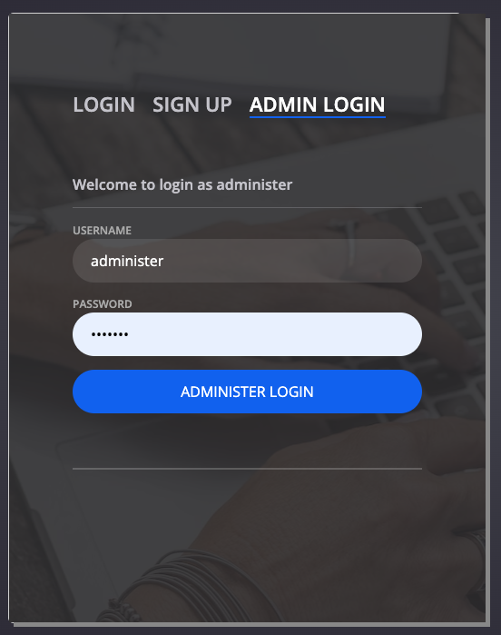
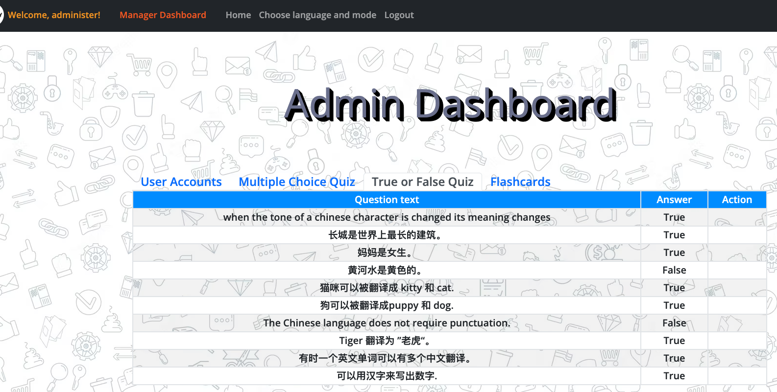
Demo screenshot for Administer account
Administer username: administer password: 1234567
Test user username: tester password: 1234567

Slide 6
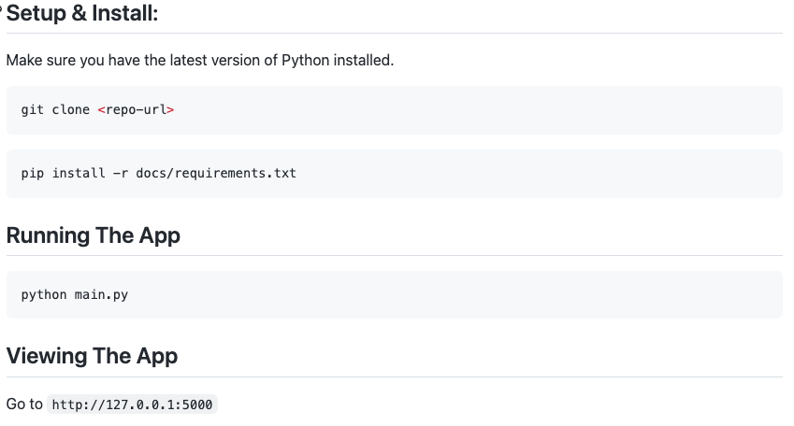



Documentation for expert users

Slide 7
Testing Plan
Functionality testing:
Check that all the links on the website are working properly.
Verify that users can log in, sign up, and log out successfully.
Ensure that users are redirected to the correct pages after logging in or signing up.
Check that users are able to choose a language mode and access the quiz.
User interface testing:
Verify that the website is visually appealing and easy to navigate.
Check that all buttons and forms are properly labeled and functioning correctly.
Ensure that the website is responsive and looks good on different size of screens.
Security testing:
Check that user passwords are being stored securely (using a secure hashing algorithm).
Database testing:
Verify that user information is being stored correctly in the database.
Check that the database schema is designed properly and optimized for performance.
Performance testing:
Test the website's load times to ensure that it is loading quickly and efficiently.
Use JMeter to check that the website is able to handle a large number of users simultaneously without crashing or slowing down.

Slide 8
Follow up from previous partner: Codescapes
- make sure your files in weekly_team_presentation and weekly_team_report are formatted the same - ex. week1, week2, week3, ... (Done)
- easy setup - documentation was easy to follow - minor change: tell users to change into dev folder before running main.py or change command to python dev/main.py (Done)
Recommendation: - create an about us page - cool seeing team members, but it takes up more than half the main page (Might do that if have time, but seems not very important)

Slide 9
Feedback from ThriveToday
Website works and looks good! (Thank you)
Possible light mode? Or easier to read colors. (May not have time to implement a light mode, but will modify some of the CSS at the end.)

Slide 10
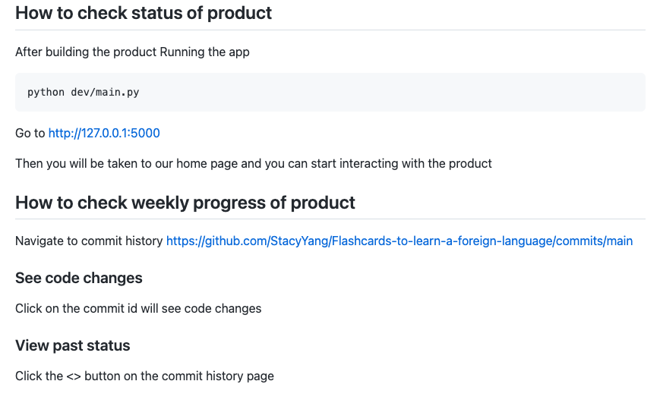
How to check the status for our product

