Slide 1
Team: Luna R
Week 6
Xinghai Nian, Bingzhen Chen, Xiaoqian Yang

Slide 2
Flashcards to learn a foreign language
Description: A website where users can learn a foreign language using flashcards.
Users would need to register or sign in first before they can choose a language.
Then there are two modes:
1. Study Mode: using flashcards to study.
2. Quiz Mode: Multiple choices, true and false questions.
User score, score rank, time to take the quiz will be saved.

Slide 3

What we’ve accomplished:
Milestone 2, 3.
A transaction page after user login to allow users choose language and mode.
Quiz mode frontend & backend design.
Milestone 2 | Frontend/backend development (home page, register, login) | week 4: 02/23/2023
Milestone 3 | Frontend/backend development (study mode design) | week 6: 03/09/2023
Milestone 4 | Frontend/backend development (quiz mode design) | week 8: 03/23/2023
Milestone 5 | Frontend/backend development (score board design) Test website, possibly deploy the website. | week 10: 4/15/2023

Slide 4

What we are doing right now:
Improve the UI of the Study mode, store notes to database.
Store scores to database.
Frontend & backend design for Scoreboard

Slide 5
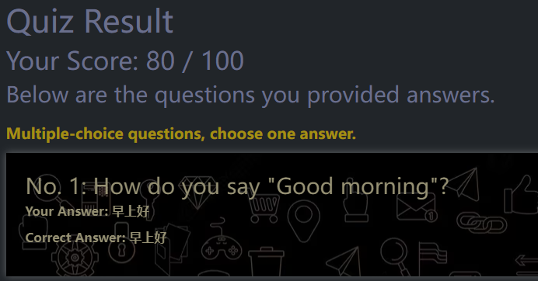
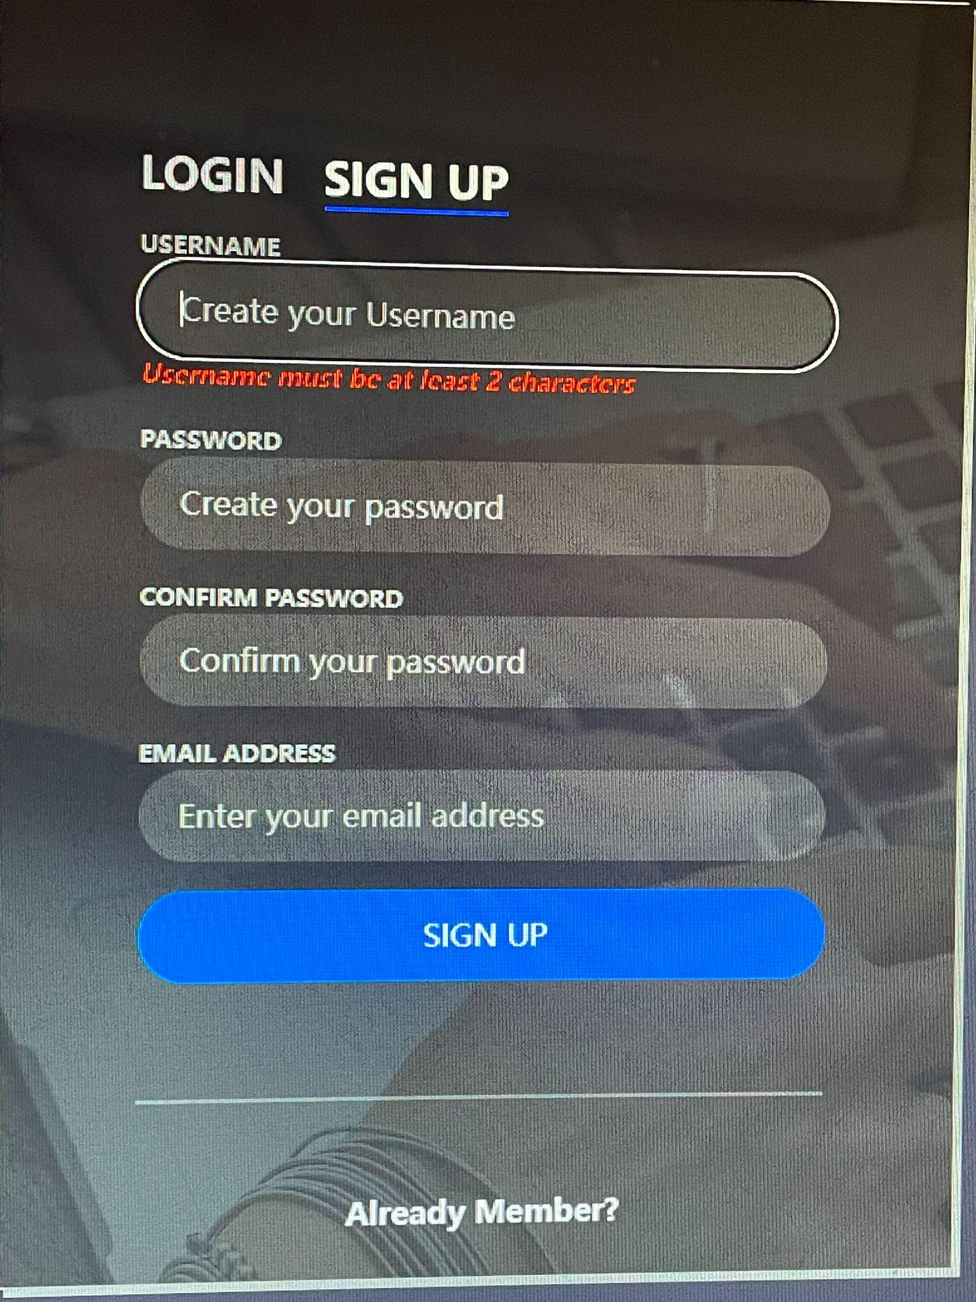
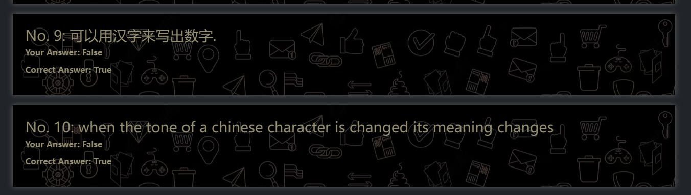
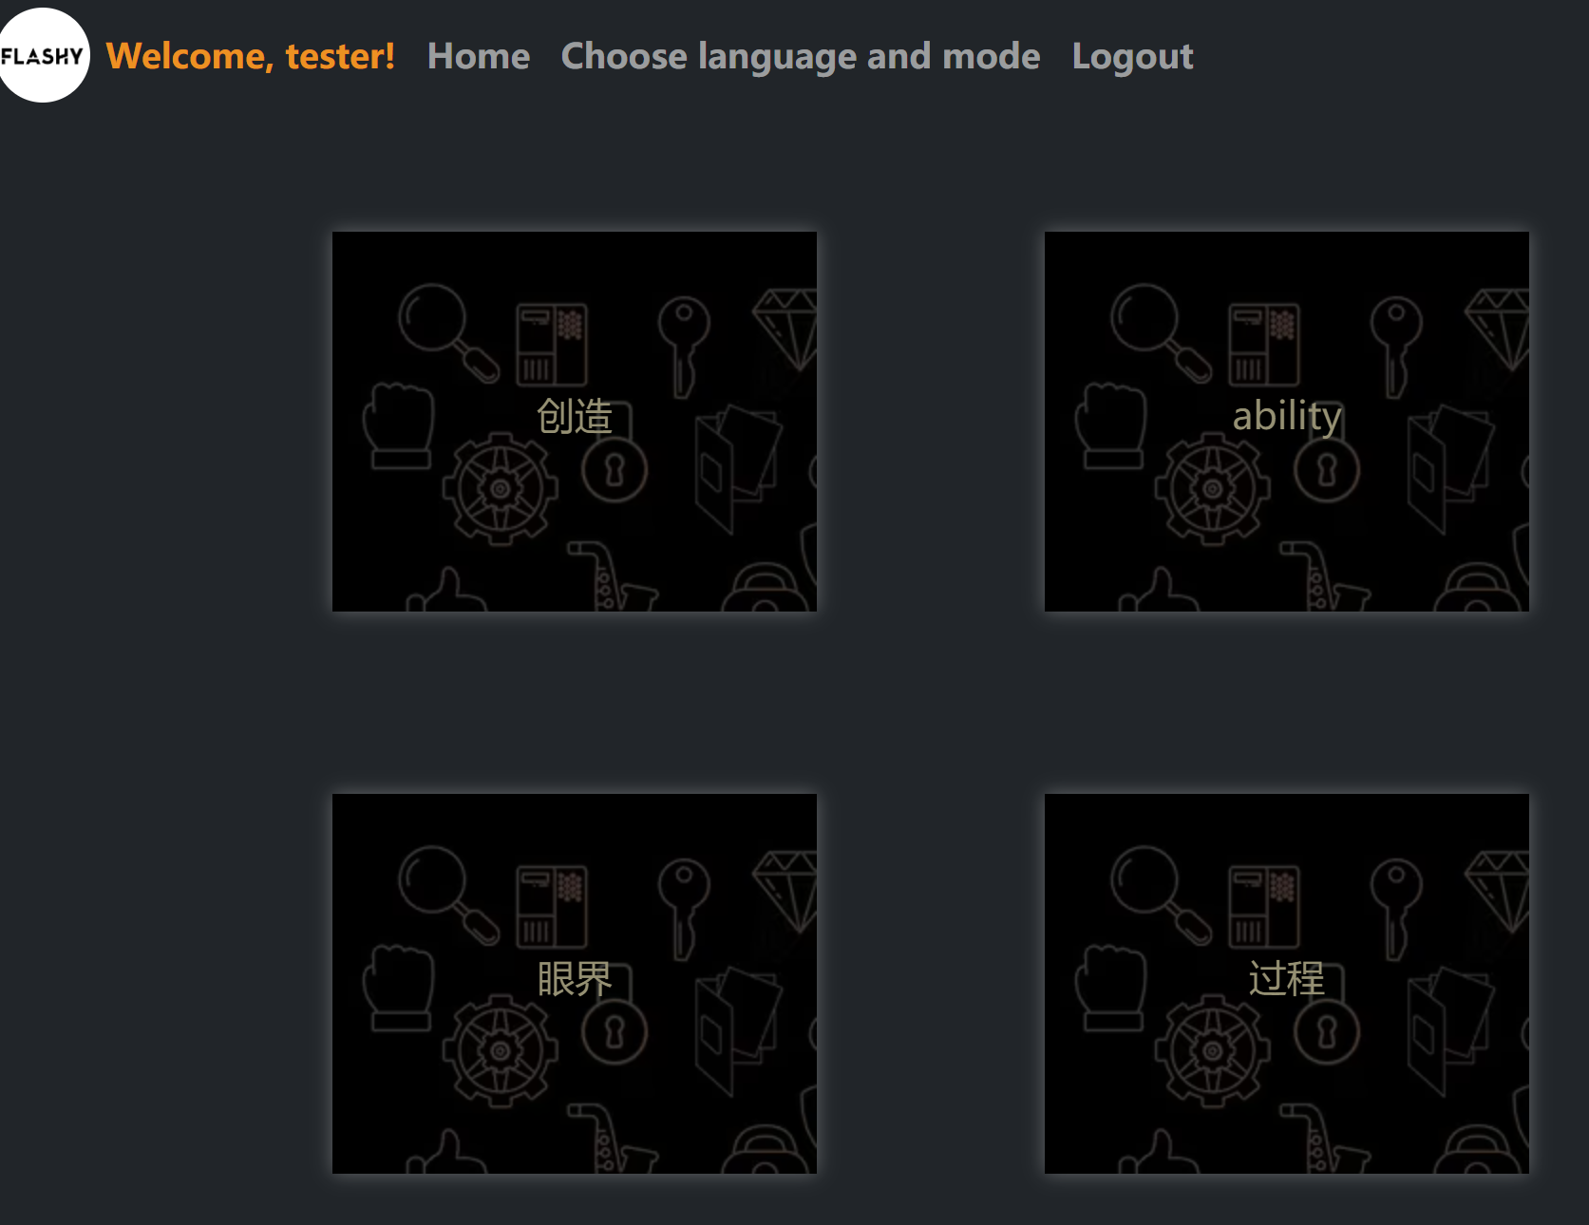
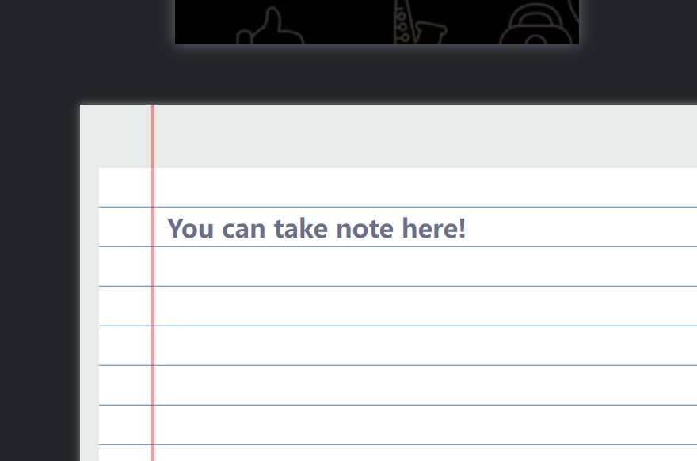
Update
Completed Quiz Result, score and correct answer will be displayed after the user answers
Display requirements at registration
Preliminary completion of the study mode section

Slide 6
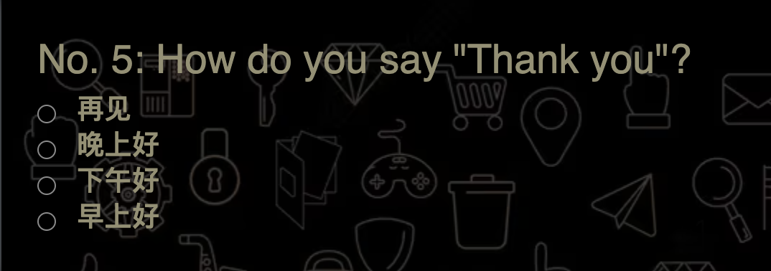
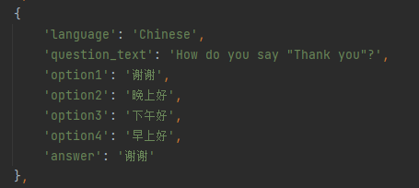
Update
Fixed the problem of not having the correct answer
No correct answer
After change

Slide 7
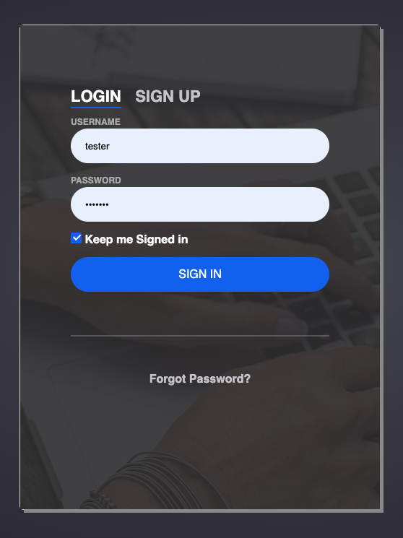
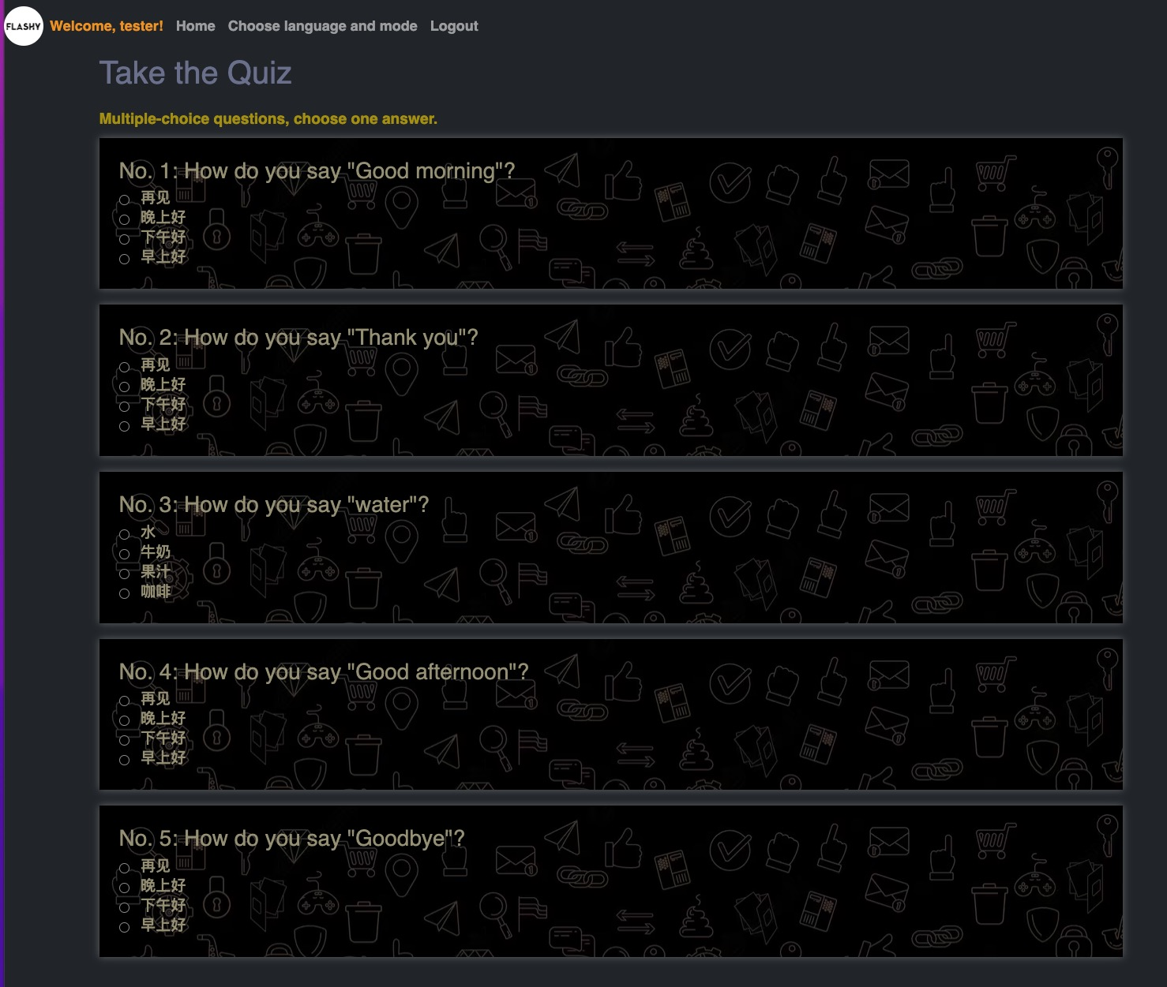
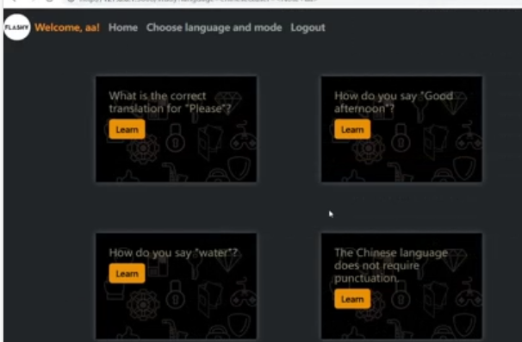
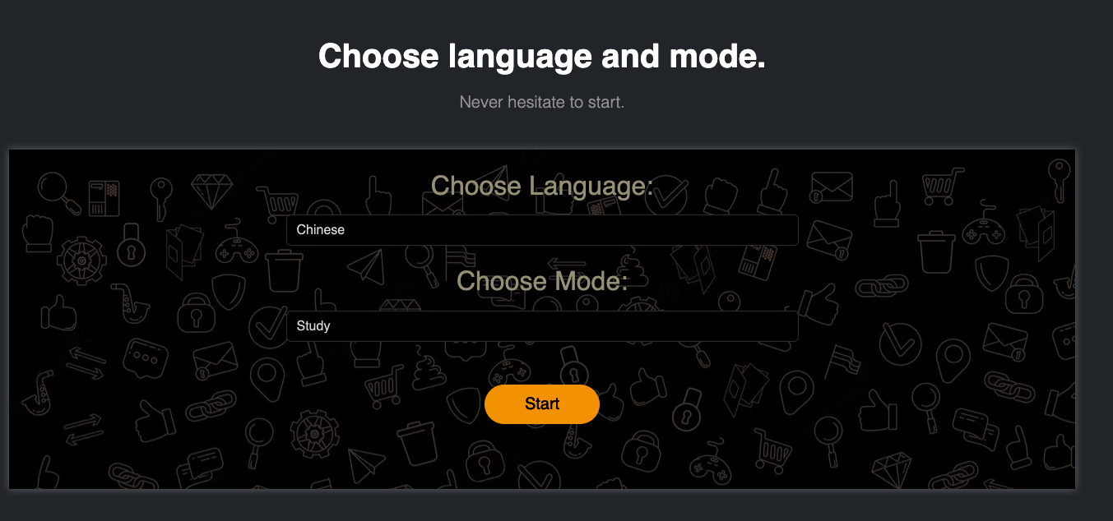
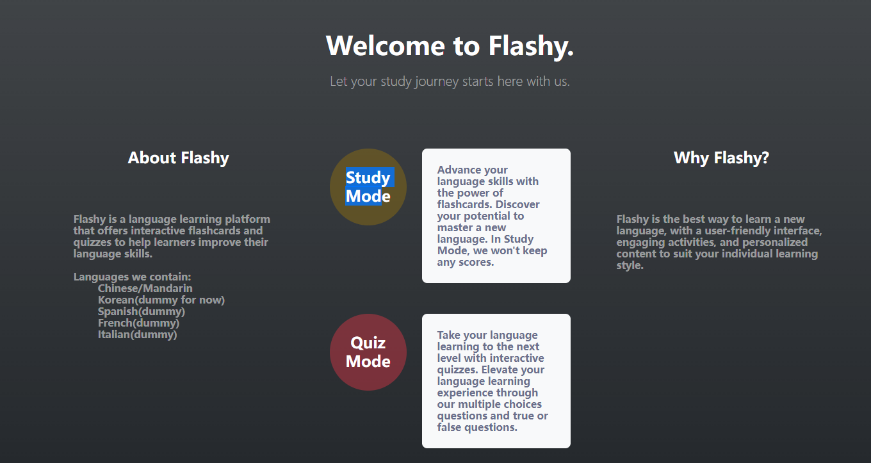
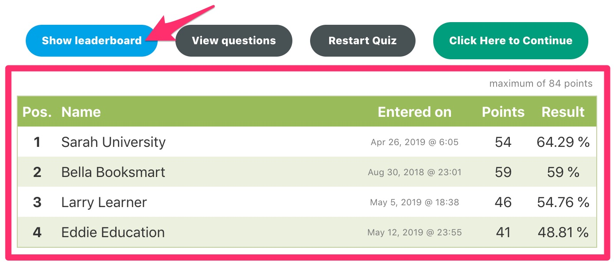
Documentation for application users
register
login
study or quiz
study by using flashcards
T/F and multiple choice questions
scoreboard after quiz

Slide 8
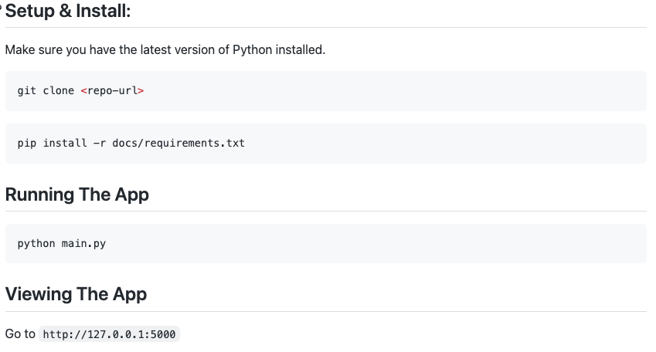



Documentation for expert users

Slide 9
Testing Plan
Check that all the links on the website are working properly.
Verify that users can log in, sign up, and log out successfully.
Ensure that users are redirected to the correct pages after logging in or signing up.
Check that users are able to choose a language mode and access the study and quiz.
Test the flip function of flashcards
Try typing in the note section
Select the answer in quiz mode

Slide 10
Feedback from The Librarians
Kyle
Overall great work so far. Since we have a Flask app as well, I would be interested to see a more detailed Testing Plan.
Dexter
Great job with the UI. I would love to see more stuff for accessibility. Stuff like changing the font size, font color, background color can allow a bigger varieties of users to use the website.

Slide 11
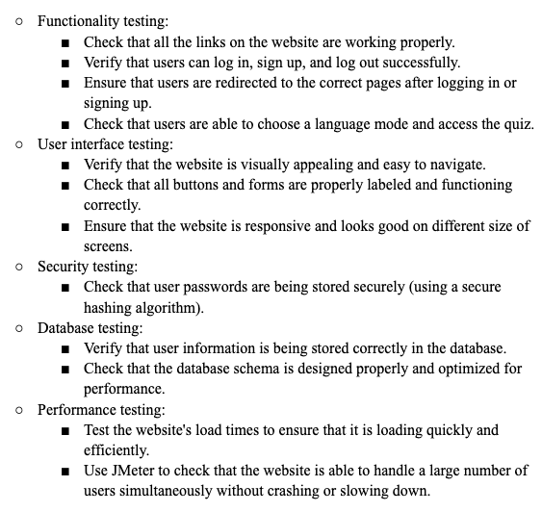
Response to Feedback
A more detailed testing plan:

