Slide 1
Team: Luna R
Week 9
Xinghai Nian, Bingzhen Chen, Xiaoqian Yang

Slide 2
Flashcards to learn a foreign language
Description: A website where users can learn a foreign language using flashcards.
Users would need to register or sign in first before they can choose a language.
Then there are two modes:
1. Study Mode: using flashcards to study.
2. Quiz Mode: Multiple choices, true and false questions.
User score, score rank, time to take the quiz will be saved.
3. Administer: List all user accounts, all questions and all flashcards. And allow administer to delete them.
Github: https://github.com/StacyYang/Flashcards-to-learn-a-foreign-language

Slide 3

What we’ve accomplished:
NEW UPDATES:
1. For administer account, we can list all user accounts, remove any account. And list all questions and flashcards and allow administer to delete them.
2. Fix the issue of sign up page: Before always direct to login page when sign up requirements not satisfied, right now it will stay in sign up page.
Last Mission:
Milestone 5 | Frontend/backend development (score board design) Test website, possibly deploy the website. Administer account | week 10: 4/15/2023

Slide 4

What we are doing right now:
Work on frontend & backend design for Scoreboard
Admin dashboard:
Allow administer to add new questions and flashcards
3. Allow users to reset their password

Slide 5
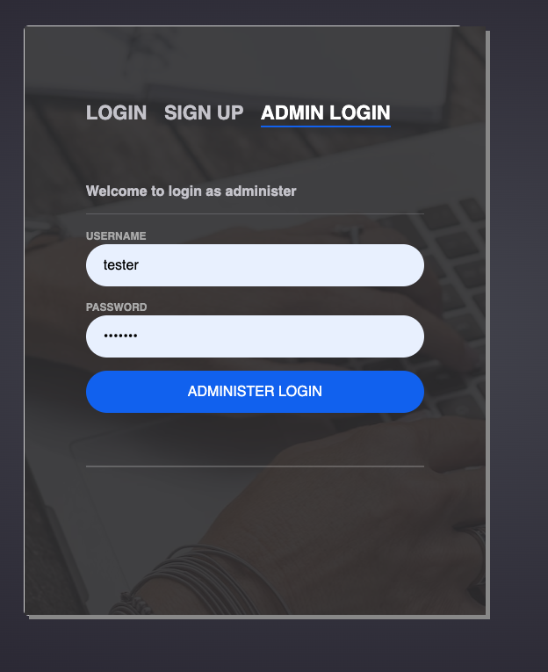
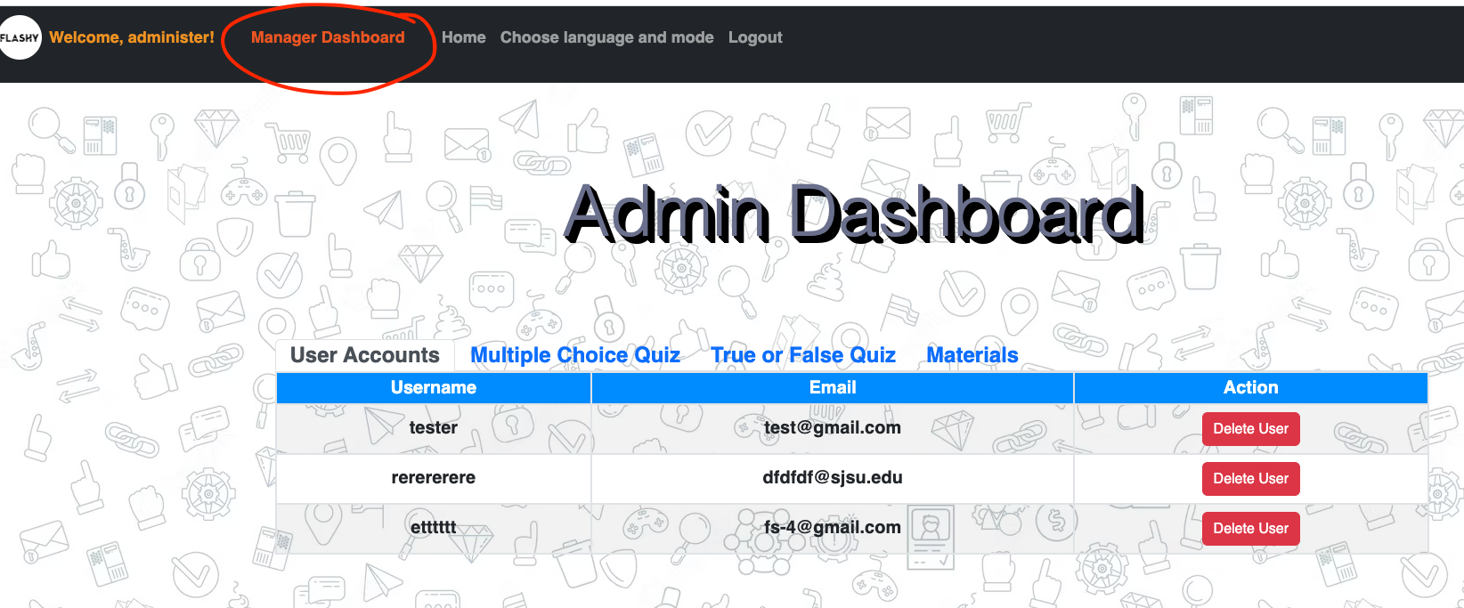
Administer account
Administer username: administer password: 1234567
Test user username: tester password: 1234567

Slide 6
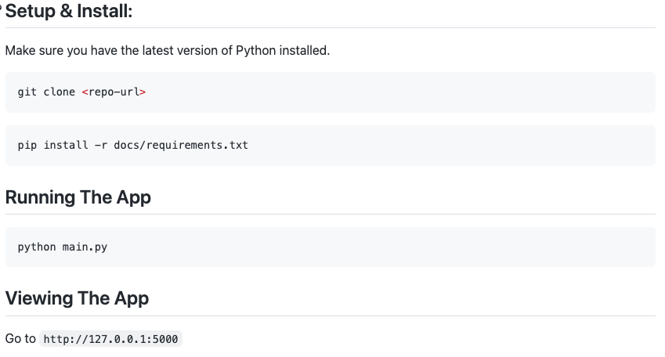



Documentation for expert users

Slide 7
Testing Plan
Functionality testing:
Check that all the links on the website are working properly.
Verify that users can log in, sign up, and log out successfully.
Ensure that users are redirected to the correct pages after logging in or signing up.
Check that users are able to choose a language mode and access the quiz.
User interface testing:
Verify that the website is visually appealing and easy to navigate.
Check that all buttons and forms are properly labeled and functioning correctly.
Ensure that the website is responsive and looks good on different size of screens.
Security testing:
Check that user passwords are being stored securely (using a secure hashing algorithm).
Database testing:
Verify that user information is being stored correctly in the database.
Check that the database schema is designed properly and optimized for performance.
Performance testing:
Test the website's load times to ensure that it is loading quickly and efficiently.
Use JMeter to check that the website is able to handle a large number of users simultaneously without crashing or slowing down.

Slide 8
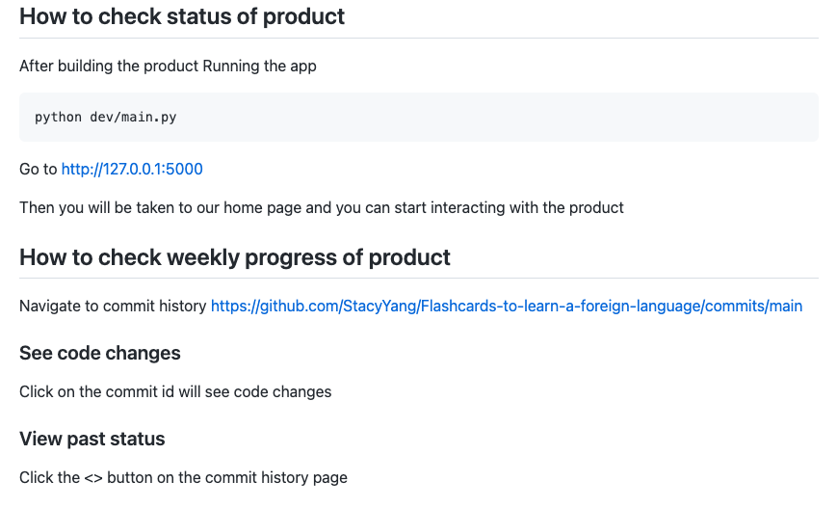
How to check the status for our product

Slide 9
Supervisor account
We think it’s a good idea to have a supervisor account.
The amount of Time and effort needed: three weeks
Since we are ahead of our schedule, so it is possible for us to implements some of the features.
It is a plus to the product. Easy and reasonable to maintain the website.
Features we plan to implement:
list/summarize the individual data of registered users. (Done)
remove user accounts (Done)
(and have all the capabilities of a regular user?) (Done)
delete quizzes and flashcards. (Done)
reset users' password (??)

Slide 10
Feedback from previous partner Codescapes
- make sure your files in weekly_team_presentation and weekly_team_report are formatted the same - ex. week1, week2, week3, ... (DONE)
- easy setup - documentation was easy to follow - minor change: tell users to change into dev folder before running main.py or change command to python dev/main.py (DONE)
Recommendation: - create an about us page - cool seeing team members, but it takes up more than half the main page (Might do that if have time)

Slide 11
Feedback from new partner: Gladiators
- Successfully ran application locally
- The documentation was clear and easy to understand
- App setup was also smooth
- The website has a really nice UI. I like the dark mode theme
- I was able to create an account, but when I click on Start under Choose a Language and mode, it is taking me to another page with index error (Will Look into it)

Slide 12
User-friendliness: how to make your product more user friendly? Give examples like the following
Ask users to repeat passwords during the sign up (Alright have it)
Help users to recall their account names and passwords (Will do that)
Automatic log out if idle too long (might do that)

