Slide 1
Team: Luna R
Xinghai Nian(Leader), Bingzhen Chen, Xiaoqian Yang

Slide 2
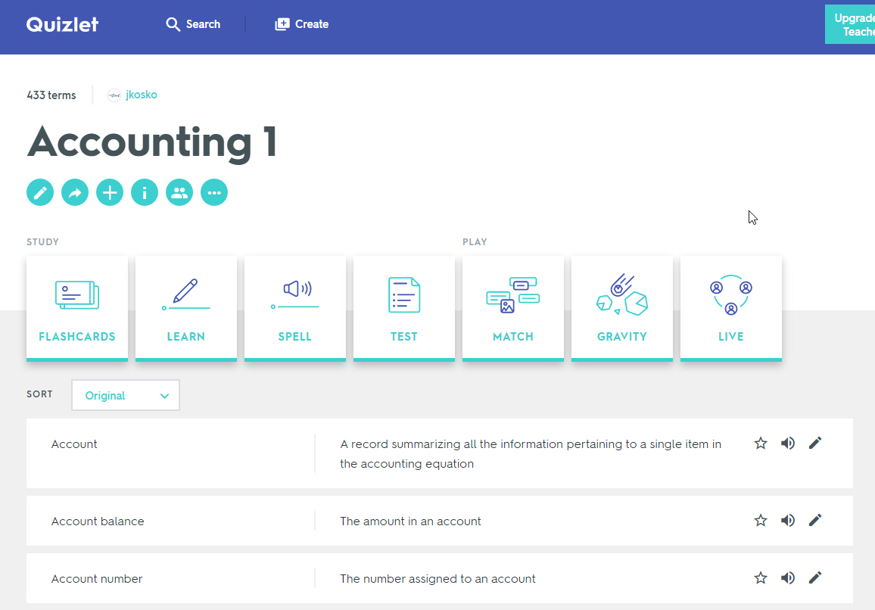
Flashcards to learn a foreign language
Description: A website where users can learn a foreign language using flashcards with their friends or alone.
(Original idea, things may change as we design.)

Slide 3
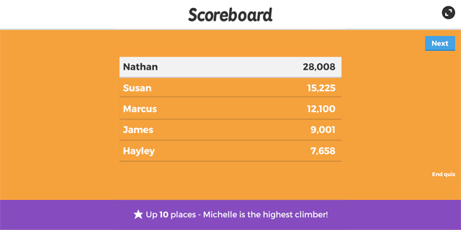
Flashcards to learn a foreign language
Description: A website where users can learn a foreign language using flashcards with their friends or alone.
Users would need to register or sign in first.
Then there are two choices: 1. Study, no score will be recorded.
2. Quiz, the score, rank will be record.

Slide 4
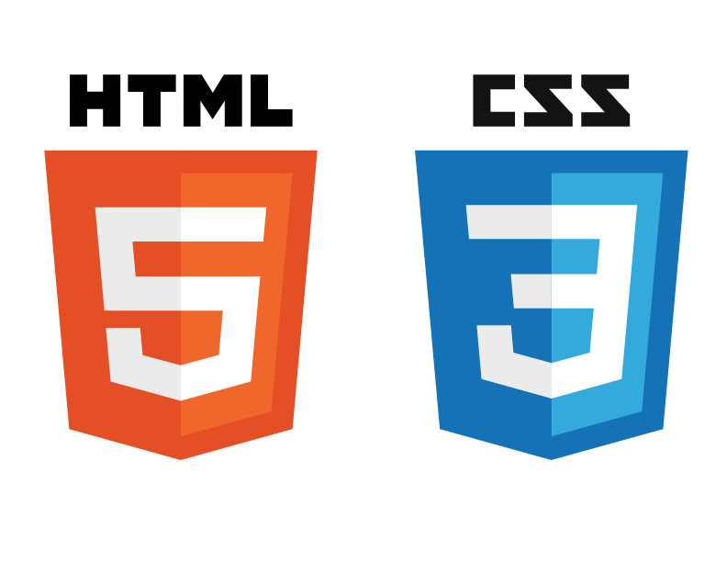




Technologies involved
Frontend: HTML, CSS, JavaScript
Backend: Flask/Jinja, Python, MongoDB/SQLite for database
Notes:
Job assignments, what did u do, website structure

Slide 5
Milestones:
Milestone1: Setup Github repo & work enviorment
Research on tech skills to learn
Website structure design
Milestone2: Frontend/backend development (home page, register, login)
Milestone3: Frontend/backend development (study mode design)
Milestone4: Frontend/backend development (quiz mode design)
Milestone5: Frontend/backend development (score board design)
Milestone6: Test website, possibly deploy the website.

Slide 6
What we look forward to:
Get familiar with more programming languages and technologies
2. Learn end-to-end software engineering approach to developing applications.

