Slide 1
Team: Luna R
Week 13
Xinghai Nian, Bingzhen Chen, Xiaoqian Yang

Slide 2
Flashcards to learn a foreign language
Description: A website where users can learn a foreign language using flashcards.
Users would need to register or sign in first before they can choose a language.
Then there are two modes:
1. Study Mode: using flashcards to study.
2. Quiz Mode: Multiple choices, true and false questions.
User score, score rank, time to take the quiz will be saved.
3. Administer: List all user accounts, all questions and all flashcards. And allow administer to delete them.
Github: https://github.com/StacyYang/Flashcards-to-learn-a-foreign-language

Slide 3
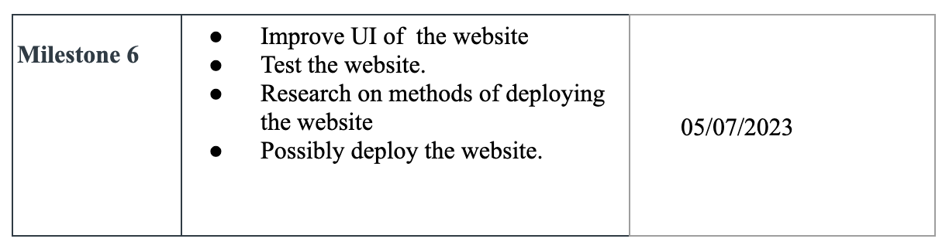

What we’ve accomplished:
Last Mission:

Slide 4

What we are doing right now:
Research on hosting the website.

Slide 5
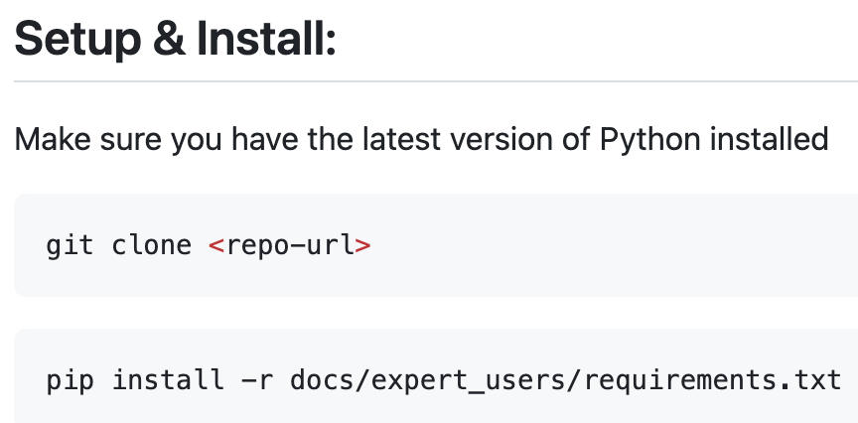



Documentation for expert users

Slide 6
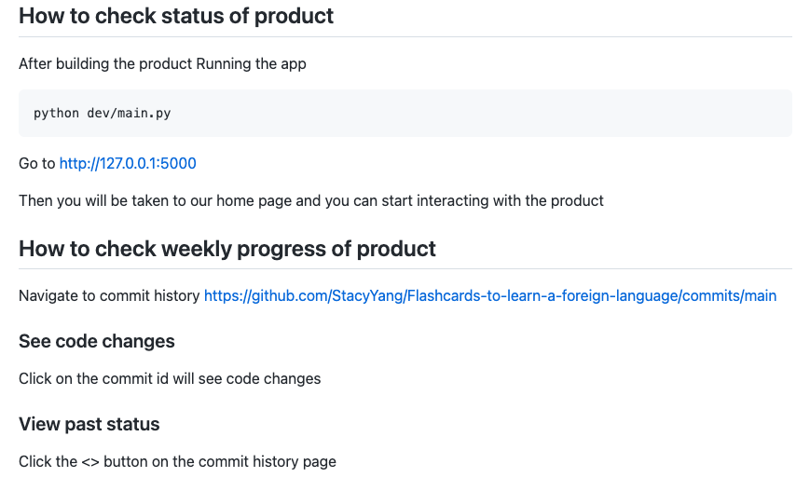
How to check the status for our product

Slide 7
Hosting methods:
Two common methods we can consider for our website:
Heroku
AWS EC2
We might not move on with deploying the website if it’s not a hard request.

Slide 8
Help offered and received:
None this week.

Slide 9
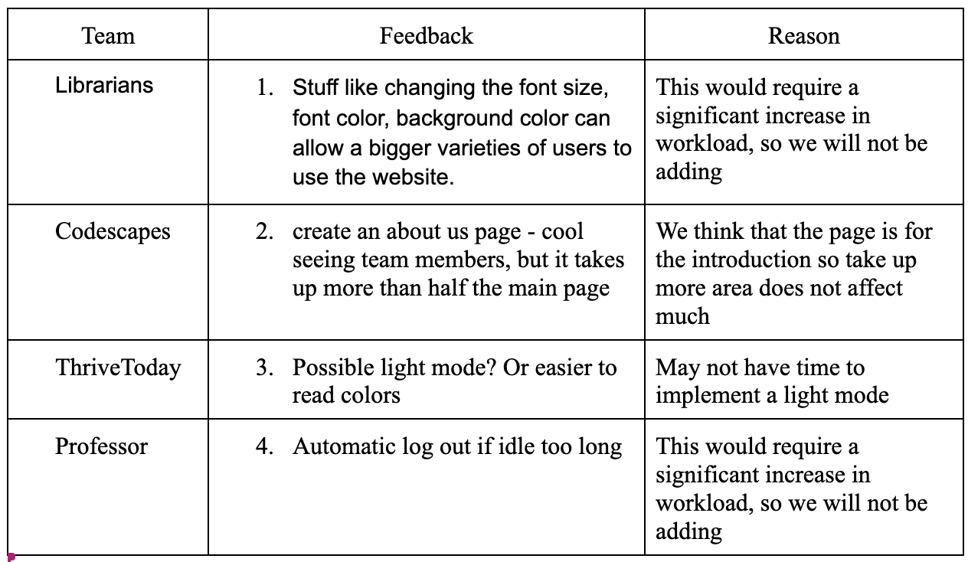
Feedback summary : not to be fixed

Slide 10
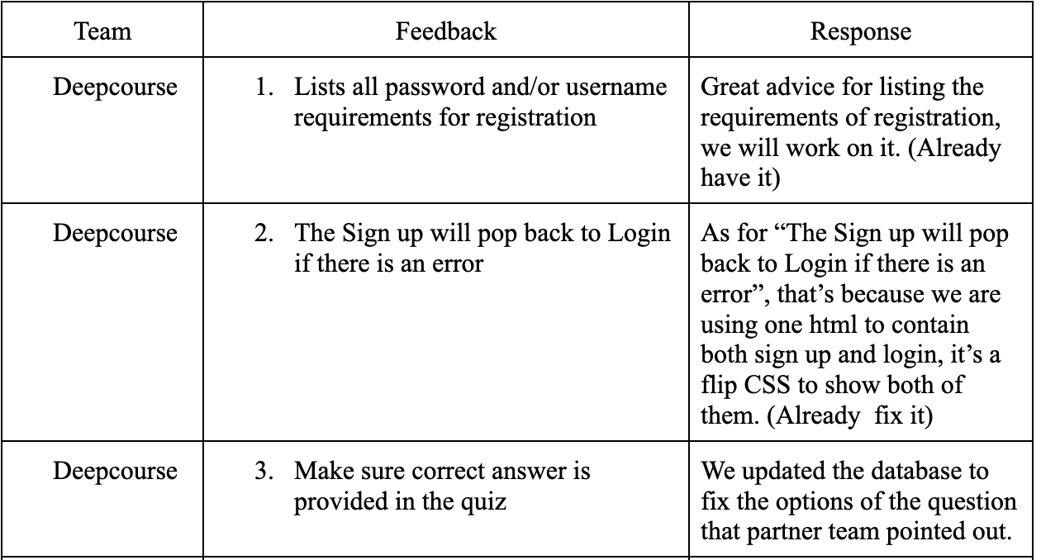
Feedback summary : to be fixed

Slide 11
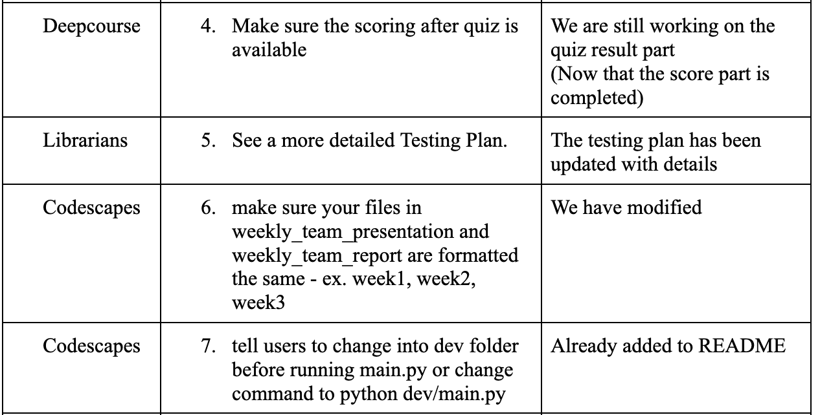
Feedback summary : to be fixed continued

Slide 12
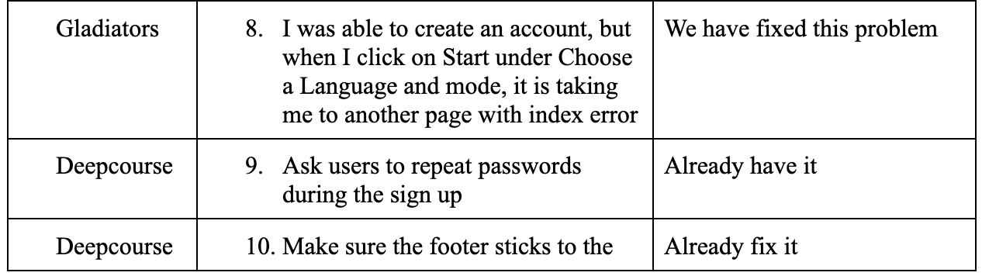
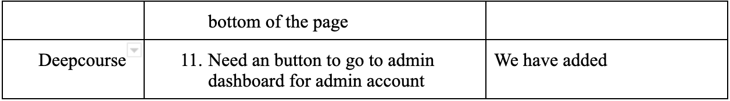
Feedback summary : to be fixed continued

Slide 13
Feedback from partner: Thrive Today
Expert user experience on building/testing the product:
Website looks great, user interface makes sense
Created account successfully and added notes to study cards
The animations look great
Build instructions were simple, clear, easy to follow

Slide 14
Demo

