Slide 1
Team: Luna R
Week 11
Xinghai Nian, Bingzhen Chen, Xiaoqian Yang

Slide 2
Flashcards to learn a foreign language
Description: A website where users can learn a foreign language using flashcards.
Users would need to register or sign in first before they can choose a language.
Then there are two modes:
1. Study Mode: using flashcards to study.
2. Quiz Mode: Multiple choices, true and false questions.
User score, score rank, time to take the quiz will be saved.
3. Administer: List all user accounts, all questions and all flashcards. And allow administer to delete them.
Github: https://github.com/StacyYang/Flashcards-to-learn-a-foreign-language

Slide 3

What we’ve accomplished:
Last Mission:
Milestone 5 | Frontend/backend development (score board design) Test website, possibly deploy the website. Administer account | week 10: 4/15/2023

Slide 4

What we are doing right now:
Research on hosting the website.
2. Research on how to allow users to reset their password

Slide 5
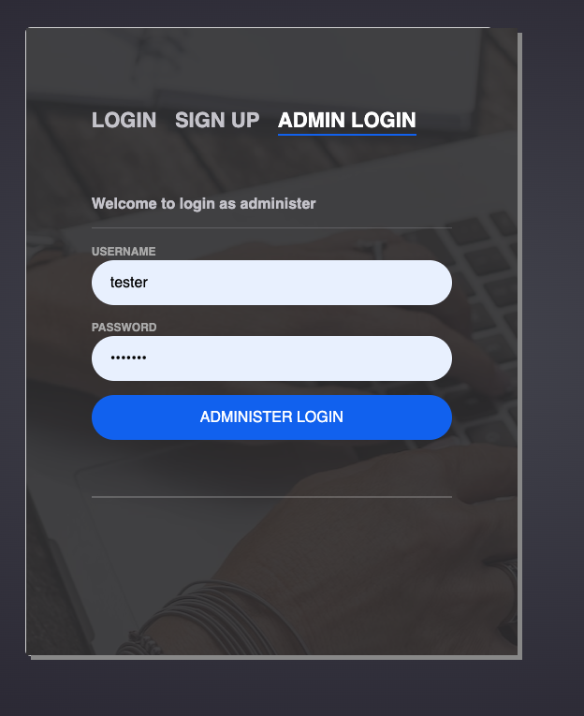
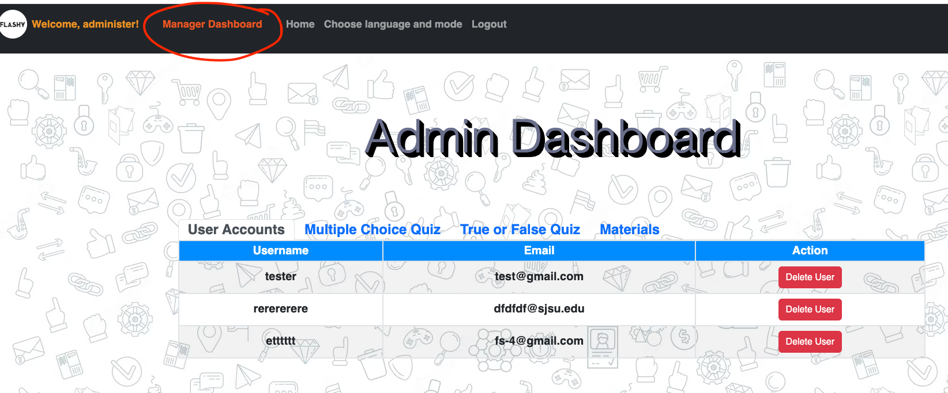
Administer account
Administer username: administer password: 1234567
Test user username: tester password: 1234567

Slide 6
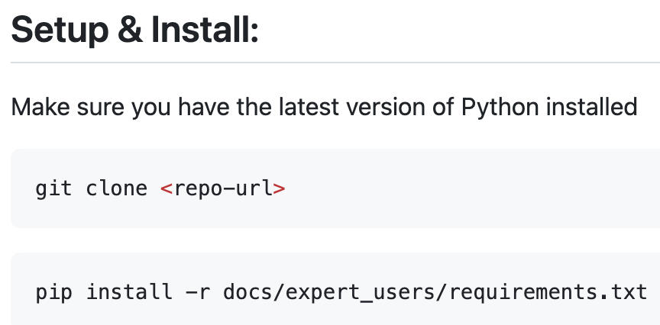



Documentation for expert users

Slide 7
Testing Plan
Functionality testing:
Check that all the links on the website are working properly.
Verify that users can log in, sign up, and log out successfully.
Ensure that users are redirected to the correct pages after logging in or signing up.
Check that users are able to choose a language mode and access the quiz.
User interface testing:
Verify that the website is visually appealing and easy to navigate.
Check that all buttons and forms are properly labeled and functioning correctly.
Ensure that the website is responsive and looks good on different size of screens.
Security testing:
Check that user passwords are being stored securely (using a secure hashing algorithm).
Database testing:
Verify that user information is being stored correctly in the database.
Check that the database schema is designed properly and optimized for performance.
Performance testing:
Test the website's load times to ensure that it is loading quickly and efficiently.
Use JMeter to check that the website is able to handle a large number of users simultaneously without crashing or slowing down.

Slide 8
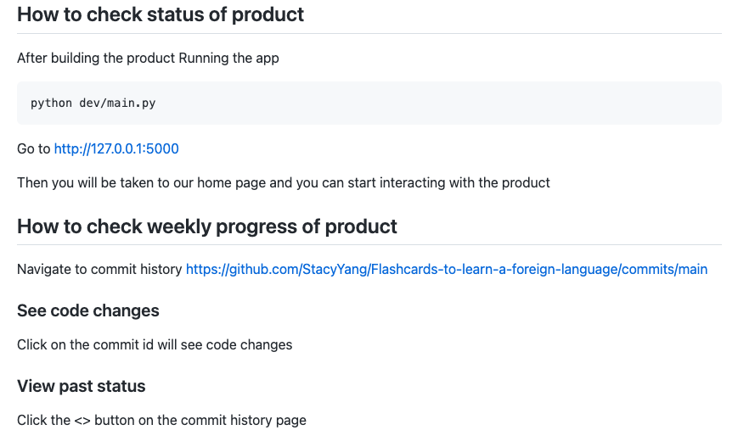
How to check the status for our product

Slide 9
Hosting methods:
Two common methods we can consider for our website:
Heroku
AWS EC2
However, we think it’s both time and money consuming, so we might not move on with deploying the website if it’s not a hard request.

Slide 10
Feedback from partner: TreeHouse
Expert user experience on building/testing the product:
Clean and organized UI.
Responsive UI.
The flow of the learning is intuitive
Looking forward to the completed project
Build instructions are easy to follow. We were able to run the app first try.

