Slide 1
Team: Luna R
Week 12
Xinghai Nian, Bingzhen Chen, Xiaoqian Yang

Slide 2
Flashcards to learn a foreign language
Description: A website where users can learn a foreign language using flashcards.
Users would need to register or sign in first before they can choose a language.
Then there are two modes:
1. Study Mode: using flashcards to study.
2. Quiz Mode: Multiple choices, true and false questions.
User score, score rank, time to take the quiz will be saved.
3. Administer: List all user accounts, all questions and all flashcards. And allow administer to delete them.
Github: https://github.com/StacyYang/Flashcards-to-learn-a-foreign-language

Slide 3

What we’ve accomplished:
Last Mission:
Milestone 5 | Frontend/backend development (score board design) Test website, possibly deploy the website. Administer account | week 10: 4/15/2023

Slide 4
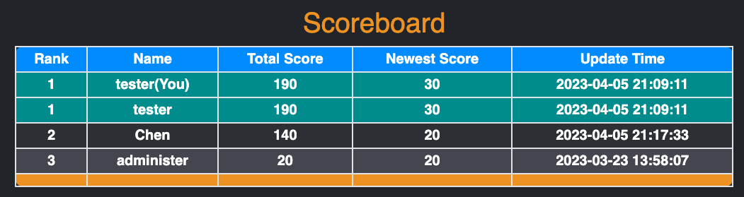
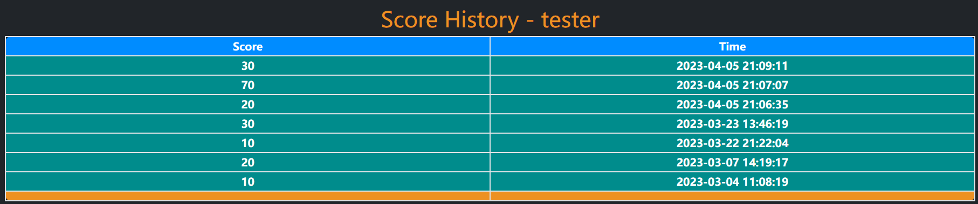
Scoreboard

Slide 5

What we are doing right now:
Research on hosting the website.
2. Research on how to allow users to reset their password

Slide 6
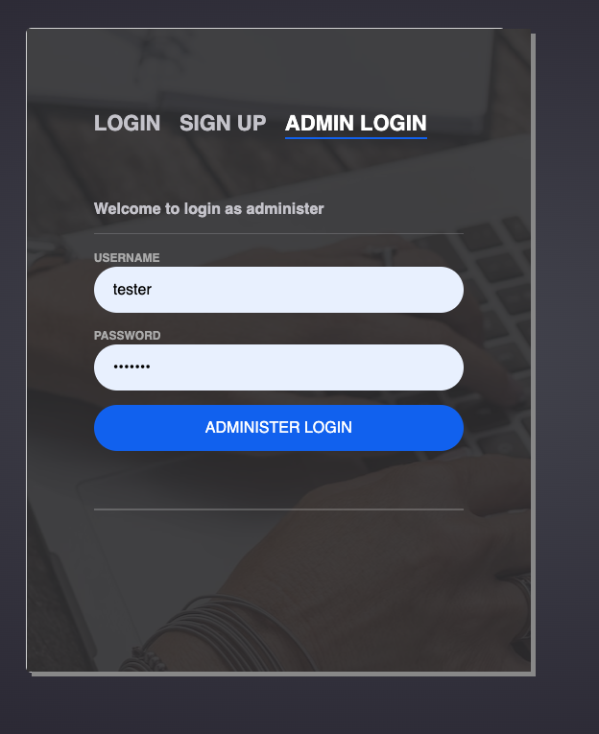
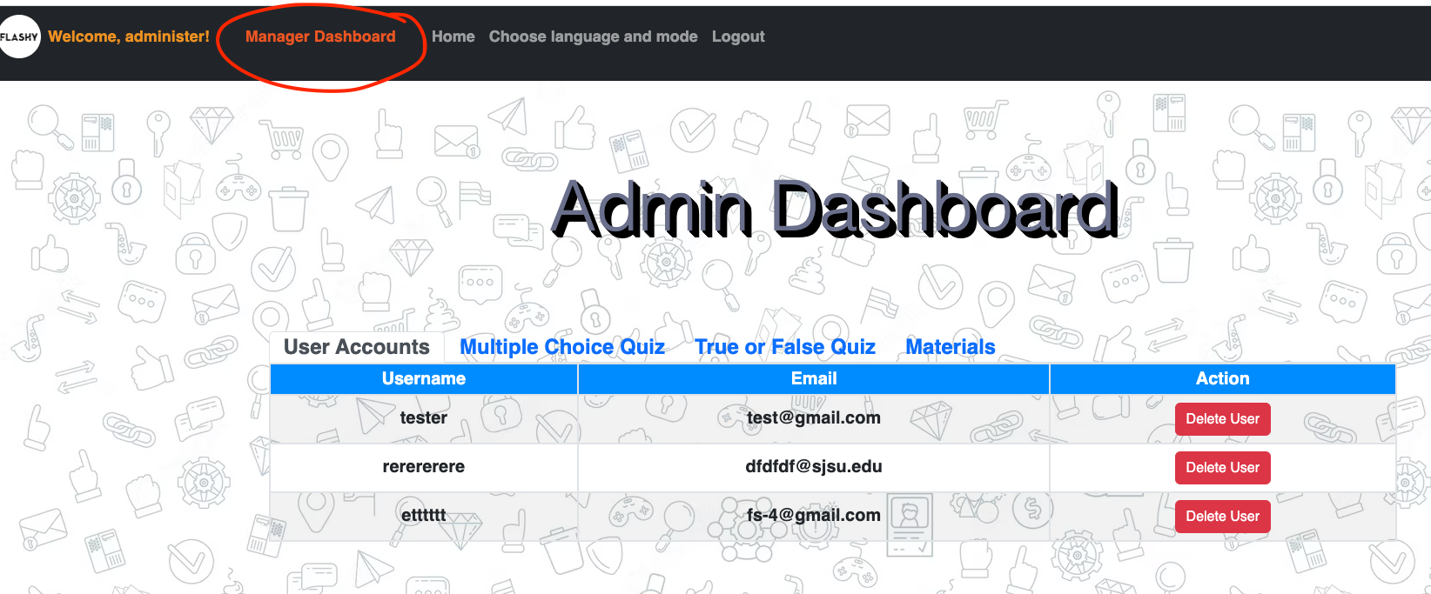
Administer account
Administer username: administer password: 1234567
Test user username: tester password: 1234567

Slide 7
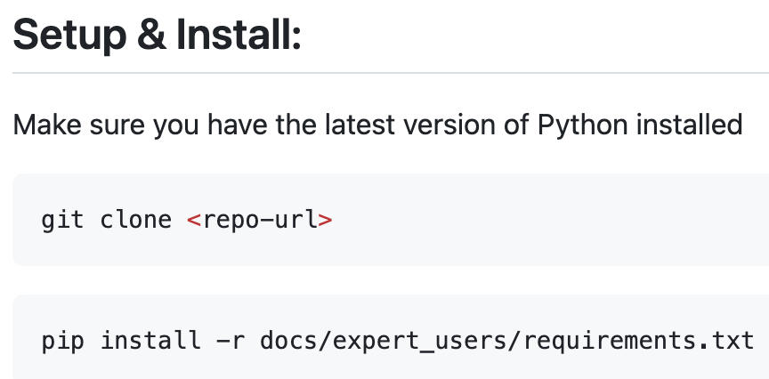



Documentation for expert users

Slide 8
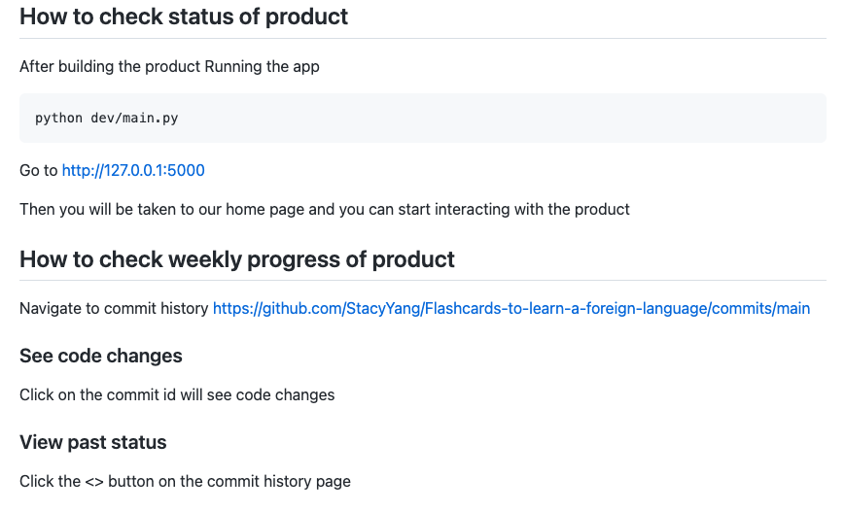
How to check the status for our product

Slide 9
Hosting methods:
Two common methods we can consider for our website:
Heroku
AWS EC2
We might not move on with deploying the website if it’s not a hard request.

Slide 10
Feedback from partner: Deepcourse
Expert user experience on building/testing the product:
Clean, easy to understand user interface / user experience
Core functionality operational
No major bugs encountered
Make sure the footer sticks to the bottom of the page (Alright fix it)
Need an button to go to admin dashboard for admin account (Alright fix it)
Build instructions were simple, clear, easy to follow
Product was successfully built and tested by Team Deepcourse

