Slide 1
HCS01 Job Simulation
Stafford Ho

Slide 2
DISCLAIMER
Documentation is attempted to be in order but actual testing may not reflect the same sequence. It is up to user to determine what sequence of steps to take to perform testing and simulations.

Slide 3
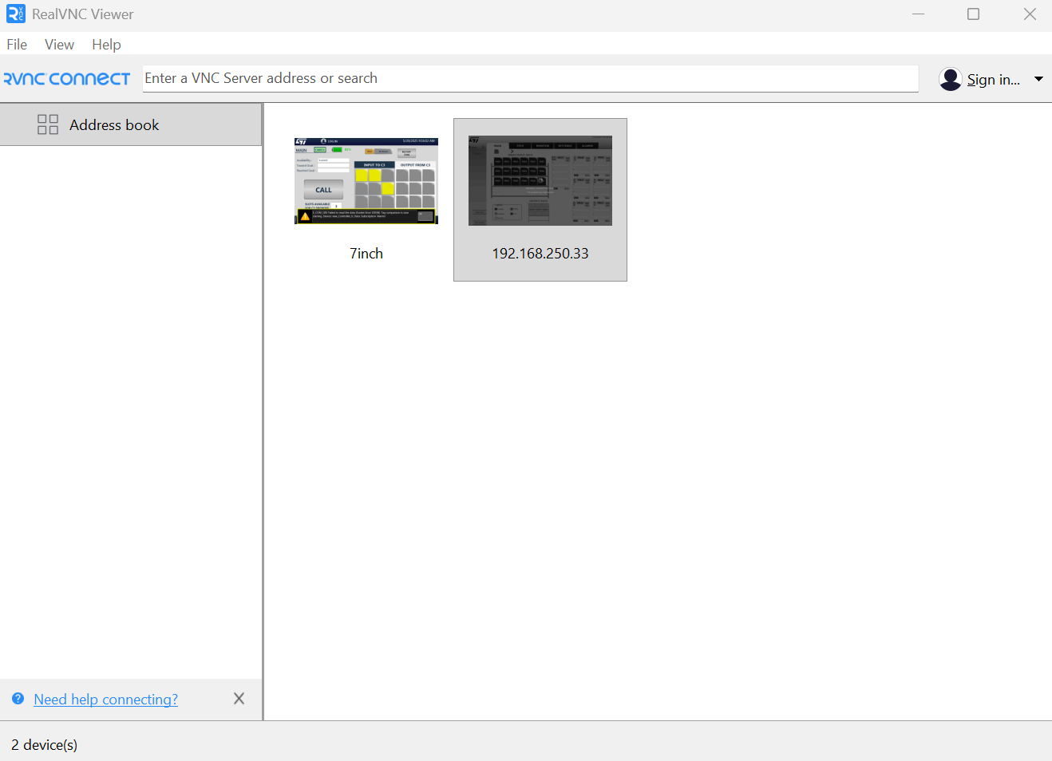
Open REALVNC Viewer and connect to HMI
Connect to 192.168.250.33 (Current HMI Address)

Slide 4
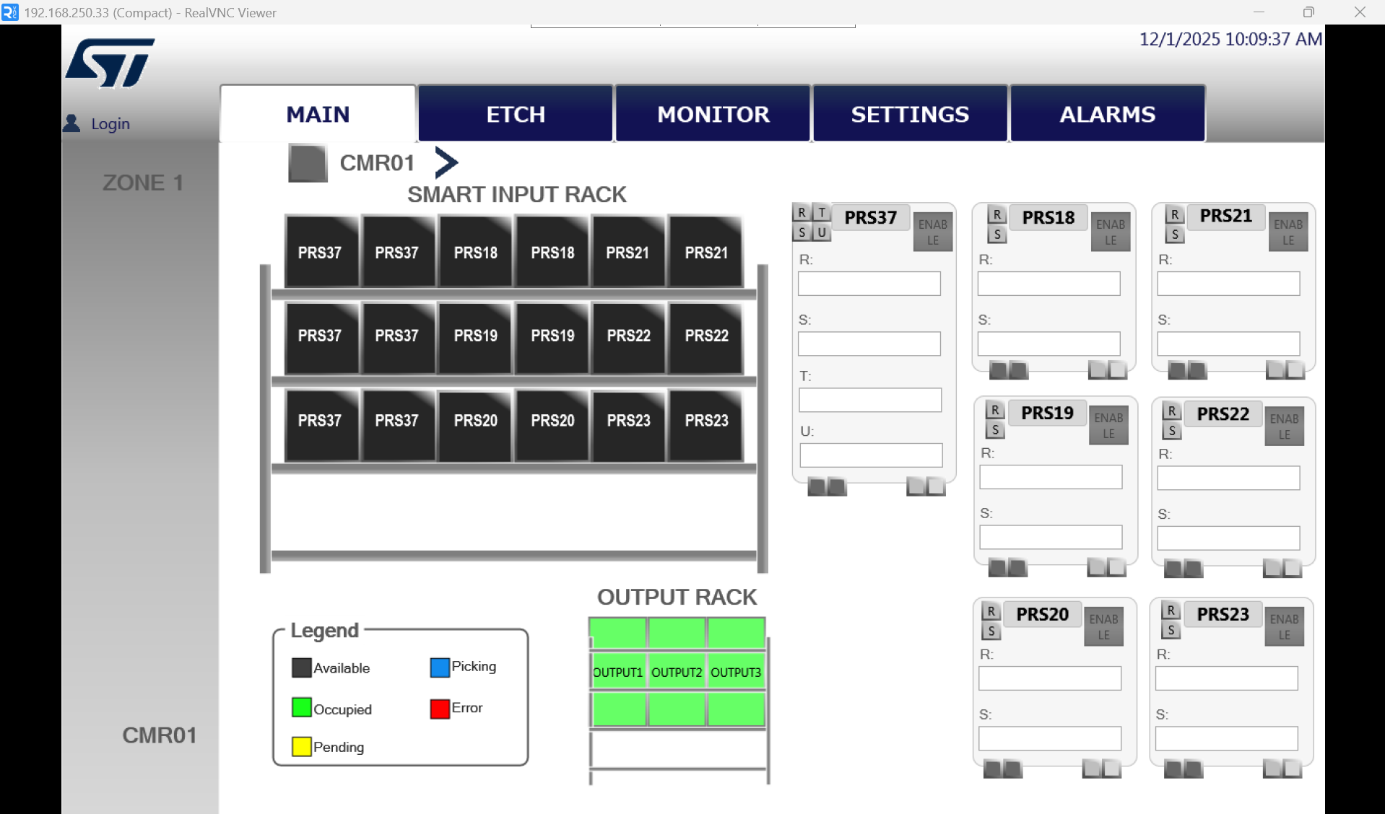
Login
Username: omron
Password: 11111111

Slide 5
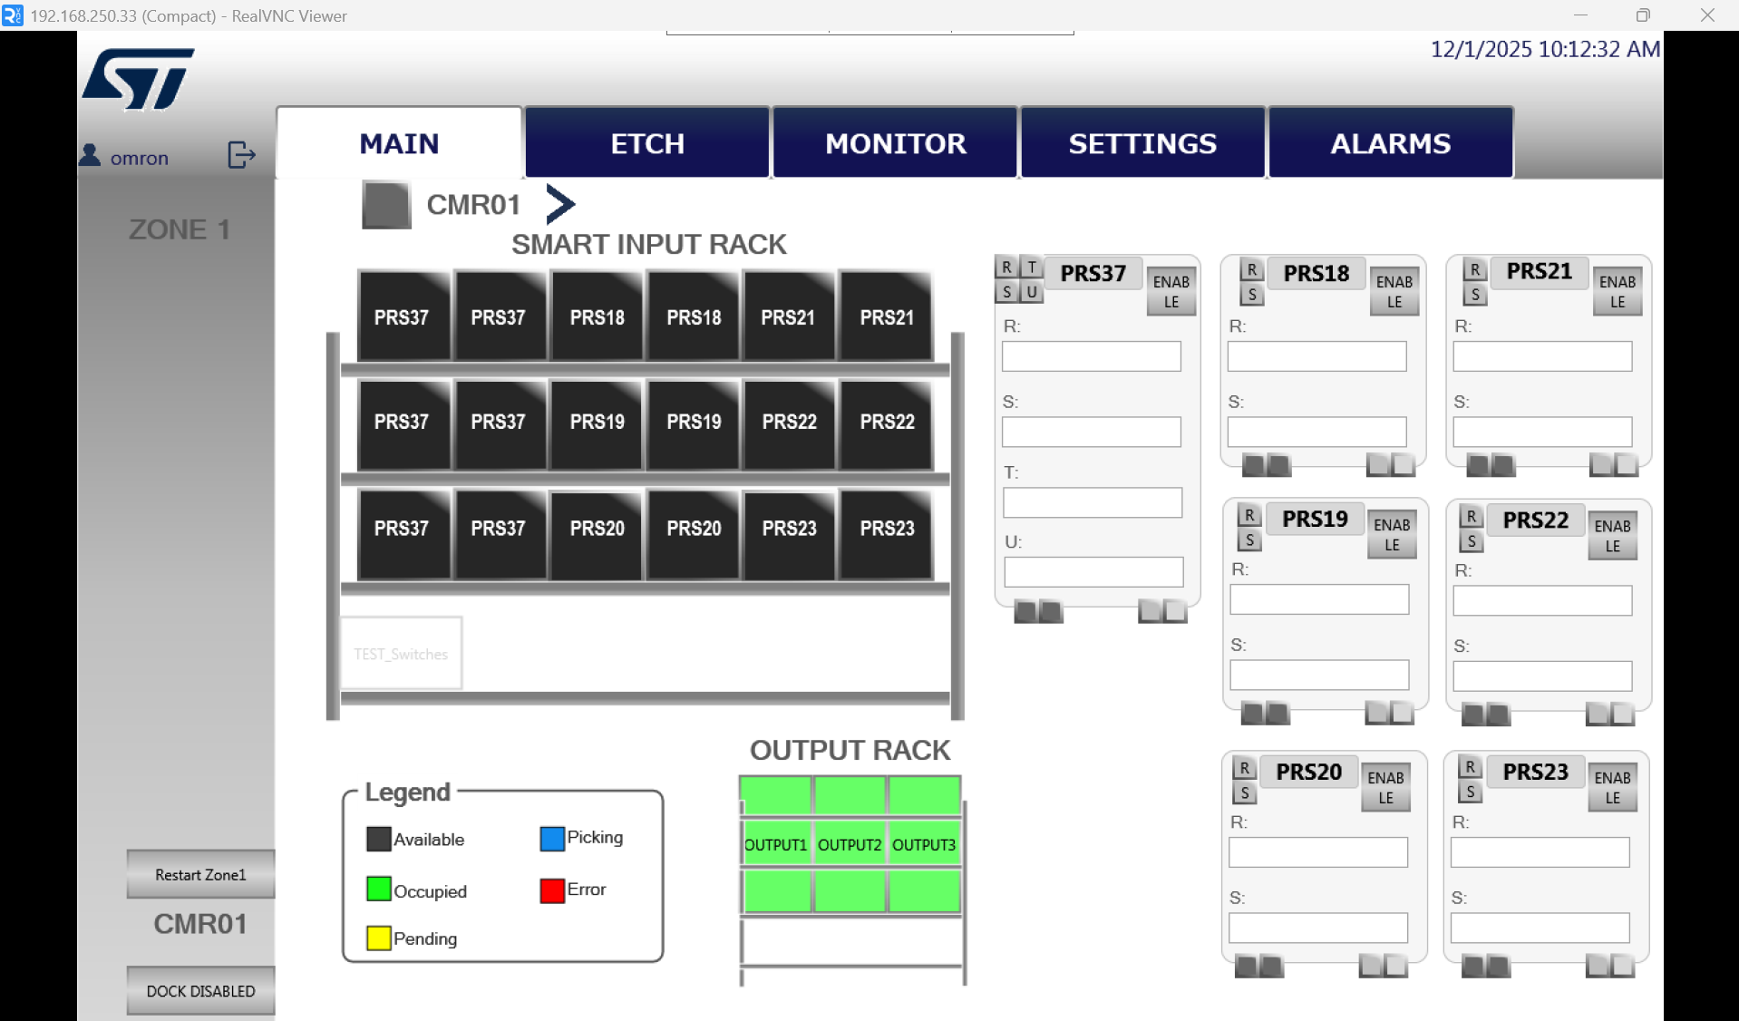
Currently in Zone 1
Select to Restart Zone

Slide 6
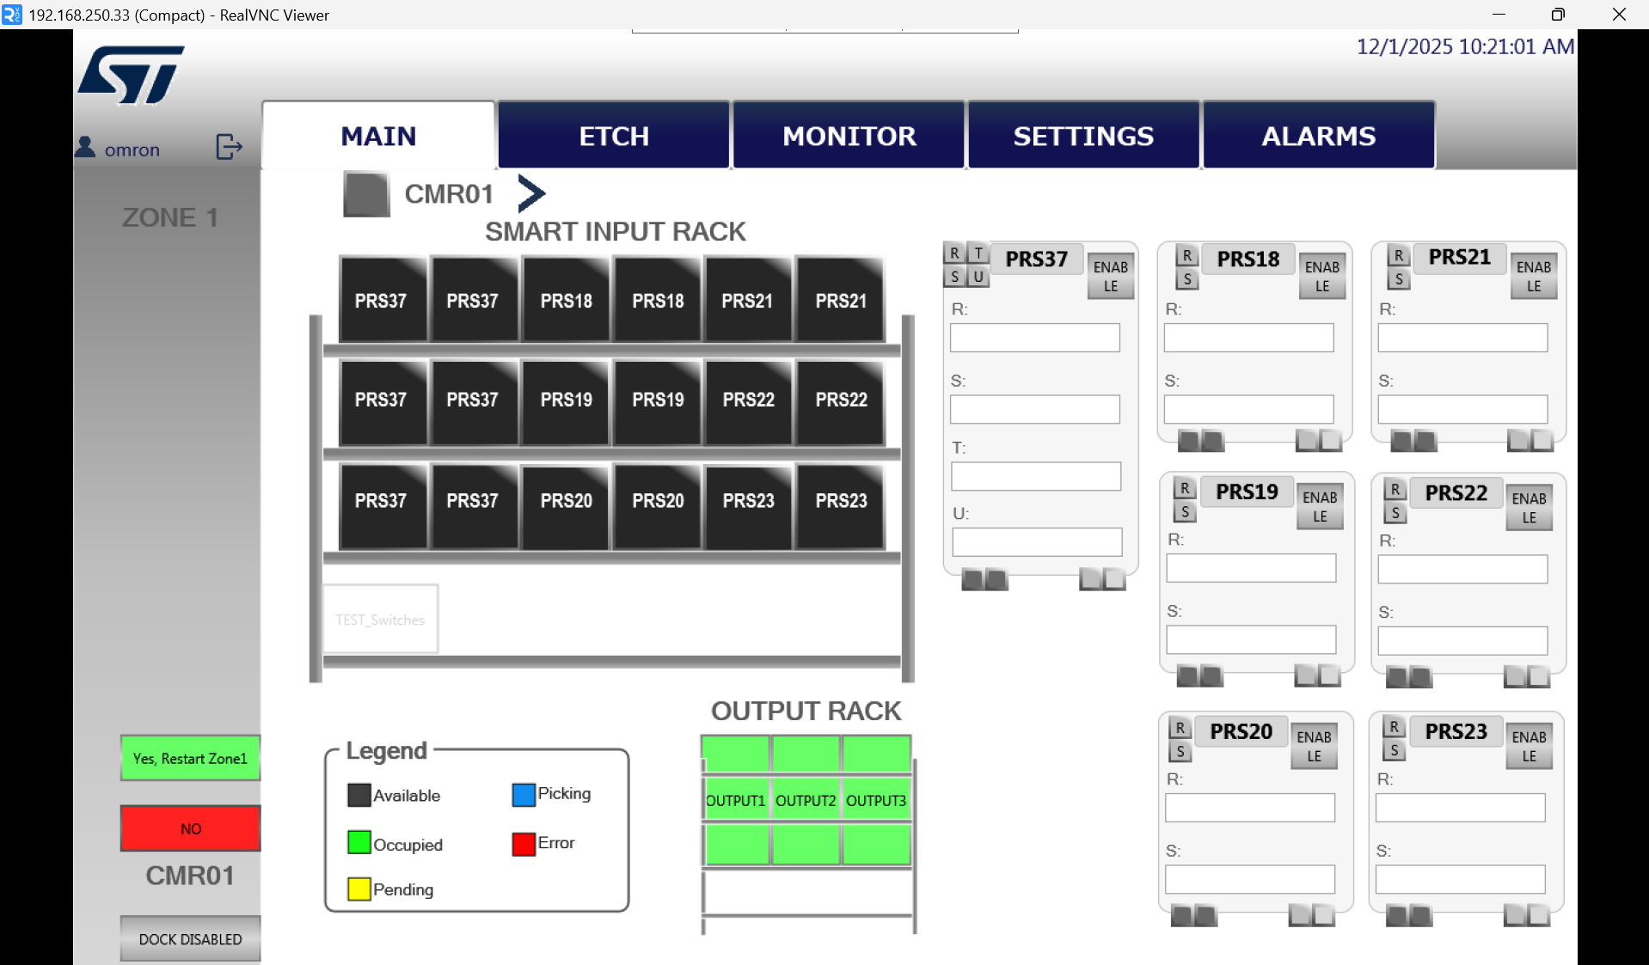
Select to confirm Restart Zone

Slide 7
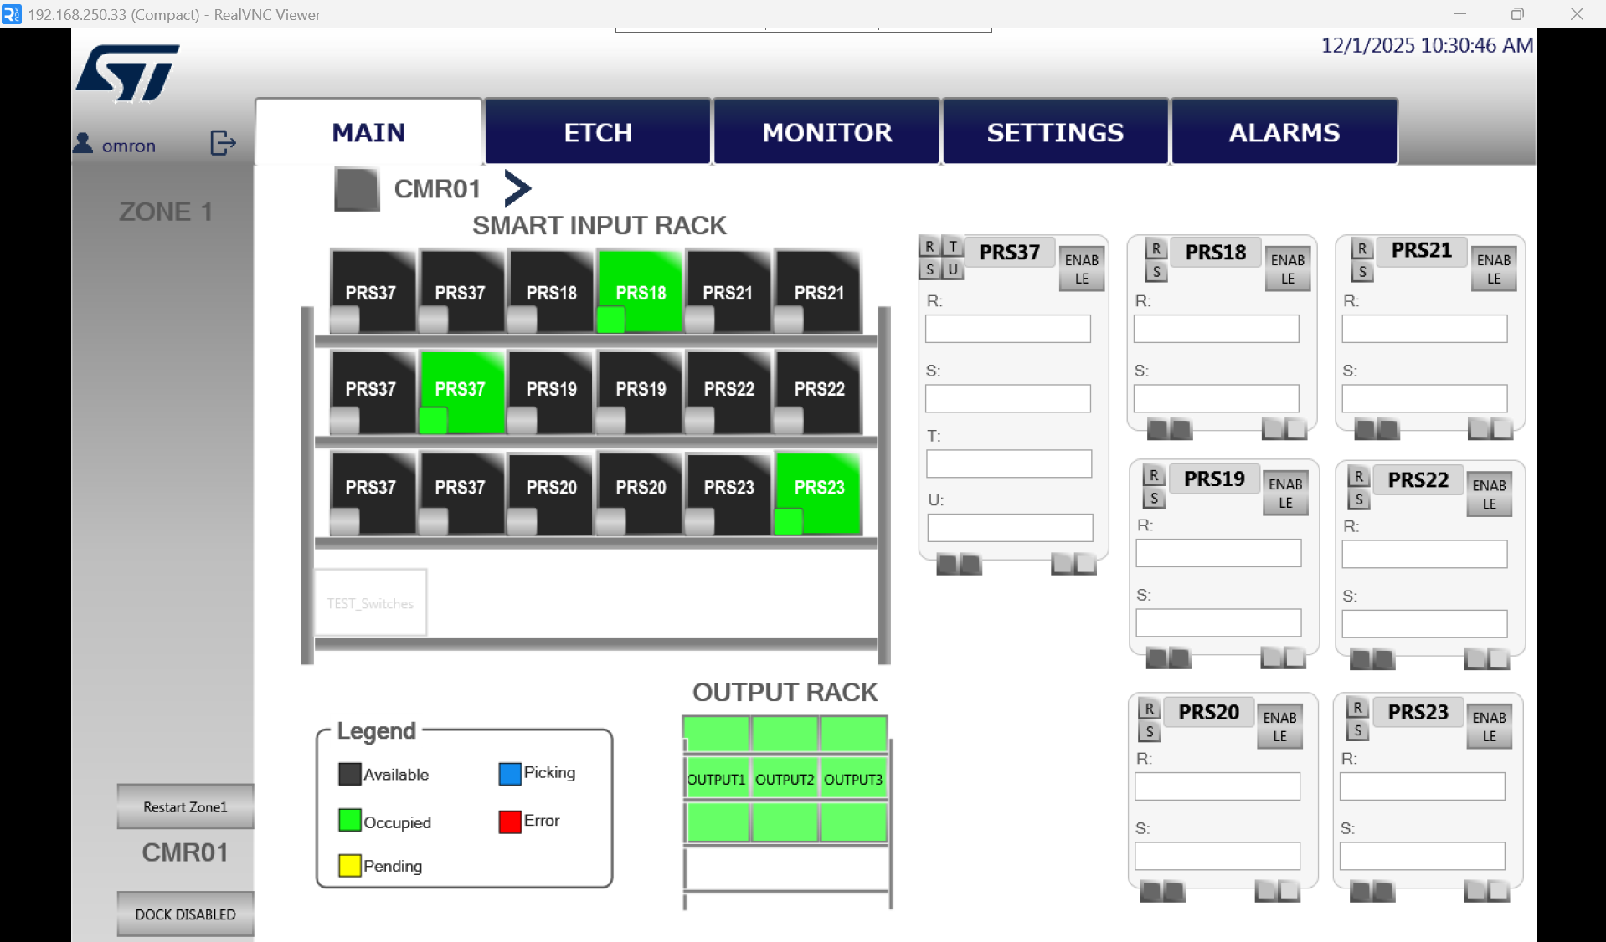
2. Toggle to trigger specific ERACK Slot e.g. 3 ERACK slots are triggered
Toggle to trigger ERACK Slot for testing EV/PDUV_E
3. Toggle again when finished

Slide 8
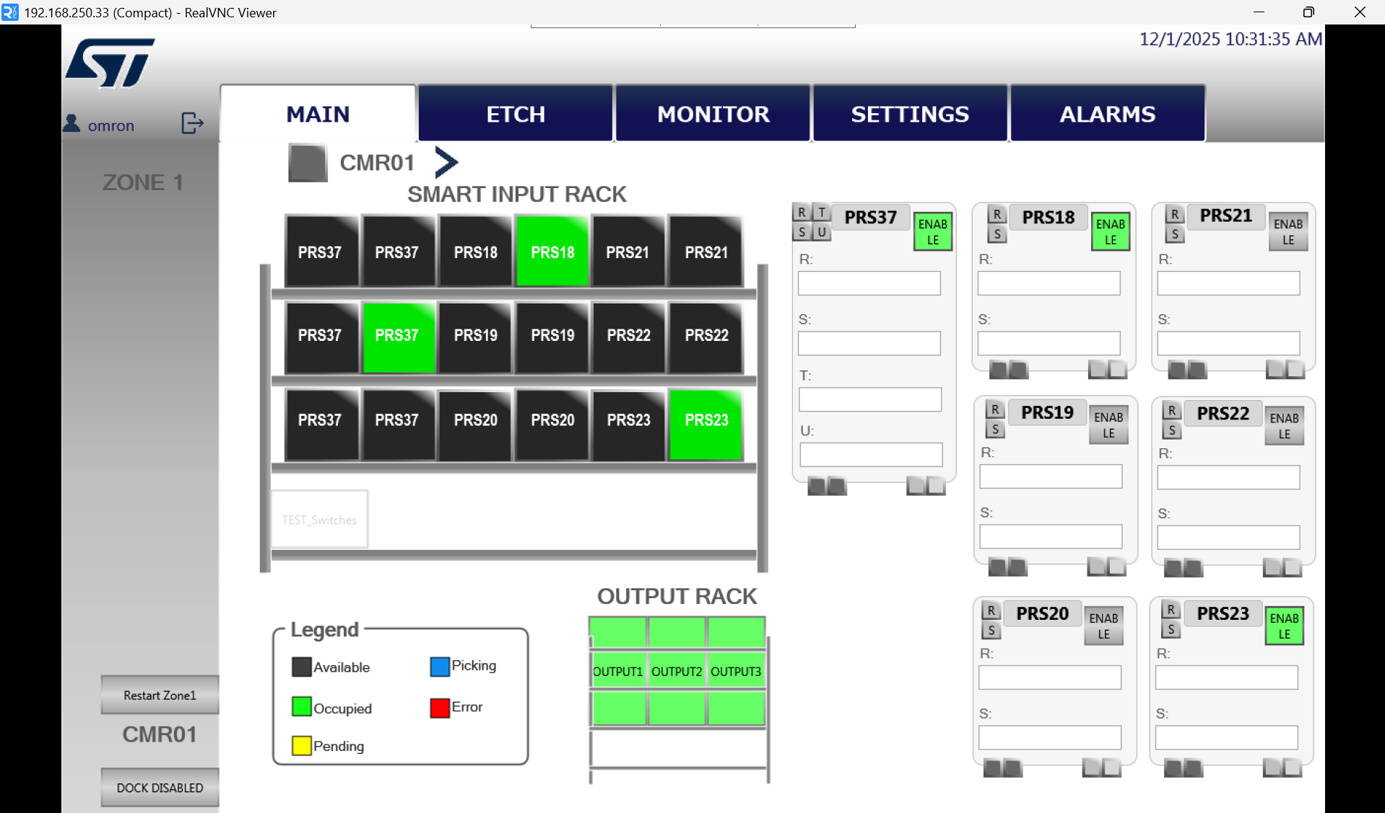
Toggle to enable Tool(s) for PDUV jobs

Slide 9
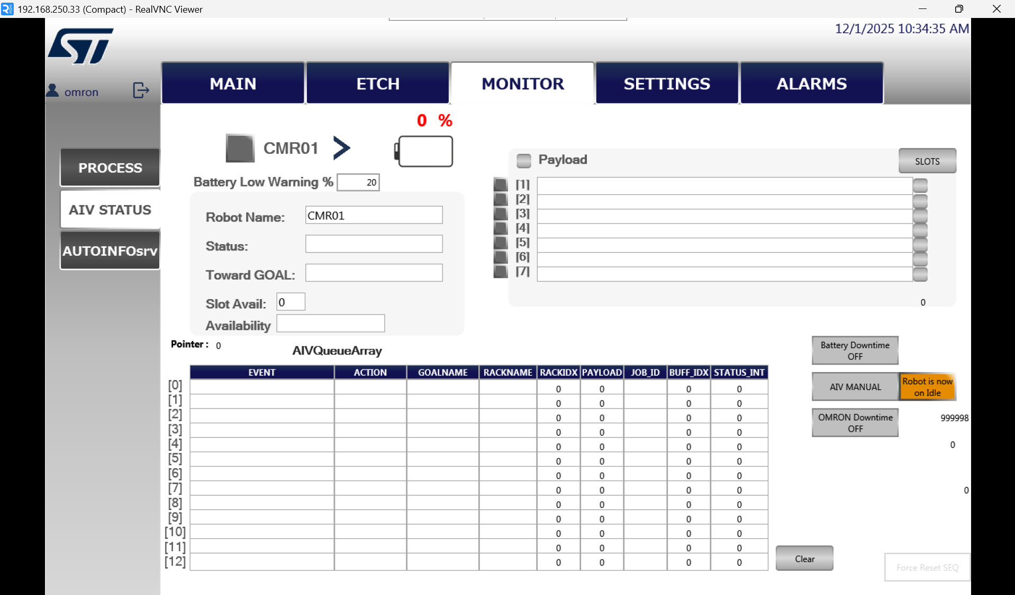
1. Select Monitor
2. Select AIV STATUS
3. Toggle to set AIV AUTO mode

Slide 10
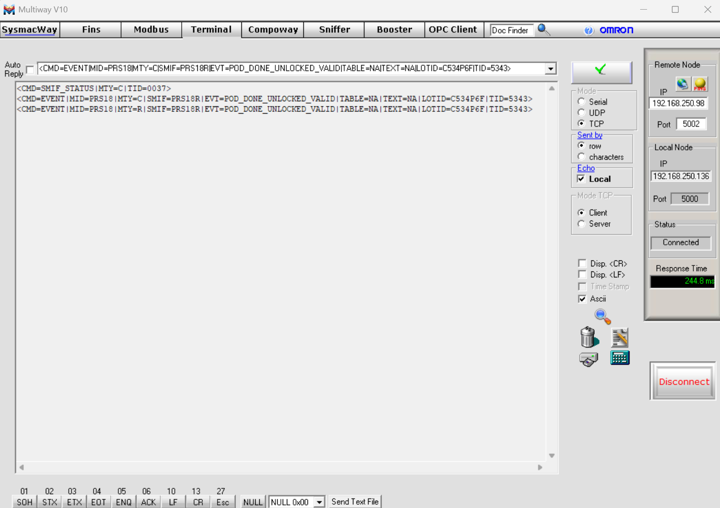
Create event job

Slide 11
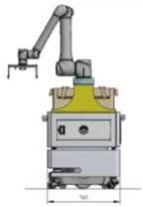
PDUV_E (EV + PDUV)
Goals for TM Robot Arm (Manipulation)
TOOL/MACHINE: PRS37
2
R
S
T
U
1
PDUV
EV
INPUT RACK: ERACK1
PRS37L
PRS37R
OUTPUT RACK: OUTPUT1
1
2
1
2
1
2
1
2
1
2
1
2
1
2
3
4
3
4
3
4
3
4
3
4
3
4
5
6
5
6
5
6
5
6
5
6
5
6
ERACK11
ERACK12
ERACK13
OUTPUT11
OUTPUT12
OUTPUT13
MoMa
Goals for LD90 AMR (Navigation)

Slide 12
Empty_Valid (EV)
Pod_Done_Unlocked_Valid (PDUV)
Pod_Done_Unlocked_Valid_E (PDUV_E)
MoMa (Mobile Manipulator)

