Slide 1
Dock Definition and Assignment

Slide 2
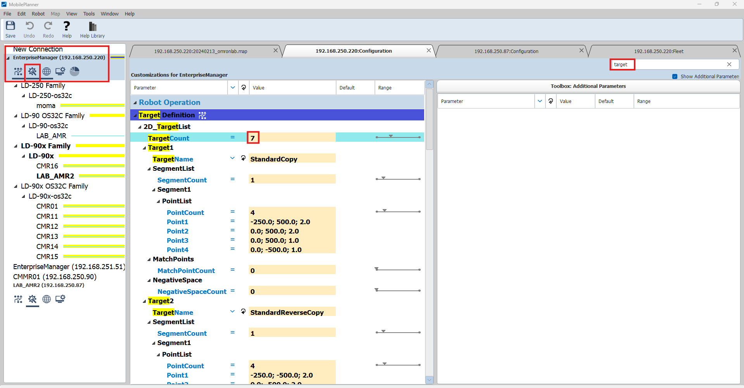
1. Select EM
3. Search for “target”
2. Enter Configuration
4. Increase TargetCount
5. Scroll Down

Slide 3
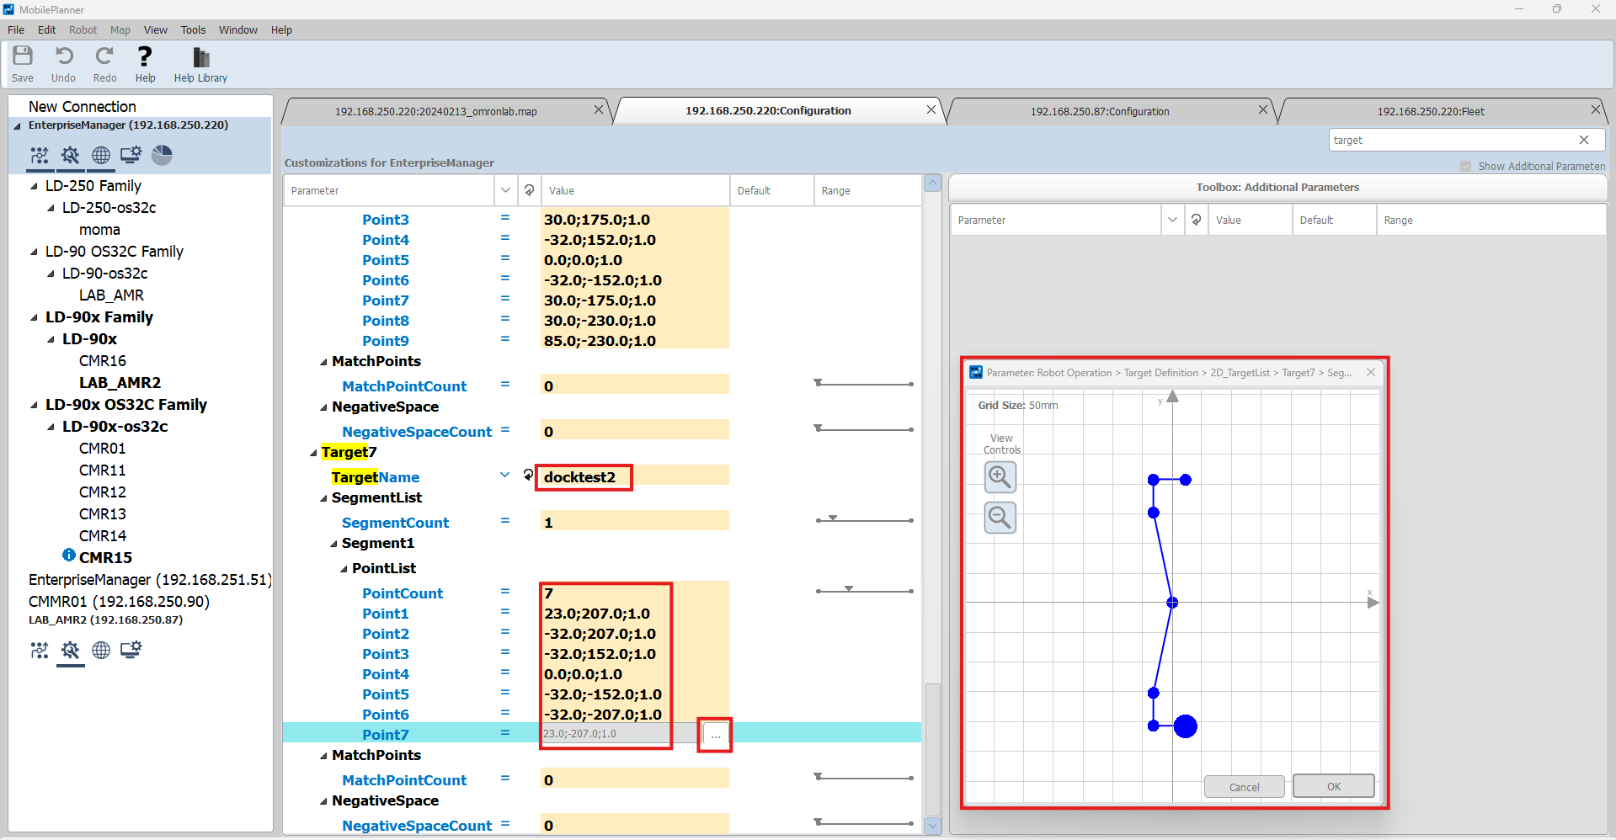
6. Rename the target
7. Modify the points
8. Click to view points in Grid

Slide 4
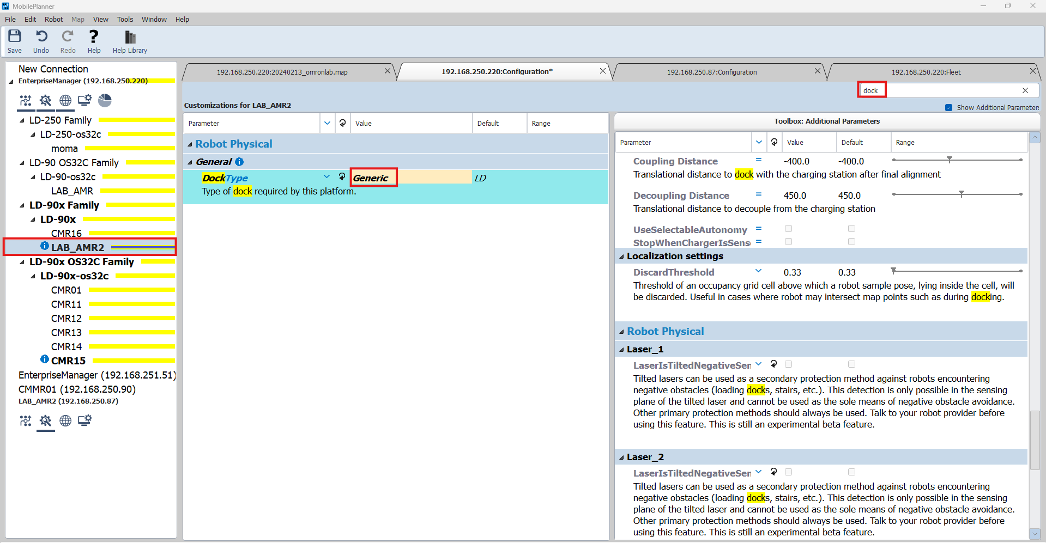
10. Search for “dock”
11. Select “Generic”
9. Select Robot
12. If Blue i sign appears, Right-click DockType and promote parameter

Slide 5
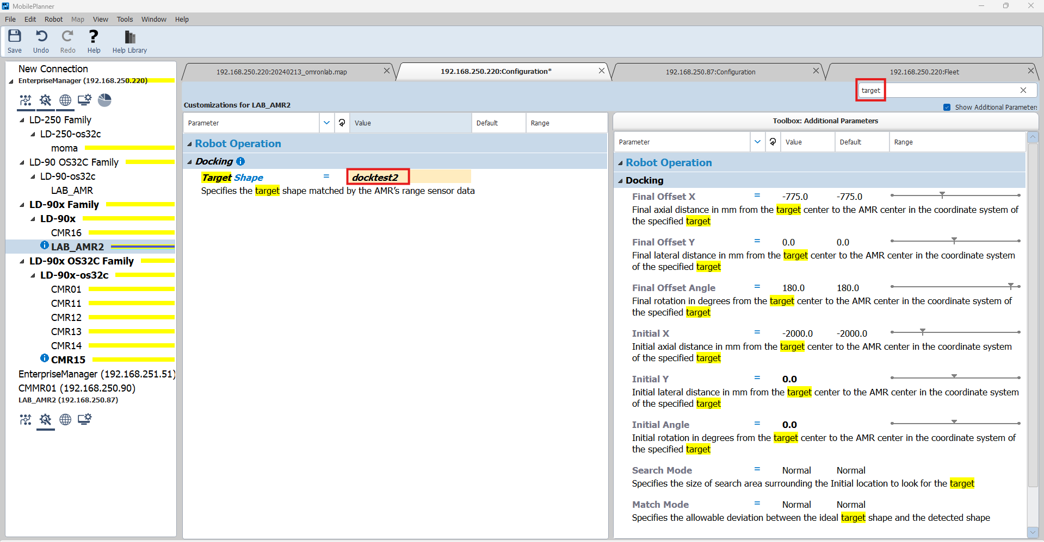
13. Search for “target”
14. Select name of your target (see 6.)
15*. If Blue i sign appears, Right-click Target Shape and promote parameter
*. Select where parameter was promoted to.
If Blue i sign appears again, Right-click Target Shape and promote parameter again

Slide 6
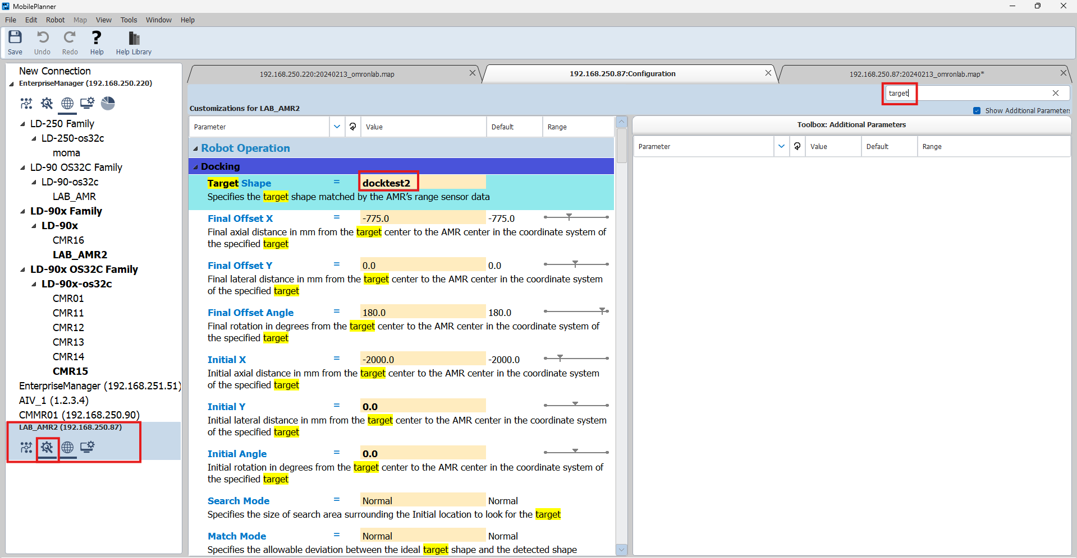
18. Search for “target”
19. Select name of your target (see 14.)
16. Select Robot (IP address)
17. Enter Configuration

Slide 7
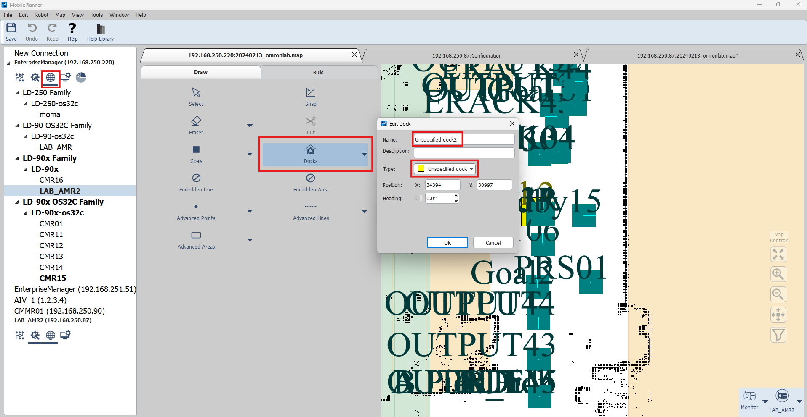
20. Enter Map
21. Select “Docks” and place in map
23. Rename the dock
22. Select “Unspecified dock”

Slide 8
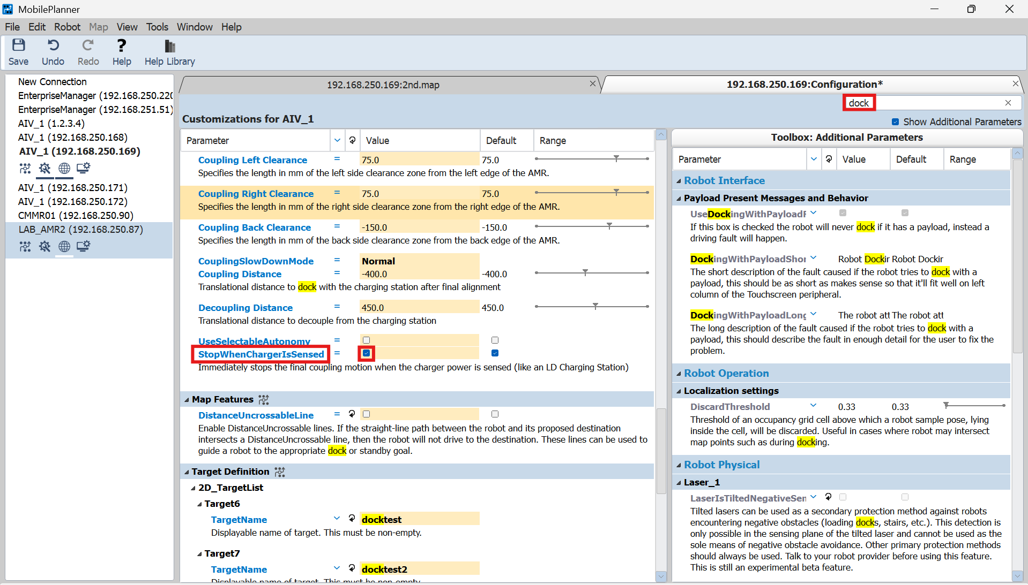
24. Search for “dock”
25. Check “StopWhenChargerIsSensed”

