Slide 1

ML Stock Prediction
By: Haystack Group

Slide 2
Haystack Group
Danielle Alex Basden
Curtis Hill
Taylor Davis
Brian Luing
Lisa Thoms
Keita Sakurai

Slide 3
Overview of ML Stock Prediction
Web-based application using Flask.
Predicts future stock prices using
machine learning.
Users can input stock symbols

Slide 4
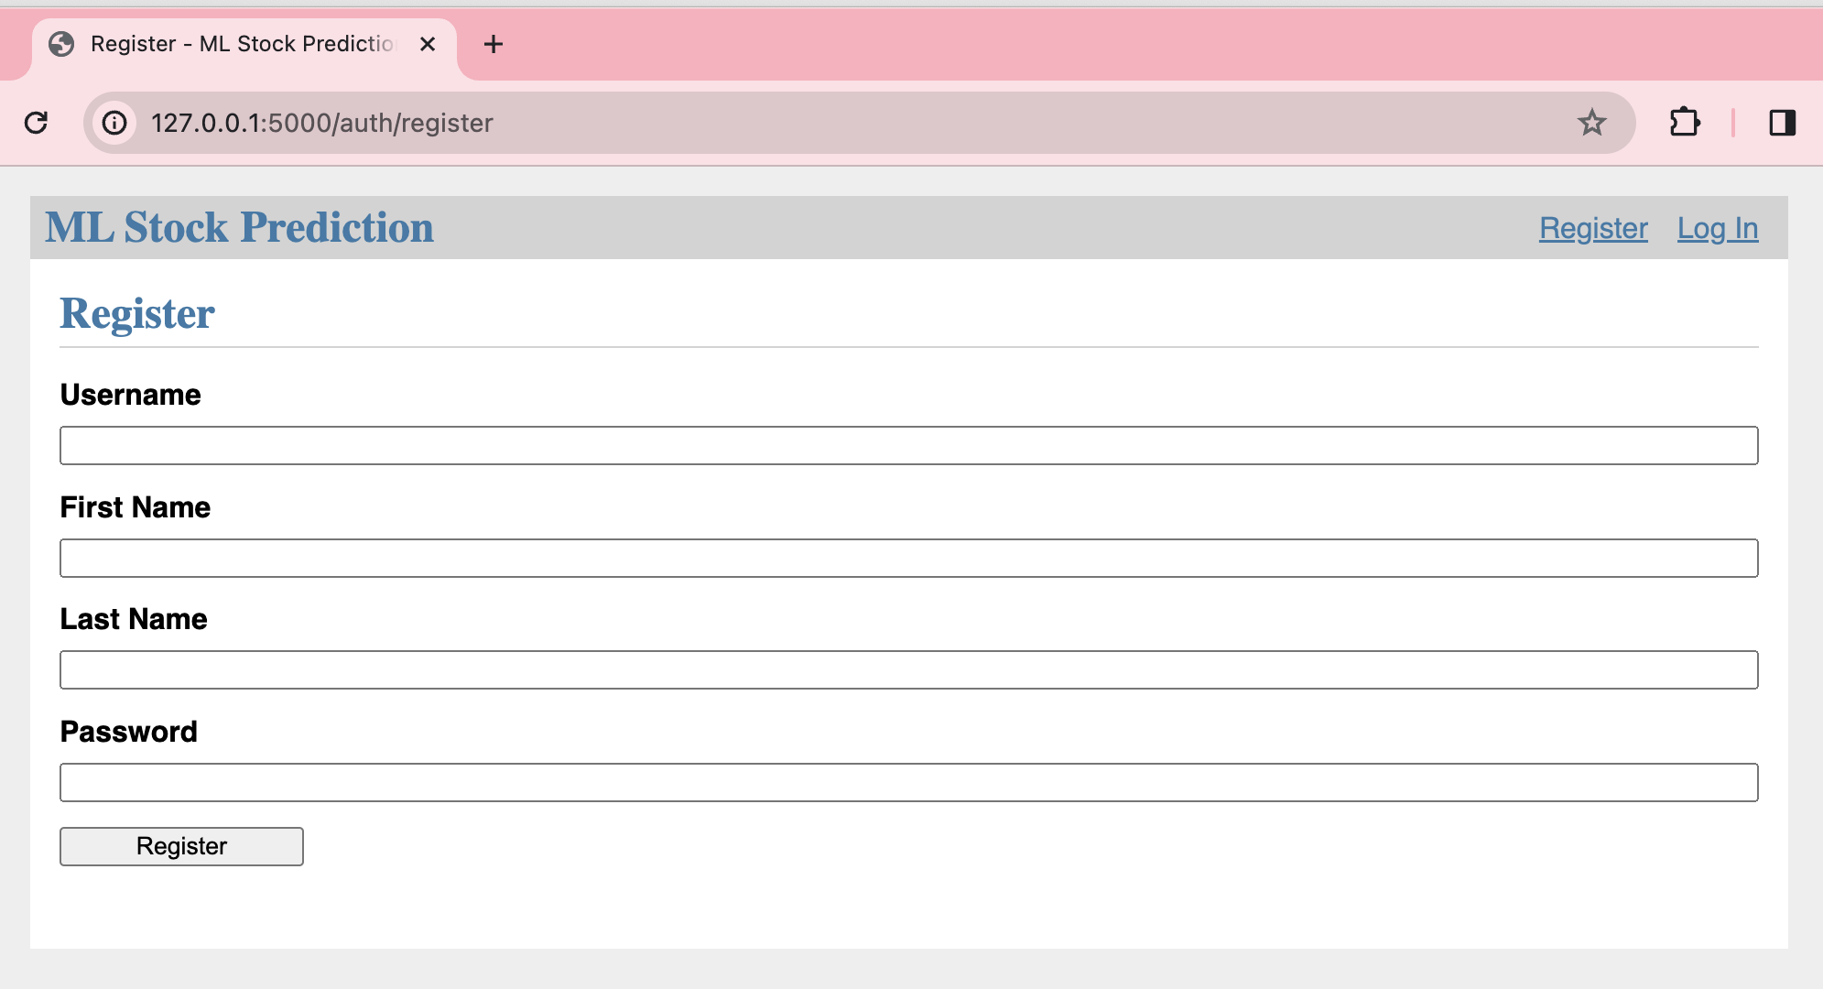

Slide 5
User Register/ Login
User can create an account by accessing the register page
Username, password, First and Last name will be stored in the database
Catches in place to not allow duplicate username
Catch in place to notify user if they have entered the incorrect username or password

Slide 6
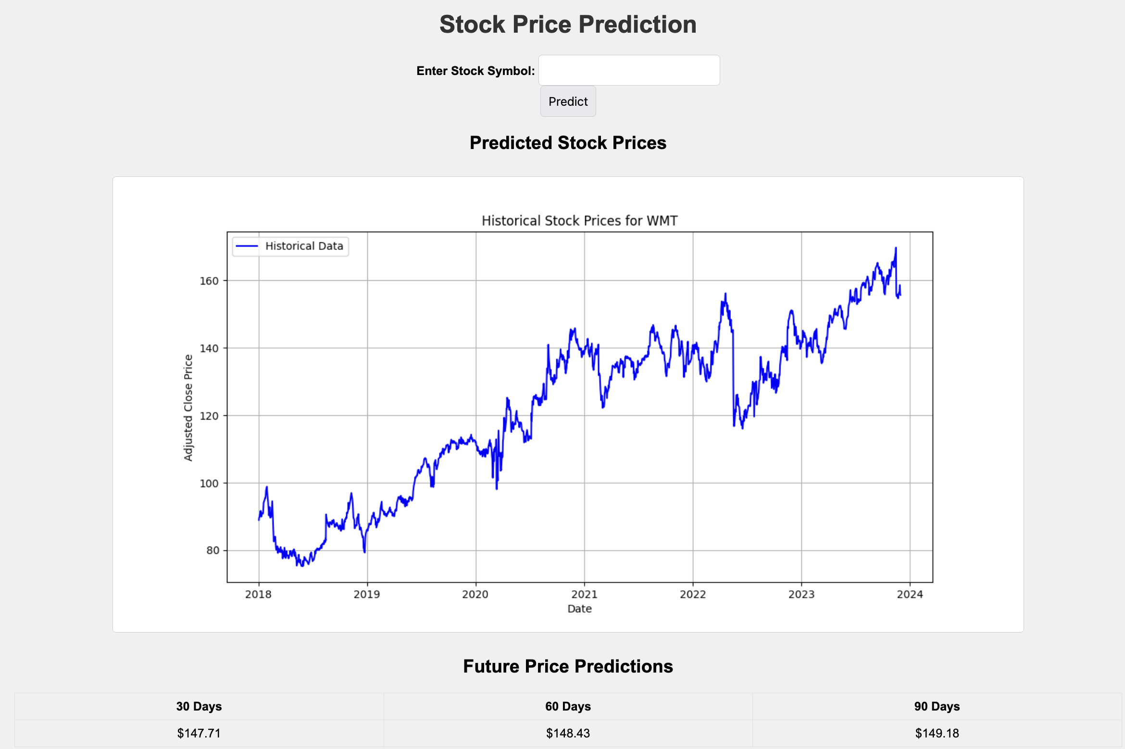

Slide 7
Gathering Stock Data
Uses Yahoo Finance (yfinance) to download stock data.
Handles data for specified stock symbols
Error handling for unavailable data.

Slide 8
Data Processing
Scaling data using MinMaxScaler for normalization.
Uses 50 LSTM Layers (Memory Blocks)
Creating sequences from adjusted close prices.
Splitting data into training and testing sets.
Dense layers for output generation.
Trained using mean squared error and Adam optimizer.

Slide 9
Flask Web Application
Users input stock symbol.
Flask handles requests and displays predictions.
Historical data and predictions visualized using Matplotlib.
Line graph of historical and predicted prices.
Uses Matplotlib for plotting.
Converts plots to Base64 for web display.

Slide 10
Forecasting Stock Prices
Predicts prices for 30, 60 and 90 future days.
Utilizes the last sequence of data for prediction.
Inverse transforms predictions to original scale.

Slide 11
Roadmap
1. Webserver Launch:
Goal: Deploy the application on a web server.
2. Model Saving & Retrieval:
Goal: Achieve error-free functionality.
3. User Authentication:
Goal: Implement secure login and save predictions.

Slide 12
Conclusion
Integrates finance, machine learning, and web technology.
Useful for investors and financial analysts.
A step towards data-driven financial decisions.

