Slide 1
MIT 007 — Cloud Computing
MC Accreditation Hub
A digital evidence and compliance platform for the Graduate School of Mabini Colleges, Inc.
Proponent: Rainell John O. Abanto
Course presentation · October 2026
Notes:
Point: A digital evidence and compliance platform for the Graduate School of Mabini Colleges, Inc.
Explain: MIT 007 — Cloud Computing
Explain: Proponent: Rainell John O. Abanto
Explain: Course presentation · October 2026
Source: Original 11-slide MC_Accreditation_Hub.pptx; README.md
Limit: This status is local, provisional, or proposed as labeled on the slide; it is not institutional approval or a participant finding.
Transition: The accreditation records problem.

Slide 2
PROJECT
PROJECT RATIONALE
The accreditation records problem
Evidence scattered across offices, folders, and devices takes time to verify and retrieve.
• Requirements and files may be tracked separately.
• Teams need to know which exact version was reviewed.
• Missing work is hard to see without a shared status view.
• The presentation describes this problem; no time-savings study has been completed.
MC Accreditation Hub · MIT 007 · Fictional local evidence unless marked otherwise
02 / 53
Notes:
Point: Evidence scattered across offices, folders, and devices takes time to verify and retrieve.
Explain: Requirements and files may be tracked separately.
Explain: Teams need to know which exact version was reviewed.
Explain: Missing work is hard to see without a shared status view.
Explain: The presentation describes this problem; no time-savings study has been completed.
Source: Source presentation, slides 2–3
Limit: This status is local, provisional, or proposed as labeled on the slide; it is not institutional approval or a participant finding.
Transition: Project objectives.

Slide 3
PROJECT
PROJECT SCOPE
Project objectives
The Hub brings requirements, files, review, monitoring, and reporting into one workflow.
• Centralize accreditation-related records.
• Classify evidence by area and requirement.
• Track missing and incomplete work.
• Review submitted evidence independently.
• Retrieve authorized versions and produce preparation reports.
MC Accreditation Hub · MIT 007 · Fictional local evidence unless marked otherwise
03 / 53
Notes:
Point: The Hub brings requirements, files, review, monitoring, and reporting into one workflow.
Explain: Centralize accreditation-related records.
Explain: Classify evidence by area and requirement.
Explain: Track missing and incomplete work.
Explain: Review submitted evidence independently.
Explain: Retrieve authorized versions and produce preparation reports.
Source: Source presentation, slide 3; docs/MC_Accreditation_Hub.md
Limit: This status is local, provisional, or proposed as labeled on the slide; it is not institutional approval or a participant finding.
Transition: Scope and current state.

Slide 4
PROJECT
LOCAL IMPLEMENTATION
Scope and current state
A working local React and Django system supports the core evidence workflow.
• Implemented locally: accounts and scoped roles, cycles, requirements, evidence versions, package review, certification, search, reports, and audit.
• Fictional demo data only; the sample instrument is not official PACUCOA criteria.
• School deployment, real-file intake, and institutional approval remain open.
MC Accreditation Hub · MIT 007 · Fictional local evidence unless marked otherwise
04 / 53
Notes:
Point: A working local React and Django system supports the core evidence workflow.
Explain: Implemented locally: accounts and scoped roles, cycles, requirements, evidence versions, package review, certification, search, reports, and audit.
Explain: Fictional demo data only; the sample instrument is not official PACUCOA criteria.
Explain: School deployment, real-file intake, and institutional approval remain open.
Source: README.md; docs/PROGRESS.md; docs/D16_VERSION_1_BASELINE_PROPOSAL.md
Limit: This status is local, provisional, or proposed as labeled on the slide; it is not institutional approval or a participant finding.
Transition: Users and responsibilities.

Slide 5
PROJECT
LOCAL / PENDING POLICY
Users and responsibilities
Academic and technical duties have separate authority.
• Custodian contributes assigned evidence; Reviewer makes an independent package decision.
• Coordinator manages requirements and deliberately certifies completion.
• Viewer monitors approved evidence; product Administrator has no automatic evidence authority.
• School IT operating roles require separate named assignments.
MC Accreditation Hub · MIT 007 · Fictional local evidence unless marked otherwise
05 / 53
Notes:
Point: Academic and technical duties have separate authority.
Explain: Custodian contributes assigned evidence; Reviewer makes an independent package decision.
Explain: Coordinator manages requirements and deliberately certifies completion.
Explain: Viewer monitors approved evidence; product Administrator has no automatic evidence authority.
Explain: School IT operating roles require separate named assignments.
Source: README.md, Rules and access; docs/LAUNCH_ADMINISTRATION.md
Limit: This status is local, provisional, or proposed as labeled on the slide; it is not institutional approval or a participant finding.
Transition: End-to-end evidence workflow.

Slide 6
PROJECT
LOCAL IMPLEMENTATION
End-to-end evidence workflow
A requirement becomes complete only after evidence review and a Coordinator decision.
• Requirement and mandatory items → assigned contributor → versioned upload and mapping.
• Draft package → submit → independent Reviewer approval or revision request.
• Approved package → Coordinator certification with rationale → readiness update.
• History retains the pinned version, decision, and criteria context.
MC Accreditation Hub · MIT 007 · Fictional local evidence unless marked otherwise
06 / 53
Notes:
Point: A requirement becomes complete only after evidence review and a Coordinator decision.
Explain: Requirement and mandatory items → assigned contributor → versioned upload and mapping.
Explain: Draft package → submit → independent Reviewer approval or revision request.
Explain: Approved package → Coordinator certification with rationale → readiness update.
Explain: History retains the pinned version, decision, and criteria context.
Source: backend/hub/models.py; backend/hub/views.py; docs/API.md
Limit: This status is local, provisional, or proposed as labeled on the slide; it is not institutional approval or a participant finding.
Transition: Technology architecture.

Slide 7
PROJECT
LOCAL IMPLEMENTATION
Technology architecture
The browser uses a same-origin application API; PostgreSQL and private file storage stay behind Django.
POSTGRESQL
BROWSER
APPLICATION API
→
Relational records
History + constraints
React · Vite · TypeScript
Session + CSRF
→
Django REST Framework
Scope + workflow + audit
PRIVATE MEDIA
→
Versioned bytes
Protected downloads
Django authorizes every metadata query and file response; no public evidence route.
MC Accreditation Hub · MIT 007 · Fictional local evidence unless marked otherwise
07 / 53
Notes:
Point: The browser uses a same-origin application API; PostgreSQL and private file storage stay behind Django.
Explain: React + Vite + TypeScript: browser interface.
Explain: Django REST Framework: session auth, permissions, workflow, reports.
Explain: PostgreSQL: relational history and transactional constraints.
Explain: Protected filesystem: immutable evidence bytes; no public media route.
Source: README.md; backend/config/settings.py; frontend/package.json
Limit: This status is local, provisional, or proposed as labeled on the slide; it is not institutional approval or a participant finding.
Transition: Request and evidence data flow.

Slide 8
PROJECT
LOCAL IMPLEMENTATION
Request and evidence data flow
Each request checks identity, scope, record state, and exact file availability.
• Browser → /api/ session and CSRF → Django authorization.
• Django reads/writes PostgreSQL records and private file bytes.
• Upload scans the exact checksum; failed or absent verdicts quarantine the version.
• Approved evidence access remains scoped and audited.
MC Accreditation Hub · MIT 007 · Fictional local evidence unless marked otherwise
08 / 53
Notes:
Point: Each request checks identity, scope, record state, and exact file availability.
Explain: Browser → /api/ session and CSRF → Django authorization.
Explain: Django reads/writes PostgreSQL records and private file bytes.
Explain: Upload scans the exact checksum; failed or absent verdicts quarantine the version.
Explain: Approved evidence access remains scoped and audited.
Source: backend/hub/access.py; backend/hub/scanning.py; backend/hub/views.py
Limit: This status is local, provisional, or proposed as labeled on the slide; it is not institutional approval or a participant finding.
Transition: Core data relationships.

Slide 9
PROJECT
LOCAL IMPLEMENTATION
Core data relationships
Cycles contain areas and requirements; evidence and decisions preserve exact history.
• Cycle → Area → Requirement → Evidence Item.
• Document → immutable Document Version → scan verdict and item mapping.
• Requirement → Package Attempt → pinned versions → Reviewer decision.
• Requirement → Coordinator certification; Audit Event records actions.
MC Accreditation Hub · MIT 007 · Fictional local evidence unless marked otherwise
09 / 53
Notes:
Point: Cycles contain areas and requirements; evidence and decisions preserve exact history.
Explain: Cycle → Area → Requirement → Evidence Item.
Explain: Document → immutable Document Version → scan verdict and item mapping.
Explain: Requirement → Package Attempt → pinned versions → Reviewer decision.
Explain: Requirement → Coordinator certification; Audit Event records actions.
Source: backend/hub/models.py; docs/D16_VERSION_1_BASELINE_PROPOSAL.md
Limit: This status is local, provisional, or proposed as labeled on the slide; it is not institutional approval or a participant finding.
Transition: Cycles and requirements.

Slide 10
PROJECT
LOCAL IMPLEMENTATION
Cycles and requirements
Academic work is scoped to an assessment cycle and its areas.
• Requirements include criteria, mandatory items, responsible office, and optional deadline.
• Active and applicable requirements form the readiness denominator.
• Closed cycles reject ordinary writes; archive is a separate reasoned lifecycle action.
• The demo cycle and eight requirements are fictional.
MC Accreditation Hub · MIT 007 · Fictional local evidence unless marked otherwise
10 / 53
Notes:
Point: Academic work is scoped to an assessment cycle and its areas.
Explain: Requirements include criteria, mandatory items, responsible office, and optional deadline.
Explain: Active and applicable requirements form the readiness denominator.
Explain: Closed cycles reject ordinary writes; archive is a separate reasoned lifecycle action.
Explain: The demo cycle and eight requirements are fictional.
Source: backend/hub/models.py; backend/hub/compliance.py; backend/hub/management/commands/seed_demo.py
Limit: This status is local, provisional, or proposed as labeled on the slide; it is not institutional approval or a participant finding.
Transition: Assignment and stewardship.

Slide 11
PROJECT
LOCAL / PROVISIONAL
Assignment and stewardship
A named Custodian assignment controls new requirement work.
• A document records its owning area and steward.
• The steward replaces versions; scoped Coordinator exceptions require a reason.
• A team member cannot silently replace another person’s evidence.
• Academic owners still need to ratify this institutional role mapping.
MC Accreditation Hub · MIT 007 · Fictional local evidence unless marked otherwise
11 / 53
Notes:
Point: A named Custodian assignment controls new requirement work.
Explain: A document records its owning area and steward.
Explain: The steward replaces versions; scoped Coordinator exceptions require a reason.
Explain: A team member cannot silently replace another person’s evidence.
Explain: Academic owners still need to ratify this institutional role mapping.
Source: backend/hub/models.py; backend/hub/access.py; decision D04
Limit: This status is local, provisional, or proposed as labeled on the slide; it is not institutional approval or a participant finding.
Transition: Protected evidence versions.

Slide 12
PROJECT
LOCAL IMPLEMENTATION
Protected evidence versions
Replacement adds an immutable version instead of overwriting reviewed bytes.
• Each version has its own checksum, uploader, timestamp, and optional validity date.
• A submitted package pins exact versions and criteria.
• Older reviews and certifications remain historical after a replacement.
• Downloads and inline previews require current authorization and a clean matching scan.
MC Accreditation Hub · MIT 007 · Fictional local evidence unless marked otherwise
12 / 53
Notes:
Point: Replacement adds an immutable version instead of overwriting reviewed bytes.
Explain: Each version has its own checksum, uploader, timestamp, and optional validity date.
Explain: A submitted package pins exact versions and criteria.
Explain: Older reviews and certifications remain historical after a replacement.
Explain: Downloads and inline previews require current authorization and a clean matching scan.
Source: backend/hub/models.py; backend/hub/scanning.py; docs/API.md
Limit: This status is local, provisional, or proposed as labeled on the slide; it is not institutional approval or a participant finding.
Transition: Quarantine and scan boundary.

Slide 13
PROJECT
DEMO / PENDING APPROVAL
Quarantine and scan boundary
A version stays unusable until a configured local scanner records a clean verdict for its checksum.
• Absent, failed, infected, or mismatched scans block preview, download, mapping, review, and certification.
• The course demonstration uses a guarded synthetic verdict for two fictional PDFs only.
• School IT has not approved a real scanner or completed target tests.
MC Accreditation Hub · MIT 007 · Fictional local evidence unless marked otherwise
13 / 53
Notes:
Point: A version stays unusable until a configured local scanner records a clean verdict for its checksum.
Explain: Absent, failed, infected, or mismatched scans block preview, download, mapping, review, and certification.
Explain: The course demonstration uses a guarded synthetic verdict for two fictional PDFs only.
Explain: School IT has not approved a real scanner or completed target tests.
Source: backend/hub/scanning.py; docs/DEPLOYMENT.md; decision D11
Limit: Never describe the demo fixture as malware protection for institutional files.
Transition: Package attempts.

Slide 14
PROJECT
LOCAL / PROVISIONAL
Package attempts
New requirements use deliberate package drafts and immutable submitted attempts.
• The owner selects exact mapped versions, adds notes, and submits the draft.
• A pending attempt can be withdrawn before review; revision work creates a new draft.
• Only one submitted attempt per requirement can await review.
• Older item-level submissions remain preserved as legacy history.
MC Accreditation Hub · MIT 007 · Fictional local evidence unless marked otherwise
14 / 53
Notes:
Point: New requirements use deliberate package drafts and immutable submitted attempts.
Explain: The owner selects exact mapped versions, adds notes, and submits the draft.
Explain: A pending attempt can be withdrawn before review; revision work creates a new draft.
Explain: Only one submitted attempt per requirement can await review.
Explain: Older item-level submissions remain preserved as legacy history.
Source: backend/hub/models.py; backend/hub/views.py; decision D07
Limit: This status is local, provisional, or proposed as labeled on the slide; it is not institutional approval or a participant finding.
Transition: Independent review.

Slide 15
PROJECT
LOCAL / PROVISIONAL
Independent review
Reviewers decide on submitted evidence in their assigned area.
• The review dialog shows owner, submitted criteria, current criteria, exact filenames, and checksums.
• A Reviewer cannot approve their own upload or submission.
• Current new-package outcomes are Approve and Request revisions.
• A separate Reject outcome remains pending an Academic Owner rule.
MC Accreditation Hub · MIT 007 · Fictional local evidence unless marked otherwise
15 / 53
Notes:
Point: Reviewers decide on submitted evidence in their assigned area.
Explain: The review dialog shows owner, submitted criteria, current criteria, exact filenames, and checksums.
Explain: A Reviewer cannot approve their own upload or submission.
Explain: Current new-package outcomes are Approve and Request revisions.
Explain: A separate Reject outcome remains pending an Academic Owner rule.
Source: frontend/src/main.tsx; backend/hub/views.py; decision D07
Limit: This status is local, provisional, or proposed as labeled on the slide; it is not institutional approval or a participant finding.
Transition: Coordinator certification.

Slide 16
PROJECT
LOCAL / PROVISIONAL
Coordinator certification
Reviewer approval makes a requirement ready for completion review; it does not complete it.
• The Coordinator selects approved support and records a rationale.
• The certification pins the package/version and criteria snapshot.
• Reopening adds a new reasoned record and removes the requirement from the completed count.
• Older unsupported certifications remain marked legacy.
MC Accreditation Hub · MIT 007 · Fictional local evidence unless marked otherwise
16 / 53
Notes:
Point: Reviewer approval makes a requirement ready for completion review; it does not complete it.
Explain: The Coordinator selects approved support and records a rationale.
Explain: The certification pins the package/version and criteria snapshot.
Explain: Reopening adds a new reasoned record and removes the requirement from the completed count.
Explain: Older unsupported certifications remain marked legacy.
Source: backend/hub/compliance.py; backend/hub/models.py; decision D05
Limit: This status is local, provisional, or proposed as labeled on the slide; it is not institutional approval or a participant finding.
Transition: Readiness calculation.

Slide 17
PROJECT
LOCAL / PROVISIONAL
Readiness calculation
Internal readiness uses unweighted Coordinator-certified requirements.
• Readiness = 100 × complete active applicable non-archived requirements / all active applicable non-archived requirements.
• Draft, excluded, and archived requirements do not enter that population.
• Status filters change displayed rows, not the selected cycle/area readiness population.
• This is an internal preparation measure, never an official PACUCOA score.
MC Accreditation Hub · MIT 007 · Fictional local evidence unless marked otherwise
17 / 53
Notes:
Point: Internal readiness uses unweighted Coordinator-certified requirements.
Explain: Readiness = 100 × complete active applicable non-archived requirements / all active applicable non-archived requirements.
Explain: Draft, excluded, and archived requirements do not enter that population.
Explain: Status filters change displayed rows, not the selected cycle/area readiness population.
Explain: This is an internal preparation measure, never an official PACUCOA score.
Source: backend/hub/compliance.py; docs/API.md; decision D21
Limit: This status is local, provisional, or proposed as labeled on the slide; it is not institutional approval or a participant finding.
Transition: Live demonstration route.

Slide 18
PROJECT
FICTIONAL DEMO
Live demonstration route
The fictional Faculty requirement shows the complete role handoff.
• Start with 0 of 8 demo requirements complete.
• Custodian maps two known fictional PDFs and submits one package.
• Reviewer approves; Coordinator certifies with a rationale.
• Report then shows 1 of 8 complete = 12.5%; Viewer package history is denied.
MC Accreditation Hub · MIT 007 · Fictional local evidence unless marked otherwise
18 / 53
Notes:
Point: The fictional Faculty requirement shows the complete role handoff.
Explain: Start with 0 of 8 demo requirements complete.
Explain: Custodian maps two known fictional PDFs and submits one package.
Explain: Reviewer approves; Coordinator certifies with a rationale.
Explain: Report then shows 1 of 8 complete = 12.5%; Viewer package history is denied.
Source: docs/course-presentation/screenshots; frontend/course-demo-capture.mjs
Limit: This status is local, provisional, or proposed as labeled on the slide; it is not institutional approval or a participant finding.
Transition: Dashboard before certification.

Slide 19
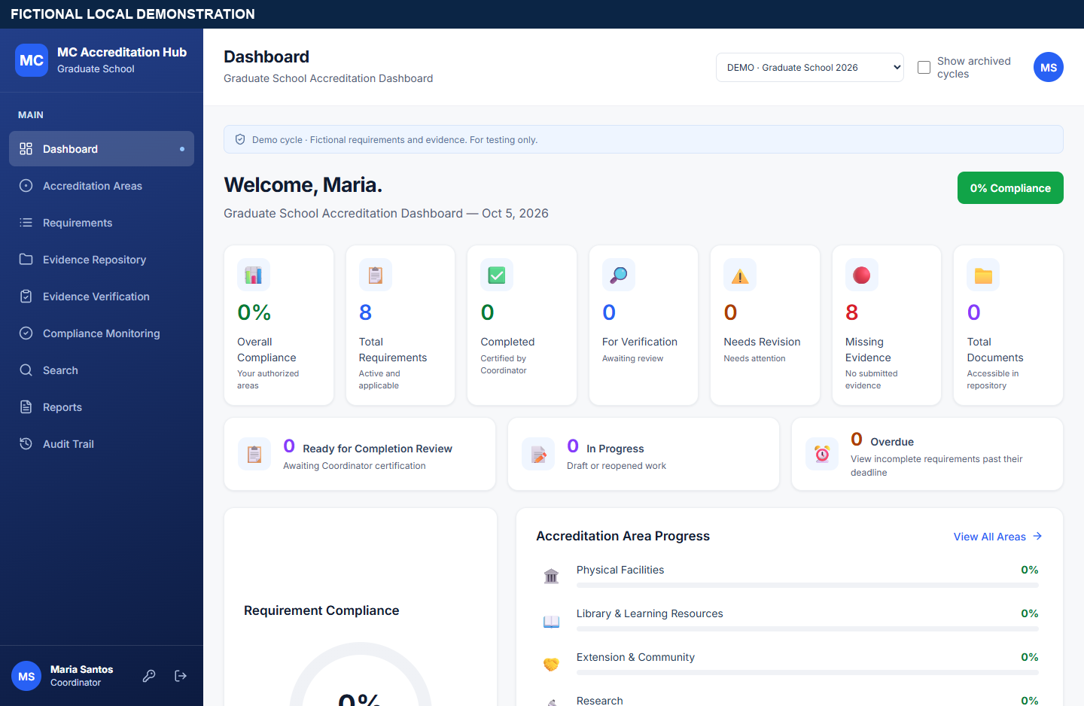
APP WALKTHROUGH
FICTIONAL DEMO
Dashboard before certification
The fictional cycle starts with eight active applicable requirements and no completions.
• The initial internal readiness is 0%.
• The sample data contains no official instrument or institutional evidence.
MC Accreditation Hub · MIT 007 · Fictional local evidence unless marked otherwise
19 / 53
Notes:
Point: The fictional cycle starts with eight active applicable requirements and no completions.
Explain: The initial internal readiness is 0%.
Explain: The sample data contains no official instrument or institutional evidence.
Source: screenshots/02-dashboard-before.png
Limit: This status is local, provisional, or proposed as labeled on the slide; it is not institutional approval or a participant finding.
Transition: Requirement and assignment.

Slide 20
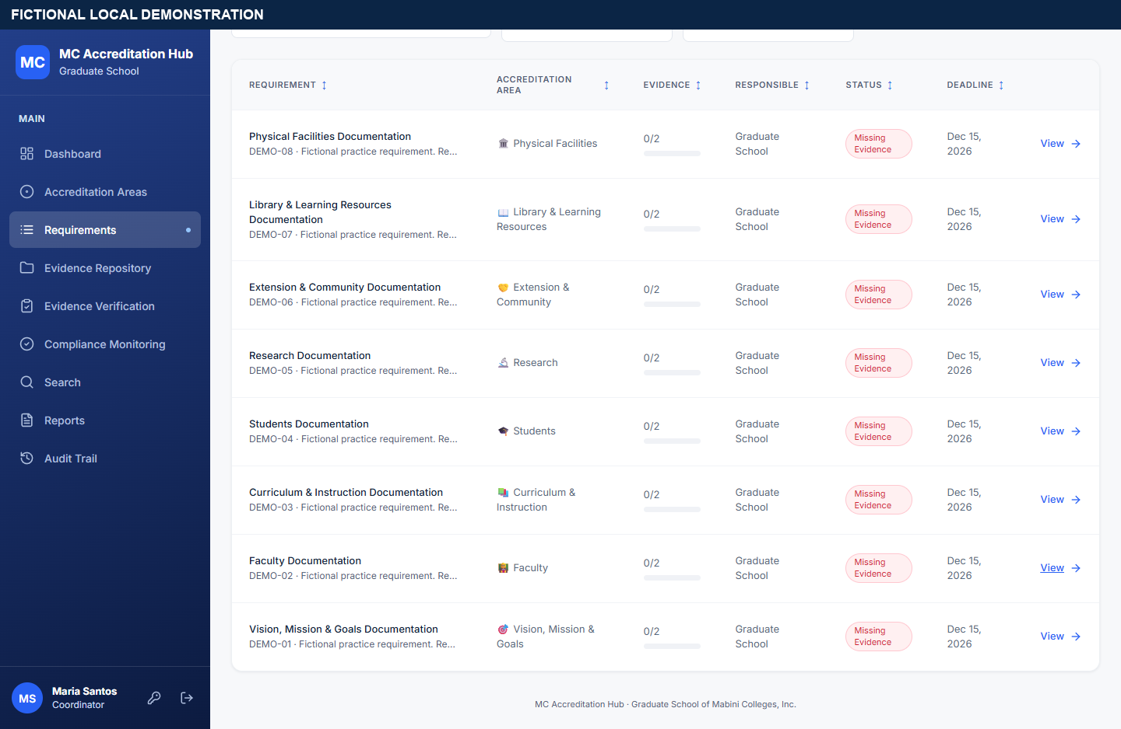
APP WALKTHROUGH
FICTIONAL DEMO
Requirement and assignment
The Faculty requirement has two mandatory evidence items and an assigned Custodian.
• The assignment narrows who may contribute new evidence.
• Other seeded requirements remain Missing.
MC Accreditation Hub · MIT 007 · Fictional local evidence unless marked otherwise
20 / 53
Notes:
Point: The Faculty requirement has two mandatory evidence items and an assigned Custodian.
Explain: The assignment narrows who may contribute new evidence.
Explain: Other seeded requirements remain Missing.
Source: screenshots/03-requirement-before.png; screenshots/04-assignment.png
Limit: This status is local, provisional, or proposed as labeled on the slide; it is not institutional approval or a participant finding.
Transition: Evidence mapping and scan state.

Slide 21
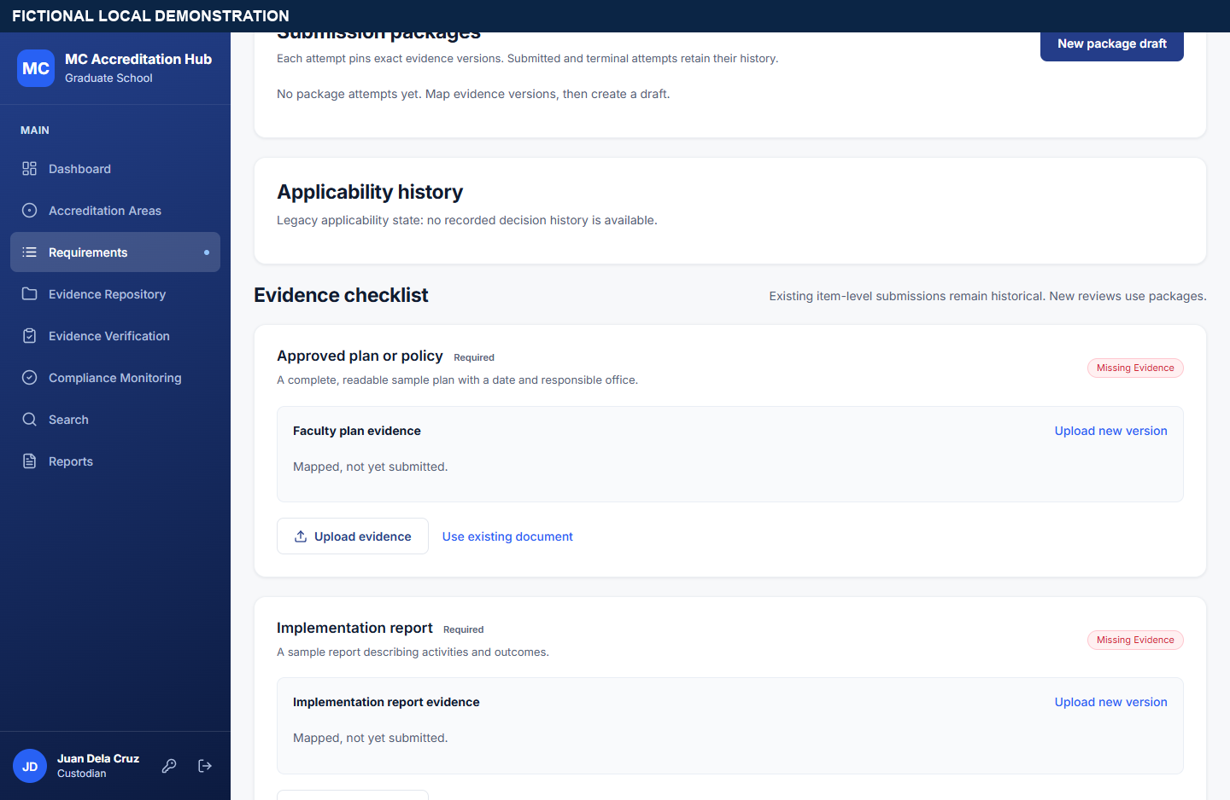
APP WALKTHROUGH
FICTIONAL DEMO
Evidence mapping and scan state
The Custodian uploads fictional PDFs and maps them to the two required items.
• Versions remain immutable and checksum-linked.
• The demo-only scan verdict is simulated and local.
MC Accreditation Hub · MIT 007 · Fictional local evidence unless marked otherwise
21 / 53
Notes:
Point: The Custodian uploads fictional PDFs and maps them to the two required items.
Explain: Versions remain immutable and checksum-linked.
Explain: The demo-only scan verdict is simulated and local.
Source: screenshots/05-evidence-mapped.png; screenshots/06-repository-and-scan.png
Limit: This status is local, provisional, or proposed as labeled on the slide; it is not institutional approval or a participant finding.
Transition: Version history and simulated scan.

Slide 22
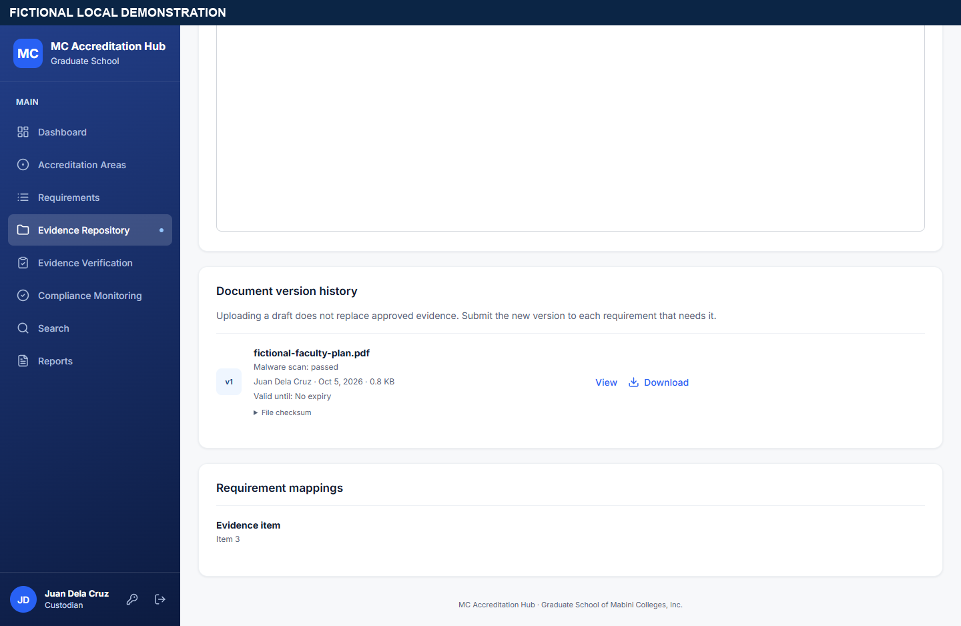
APP WALKTHROUGH
FICTIONAL DEMO
Version history and simulated scan
The Repository displays the exact file version, its history, and the local scan state.
• The known generated PDF received a simulated clean verdict in this isolated fixture.
• A later upload would add a version rather than overwrite these bytes.
MC Accreditation Hub · MIT 007 · Fictional local evidence unless marked otherwise
22 / 53
Notes:
Point: The Repository displays the exact file version, its history, and the local scan state.
Explain: The known generated PDF received a simulated clean verdict in this isolated fixture.
Explain: A later upload would add a version rather than overwrite these bytes.
Source: screenshots/06b-version-history-and-scan.png; scripts/course_demo_scanner.py
Limit: This simulated verdict is not an institutional malware scan.
Transition: Package submission.

Slide 23
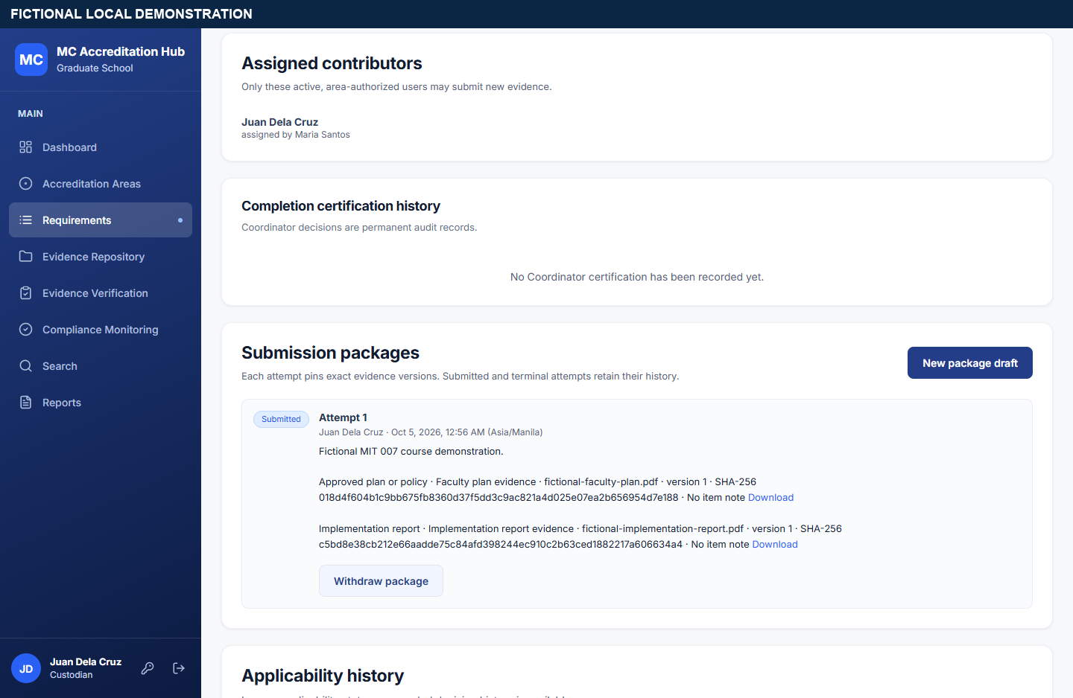
APP WALKTHROUGH
FICTIONAL DEMO
Package submission
The Custodian deliberately selects both item versions and submits a package.
• Package status becomes For Verification.
• The selected version and criteria context are retained.
MC Accreditation Hub · MIT 007 · Fictional local evidence unless marked otherwise
23 / 53
Notes:
Point: The Custodian deliberately selects both item versions and submits a package.
Explain: Package status becomes For Verification.
Explain: The selected version and criteria context are retained.
Source: screenshots/07-package-draft.png; screenshots/08-package-submitted.png
Limit: This status is local, provisional, or proposed as labeled on the slide; it is not institutional approval or a participant finding.
Transition: Reviewer context.

Slide 24
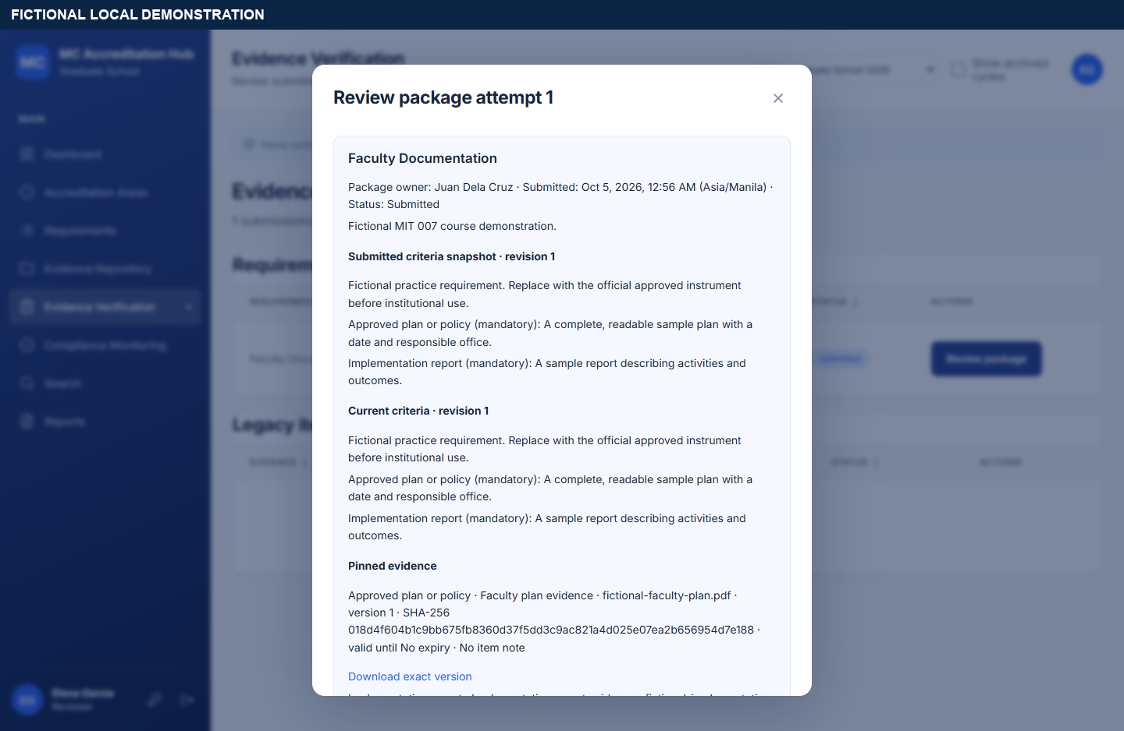
APP WALKTHROUGH
FICTIONAL DEMO
Reviewer context
The Reviewer sees the submitted criteria and exact pinned evidence before approving.
• The Reviewer is a separate fictional account.
• The new package Reject outcome is currently unavailable.
MC Accreditation Hub · MIT 007 · Fictional local evidence unless marked otherwise
24 / 53
Notes:
Point: The Reviewer sees the submitted criteria and exact pinned evidence before approving.
Explain: The Reviewer is a separate fictional account.
Explain: The new package Reject outcome is currently unavailable.
Source: screenshots/10-review-context.png
Limit: This status is local, provisional, or proposed as labeled on the slide; it is not institutional approval or a participant finding.
Transition: Completion decision.

Slide 25
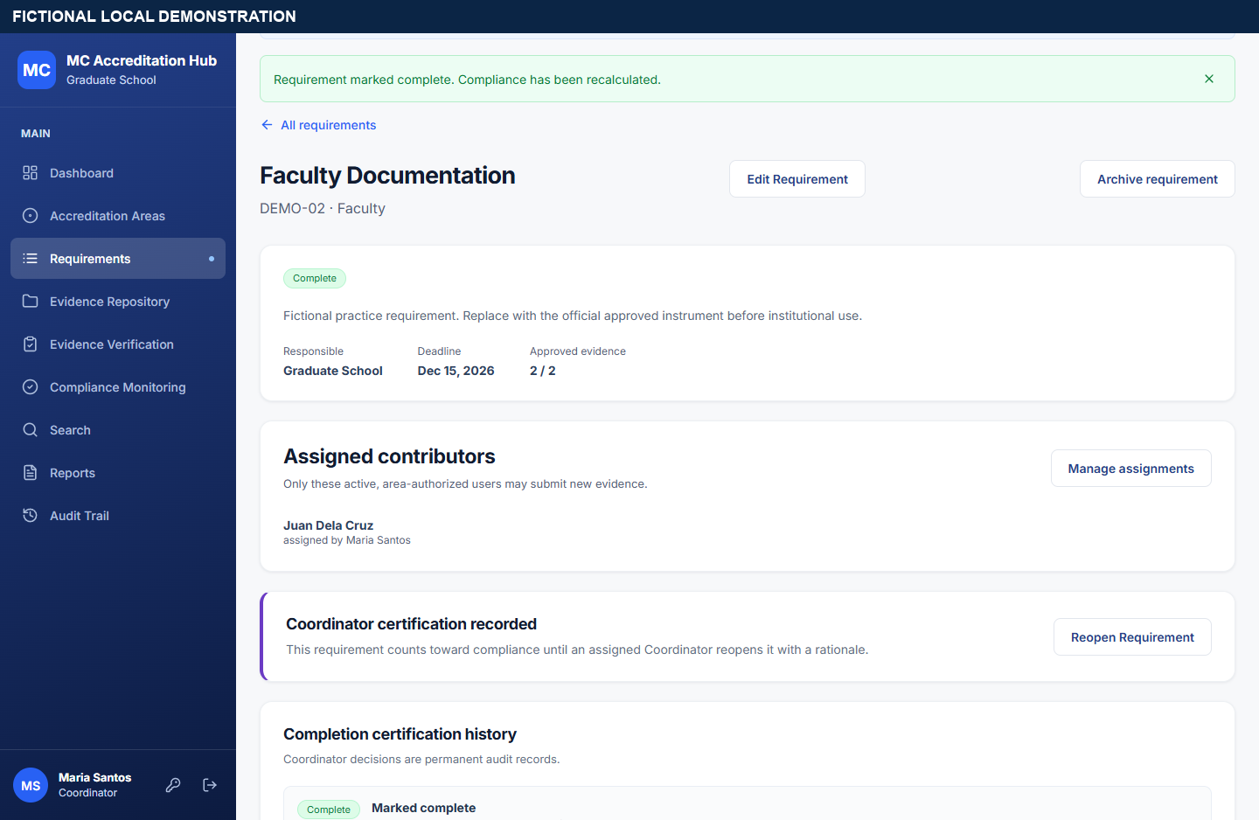
APP WALKTHROUGH
FICTIONAL DEMO
Completion decision
After review, the Coordinator selects the approved package and records a rationale.
• The requirement becomes Complete only after this step.
• The history retains the earlier submitted and review records.
MC Accreditation Hub · MIT 007 · Fictional local evidence unless marked otherwise
25 / 53
Notes:
Point: After review, the Coordinator selects the approved package and records a rationale.
Explain: The requirement becomes Complete only after this step.
Explain: The history retains the earlier submitted and review records.
Source: screenshots/12-certification-dialog.png; screenshots/13-requirement-complete.png
Limit: This status is local, provisional, or proposed as labeled on the slide; it is not institutional approval or a participant finding.
Transition: Dashboard after certification.

Slide 26
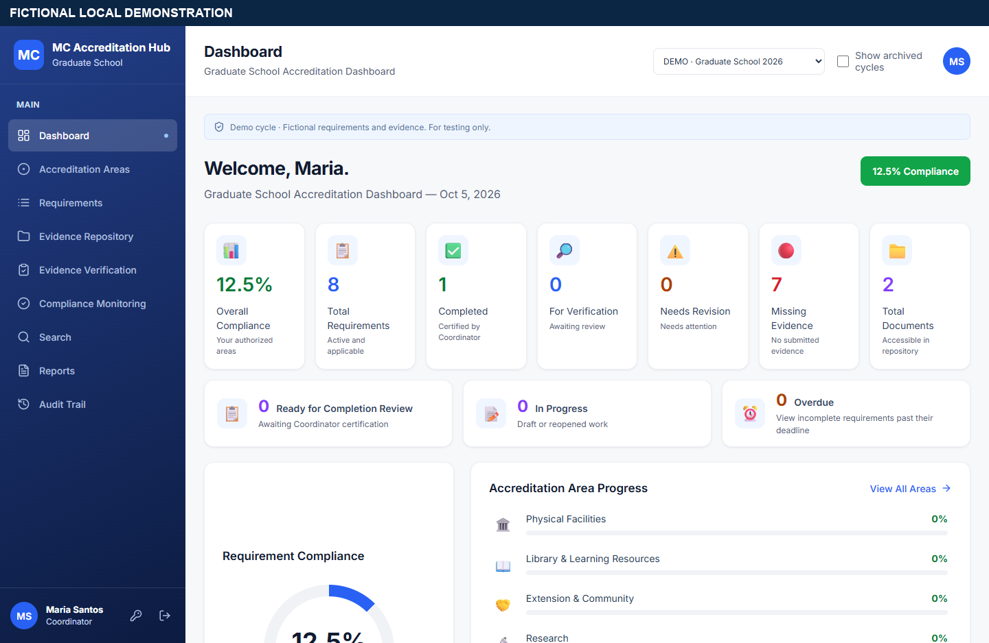
APP WALKTHROUGH
FICTIONAL DEMO
Dashboard after certification
One of eight fictional requirements is complete: 12.5% internal readiness.
• The calculation matches the report’s unfiltered cycle population.
• This figure is a demo result, not an institutional accreditation rating.
MC Accreditation Hub · MIT 007 · Fictional local evidence unless marked otherwise
26 / 53
Notes:
Point: One of eight fictional requirements is complete: 12.5% internal readiness.
Explain: The calculation matches the report’s unfiltered cycle population.
Explain: This figure is a demo result, not an institutional accreditation rating.
Source: screenshots/14-dashboard-after.png
Limit: This status is local, provisional, or proposed as labeled on the slide; it is not institutional approval or a participant finding.
Transition: Reports and provenance.

Slide 27
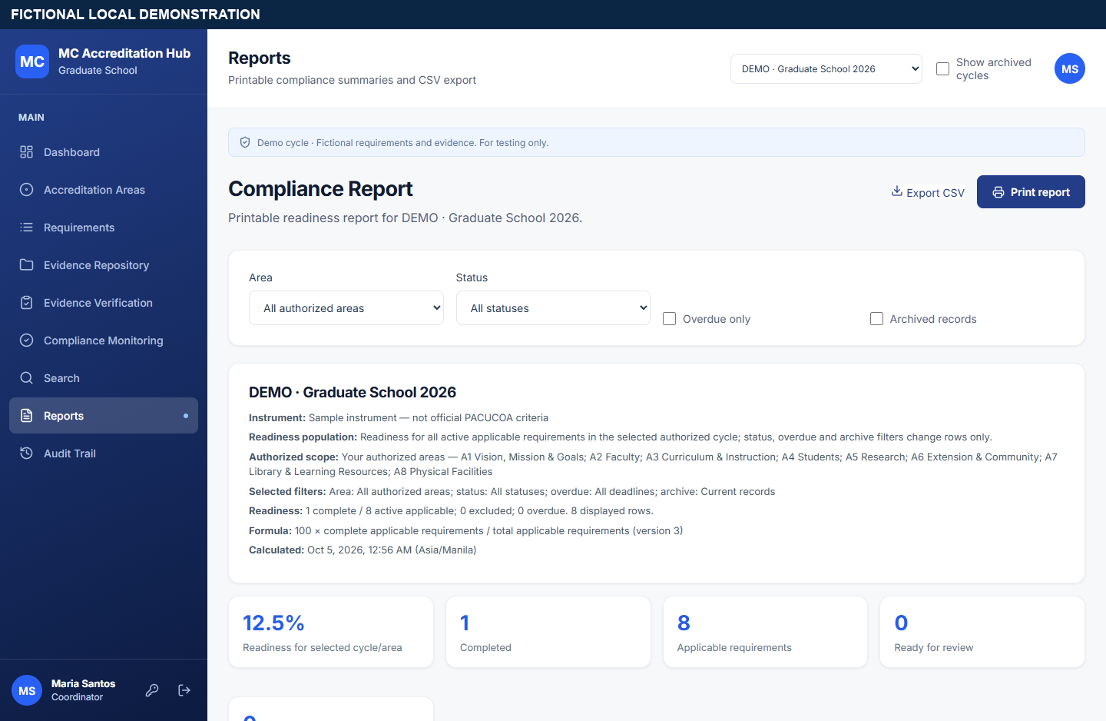
APP WALKTHROUGH
FICTIONAL DEMO
Reports and provenance
The report states its cycle, instrument, scope, population, formula version, and calculation time.
• The captured fictional report shows 1 / 8 = 12.5%.
• Area/status filters, print output, and formula-safe CSV are available.
MC Accreditation Hub · MIT 007 · Fictional local evidence unless marked otherwise
27 / 53
Notes:
Point: The report states its cycle, instrument, scope, population, formula version, and calculation time.
Explain: The captured fictional report shows 1 / 8 = 12.5%.
Explain: Area/status filters, print output, and formula-safe CSV are available.
Source: screenshots/15-compliance-report.png; docs/API.md
Limit: This status is local, provisional, or proposed as labeled on the slide; it is not institutional approval or a participant finding.
Transition: Search, audit, and Viewer boundary.

Slide 28
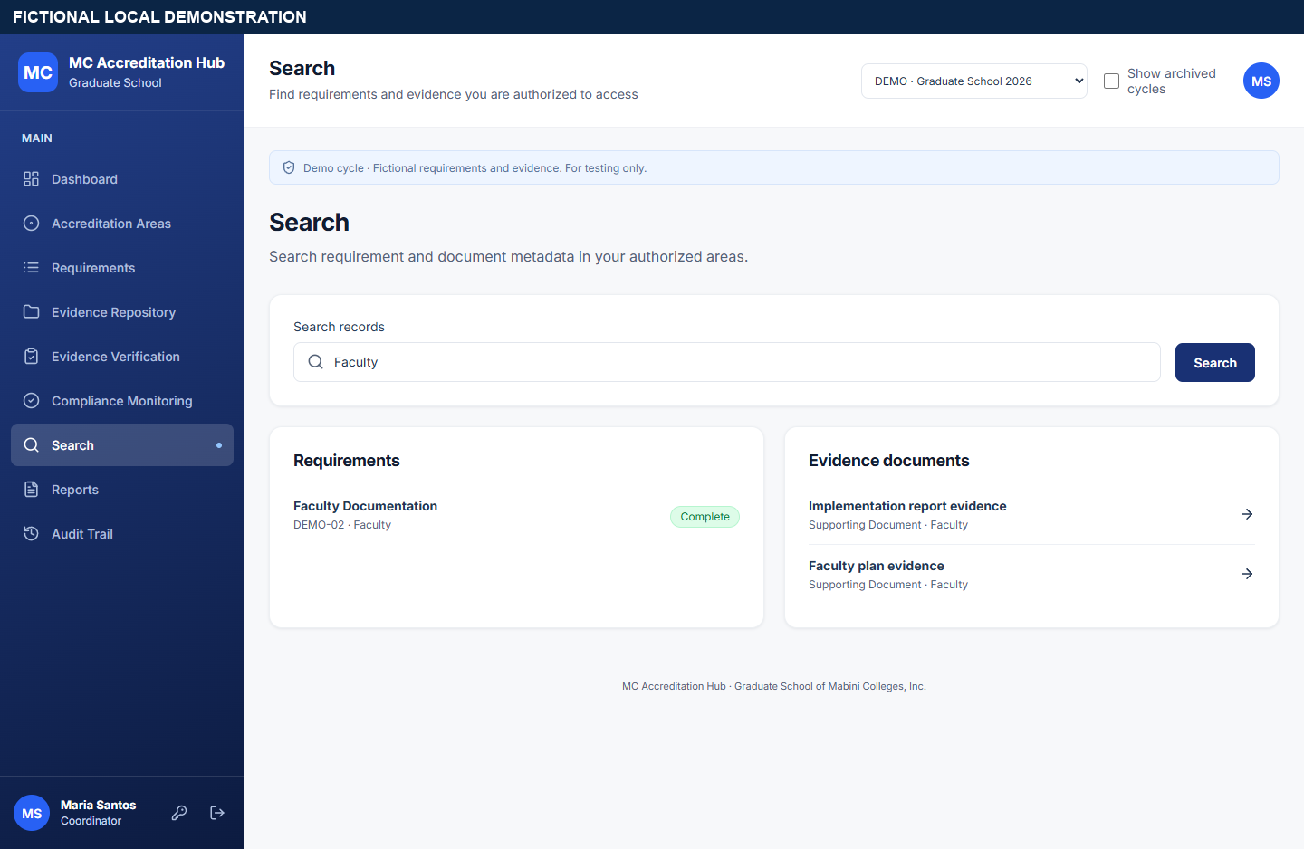
APP WALKTHROUGH
FICTIONAL DEMO
Search, audit, and Viewer boundary
Search returns only authorized metadata; audit records actions with scoped access.
• The Viewer can access approved evidence but cannot retrieve package history.
• A direct Viewer request for the demo package returned HTTP 404 in the local capture.
MC Accreditation Hub · MIT 007 · Fictional local evidence unless marked otherwise
28 / 53
Notes:
Point: Search returns only authorized metadata; audit records actions with scoped access.
Explain: The Viewer can access approved evidence but cannot retrieve package history.
Explain: A direct Viewer request for the demo package returned HTTP 404 in the local capture.
Source: screenshots/16-scoped-search.png; screenshots/17-audit-trail.png; screenshots/19-scoped-denial.png
Limit: This status is local, provisional, or proposed as labeled on the slide; it is not institutional approval or a participant finding.
Transition: Security boundaries.

Slide 29
VALIDATION
LOCAL / TARGET PENDING
Security boundaries
Local controls cover login, sessions, CSRF, scoped queries, protected files, and audit history.
• New accounts and grants require separate named operations and reasons.
• Recovery email stays disabled until school SMTP and HTTPS settings are approved.
• Target proxy, networks, scanner, retention, and restore checks remain open.
MC Accreditation Hub · MIT 007 · Fictional local evidence unless marked otherwise
29 / 53
Notes:
Point: Local controls cover login, sessions, CSRF, scoped queries, protected files, and audit history.
Explain: New accounts and grants require separate named operations and reasons.
Explain: Recovery email stays disabled until school SMTP and HTTPS settings are approved.
Explain: Target proxy, networks, scanner, retention, and restore checks remain open.
Source: README.md; docs/DEPLOYMENT.md; docs/PROGRESS.md
Limit: This status is local, provisional, or proposed as labeled on the slide; it is not institutional approval or a participant finding.
Transition: Accessibility work.

Slide 30
VALIDATION
LOCAL TESTED
Accessibility work
Shared dialogs, navigation, focus behavior, contrast, and named compliance meters received focused checks.
• Keyboard dialog behavior and mobile navigation were tested locally.
• This does not claim a complete accessibility certification or replace screen-reader evaluation.
MC Accreditation Hub · MIT 007 · Fictional local evidence unless marked otherwise
30 / 53
Notes:
Point: Shared dialogs, navigation, focus behavior, contrast, and named compliance meters received focused checks.
Explain: Keyboard dialog behavior and mobile navigation were tested locally.
Explain: This does not claim a complete accessibility certification or replace screen-reader evaluation.
Source: docs/PROGRESS.md, F24 checkpoint; frontend/e2e/accessibility-core.spec.ts
Limit: This status is local, provisional, or proposed as labeled on the slide; it is not institutional approval or a participant finding.
Transition: Current verification evidence.

Slide 31
VALIDATION
LOCAL TESTED
Current verification evidence
Tests and the demo rehearsal provide dated local evidence for this checkout.
• Django system check and migration dry run: passed.
• Frontend TypeScript/Vite build: record current result in the evidence sheet.
• Backend PostgreSQL suite: record current count and result in the evidence sheet.
• The fictional browser capture completed the full role handoff and Viewer denial.
MC Accreditation Hub · MIT 007 · Fictional local evidence unless marked otherwise
31 / 53
Notes:
Point: Tests and the demo rehearsal provide dated local evidence for this checkout.
Explain: Django system check and migration dry run: passed.
Explain: Frontend TypeScript/Vite build: record current result in the evidence sheet.
Explain: Backend PostgreSQL suite: record current count and result in the evidence sheet.
Explain: The fictional browser capture completed the full role handoff and Viewer denial.
Source: docs/course-presentation/EVIDENCE.md
Limit: Do not convert a local test pass into School IT target acceptance.
Transition: Evaluation protocol.

Slide 32
EVALUATION
METHOD READY
Evaluation protocol
The thesis packet defines repeatable tasks but contains no participant results.
• Retrieve an approved version and identify missing work.
• Submit/review fictional evidence and certify completion.
• Record elapsed time, success, errors, help needed, and participant feedback.
• Use consent and anonymous participant codes before any study.
MC Accreditation Hub · MIT 007 · Fictional local evidence unless marked otherwise
32 / 53
Notes:
Point: The thesis packet defines repeatable tasks but contains no participant results.
Explain: Retrieve an approved version and identify missing work.
Explain: Submit/review fictional evidence and certify completion.
Explain: Record elapsed time, success, errors, help needed, and participant feedback.
Explain: Use consent and anonymous participant codes before any study.
Source: docs/THESIS_EVALUATION.md
Limit: This status is local, provisional, or proposed as labeled on the slide; it is not institutional approval or a participant finding.
Transition: Results and limitations.

Slide 33
EVALUATION
PENDING EVIDENCE
Results and limitations
Observed participant outcomes and target operations remain pending.
• No usability sample size, comparison timing, or participant scores have been collected.
• No real institutional evidence, official instrument, or School IT server has been verified here.
• Performance and scalability are design goals until measured against an approved capacity target.
MC Accreditation Hub · MIT 007 · Fictional local evidence unless marked otherwise
33 / 53
Notes:
Point: Observed participant outcomes and target operations remain pending.
Explain: No usability sample size, comparison timing, or participant scores have been collected.
Explain: No real institutional evidence, official instrument, or School IT server has been verified here.
Explain: Performance and scalability are design goals until measured against an approved capacity target.
Source: docs/THESIS_EVALUATION.md; docs/PROGRESS.md
Limit: This status is local, provisional, or proposed as labeled on the slide; it is not institutional approval or a participant finding.
Transition: Institution-owned hosting intent.

Slide 34
OPERATIONS
PROPOSED
Institution-owned hosting intent
The source presentation proposes a school-owned, on-premises private-cloud model.
• A Linux reference uses Nginx, Gunicorn, Django, PostgreSQL, and protected evidence storage.
• Actual server, proxy, networks, TLS, service owner, and private-cloud characteristics require School IT confirmation.
• The course demo runs only on the presenter’s loopback Windows laptop.
MC Accreditation Hub · MIT 007 · Fictional local evidence unless marked otherwise
34 / 53
Notes:
Point: The source presentation proposes a school-owned, on-premises private-cloud model.
Explain: A Linux reference uses Nginx, Gunicorn, Django, PostgreSQL, and protected evidence storage.
Explain: Actual server, proxy, networks, TLS, service owner, and private-cloud characteristics require School IT confirmation.
Explain: The course demo runs only on the presenter’s loopback Windows laptop.
Source: Source presentation, slide 4; docs/DEPLOYMENT.md; decision D18
Limit: This status is local, provisional, or proposed as labeled on the slide; it is not institutional approval or a participant finding.
Transition: Backup and recovery.

Slide 35
OPERATIONS
TARGET PENDING
Backup and recovery
The repository contains backup, archive verification, and restore procedures.
• A recoverable set includes database, evidence bytes, and required configuration.
• A separate-environment rehearsal must prove file and history restoration on the target.
• School IT must choose operators, backup destinations, retention, and recovery targets.
MC Accreditation Hub · MIT 007 · Fictional local evidence unless marked otherwise
35 / 53
Notes:
Point: The repository contains backup, archive verification, and restore procedures.
Explain: A recoverable set includes database, evidence bytes, and required configuration.
Explain: A separate-environment rehearsal must prove file and history restoration on the target.
Explain: School IT must choose operators, backup destinations, retention, and recovery targets.
Source: docs/RESTORE.md; docs/RELEASE_CHECKLIST.md; decision D19
Limit: This status is local, provisional, or proposed as labeled on the slide; it is not institutional approval or a participant finding.
Transition: Sustainable development alignment.

Slide 36
CONCLUSION
PROJECT RATIONALE
Sustainable development alignment
The project proposes contributions to education and institutional recordkeeping.
• SDG 4: supports quality assurance preparation through organized evidence.
• SDG 9: applies digital infrastructure to institutional workflows.
• SDG 16: supports traceable decisions and records.
• These are intended alignments, not measured SDG outcomes.
MC Accreditation Hub · MIT 007 · Fictional local evidence unless marked otherwise
36 / 53
Notes:
Point: The project proposes contributions to education and institutional recordkeeping.
Explain: SDG 4: supports quality assurance preparation through organized evidence.
Explain: SDG 9: applies digital infrastructure to institutional workflows.
Explain: SDG 16: supports traceable decisions and records.
Explain: These are intended alignments, not measured SDG outcomes.
Source: Source presentation, slide 9
Limit: This status is local, provisional, or proposed as labeled on the slide; it is not institutional approval or a participant finding.
Transition: Next work after the class demo.

Slide 37
CONCLUSION
NEXT STEPS
Next work after the class demo
The class package documents what works locally and what remains for institutional use.
• Gather real evaluation results under the school’s research rules.
• Approve instrument, roles, file policy, and the D16 version 1 baseline.
• School IT must verify target scanning, HTTPS/proxy, capacity, backup, and restore.
• Keep real-evidence intake and production acceptance pending until those gates close.
MC Accreditation Hub · MIT 007 · Fictional local evidence unless marked otherwise
37 / 53
Notes:
Point: The class package documents what works locally and what remains for institutional use.
Explain: Gather real evaluation results under the school’s research rules.
Explain: Approve instrument, roles, file policy, and the D16 version 1 baseline.
Explain: School IT must verify target scanning, HTTPS/proxy, capacity, backup, and restore.
Explain: Keep real-evidence intake and production acceptance pending until those gates close.
Source: docs/PROGRESS.md; docs/PRODUCTION_ACCEPTANCE_DECISION_REGISTER.md
Limit: This status is local, provisional, or proposed as labeled on the slide; it is not institutional approval or a participant finding.
Transition: MC Accreditation Hub.

Slide 38
Working fictional local demonstration.
MC Accreditation Hub
Organized requirements, exact evidence versions, deliberate review, and traceable internal readiness.
School deployment and institutional approval remain future work.
Questions and discussion
Notes:
Point: Organized requirements, exact evidence versions, deliberate review, and traceable internal readiness.
Explain: Working fictional local demonstration.
Explain: School deployment and institutional approval remain future work.
Explain: Questions and discussion
Source: Source presentation, slide 11; README.md
Limit: This status is local, provisional, or proposed as labeled on the slide; it is not institutional approval or a participant finding.
Transition: Role and access matrix.

Slide 39
APPENDIX
PROVISIONAL POLICY
Role and access matrix
Product roles are additive only inside explicit cycle/area grants.
Role
Draft
Submitted
Approved
Other authority
Coordinator
Read/manage in grant
Read/review in grant
Read/download in grant
Certifies; cycle-wide grant for lifecycle
Reviewer
Hidden
Read/review in area
Read/download in area
No self-review
Custodian
Own work
Own submission
Shared approved
Assigned upload/map/submit
Viewer
Hidden
Hidden
Read/download in grant
No package history
Administrator
No implicit access
No implicit access
No implicit access
Account label only; separate operators
MC Accreditation Hub · MIT 007 · Fictional local evidence unless marked otherwise
39 / 53
Notes:
Point: Product roles are additive only inside explicit cycle/area grants.
Explain: Role | Draft | Submitted | Approved | Other authority
Explain: Coordinator | Read/manage in grant | Read/review in grant | Read/download in grant | Certifies; cycle-wide grant for lifecycle
Explain: Reviewer | Hidden | Read/review in area | Read/download in area | No self-review
Explain: Custodian | Own work | Own submission | Shared approved | Assigned upload/map/submit
Explain: Viewer | Hidden | Hidden | Read/download in grant | No package history
Explain: Administrator | No implicit access | No implicit access | No implicit access | Account label only; separate operators
Source: backend/hub/access.py; docs/PRODUCTION_ACCEPTANCE_DECISION_REGISTER.md
Limit: This status is local, provisional, or proposed as labeled on the slide; it is not institutional approval or a participant finding.
Transition: Workflow state reference.

Slide 40
APPENDIX
LOCAL / PROVISIONAL
Workflow state reference
A package decision and a completion certification are distinct records.
State
Trigger
Meaning
Next action
Draft package
Custodian saves
Selected versions remain editable
Submit
Submitted
Custodian submits
Attempt frozen; For Verification
Reviewer decision
Approved
Reviewer approves
Evidence accepted; not Complete
Coordinator certification
Revisions requested
Reviewer decides
Attempt closed; rationale retained
New draft and resubmit
Withdrawn
Owner withdraws
Attempt closed before decision
New draft
Complete
Coordinator certifies
Rationale and support pinned
Reasoned reopen if needed
MC Accreditation Hub · MIT 007 · Fictional local evidence unless marked otherwise
40 / 53
Notes:
Point: A package decision and a completion certification are distinct records.
Explain: State | Trigger | Meaning | Next action
Explain: Draft package | Custodian saves | Selected versions remain editable | Submit
Explain: Submitted | Custodian submits | Attempt frozen; For Verification | Reviewer decision
Explain: Approved | Reviewer approves | Evidence accepted; not Complete | Coordinator certification
Explain: Revisions requested | Reviewer decides | Attempt closed; rationale retained | New draft and resubmit
Explain: Withdrawn | Owner withdraws | Attempt closed before decision | New draft
Explain: Complete | Coordinator certifies | Rationale and support pinned | Reasoned reopen if needed
Source: backend/hub/compliance.py; backend/hub/models.py; decision D07
Limit: This status is local, provisional, or proposed as labeled on the slide; it is not institutional approval or a participant finding.
Transition: Data and API reference.

Slide 41
APPENDIX
LOCAL IMPLEMENTATION
Data and API reference
The current API is same-origin under /api/ and uses scoped integer and UUID identifiers.
• Main entities: User, RoleAssignment, Cycle, Area, Requirement, EvidenceItem, Document, DocumentVersion.
• History: PackageAttempt/Item/Decision, RequirementCertification, DocumentScan, AuditEvent.
• Django owns permissions and transitions; the browser displays returned capabilities.
• API routes and data shapes are documented separately.
MC Accreditation Hub · MIT 007 · Fictional local evidence unless marked otherwise
41 / 53
Notes:
Point: The current API is same-origin under /api/ and uses scoped integer and UUID identifiers.
Explain: Main entities: User, RoleAssignment, Cycle, Area, Requirement, EvidenceItem, Document, DocumentVersion.
Explain: History: PackageAttempt/Item/Decision, RequirementCertification, DocumentScan, AuditEvent.
Explain: Django owns permissions and transitions; the browser displays returned capabilities.
Explain: API routes and data shapes are documented separately.
Source: docs/API.md; backend/hub/models.py; backend/config/urls.py
Limit: This status is local, provisional, or proposed as labeled on the slide; it is not institutional approval or a participant finding.
Transition: File and scan policy.

Slide 42
APPENDIX
LOCAL / PENDING POLICY
File and scan policy
Current local validation accepts PDF, DOCX, XLSX, PNG, and JPEG up to 25 MiB.
• The application checks file content and bounds archive expansion.
• It quarantines unscanned, infected, failed, or checksum-mismatched versions.
• The course fixture simulates a clean verdict only for two known fictional PDFs.
• Accepted formats, resources, scanner, and records classes still need owner approval.
MC Accreditation Hub · MIT 007 · Fictional local evidence unless marked otherwise
42 / 53
Notes:
Point: Current local validation accepts PDF, DOCX, XLSX, PNG, and JPEG up to 25 MiB.
Explain: The application checks file content and bounds archive expansion.
Explain: It quarantines unscanned, infected, failed, or checksum-mismatched versions.
Explain: The course fixture simulates a clean verdict only for two known fictional PDFs.
Explain: Accepted formats, resources, scanner, and records classes still need owner approval.
Source: README.md; backend/hub/files.py; backend/hub/scanning.py; decisions D10–D12
Limit: This status is local, provisional, or proposed as labeled on the slide; it is not institutional approval or a participant finding.
Transition: Report calculation reference.

Slide 43
APPENDIX
LOCAL / SAMPLE CORRECTED
Report calculation reference
Readiness and filtered row count answer different questions.
• Numerator: complete active applicable non-archived requirements in the selected authorized cycle/area.
• Denominator: all active applicable non-archived requirements in that population.
• Status filters affect rows only; JSON, CSV, and print state the provenance.
• Fictional demo: 1 / 8 = 12.5%. The source deck’s 94 / 120 would equal 78.3%, not 87%.
MC Accreditation Hub · MIT 007 · Fictional local evidence unless marked otherwise
43 / 53
Notes:
Point: Readiness and filtered row count answer different questions.
Explain: Numerator: complete active applicable non-archived requirements in the selected authorized cycle/area.
Explain: Denominator: all active applicable non-archived requirements in that population.
Explain: Status filters affect rows only; JSON, CSV, and print state the provenance.
Explain: Fictional demo: 1 / 8 = 12.5%. The source deck’s 94 / 120 would equal 78.3%, not 87%.
Source: backend/hub/compliance.py; docs/API.md; source presentation, slide 7
Limit: This status is local, provisional, or proposed as labeled on the slide; it is not institutional approval or a participant finding.
Transition: Test and screenshot inventory.

Slide 44
APPENDIX
LOCAL EVIDENCE
Test and screenshot inventory
Current test outputs belong in the evidence sheet with date, checkout, and environment.
• Backend: workflow, permissions, scan quarantine, audit, and reporting checks.
• Frontend: TypeScript/Vite build and isolated browser workflows.
• Course capture: 19 viewport screenshots plus full-page copies, all fictional.
• The local checks do not substitute for a school HTTPS or restore rehearsal.
MC Accreditation Hub · MIT 007 · Fictional local evidence unless marked otherwise
44 / 53
Notes:
Point: Current test outputs belong in the evidence sheet with date, checkout, and environment.
Explain: Backend: workflow, permissions, scan quarantine, audit, and reporting checks.
Explain: Frontend: TypeScript/Vite build and isolated browser workflows.
Explain: Course capture: 19 viewport screenshots plus full-page copies, all fictional.
Explain: The local checks do not substitute for a school HTTPS or restore rehearsal.
Source: docs/course-presentation/EVIDENCE.md; frontend/course-demo-capture.mjs
Limit: This status is local, provisional, or proposed as labeled on the slide; it is not institutional approval or a participant finding.
Transition: Participant evaluation worksheet.

Slide 45
APPENDIX
RESULTS PENDING
Participant evaluation worksheet
Use comparable tasks and record actual results after consent.
• Participant code, role, date, and environment.
• Task success, time, errors, assistance, and observed feedback.
• Compare like-for-like baseline and Hub tasks; report sample size and exclusions.
• No participant findings have been supplied for this deck.
MC Accreditation Hub · MIT 007 · Fictional local evidence unless marked otherwise
45 / 53
Notes:
Point: Use comparable tasks and record actual results after consent.
Explain: Participant code, role, date, and environment.
Explain: Task success, time, errors, assistance, and observed feedback.
Explain: Compare like-for-like baseline and Hub tasks; report sample size and exclusions.
Explain: No participant findings have been supplied for this deck.
Source: docs/THESIS_EVALUATION.md
Limit: This status is local, provisional, or proposed as labeled on the slide; it is not institutional approval or a participant finding.
Transition: Deployment and recovery gates.

Slide 46
APPENDIX
TARGET PENDING
Deployment and recovery gates
Real evidence requires more than a working local application.
• D11 scanner and D12 records handling must be approved and verified.
• D18 network/admin boundary, D19 backup/restore, D20 capacity/operations, and D22 acceptance require School IT evidence.
• A synthetic browser test or archive checksum does not establish target acceptance.
MC Accreditation Hub · MIT 007 · Fictional local evidence unless marked otherwise
46 / 53
Notes:
Point: Real evidence requires more than a working local application.
Explain: D11 scanner and D12 records handling must be approved and verified.
Explain: D18 network/admin boundary, D19 backup/restore, D20 capacity/operations, and D22 acceptance require School IT evidence.
Explain: A synthetic browser test or archive checksum does not establish target acceptance.
Source: docs/RELEASE_CHECKLIST.md; docs/PRODUCTION_ACCEPTANCE_DECISION_REGISTER.md
Limit: This status is local, provisional, or proposed as labeled on the slide; it is not institutional approval or a participant finding.
Transition: Corrections to the source deck.

Slide 47
APPENDIX
SOURCE RECONCILIATION
Corrections to the source deck
The presentation’s 11 slides supply the project concept; this course deck reports actual local behavior.
• Slide 5 mentions Reject; new package Reject is unavailable pending an Academic Owner rule.
• Slide 6 says Coordinator review; the implementation separates Reviewer approval and Coordinator certification.
• Slide 7 shows 87% with 94 of 120 complete; that fraction is 78.3%.
• Slide 4 describes private cloud; school infrastructure has not been verified.
MC Accreditation Hub · MIT 007 · Fictional local evidence unless marked otherwise
47 / 53
Notes:
Point: The presentation’s 11 slides supply the project concept; this course deck reports actual local behavior.
Explain: Slide 5 mentions Reject; new package Reject is unavailable pending an Academic Owner rule.
Explain: Slide 6 says Coordinator review; the implementation separates Reviewer approval and Coordinator certification.
Explain: Slide 7 shows 87% with 94 of 120 complete; that fraction is 78.3%.
Explain: Slide 4 describes private cloud; school infrastructure has not been verified.
Source: docs/MC_Accreditation_Hub.pptx; docs/PROGRESS.md
Limit: This status is local, provisional, or proposed as labeled on the slide; it is not institutional approval or a participant finding.
Transition: Decisions D01–D05.

Slide 48
APPENDIX · DECISION REGISTER
APPROVAL PENDING
Decisions D01–D05
The selected option remains provisional until every listed owner records approval evidence.
D01
Cycle-wide authority
Provisional A
Academic Owner; Project Owner
Approve whole-cycle delegation and scope. Pilot: lifecycle authority gate.
D02
Evidence visibility
Provisional A
Security/Records; Academic Owner
Approve draft/history/file boundaries. Real evidence: visibility gate.
D03
Sharing boundary
Provisional A
Security/Records; Academic Owner
Approve cross-scope and legacy retrieval. Real evidence: sharing/search gate.
D04
Assignments/stewards
Provisional A
Academic Owner; Project Owner
Approve contributor and exception model. Real evidence: assignment gate.
D05
Pinned certification
Provisional A
Academic Owner; Security/Records
Approve exact support and legacy treatment. Pilot: certification support gate.
MC Accreditation Hub · MIT 007 · Fictional local evidence unless marked otherwise
48 / 53
Notes:
Point: The selected option remains provisional until every listed owner records approval evidence.
Explain: D01 Cycle-wide authority | Provisional A | Academic Owner; Project Owner | Approve whole-cycle delegation and scope. Pilot: lifecycle authority gate.
Explain: D02 Evidence visibility | Provisional A | Security/Records; Academic Owner | Approve draft/history/file boundaries. Real evidence: visibility gate.
Explain: D03 Sharing boundary | Provisional A | Security/Records; Academic Owner | Approve cross-scope and legacy retrieval. Real evidence: sharing/search gate.
Explain: D04 Assignments/stewards | Provisional A | Academic Owner; Project Owner | Approve contributor and exception model. Real evidence: assignment gate.
Explain: D05 Pinned certification | Provisional A | Academic Owner; Security/Records | Approve exact support and legacy treatment. Pilot: certification support gate.
Source: docs/PRODUCTION_ACCEPTANCE_DECISION_REGISTER.md
Limit: This status is local, provisional, or proposed as labeled on the slide; it is not institutional approval or a participant finding.
Transition: Decisions D06–D10.

Slide 49
APPENDIX · DECISION REGISTER
APPROVAL PENDING
Decisions D06–D10
The selected option remains provisional until every listed owner records approval evidence.
D06
Criteria/applicability
Provisional A
Academic Owner; Security/Records
Approve reopen and decision history. Pilot: criteria history gate.
D07
Package workflow
Provisional A
Academic Owner
Approve states and separate Reject rule. Pilot: package/review gate.
D08
Validity/expiry
Pending
Academic Owner; Security/Records
Choose warning or eligibility effect. Pilot: validity rule gate.
D09
Audit access
Provisional A
Security/Records; IT; Academic Owner
Approve readers, fields, preservation. Real evidence: audit access gate.
D10
Formats/limits
Pending
Academic Owner; IT; Security/Records
Approve type, byte limit, target bounds. Real evidence: file policy gate.
MC Accreditation Hub · MIT 007 · Fictional local evidence unless marked otherwise
49 / 53
Notes:
Point: The selected option remains provisional until every listed owner records approval evidence.
Explain: D06 Criteria/applicability | Provisional A | Academic Owner; Security/Records | Approve reopen and decision history. Pilot: criteria history gate.
Explain: D07 Package workflow | Provisional A | Academic Owner | Approve states and separate Reject rule. Pilot: package/review gate.
Explain: D08 Validity/expiry | Pending | Academic Owner; Security/Records | Choose warning or eligibility effect. Pilot: validity rule gate.
Explain: D09 Audit access | Provisional A | Security/Records; IT; Academic Owner | Approve readers, fields, preservation. Real evidence: audit access gate.
Explain: D10 Formats/limits | Pending | Academic Owner; IT; Security/Records | Approve type, byte limit, target bounds. Real evidence: file policy gate.
Source: docs/PRODUCTION_ACCEPTANCE_DECISION_REGISTER.md
Limit: This status is local, provisional, or proposed as labeled on the slide; it is not institutional approval or a participant finding.
Transition: Decisions D11–D15.

Slide 50
APPENDIX · DECISION REGISTER
APPROVAL PENDING
Decisions D11–D15
The selected option remains provisional until every listed owner records approval evidence.
D11
Malware scanning
Pending
Security/Records; IT
Approve scanner and target failure tests. Real evidence: approved scan required.
D12
Records schedule
Pending
Security/Records; IT; Academic Owner
Approve classes, retention, holds, disposal. Real evidence: records control required.
D13
Overdue rule
Pending
Academic Owner; Project Owner
Approve deadline and Manila boundary. Pilot: overdue semantics gate.
D14
Archive lifecycle
Pending
Project; Academic; Security/Records
Approve transitions and preservation. Pilot: archive lifecycle gate.
D15
Launch administration
Pending
Project; IT; Academic Owner
Approve separate named operators. Pilot: named operators gate.
MC Accreditation Hub · MIT 007 · Fictional local evidence unless marked otherwise
50 / 53
Notes:
Point: The selected option remains provisional until every listed owner records approval evidence.
Explain: D11 Malware scanning | Pending | Security/Records; IT | Approve scanner and target failure tests. Real evidence: approved scan required.
Explain: D12 Records schedule | Pending | Security/Records; IT; Academic Owner | Approve classes, retention, holds, disposal. Real evidence: records control required.
Explain: D13 Overdue rule | Pending | Academic Owner; Project Owner | Approve deadline and Manila boundary. Pilot: overdue semantics gate.
Explain: D14 Archive lifecycle | Pending | Project; Academic; Security/Records | Approve transitions and preservation. Pilot: archive lifecycle gate.
Explain: D15 Launch administration | Pending | Project; IT; Academic Owner | Approve separate named operators. Pilot: named operators gate.
Source: docs/PRODUCTION_ACCEPTANCE_DECISION_REGISTER.md
Limit: This status is local, provisional, or proposed as labeled on the slide; it is not institutional approval or a participant finding.
Transition: Decisions D16–D19.

Slide 51
APPENDIX · DECISION REGISTER
APPROVAL PENDING
Decisions D16–D19
The selected option remains provisional until every listed owner records approval evidence.
D16
Version 1 baseline
Pending
Project; Academic; IT; Security/Records
Resolve D01–D15 before ratification. Pilot: no version 1 baseline yet.
D17
Account recovery
Provisional A
IT; Security/Records
Approve assisted recovery procedure. Pilot: recovery procedure gate.
D18
Network/admin access
Provisional test A
IT; Security/Records
Supply actual proxy, TLS, admin networks. Pilot: target network test required.
D19
Backup/recovery
Pending
IT; Security/Records
Assign target, operators, RPO/RTO, restore. Pilot: target restore proof required.
MC Accreditation Hub · MIT 007 · Fictional local evidence unless marked otherwise
51 / 53
Notes:
Point: The selected option remains provisional until every listed owner records approval evidence.
Explain: D16 Version 1 baseline | Pending | Project; Academic; IT; Security/Records | Resolve D01–D15 before ratification. Pilot: no version 1 baseline yet.
Explain: D17 Account recovery | Provisional A | IT; Security/Records | Approve assisted recovery procedure. Pilot: recovery procedure gate.
Explain: D18 Network/admin access | Provisional test A | IT; Security/Records | Supply actual proxy, TLS, admin networks. Pilot: target network test required.
Explain: D19 Backup/recovery | Pending | IT; Security/Records | Assign target, operators, RPO/RTO, restore. Pilot: target restore proof required.
Source: docs/PRODUCTION_ACCEPTANCE_DECISION_REGISTER.md
Limit: This status is local, provisional, or proposed as labeled on the slide; it is not institutional approval or a participant finding.
Transition: Decisions D20–D22.

Slide 52
APPENDIX · DECISION REGISTER
APPROVAL PENDING
Decisions D20–D22
The selected option remains provisional until every listed owner records approval evidence.
D20
Capacity/operations
Pending
IT; Project; Security/Records
Measure pilot scale and service controls. Pilot: capacity/operations proof required.
D21
Report population
Provisional B
Academic Owner; Project Owner
Ratify filter/readiness behavior. Pilot: report semantics gate.
D22
Acceptance evidence
Provisional local B
IT; Academic; Project Owner
Name target reviewers and record. Pilot: target acceptance record required.
MC Accreditation Hub · MIT 007 · Fictional local evidence unless marked otherwise
52 / 53
Notes:
Point: The selected option remains provisional until every listed owner records approval evidence.
Explain: D20 Capacity/operations | Pending | IT; Project; Security/Records | Measure pilot scale and service controls. Pilot: capacity/operations proof required.
Explain: D21 Report population | Provisional B | Academic Owner; Project Owner | Ratify filter/readiness behavior. Pilot: report semantics gate.
Explain: D22 Acceptance evidence | Provisional local B | IT; Academic; Project Owner | Name target reviewers and record. Pilot: target acceptance record required.
Source: docs/PRODUCTION_ACCEPTANCE_DECISION_REGISTER.md
Limit: This status is local, provisional, or proposed as labeled on the slide; it is not institutional approval or a participant finding.
Transition: Source and reading map.

Slide 53
APPENDIX
SOURCE INDEX
Source and reading map
The deck connects the original concept to the current repository and its stated limits.
• Source concept: docs/MC_Accreditation_Hub.pptx (11 slides).
• Implementation: README.md; docs/API.md; backend/hub; frontend/src.
• Verification and demo: docs/PROGRESS.md; course-presentation/EVIDENCE.md; captured screenshots.
• Policy and target gates: production decision register, D16 baseline proposal, release checklist.
• Evaluation: docs/THESIS_EVALUATION.md.
MC Accreditation Hub · MIT 007 · Fictional local evidence unless marked otherwise
53 / 53
Notes:
Point: The deck connects the original concept to the current repository and its stated limits.
Explain: Source concept: docs/MC_Accreditation_Hub.pptx (11 slides).
Explain: Implementation: README.md; docs/API.md; backend/hub; frontend/src.
Explain: Verification and demo: docs/PROGRESS.md; course-presentation/EVIDENCE.md; captured screenshots.
Explain: Policy and target gates: production decision register, D16 baseline proposal, release checklist.
Explain: Evaluation: docs/THESIS_EVALUATION.md.
Source: All named local repository sources
Limit: This status is local, provisional, or proposed as labeled on the slide; it is not institutional approval or a participant finding.
Transition: Questions and discussion.

