Slide 1
AI-Based Classification of Somatic and Germline DNA Mutations Using Local Sequence Context
Stella Chantava
MSc Artificial Intelligence · June 2026

Slide 2


Why Does This Matter?
Germline Mutations
Somatic Mutations
Germline mutations are inherited and present in every cell of the body from birth. They are passed from parent to child and play a key role in hereditary disease risk and population genetics.
Somatic mutations arise during a person's lifetime and are strongly linked to cancer development. Distinguishing mutation origin is critical for precision medicine, diagnosis, and targeted therapy.

Slide 3
Can AI classify DNA mutations as Somatic or Germline using only local sequence context?
• 201 bp mutated DNA sequence
• No clinical information
• No population statistics
• No gene annotations

Slide 4
Dataset Construction
COSMIC – Somatic Mutations
ClinVar – Germline Mutations
10,000 somatic single nucleotide variants (SNVs) sourced from the COSMIC database, representing cancer-associated somatic mutations across diverse tissue types.
10,000 germline SNVs sourced from the ClinVar database, representing inherited pathogenic and likely pathogenic germline variants.
Reference Genome & Sequences
Data Split
Human reference genome GRCh38 used to extract a 201 bp local sequence context window centered on each mutation site.
Total: 20,000 SNVs (balanced). Split into Training (12,000), Validation (4,000), and Test (4,000) sets for model development and evaluation.

Slide 5

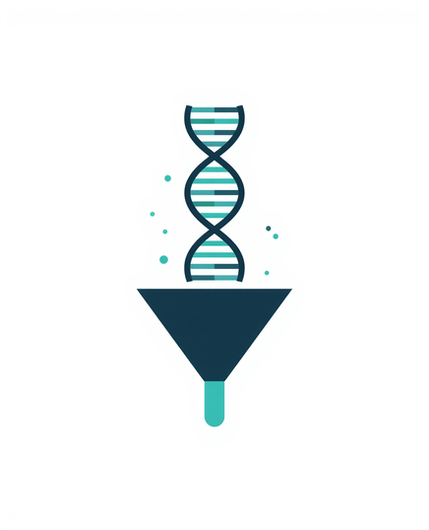
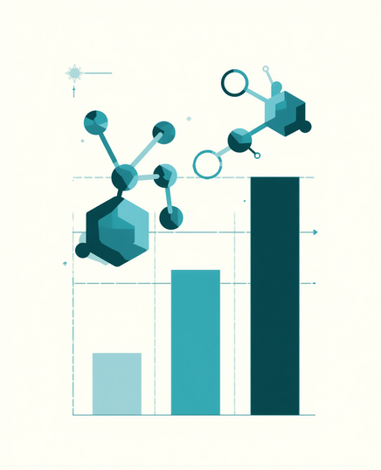
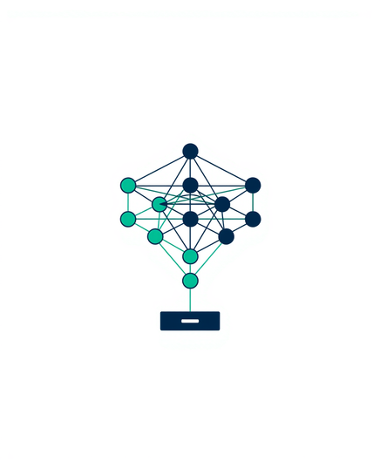
Methodology Pipeline
1
2
3
4
Data Integration
SNV Filtering & Sequence Extraction
Feature Extraction
Model Training & Evaluation
COSMIC (somatic SNVs) and ClinVar (germline SNVs) merged into a balanced 20,000-variant dataset.
Quality filtering applied; 201 bp mutated sequences extracted from GRCh38 reference genome per variant.
Biological features computed: k-mer frequencies, GC content, CpG counts, transition/transversion, homopolymer runs.
Five model architectures trained and evaluated using MCC and ROC-AUC on held-out test set (4,000 variants).

Slide 6
Models Compared
1
2
Logistic Regression
XGBoost
3
4
5
Traditional ML using k-mer frequency features
Gradient boosting with k-mer features
1D CNN
Nucleotide Transformer
Hybrid Model
Deep learning on raw DNA sequence signals
Foundation model with genomic pre-training
NT embeddings + biological features + XGBoost

Slide 7
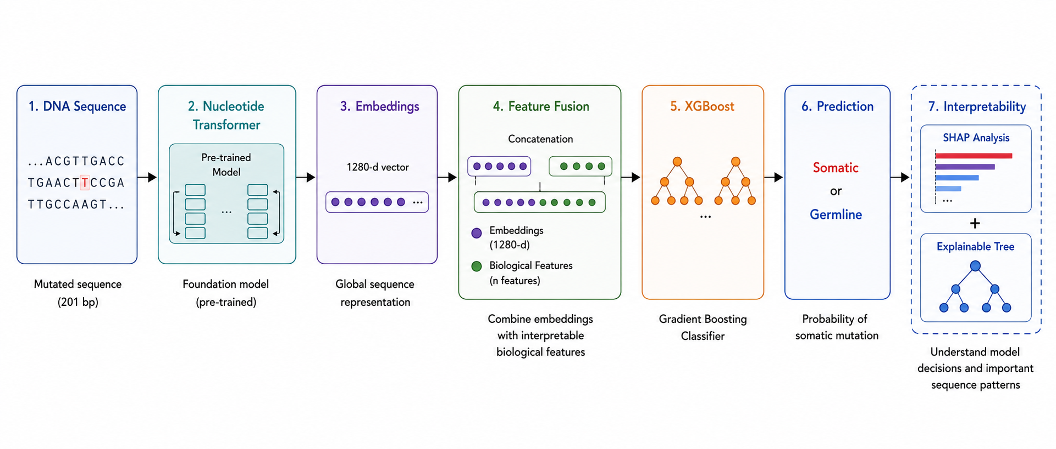
Proposed Hybrid Model

Slide 8
Biological Feature Engineering
Mutation Type & Transitions
GC Content & CpG Counts
Encodes the nucleotide substitution type (e.g., C>T) and classifies each SNV as a transition (purine↔purine or pyrimidine↔pyrimidine) or transversion, capturing mutational signature patterns.
Measures GC proportion and counts CpG dinucleotides within the 201 bp window. CpG sites are hotspots for germline methylation-driven mutations, providing strong discriminative signal.
Local Sequence Context
Homopolymer Runs & Repetitive Motifs
Captures the trinucleotide context (±1 bp) and broader flanking sequence around each mutation site. Somatic and germline mutations exhibit distinct context-dependent mutational preferences.
Detects runs of identical nucleotides and repetitive sequence motifs near the mutation site. These structural features are associated with replication slippage and differ between mutation origins.

Slide 9
Model | ROC-AUC | MCC
LR (k-mer Features) | 0.612 | 0.173
1D CNN (201bp Sequence) | 0.650 | 0.221
XGBoost focused on MUT | 0.685 | 0.277
XGBoost (k-mer Features) | 0.681 | 0.267
NT+ XGBoost | 0.692 | 0.270
Hybrid Model | 0.722 | 0.313
Model Performance
Hybrid Model achieves best overall performance with MCC 0.313 and ROC-AUC 0.722, outperforming all baseline approaches including Nucleotide Transformer + XGBoost and traditional ML models.

Slide 10
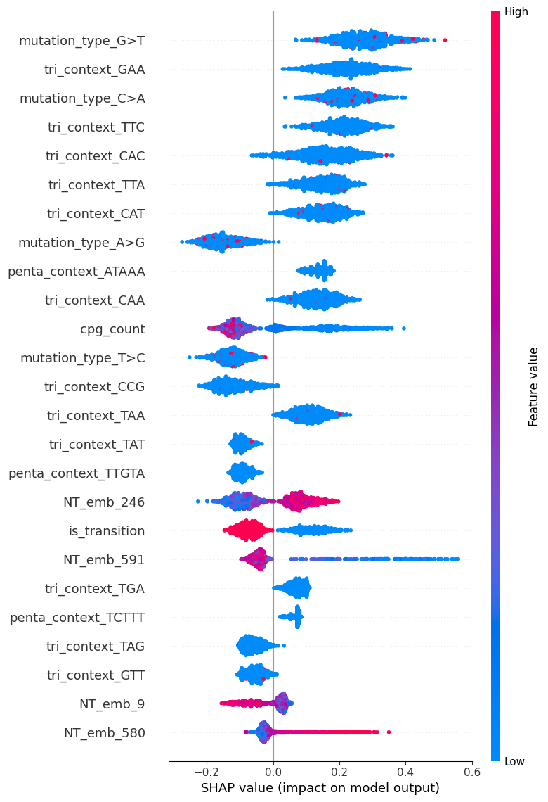
Understanding Model Decisions
SHAP Value Analysis
• Global feature importance breakdown across all predictions
• Biological features (GC Content, CpG Counts, Mutation Type) provide strong, interpretable signals
• Nucleotide Transformer embeddings capture deep sequence context
• Hybrid model benefits from complementary contributions of both feature types
• Top features align with known biological differences between somatic and germline mutations

Slide 11

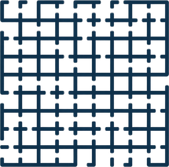
Interpreting Learned Representations
Decision Tree
Analysis
Embedding Correlations
& Sequence Patterns
Decision path analysis reveals how the hybrid model structures its classification logic. Key splits correspond to biologically meaningful thresholds in GC content and CpG density, confirming that the model learns interpretable genomic rules rather than arbitrary statistical patterns.
Nucleotide Transformer embeddings show strong correlations with GC-rich regions, CpG motifs, and repetitive sequence motifs. These patterns align with known biological differences between somatic and germline mutation landscapes, validating the model's learned representations.

Slide 12
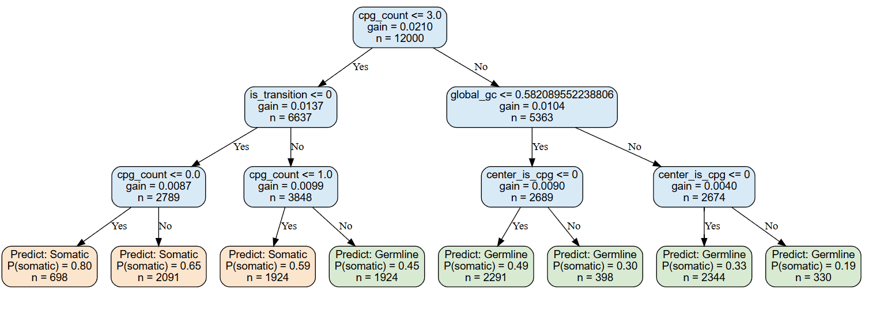
Understanding Model Decisions

Slide 13
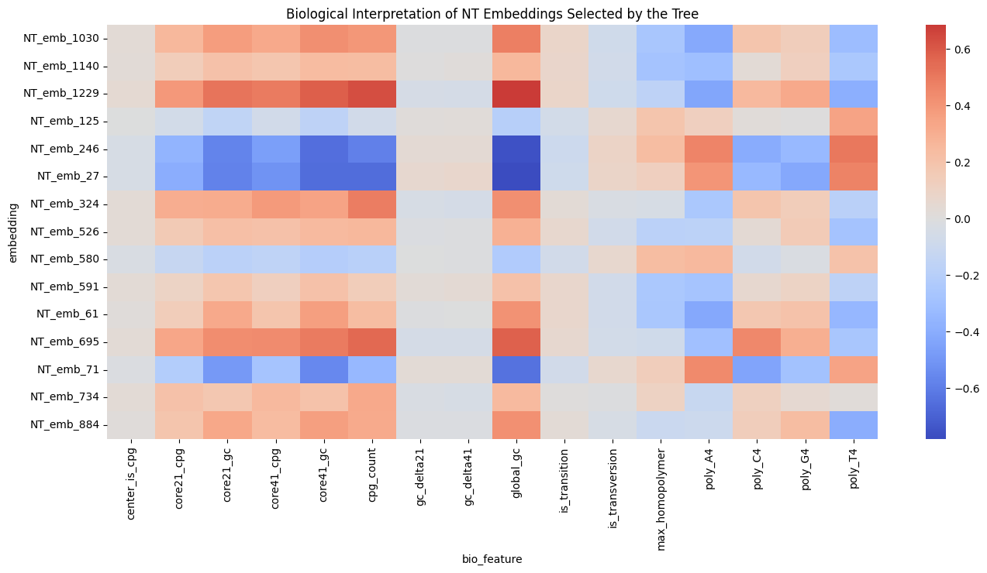
Understanding Model Decisions

Slide 14
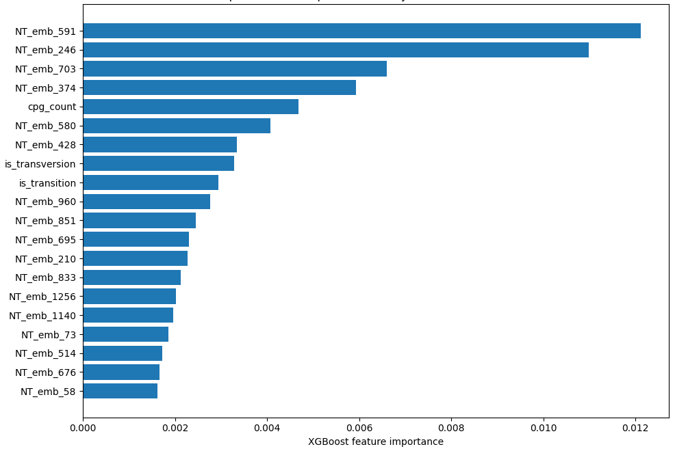
Understanding Model Decisions
{
Mix of features at the top !!!

Slide 15
Conclusions
01
Key Findings
Local DNA sequence context contains detectable mutation origin signals. The hybrid model (NT + Biological Features + XGBoost) achieves the best classification performance with MCC 0.313 and ROC-AUC 0.722, outperforming all baseline approaches.
Foundation Models vs. Traditional ML
02
Nucleotide Transformer embeddings outperform traditional k-mer and logistic regression approaches. Biological features provide complementary, interpretable information that further boosts classification performance.
Future Directions
03
Compare with DNABERT-2 foundation model; fine-tune foundation models for somatic/germline classification; explore DEFT-inspired dynamic feature generation; discover novel mutation-associated sequence motifs.

Slide 16
Thank You
Stella Chantava
MSc Artificial Intelligence · June 2026

