Slide 1

Scottish Household Survey
Access to Greenspace and Neighbourhood Rating

Slide 2

Project brief and context
Notes:
The Scottish Household Survey is:
a face-to-face survey of a sample of people in private residences in Scotland
interviewer-administered in people’s homes
Voluntary -> self-selection bias
Scotland-wide; it covers all 32 local authorities
three surveys in one: Transport and Travel in Scotland Survey, the Scottish House Condition Survey as well as the Scottish Household Survey
long-running since 1999
wide-ranging in topics covered, including evidence on the physical condition of Scotland’s homes
a provider of robust evidence on the composition, characteristics, attitudes and behaviour of private households and individuals
collects info on greenspace, neighbourhood rating and community belonging.
Questions are asked not always asked every year and not to every household.
Estimated percentage.
Do have full responses for neighbourhood rating, community belonging and distance.

Slide 3


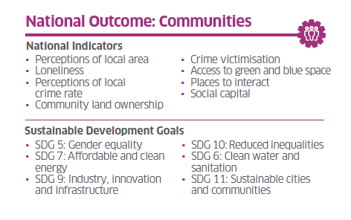
Notes:
SHS informs the NPF (along with other national surveys crime and health). NPF is Scotland’s national compliment to the UN’s 17 Sustainable development goals.
It aims at motivating the whole country, at national, local and individual levels to strive for 11 National Outcomes.
The SHS is a marker for the Communities marker. In particular national indicators “perceptions of local area” and “access to green and blue space”.

Slide 4
What is the relationship between distance to greenspace and neighbourhood rating?
Notes:
How do people feel about their local communities?
Greenspace or bluespace: nearest outdoor area.
Access questions: Distance/use/satisfaction.
How do people in neighbourhoods with good access to green space differ from those who have no good
access? Are there differences in how they rate their neighbourhoods? Are there differences in how they
rate their communities?

Slide 5
Insights

Slide 6
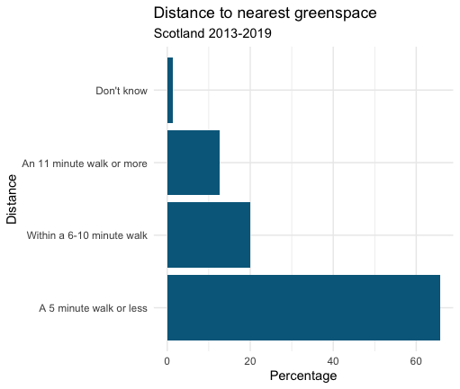
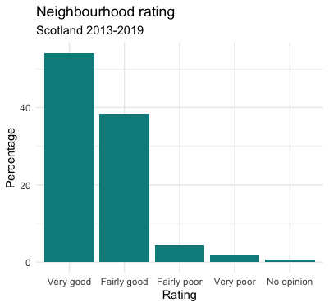
Distance to Greenspace and Neighbourhood Rating
Notes:
Data gathered from statistics.scot.gov website.
Values for across Scotland.
From dataset with estimated proportions of respondents.
Joined datasets
Majority of respondents live less than a 5 minute walk away from their nearest outdoor space.
People more likely to answer in the “Very good” or “Fairly good” than poor, for neighbourhood rating.

Slide 7
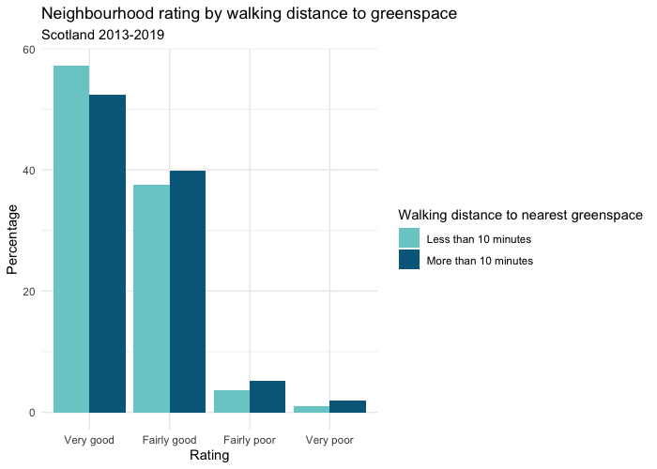
Neighbourhood Rating by Walking Distance
Notes:
No real clear pattern in they way respondents rate their neighbourhood by walking distance.

Slide 8
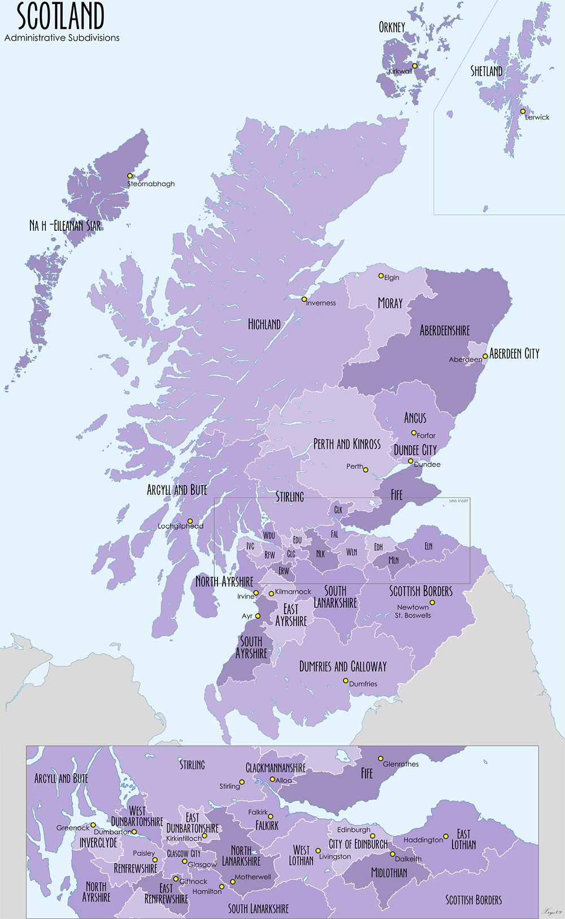
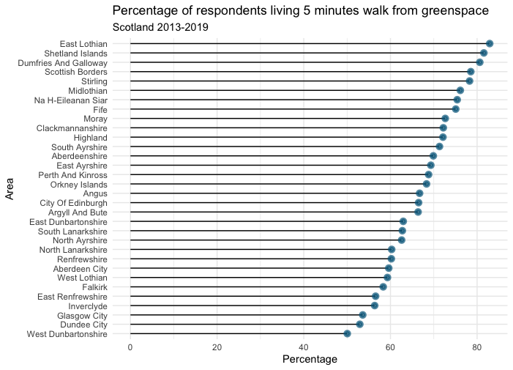
Distance to Greenspace by Area
Notes:
Graph shows those living within 5 mins (most common answer).
Vast difference (almost 50%) between top (East Lothian) and bottom (West Dunbartonshire).
Difference perhaps down to urban/rural divide.
Bottom three contains 2 cities.

Slide 9
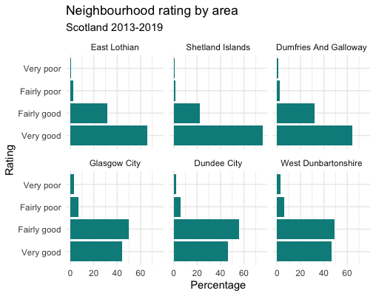
Top 3 and Bottom 3 Areas with Greenspace Access
Notes:
Ratings are different.

Slide 10
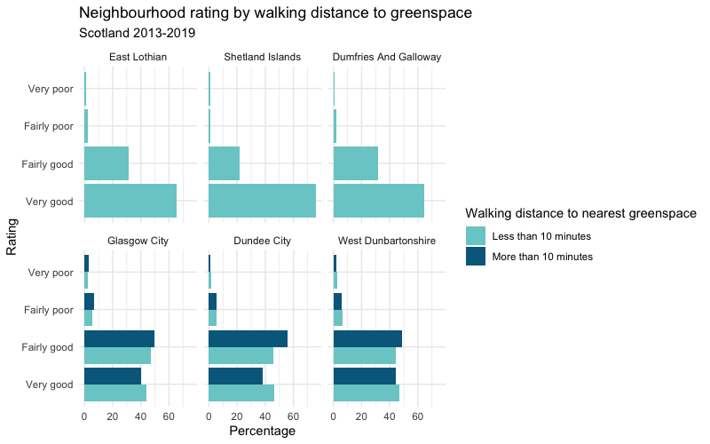
Top 3 and Bottom 3 Areas with Greenspace Access by Distance
Notes:
Easy to see from this plot that there are no respondents that live more than 10 minutes away from greenspace in the top 3 areas. Whereas the bottom three are much more varied in their distance to the outdoors.

Slide 11
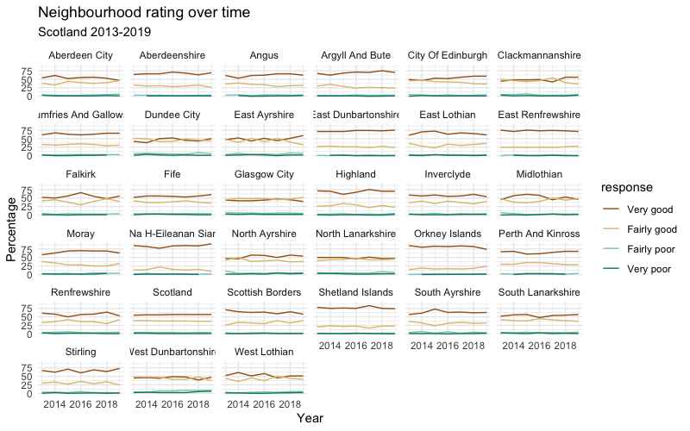

Slide 12
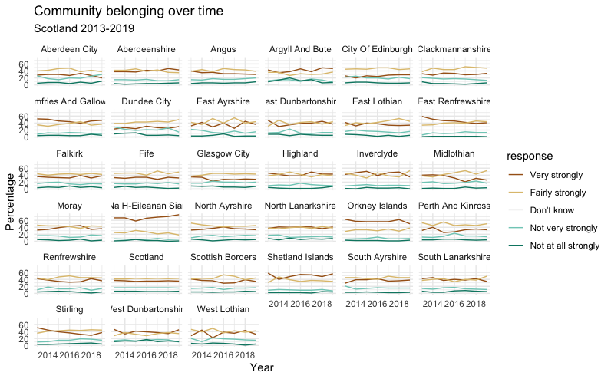

Slide 13

Modelling
Is it possible to predict neighbourhood rating?
Notes:
Must be noted that this data comes from a different set to the analysis seen so far. Not able to pull out specific local areas of interest.
Data represents individual answers to a set of questions from the SHS from 2012 to 2019.
Data is presented as total respondents and not as an estimated percentage.
Data includes different variables, including variables that refer to other aspects of access to greenspace; use, satisfaction. Also, other factors that might influence neighbourhood rating such as community belonging.
Some data missing for 2012 (volunteering), 2017 and 2018 (satisfaction). Imputed using random forest method.

Slide 14
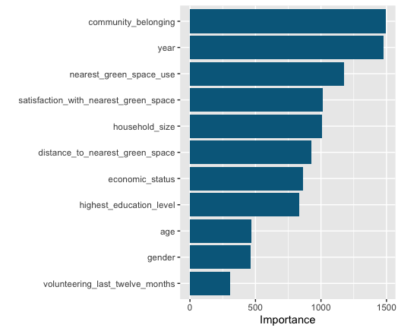
Most Important Variables
Notes:
Model used to predict neighbourhood rating is a random forest model.
75% accuracy.
Accurate prediction on “Very good” and “Fairly good” (good sensitivity and specificity values), likely because those make up the majority of the data. Good specificity values and decent sensitivity for poor ratings.
Blackbox model, difficult to interpret in a particularly detailed way.
Community belonging by far the most important.
Followed closely by year. > Perhaps this is to do with the selection of respondents or the format of questions. Questions do change or reformatted each year. The SHS informs the SSCQ, if these have changed over the year then answers might too. (Satisfaction has imputed values for 2017 and 2018.)
Greenspace use the third most important. Not a variable covered in previous data. Fairly more important than distance. Also satisfaction more important than distance.
Be good to see how in the past these variables have affected neighbourhood rating. (Data the model was trained on).

Slide 15
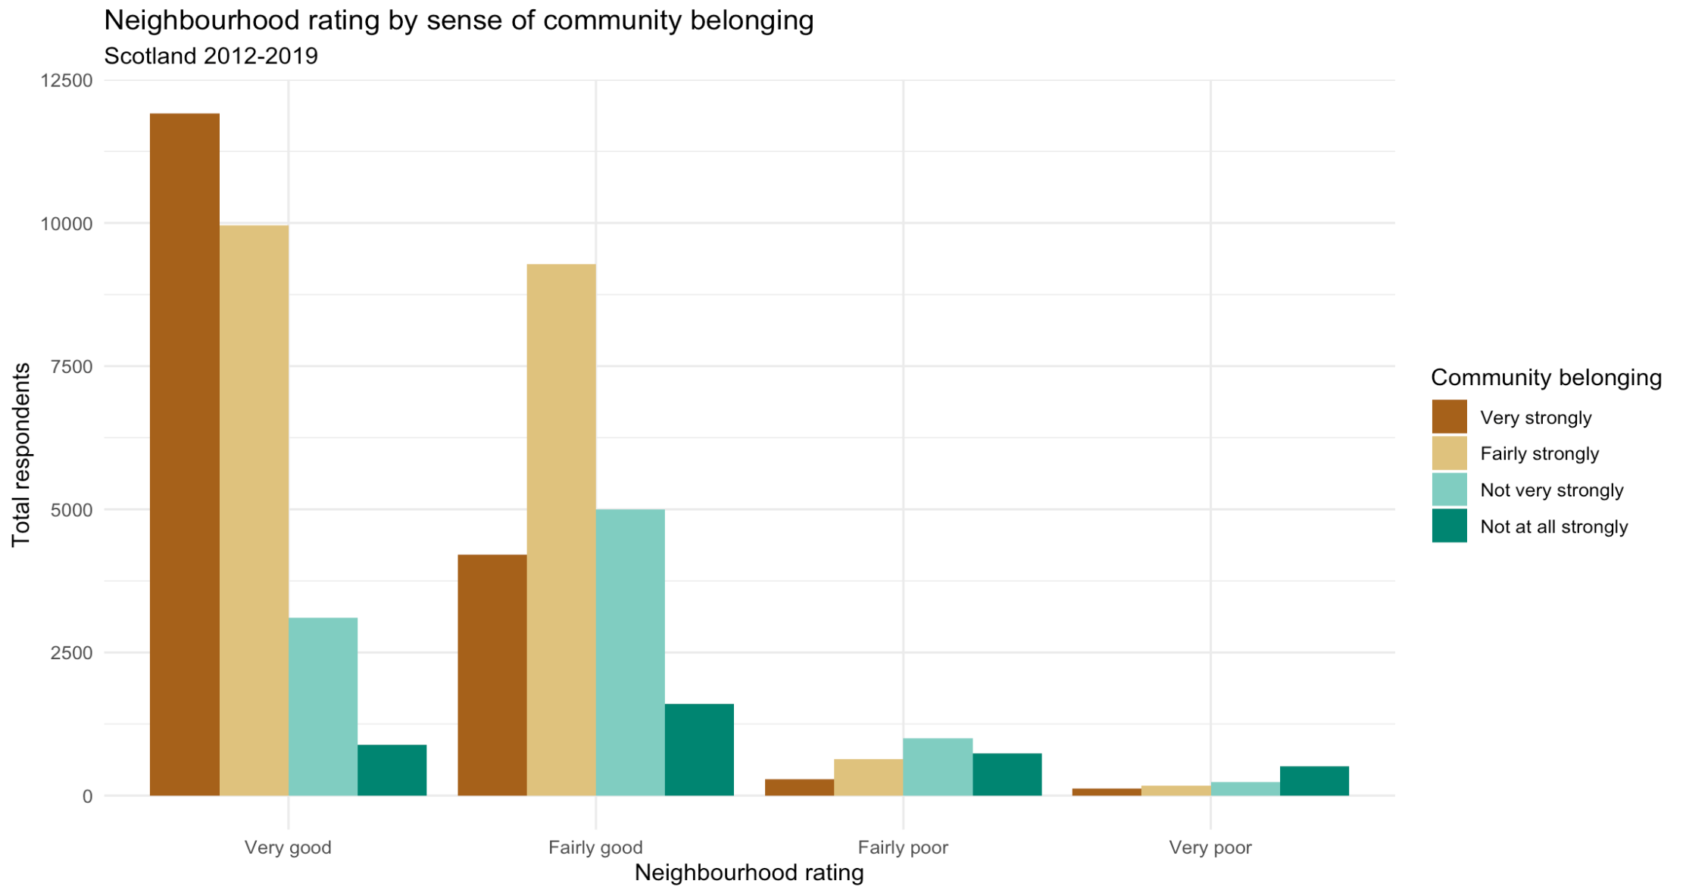
Neighbourhood Rating by Community Belonging
Notes:
There seems to be a pattern in how rating and belonging are connected. Respondents tend to answer with the same level answer to both questions.

Slide 16
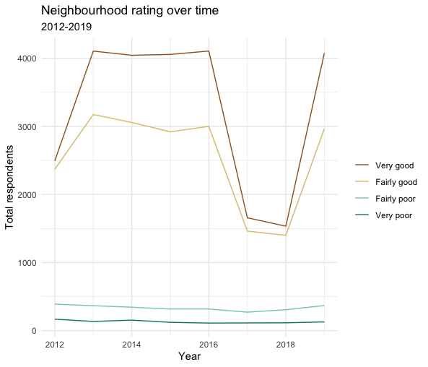
Neighbourhood Rating Over Time
Notes:
There’s a big dip in the numbers answering good in 2017 and 2018.
Perhaps there’s an outside factor that is influencing. Those years have a lot of imputed data for the satisfaction column but the neighbourhood rating data was complete, so shouldn’t be much of a difference. Suggests that there was a major change in the survey’s format in those years (but looking at the questions answered not really).

Slide 17
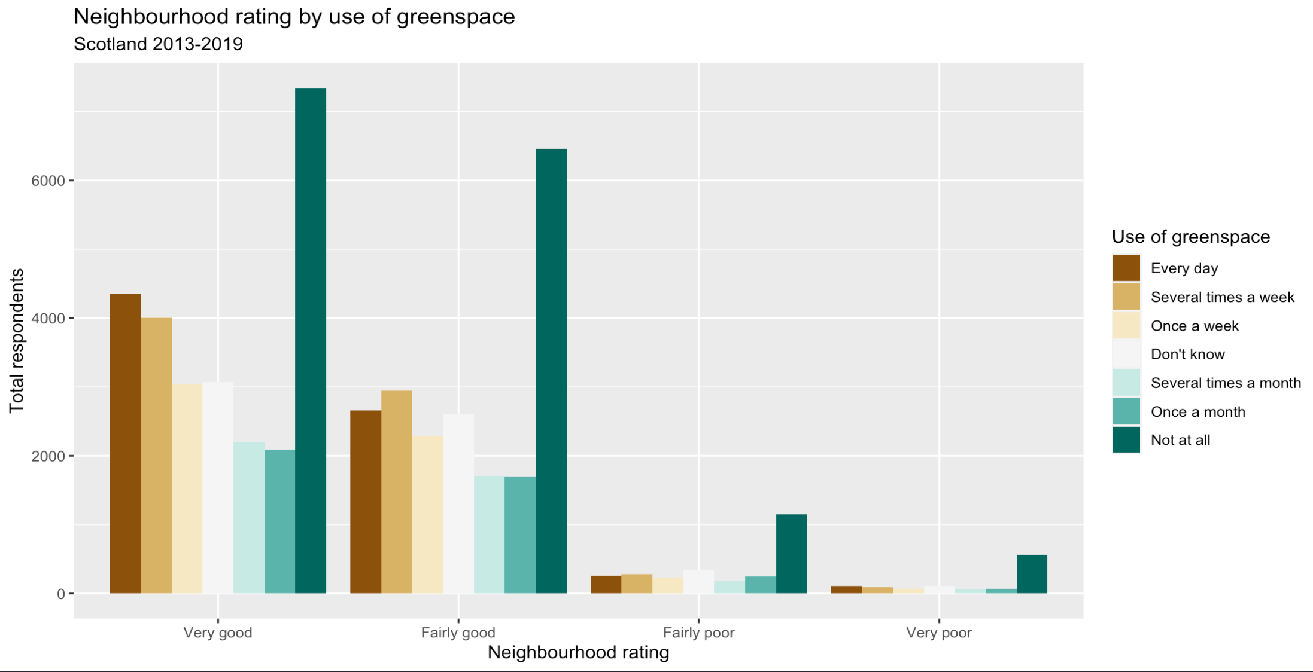
Neighbourhood Rating and Greenspace Use
Notes:
Vast majority of people are not using greenspace regularly. Discounting those people, there’s a similar pattern to community belonging and neighbourhood rating to greenspace use.
Would be interesting to see how greenspace use and distance align (and satisfaction).

Slide 18

Conclusions and possible outcomes

Slide 19
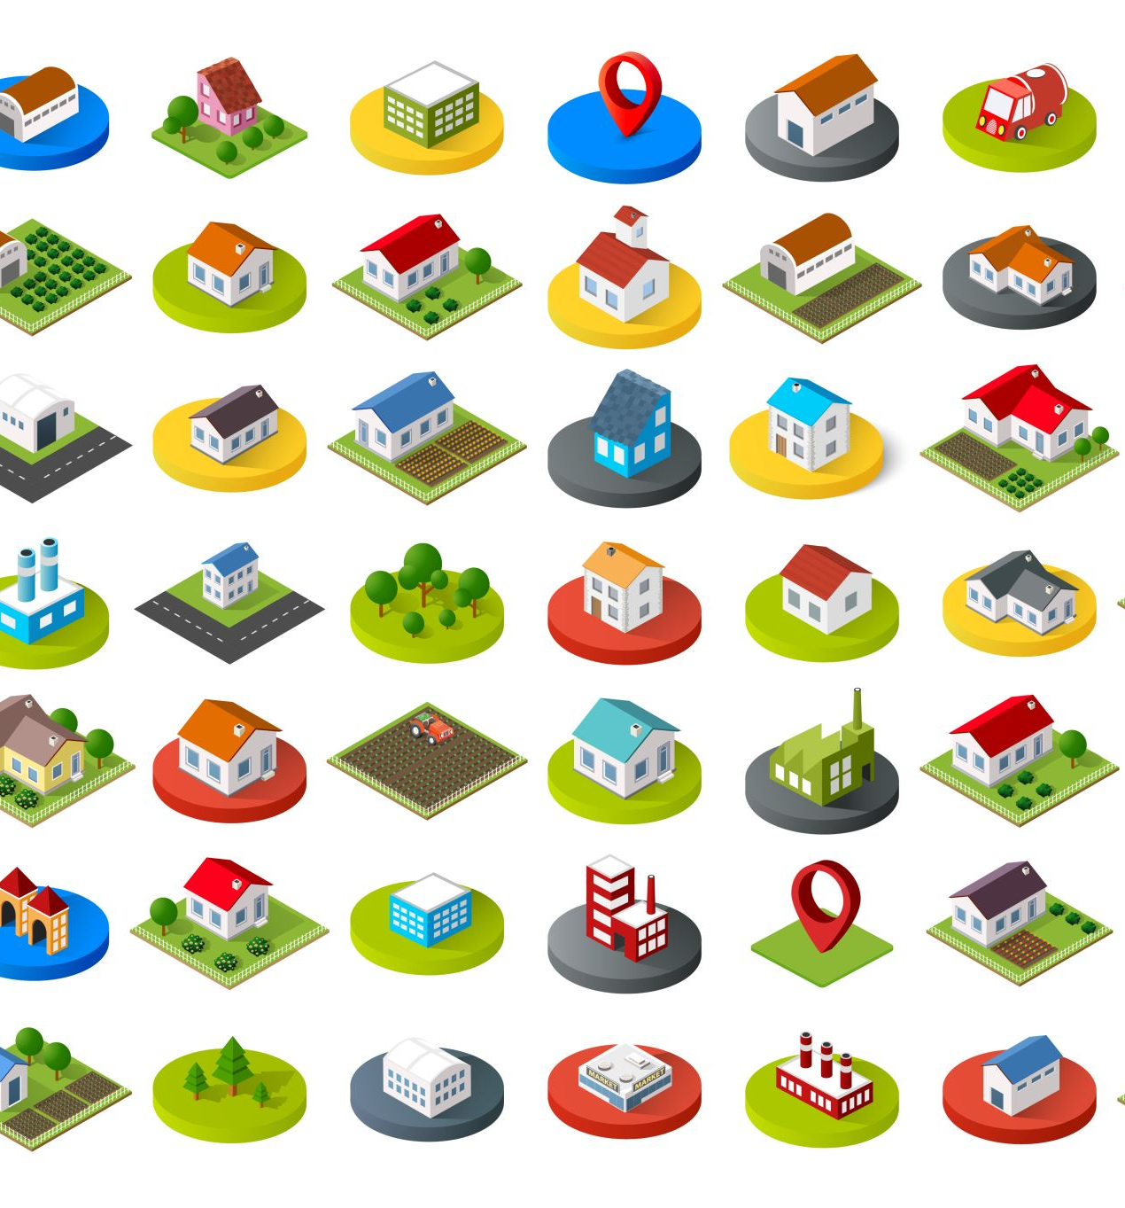
Conclusions
Distance and neighbourhood rating varies by area. Particularly between rural and urban areas.
Community belonging is a better indicator of neighbourhood rating than distance to greenspace.
Survey design or bias in respondents perhaps has an effect on results.

Slide 20
Possible Outcomes
Promote use of outdoor spaces
Review survey design
Attempt different modelling techniques

