Slide 1
Evaluating Fair Learning-to-Rank Strategies for Wikipedia Articles
Stamatis Theocharous 2380138t
Notes:
Hello I am Stamatis and I will be presenting Evaluating fair ltr strategies for Wikipedia articles

Slide 2
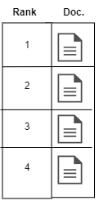
INTRODUCTION
Most relevant
The evolution of Information Retrieval Systems (IR) & Machine Learning(ML) have led to the development of advanced Search Engines
These engines are very powerful
Operate on retrieving top-k most relevant documents to the user based on a query.
One flaw, they do not optimize for fairness
​
Figure 1
Notes:
The evolution of Information Retrieval Systems (IR) & Machine Learning(ML) have led to the development of advanced Search Engines
These engines are very powerful and operate by retrieving the top-k most relevanct documents based on a users query.
(((EXPLAIN FIGURE))))
-However these systemas have one flaw. They do not optimize for relevance

Slide 3
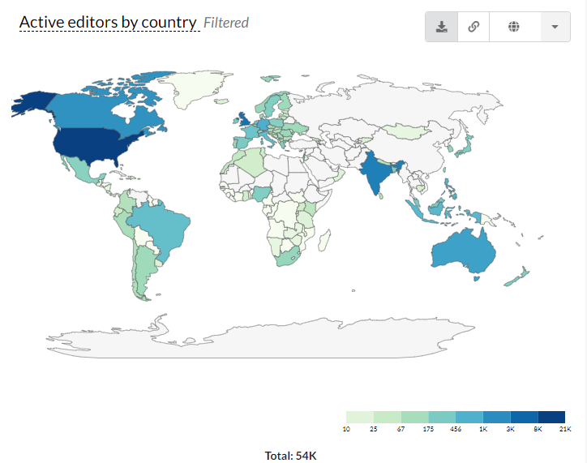
Wikipedia problem
Highly uneven distribution of groups in the data
Wikipedia editors receive less articles from regions like Antartica
Introducing natural bias
This can have real life consequences
Areas with better quality articles have been proven to be economically better
Figure 2: color map shows countries with active Wikipedia editors per month. The darker the shade of blue, the higher the number of editors. USA and the UK most active editors. Source: Wikimedia Foundation (2021)
Notes:
One system that has been characterized as unfair is the Wikipedia. It consists of a highly uneven distributional dataset.
Figure 2 is a color map of active editors antartica much less, north America and Europe top on the leaderboard
This introduces natural bias
Which can hve real life consequences
Since articles in the NA will have better quality which can create a domino effect of creating a higher economic value in that region

Slide 4
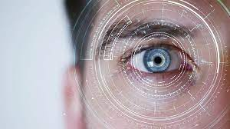
Aims
Using the Trec-Fair global IR standards of metrics, data and evaluation technique
Design and Implement 7 strategies that aim to resolve this the unfair under exposed groups of the Wikipedia articles
Increase the pool of articles edited by editors
Without affecting relevance of the top-k
Notes:
Therefore, using the Trec-Fairs global IR standatds of metrics, data and evaluation techniques
So using these datasets and standards we aimed to design and implement 7 strategies that will resolve this unfair under exposed groups of the Wikipedia article
These aim to increase the pool of articles edited by the editors without affecting the relevance of the top-k articles

Slide 5
Proposed Designs
Feature Selection
Through Selecting attributes, we can boost fairness and relevance
Divided into 3 categories
Geolocation features
Chronological features
Author Article features
Feature Boosting
Through boosting lower distributional groups, we boost feature importance
Built upon the Feature Selection Strategies
Notes:
Our proposed designs are splitted into 2 approeaches
Firstly Feature selection, wcich we choos features that when combined they can boost fairness and relevance. These are mainly divided into (
Seconds strategy is the feature boosting strategy, that by using these previous feature selection we aim to apply boosting to the features in order to further increase their importance in the ml algoriht

Slide 6
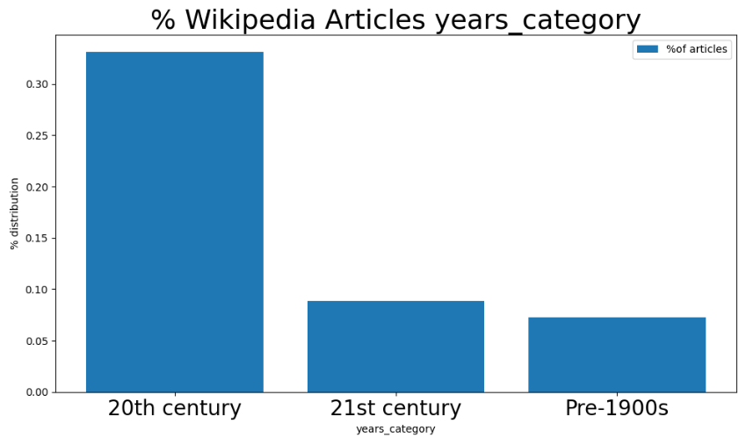
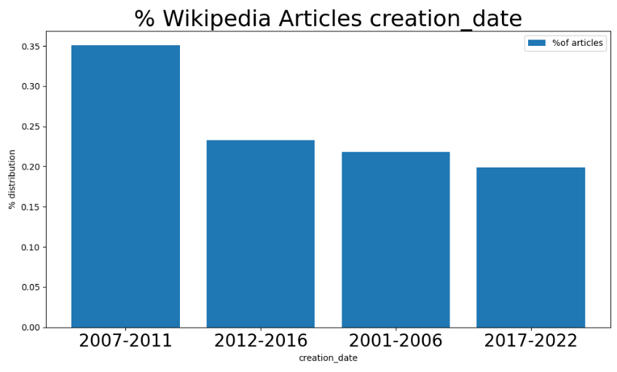
Notes:
Here follow an example of feature boosting using the chronological features, where will apply boosting to the left distribution in order to form a more uniform shape

Slide 7
Research Questions
Which type of feature (e.g. Geolocation, Chronological, Article Author Attributes or all together) have the most significant impact on improving fairness for Wikipedia editors?
What is the impact of incorporating LTR models on reducing bias and improving fairness in the ranking of the Wikipedia articles?
Does feature selection or boosting of features have a the most positive impact?

Slide 8
RESULTS

Slide 9
AREAS OF GROWTH
​Model | Reciprocal Rank | NRD | Ndcg@10​ | AWRF​ | Skewness
BM25 | 0.7651​ | 714​ | 0.4998 | 0.0769 | 2.5172
LightGBM | 0.5996​ | 720 | 0.4899 | 0.0525 | 2.4174
ASTL | 0.7333 | 731 | 0.5044 | 0.0244 | 2.1932
DASTL | 0.6530 | 729 | 0.5020 | 0.0304 | 2.1312

Slide 10
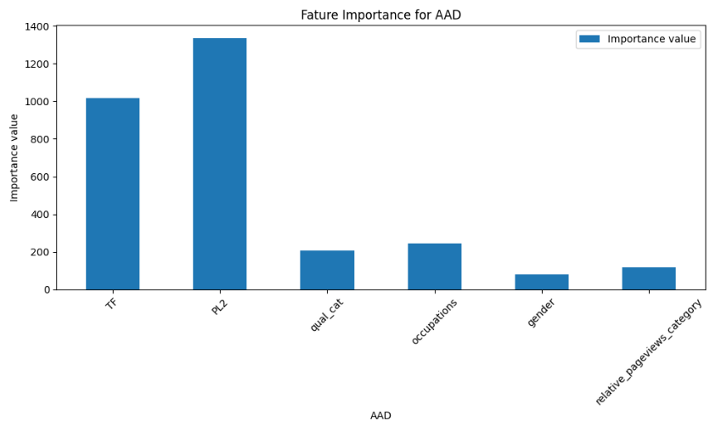
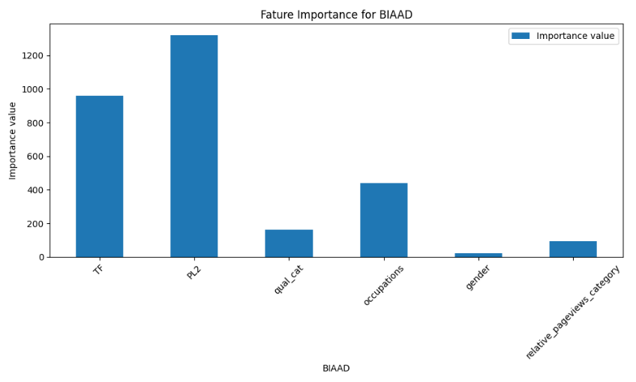
Feature importance
Feature Selection
Feature Boosting

Slide 11
SUMMARY
No statistical significance found to prove that method improved fairness
Found information about the dataset and the feature relationship
Not enough info to decide best method
Geographical locations behave better
Can improve approaches

Slide 12
THANK YOU

