Slide 1
Multiclass Gait Asymmetry Severity Classification for Post-Stroke Rehabilitation Using Wearable IMU and EMG Signals
Stamatios Orfanos
NCKU FHED 2026
Taiwan
Sensor-Derived Gait Asymmetry Severity
Notes:
Conference title slide. Author line can be expanded when the final coauthor list is confirmed.

Slide 2
Gait asymmetry after stroke
Why severity matters
Stroke can alter timing, movement amplitude, variability, and coordination between the two legs.
A single healthy-versus-stroke label cannot describe the degree of gait asymmetry.
Rehabilitation teams need repeatable measurements that can track meaningful change over time.
Bilateral
movement
Severity classification converts complex bilateral motion into an interpretable three-level outcome.
NCKU FHED 2026 · Taiwan
2
Notes:
Background framing requested by the presenter. No numerical cost claim is made on this slide.

Slide 3
GaitRehab: a lower-cost measurement pathway
Conventional assessment
GaitRehab approach
Laboratory systems can require specialized equipment, dedicated space, and trained operators.
Access may be limited outside large rehabilitation centers.
Wearable IMU and EMG measurements support portable data collection.
AI models estimate sensor-derived gait asymmetry severity from participant-level features.
This presentation focuses on SGAS-v2: Sensor-Derived Gait Asymmetry Severity
NCKU FHED 2026 · Taiwan
3
Notes:
The slide presents the project rationale. SGAS-v2 is a sensor-derived cohort-relative construct and not a clinical stroke-severity scale.

Slide 4
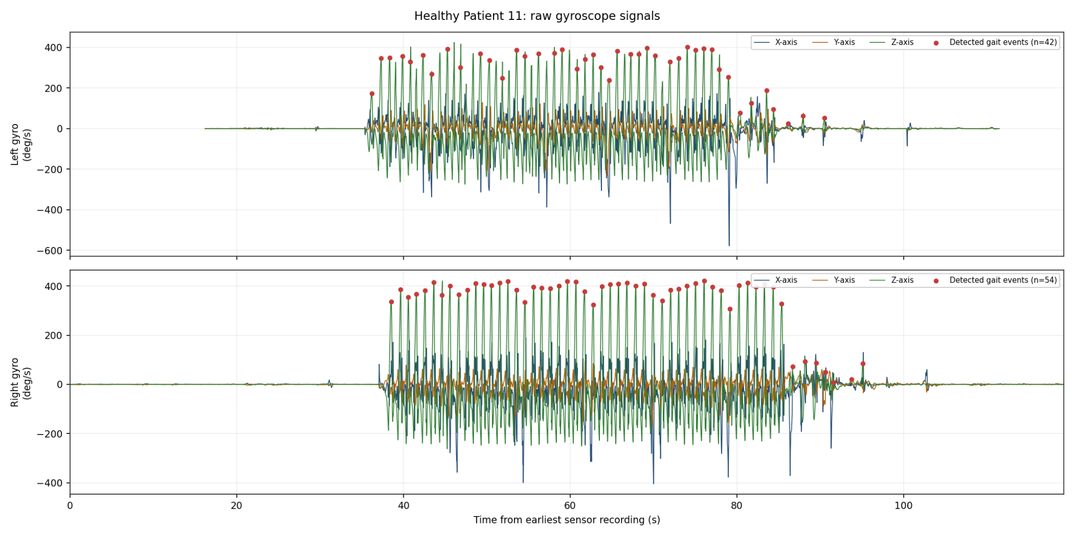
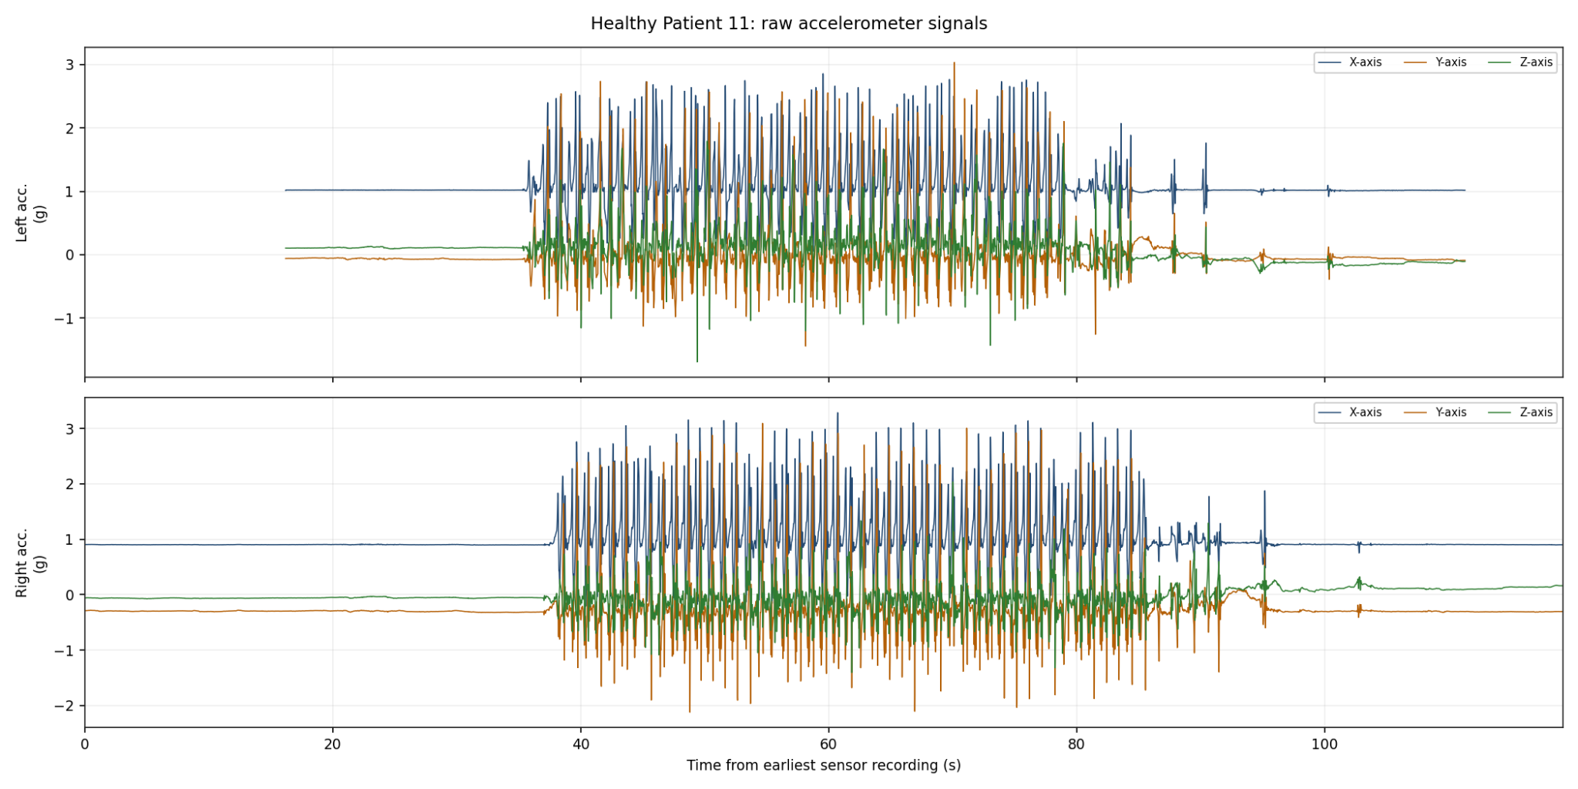
Wearable signals: IMU and EMG
IMU
Bilateral shank accelerometers capture linear movement in three axes.
Gyroscopes capture angular velocity.
  Gyroscope-z supports gait-cycle detection
  Gyroscope-x/y supplies eligible predictors.
Raw Gyroscope waveform data
Raw Accelerometer waveform data
NCKU FHED 2026 · Taiwan
4
Notes:
Source: /workspace/scratch/ad3407d0edac/upload/Materials_and_Methods_SGAS_v2_IMU_EMG(1).docx. The image frames are intentionally reserved for waveform examples supplied by the presenter.

Slide 5
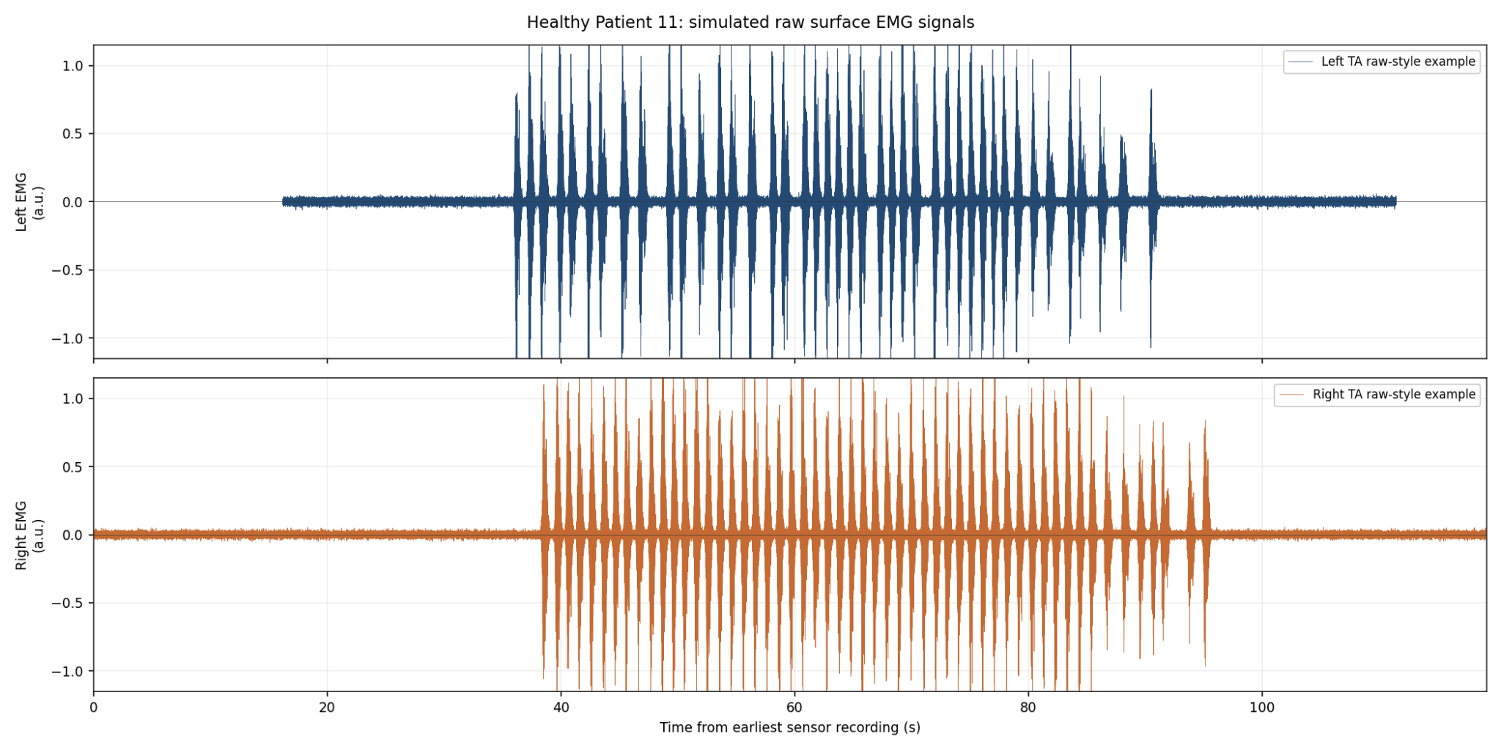
Wearable signals: IMU and EMG
EMG
Extracted features represent activation from six lower-limb muscle groups.
Order-invariant bilateral means and absolute differences avoid assuming row laterality.
Raw EMG waveform image
NCKU FHED 2026 · Taiwan
4
Notes:
Source: /workspace/scratch/ad3407d0edac/upload/Materials_and_Methods_SGAS_v2_IMU_EMG(1).docx. The image frames are intentionally reserved for waveform examples supplied by the presenter.

Slide 6
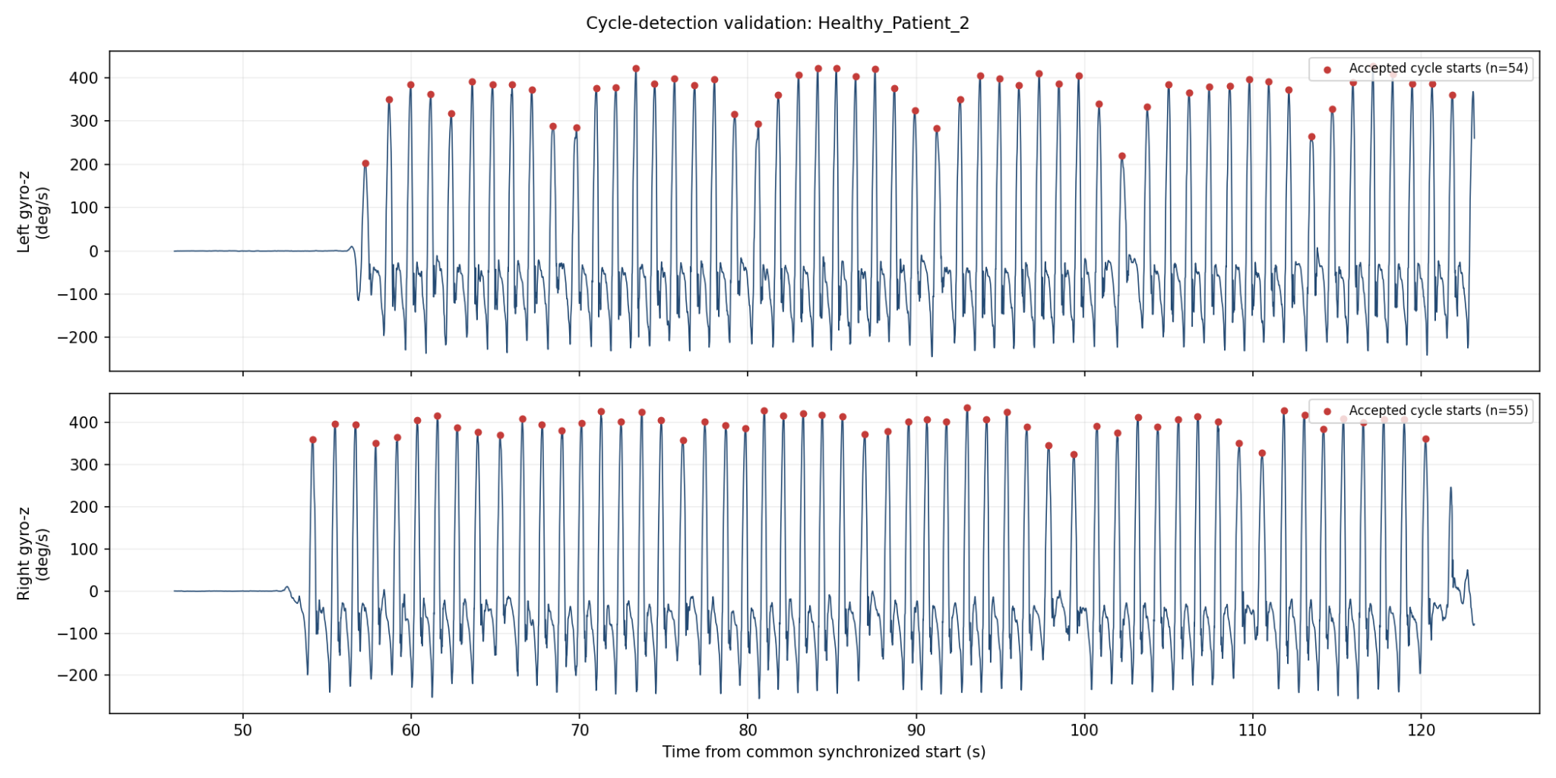
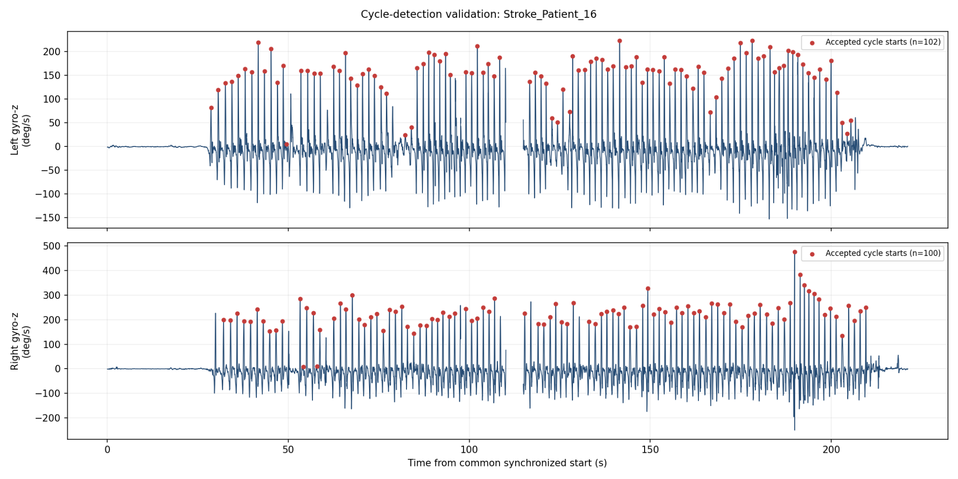
Dataset structure and analytical cohorts
32
30
28
raw participant folders
16 healthy and 16 stroke
valid frozen SGAS-v2 records
matched participants for modality comparison
Healthy participant signal example
Stroke participant signal example
NCKU FHED 2026 · Taiwan
5
Notes:
Source: /workspace/scratch/ad3407d0edac/upload/Materials_and_Methods_SGAS_v2_IMU_EMG(1).docx. Raw archive: 16 healthy and 16 stroke. Sensor-quality processing retained 30 participants; 28 formed the matched multimodal cohort.

Slide 7
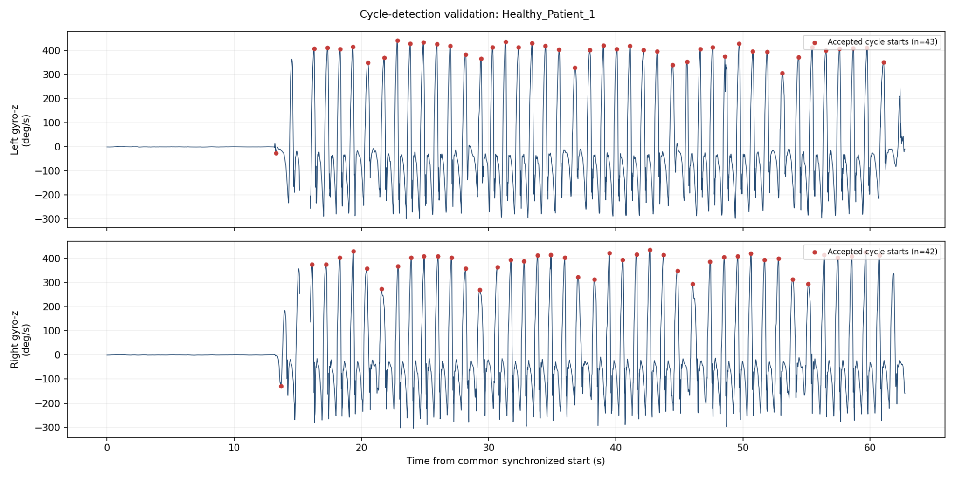
Signal synchronization and conditioning
Common interval
100 Hz grid
Valid segments
35 Hz filter
Retain the overlapping interval across four bilateral IMU streams
Linear interpolation with a 50 ms nearest-observation validity limit
Use contiguous bilateral gyroscope segments lasting at least 8 seconds
Second-order Butterworth filtering with zero phase
NCKU FHED 2026 · Taiwan
6
Notes:
Source: /workspace/scratch/ad3407d0edac/upload/Materials_and_Methods_SGAS_v2_IMU_EMG(1).docx. The valid fraction equals the mean of the bilateral gyroscope-validity vector.

Slide 8
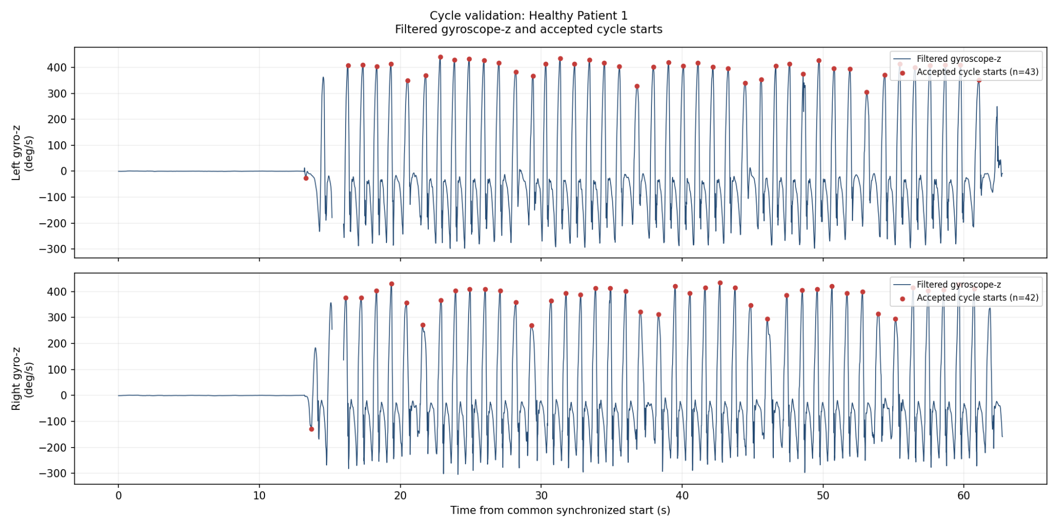
Gait-cycle detection and quality control
Signal polarity was determined within each segment before positive-peak detection.
Adaptive thresholds used the median absolute deviation and minimum peak prominence.
Accepted cycles lasted 0.60 to 2.00 seconds, with peaks at least 0.80 seconds apart.
Each participant required at least 10 valid cycles per leg.
Automatic Quality Control flags triggered plot review rather than automatic exclusion.
Cycle validation plot
Filtered gyroscope-z and accepted cycle starts
NCKU FHED 2026 · Taiwan
7
Notes:
Source: /workspace/scratch/ad3407d0edac/upload/Materials_and_Methods_SGAS_v2_IMU_EMG(1).docx. QC checks included cycle counts, bilateral count ratio, stride variability, boundary-adjacent cycles, and bilateral validity.

Slide 9
SGAS-v2 score and frozen severity classes
Four components
Healthy reference
Continuous score
Frozen classes
Temporal, amplitude, variability, and waveform asymmetry
Robust median and median absolute deviation
Nonnegative robust z-scores, asinh transform, equal weights
Low/reference, Moderate, and High asymmetry
Class formation
All valid healthy participants formed the Low/reference class.
Stroke scores were divided by a transparent median-rank rule with at least five participants per class.
A 500-resample bootstrap quantified boundary stability; confidence below 0.70 marked a borderline assignment.
The score definition and participant labels were fingerprinted before model fitting.
NCKU FHED 2026 · Taiwan
8
Notes:
Source: /workspace/scratch/ad3407d0edac/upload/Materials_and_Methods_SGAS_v2_IMU_EMG(1).docx. SGAS-v2 is cohort-relative and does not replace a clinical stroke-severity scale.

Slide 10
Processing outcomes and participant eligibility
Raw archive
Frozen SGAS-v2
Matched multimodal
32 participants
16 healthy and 16 stroke
30 valid participants
15 Low, 7 Moderate, 8 High
28 participants
14 Low, 6 Moderate, 8 High
Eligibility interpretation
Two raw participants did not produce valid frozen SGAS-v2 records after sensor-quality processing.
The matched analysis required both a frozen severity label and a verified mapped feature record.
Quality Control flags prompted manual review and did not automatically remove otherwise acceptable participants.
NCKU FHED 2026 · Taiwan
9
Notes:
Source: /workspace/scratch/ad3407d0edac/upload/Materials_and_Methods_SGAS_v2_IMU_EMG(1).docx. The source document reports cohort counts but does not embed participant-specific QC figures. The slide therefore presents the documented cohort flow.

Slide 11
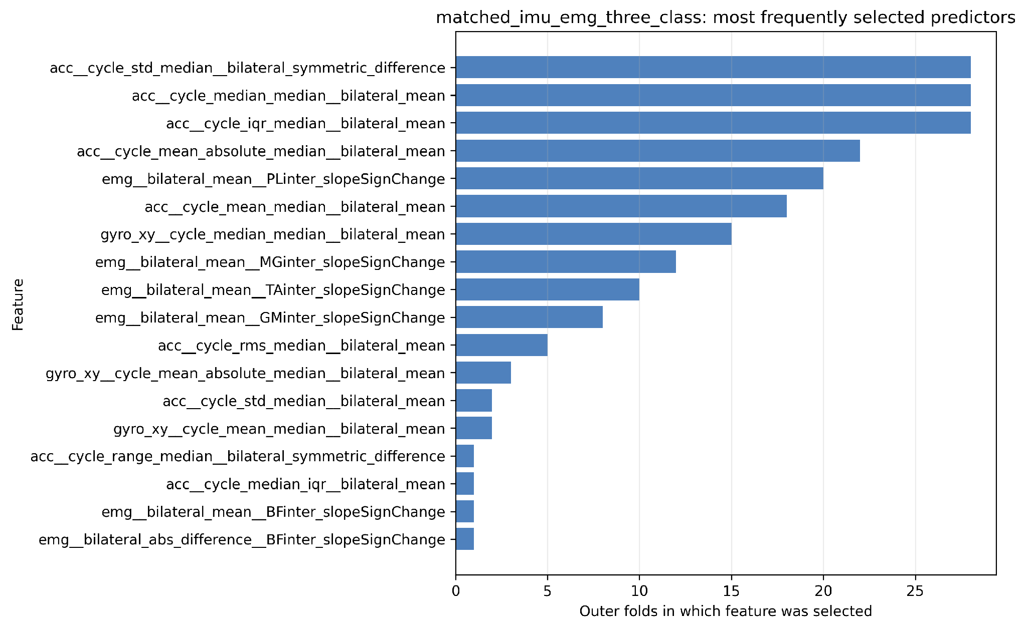
Predictor construction and leakage control
Eligible inputs
96 cycle-aligned IMU predictors from accelerometer and gyroscope-x/y signals.
312 participant-level EMG predictors from bilateral means and absolute differences.
408 predictors in the matched combined analysis before inner-fold selection.
Protected target definition
Gyroscope-z and every direct SGAS-v2 descendant were excluded from classifier inputs.
Imputation, scaling, feature selection, and fitting occurred inside the training folds only.
NCKU FHED 2026 · Taiwan
10
Notes:
Sources: /workspace/scratch/ad3407d0edac/upload/Materials_and_Methods_SGAS_v2_IMU_EMG(1).docx and /workspace/scratch/ad3407d0edac/upload/Journal_Ready_Results_IMU_EMG(1).docx. The displayed feature-frequency figure describes outer-fold stability, not causality.

Slide 12
Nested subject-level model evaluation
Outer LOSO
Inner grouped CV
Held-out prediction
Hold out one complete participant for final evaluation
Select sensor set, model, hyperparameters, and 5 or 10 predictors
Refit on outer-training participants and predict once
Candidate model families
Logistic regression, linear SVM, RBF SVM, k-nearest neighbours, Gaussian naive Bayes, and shrinkage LDA.
Decision tree, random forest, extra trees, gradient boosting, and AdaBoost.
Inner macro-F1 selected the configuration; balanced accuracy resolved ties.
Final metrics came from pooled outer predictions with 2,000 stratified bootstrap resamples for confidence intervals.
NCKU FHED 2026 · Taiwan
11
Notes:
Source: /workspace/scratch/ad3407d0edac/upload/Materials_and_Methods_SGAS_v2_IMU_EMG(1).docx. Outer test predictions were never used for inner model, sensor, hyperparameter, or feature selection.

Slide 13
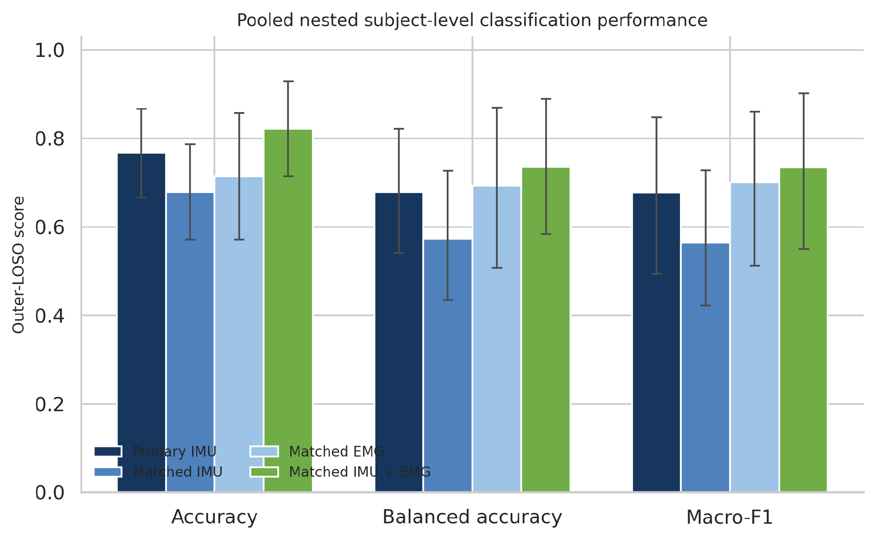
Pooled nested outer-LOSO performance
Point estimates with reported 95% confidence intervals
Matched IMU + EMG
0.821
accuracy
0.736
balanced accuracy
0.734
macro-F1
NCKU FHED 2026 · Taiwan
12
Notes:
Source: /workspace/scratch/ad3407d0edac/upload/Journal_Ready_Results_IMU_EMG(1).docx, Figure 1. Primary IMU used 30 participants. Matched IMU, EMG, and IMU plus EMG used the same 28 participants. Confidence intervals overlap, so modality differences remain descriptive.

Slide 14
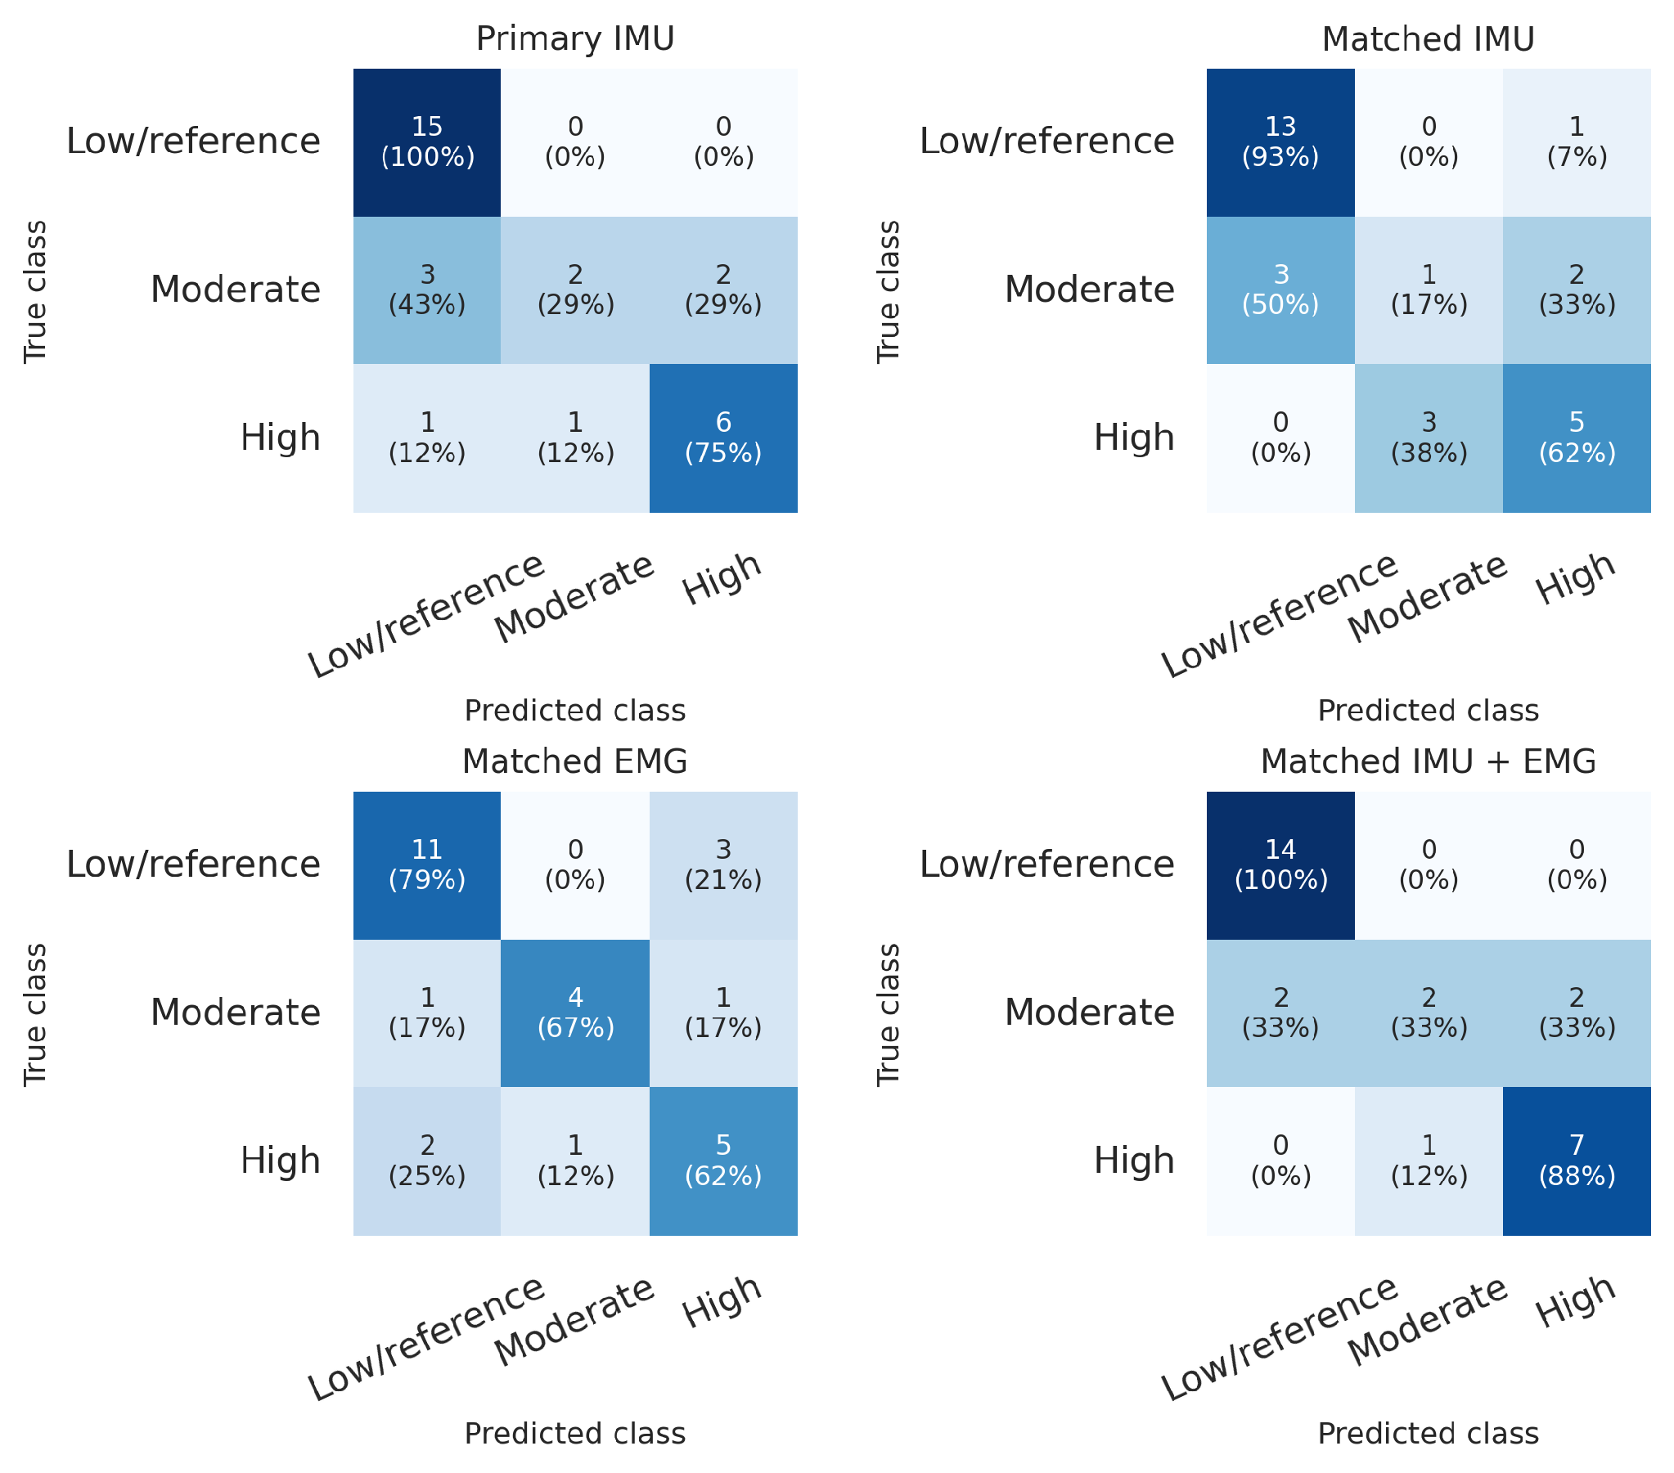
Outer-LOSO confusion matrices
Counts and row-normalized percentages
Main pattern
Low/reference recognition was consistently strongest.
The combined model classified all 14 matched low/reference participants correctly.
Moderate asymmetry remained the weakest class.
The combined model identified 7 of 8 high-asymmetry participants.
NCKU FHED 2026 · Taiwan
13
Notes:
Source: /workspace/scratch/ad3407d0edac/upload/Journal_Ready_Results_IMU_EMG(1).docx, Figure 2.

Slide 15
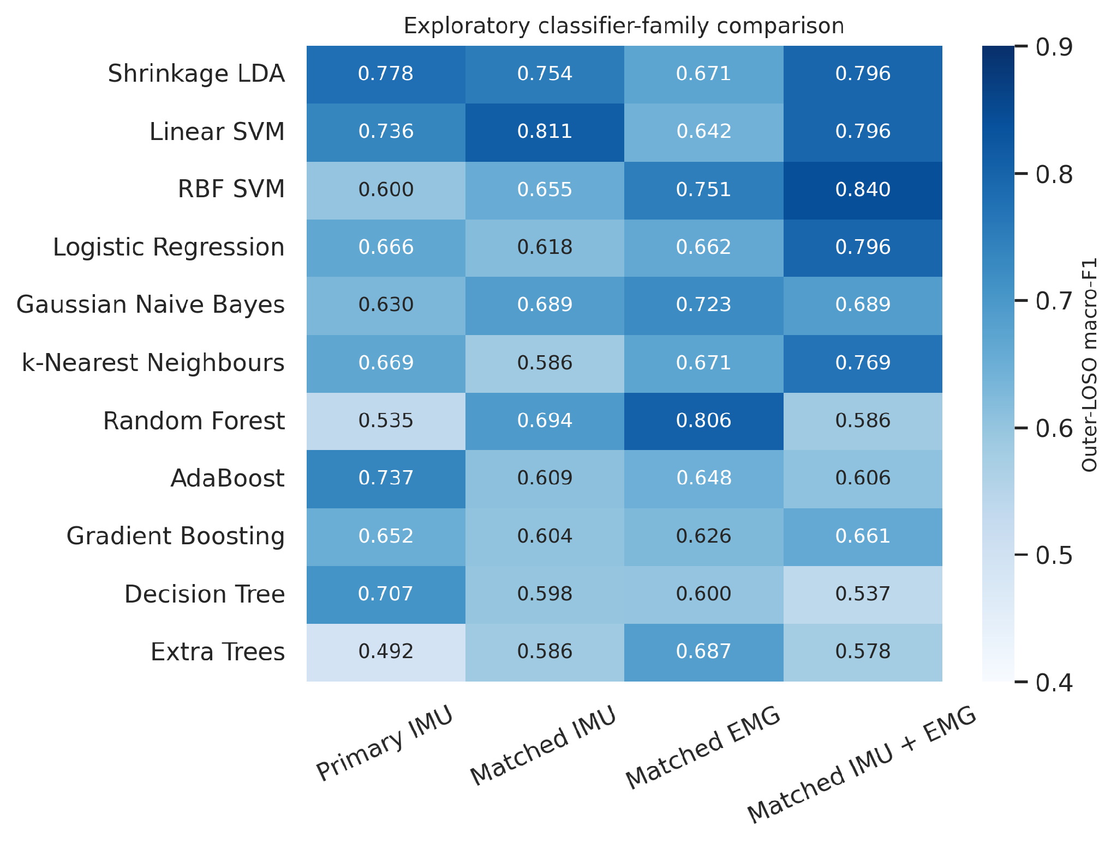
Exploratory classifier-family comparison
Descriptive outer-LOSO macro-F1 values
Highest value by analysis
Primary IMU: shrinkage LDA, 0.778.
Matched IMU: linear SVM, 0.811.
Matched EMG: random forest, 0.806.
Matched IMU + EMG: RBF SVM, 0.840.
Exploratory only. These outer predictions cannot also select and validate a final model.
NCKU FHED 2026 · Taiwan
14
Notes:
Source: /workspace/scratch/ad3407d0edac/upload/Journal_Ready_Results_IMU_EMG(1).docx, Figure 6. The primary performance claim remains the prespecified nested selection pipeline.

Slide 16
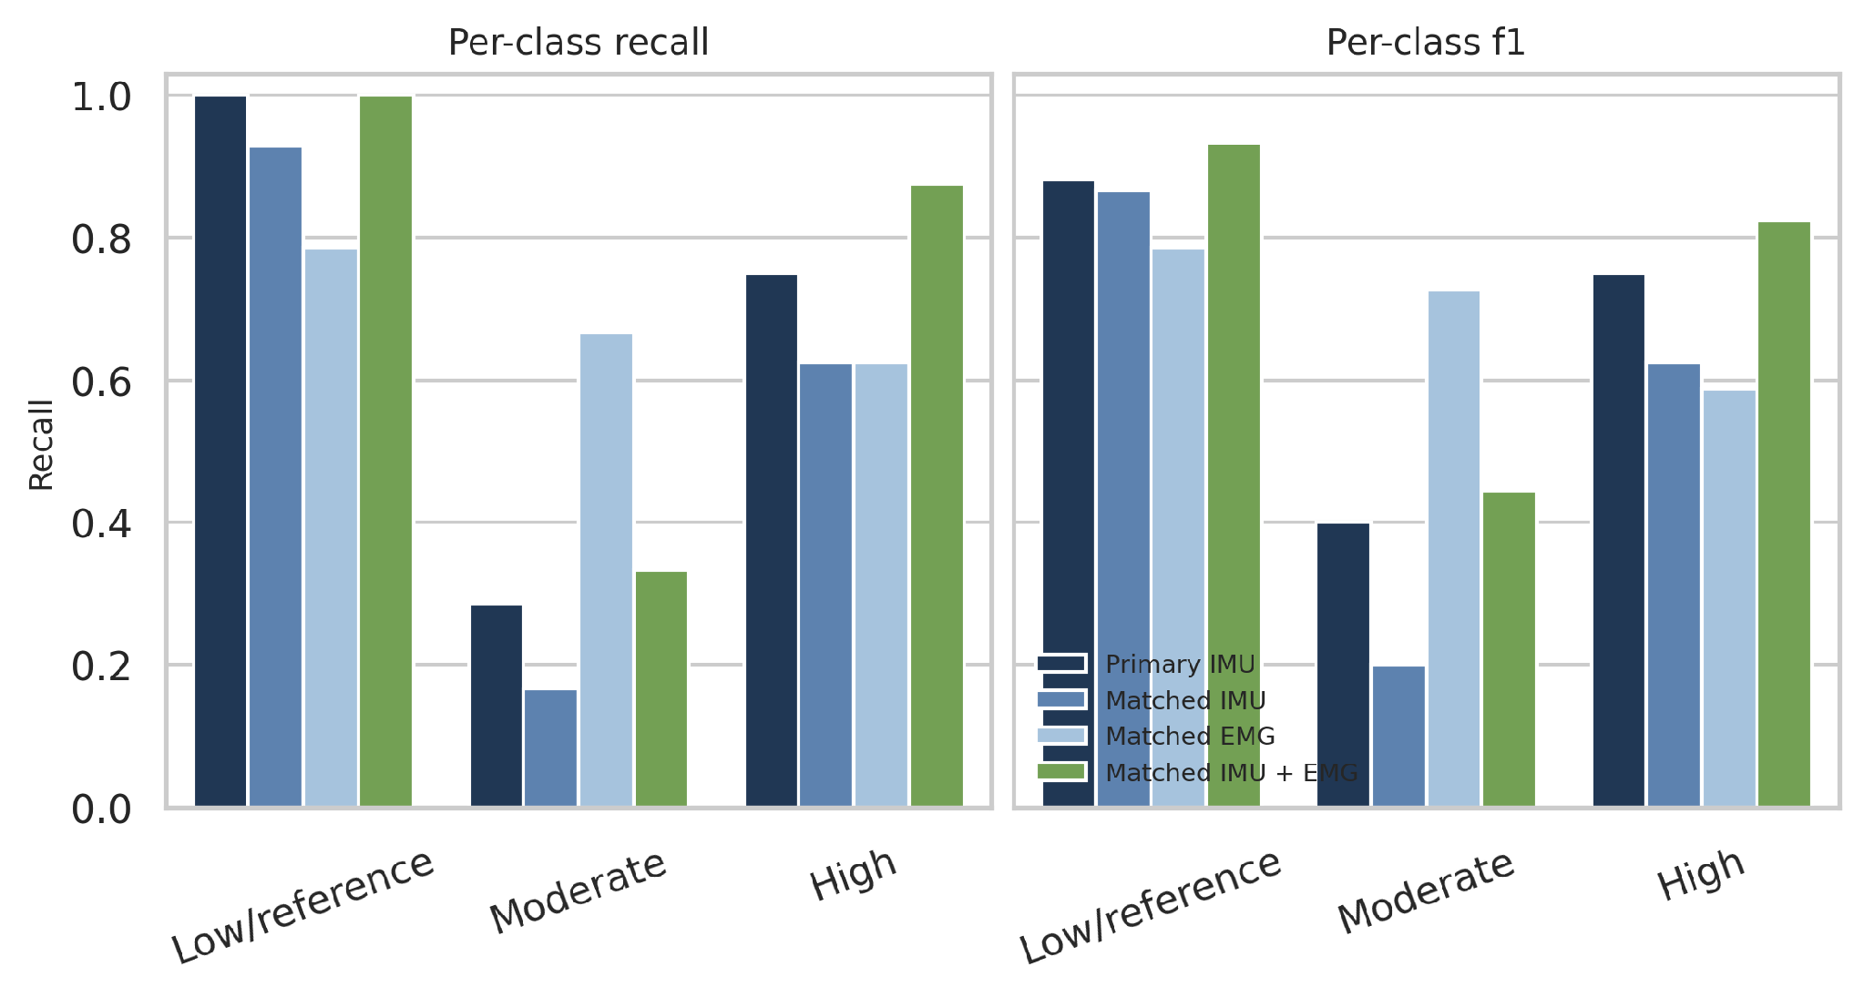
Class-specific recall and F1
Moderate asymmetry
The moderate class remained unstable across analyses.
Best moderate result
0.667
EMG-only recall
0.727
EMG-only F1
NCKU FHED 2026 · Taiwan
15
Notes:
Source: /workspace/scratch/ad3407d0edac/upload/Journal_Ready_Results_IMU_EMG(1).docx, Figure 3 and Table 4.

Slide 17
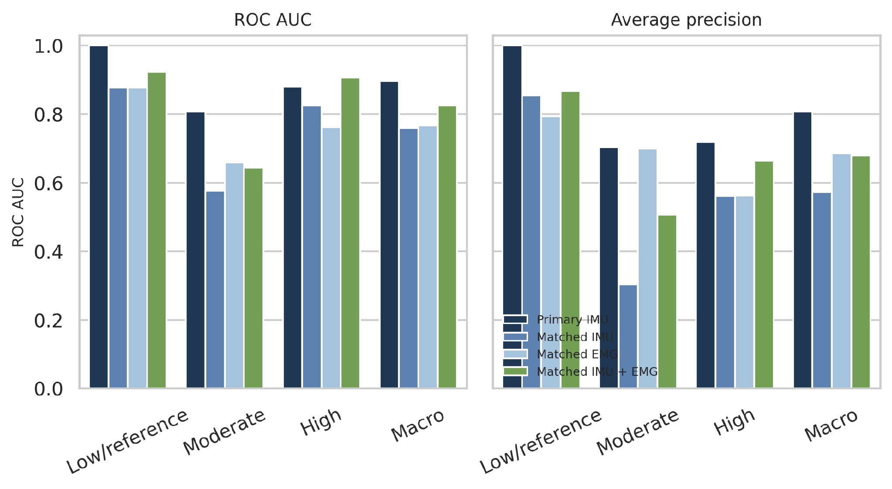
Probability-based discrimination
One-vs-rest ROC AUC and average precision
Macro summaries
Primary IMU
ROC AUC 0.896
Average precision 0.807
Matched IMU + EMG
ROC AUC 0.825
Average precision 0.679
Primary and matched results use different participant sets.
NCKU FHED 2026 · Taiwan
16
Notes:
Source: /workspace/scratch/ad3407d0edac/upload/Journal_Ready_Results_IMU_EMG(1).docx, Figure 4. Primary and matched-cohort probability metrics are shown together but are not directly exchangeable because cohort sizes differ.

Slide 18
Matched-cohort modality comparison
The same 28 participants were used in all three analyses
Modality | Accuracy | Balanced accuracy | Macro-F1
IMU only | 0.679 (0.571–0.787) | 0.573 (0.435–0.726) | 0.564 (0.422–0.727)
EMG only | 0.714 (0.571–0.857) | 0.692 (0.508–0.869) | 0.700 (0.512–0.860)
IMU + EMG | 0.821 (0.714–0.929) | 0.736 (0.583–0.889) | 0.734 (0.549–0.902)
The combined representation produced the highest point estimates, but overlapping confidence intervals prevent a claim of a statistically significant modality effect.
NCKU FHED 2026 · Taiwan
17
Notes:
Source: /workspace/scratch/ad3407d0edac/upload/Journal_Ready_Results_IMU_EMG(1).docx, Table 3. Values in parentheses are reported 95% confidence intervals.

Slide 19
Sensitivity analyses and continuous severity prediction
Three-class sensitivity analyses
Continuous SGAS-v2 regression
Analysis | Accuracy | Balanced accuracy | Macro-F1
Primary direct | 0.767 | 0.679 | 0.677
Excluding borderline | 0.643 | 0.476 | 0.455
Including waveforms | 0.733 | 0.631 | 0.603
Hierarchical | 0.700 | 0.601 | 0.600
Population | MAE | Spearman ρ | p
All participants n = 30 | 0.450 | 0.793 | <0.001
Stroke only n = 15 | 0.532 | 0.325 | 0.237
Within-stroke ordering was not statistically supported in this sample.
NCKU FHED 2026 · Taiwan
18
Notes:
Source: /workspace/scratch/ad3407d0edac/upload/Journal_Ready_Results_IMU_EMG(1).docx, Tables 5 and 6. None of the predeclared sensitivity analyses improved on the primary direct three-class pipeline.

Slide 20
Interpretation of the findings
What worked
What remains uncertain
Nested subject-level validation produced realistic held-out estimates.
The combined modality achieved the strongest matched-cohort point estimates.
Low/reference and high-asymmetry participants were recognized reliably.
Target construction and predictor development remained separated.
Moderate-asymmetry recognition remained unstable.
Confidence intervals were broad and overlapped across matched modalities.
The sample did not include an independent clinical severity scale.
NCKU FHED 2026 · Taiwan
19
Notes:
Source: /workspace/scratch/ad3407d0edac/upload/Journal_Ready_Results_IMU_EMG(1).docx, Overall interpretation.

Slide 21
Conclusions and next study
Wearable IMU and EMG signals can support proof-of-concept classification of sensor-derived gait asymmetry severity under nested subject-level validation.
Next study priorities
Recruit a larger cohort and preserve the frozen label definition.
Add independent clinical measures.
Preselect one final model family, then validate it at a second site with probability calibration.
Improve the definition and representation of the moderate class.
NCKU FHED 2026 · Taiwan
20
Notes:
Sources: /workspace/scratch/ad3407d0edac/upload/Materials_and_Methods_SGAS_v2_IMU_EMG(1).docx and /workspace/scratch/ad3407d0edac/upload/Journal_Ready_Results_IMU_EMG(1).docx. The current findings should be framed as proof-of-concept evidence.

Slide 22
Thank you for your attention
Questions and discussion
NCKU FHED 2026 · Taiwan
Notes:
Closing slide.

