Slide 1
第5章 触发器
第2讲：触发器的逻辑功能与描述

Slide 2
5.6 触发器的逻辑功能及其描述方法
本节只讨论有时钟控制的触发器。
有时钟控制的触发器，从功能不同分:
RS 触发器、
JK 触发器、
T 触发器、
D 触发器等。
n
n+1
R S
Q
Q
5-6-1. RS触发器
0 0 0
0
0 0 1
1
1. 特性表
0 1 0
1
0 1 1
1
凡在时钟控制下，逻辑功能符合此特性表的触发器就叫做 RS 触发器。
1 0 0
0
1 0 1
0
1 1 0
不定
1 1 1
不定

Slide 3
n+1
2. 特性方程
Q
n
Q
RS
0 1
由特性表填卡诺图得特性方程：
00
0 1
Q^{n+1}
Q^{n}
01
1 1
=
S
+
R
11
X X
RS = 0(约束条件）
10
0 0
状态转换图可从特性表中归纳，
3. 状态转换图
它表明 Q 从Q^{n} Q^{n+1}所需要的输入条件。
R = 0
S = 1
0
1
R = 0
R = X
S = 0
S = X
R = 1
S = 0
综上可知
描述触发器的逻辑功能有三种方法： 特性表、特性方程和状态转换图。

Slide 4
5-6-2. JK触发器
1. 特性表
凡在时钟控制下，逻辑功能符合此特性表的触发器，就叫做 JK 触发器。
J K Q^{n} Q^{n+1}
0 0 0
0
0 0 1
1
2. 特性方程
0 1 0
0
0 1 1
0
由特性表填卡诺图化简得：
1 0 0
1
n+1
n
n
1 0 1
1
Q = J Q + K Q
1 1 0
1
1 1 1
0
J = 1 K = X
3. 状态转换图
J = 0 K = X
J = X K = 0
0
1
J = X K = 1

Slide 5
5-6-3. T 触发器
1. 特性表
T Q^{n} Q^{n+1}
说明
将JK触发器的 J、K 端连在一起，引出一个 T 端，就构成了 T 触发器。
0 0
0
保持
0 1
1
1 0
1
1 1
0
计数
凡在时钟控制下，逻辑功能符合此特性表的触发器，就叫做T 触发器。
2. 特性方程
Q^{n+1} = T Q^{n} + T Q^{n}
4. 逻辑符号
3. 状态转换图
Q
Q
T = 1
SD
RD
1N
C1
T=0
0
1
T=0
T
CP
T = 1

Slide 6
5-6-4. D触发器
1. 特性表
凡在时钟控制下，逻辑功能符合此特性表的触发器,就叫做 D 触发器。
D Q^{n} Q^{n+1}
0 0
0
0 1
0
1 0
1
1 1
1
n+1
2. 特性方程
Q = D
D = 1
3. 状态转换图
D=0
0
1
D=1
D = 0

Slide 7
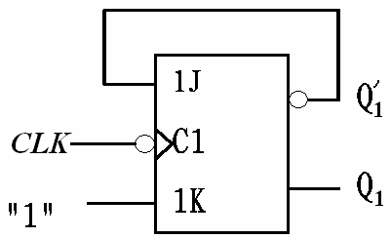
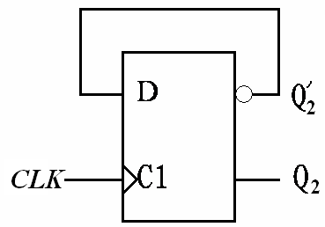
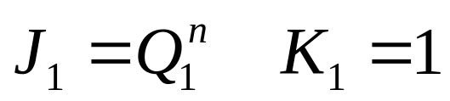
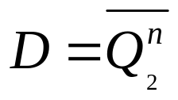
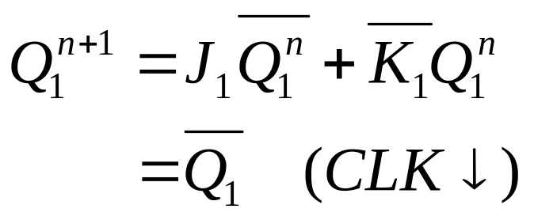
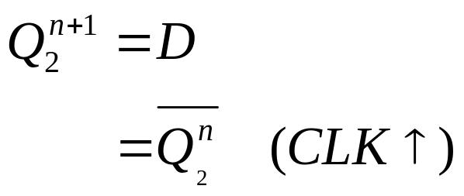
例1：时钟CLK波形如图所示,试画出各触发器输出端Q的波形,设Q的初始状态为0.

Slide 8
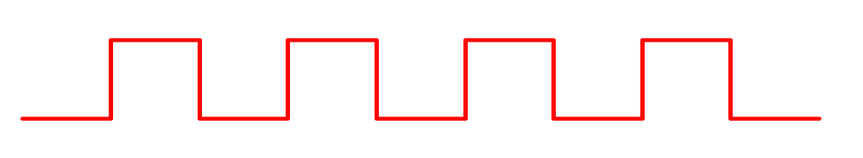
CLK
Q₁
Q₂

Slide 9
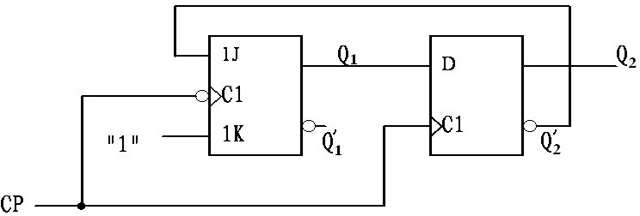
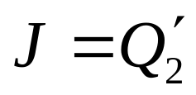
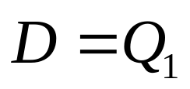
例2：时钟CP波形如图所示,试画出各触发器Q端的波形,设各输出端Q的初始状态Q=0 。
K=1
CP
CP

Slide 10
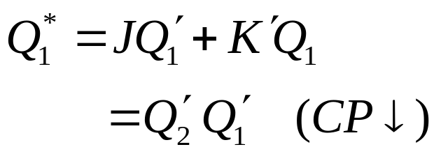
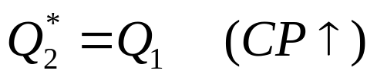
CP
Q₁
Q₂

Slide 11
5-6-5. 不同逻辑功能触发器之间的相互转换
关键：找出被转换触发器的激励条件。
利用已有触发器和待求触发器的特性方程相等的原则，求出转换逻辑，得到被转换触发器的驱动方程。

Slide 12
转换步骤：
（1）写出已有触发器和待求触发器的特性方程。
（2）变换待求触发器的特性方程，使之形式与已有触发器的特性方程一致。
（3）比较已有和待求触发器的特性方程，根据两个方程相等的原则求出转换逻辑。
（4）根据转换逻辑画出逻辑电路图。

Slide 13
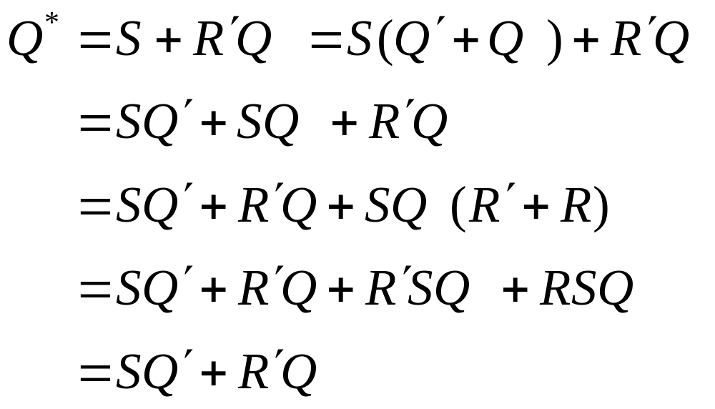
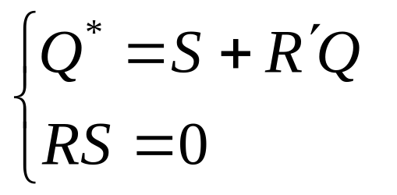
JK触发器→RS触发器
变换RS触发器的特性方程，使之形式与JK触发器的特性方程一致：
RS触发器特性方程

Slide 14
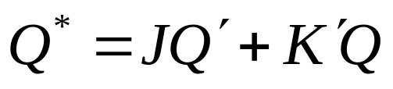
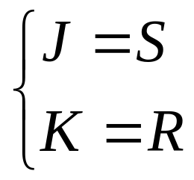
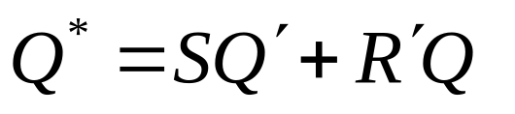
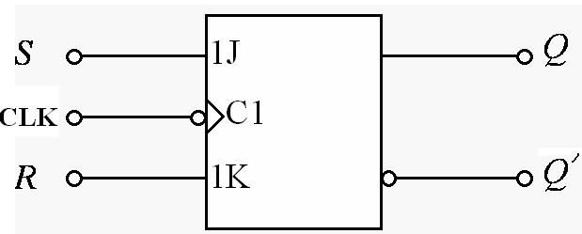
比较，得：
电路图

Slide 15
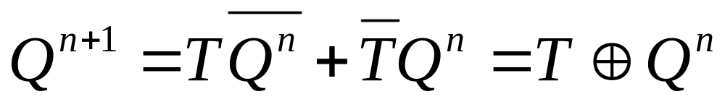
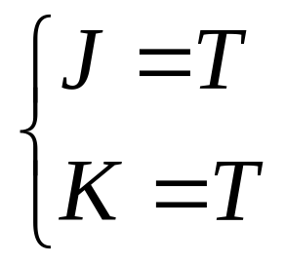
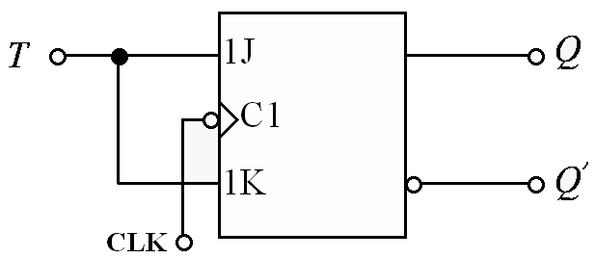
JK触发器→T触发器
T触发器特性方程：
与JK触发器的特性方程比较，得：
电路图

Slide 16
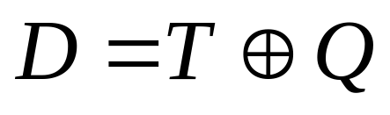
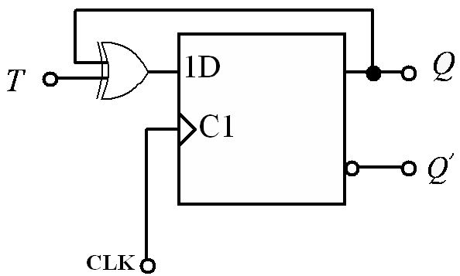
D触发器→T触发器

Slide 17
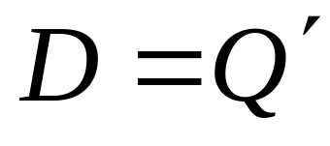
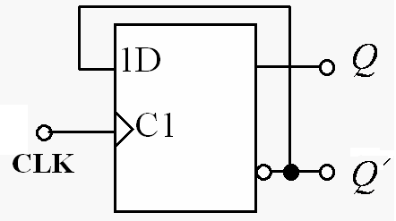
D触发器→T＇触发器

Slide 18
5-6-6.触发器电路结构和逻辑功能的关系
同一种逻辑功能的触发器可以用不同的电路结构实现。反过来，用同一种电路结构形式可以作成不同逻辑功能的触发器。
电路的结构形式决定了其触发方式。

Slide 19
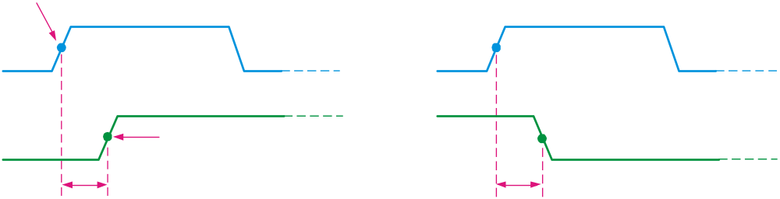
5-6-7.触发器的动态特性
Flip-flop Characteristics
Propagation delay time is specified for the rising and falling outputs. It is measured between the 50% level of the clock to the 50% level of the output transition.
50% point on triggering edge
CLK
CLK
50% point
Q
50% point on LOW-to-HIGH transition of Q
Q
50% point on HIGH-to- LOW transition of Q
t_{PLH}
t_{PHL}
The typical propagation delay time for the 74AHC family (CMOS) is 4 ns. Even faster logic is available for specialized applications.

Slide 20
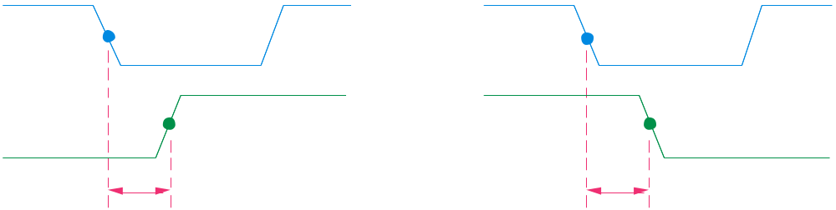
Flip-flop Characteristics
Another propagation delay time specification is the time required for an asynchronous input to cause a change in the output. Again it is measured from the 50% levels. The 74AHC family has specified delay times under 5 ns.
PRE
50% point
CLR
50% point
Q
50% point
Q
50% point
t_{PHL}
t_{PLH}

Slide 21
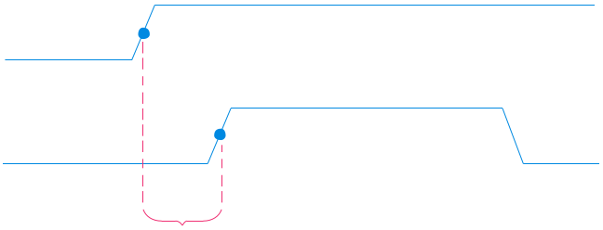
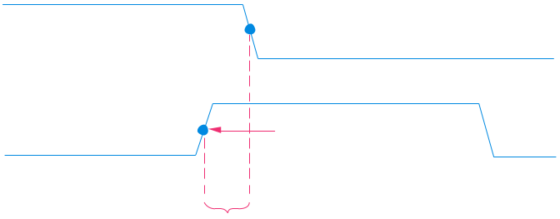
Flip-flop Characteristics
Set-up time and hold time are times required before and after the clock transition that data must be present to be reliably clocked into the flip-flop.
Setup time is the minimum time for the data to be present before the clock.
D
CLK
Set-up time, t_{s}
Hold time is the minimum time for the data to remain after the clock.
D
CLK
Hold time, t_{H}

Slide 22

Flip-flop Characteristics
Other specifications include maximum clock frequency, minimum pulse widths for various inputs, and power dissipation. The power dissipation is the product of the supply voltage and the average current required.
A useful comparison between logic families is the speed-power product which uses two of the specifications discussed: the average propagation delay and the average power dissipation. The unit is energy.
Example
What is the speed-power product for 74AHC74A? Use the data from Table 7-5 to determine the answer.
Solution
From Table 7-5, the average propagation delay is 4.6 ns. The quiescent power dissipated is 1.1 mW. Therefore, the speed-power product is
5 pJ

Slide 23

Quiz
1. The output of a D latch will not change if
a. the output is LOW
b. Enable is not active
c. D is LOW
d. all of the above
© 2008 Pearson Education

Slide 24
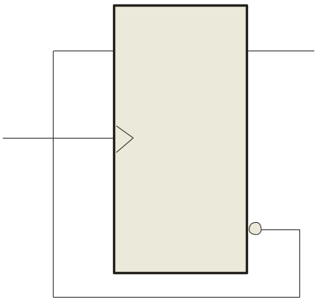
Quiz
2. The D flip-flop shown will
a. set on the next clock pulse
b. reset on the next clock pulse
c. latch on the next clock pulse
d. toggle on the next clock pulse
D
Q
CLK
CLK
Q
© 2008 Pearson Education

Slide 25
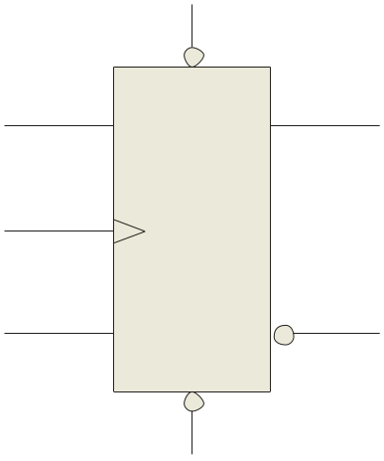
Quiz
3. For the J-K flip-flop shown, the number of inputs that are asynchronous is
a. 1
b. 2
c. 3
d. 4
PRE
Q
J
CLK
K
Q
CLR
© 2008 Pearson Education

Slide 26
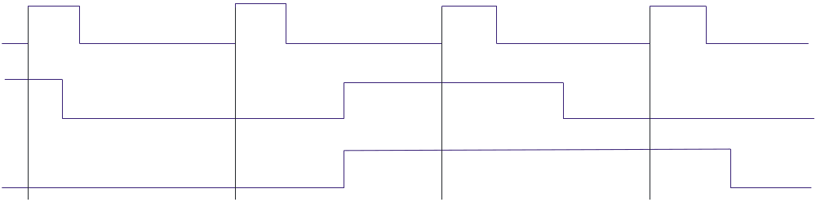
Quiz
4. Assume the output is initially HIGH on a leading edge triggered J-K flip flop. For the inputs shown, the output will go from HIGH to LOW on which clock pulse?
a. 1
b. 2
c. 3
d. 4
CLK
J
K
1 2 3 4
© 2008 Pearson Education

Slide 27
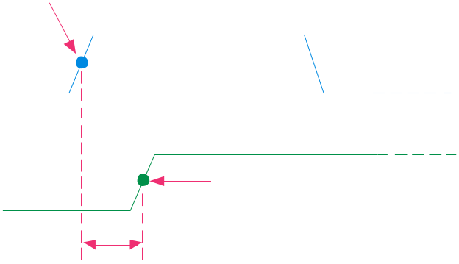
Quiz
5. The time interval illustrated is called
a. t_{PHL}
b. t_{PLH}
c. set-up time
d. hold time
50% point on triggering edge
CLK
Q
50% point on LOW-to-HIGH transition of Q
?
© 2008 Pearson Education

