Slide 1
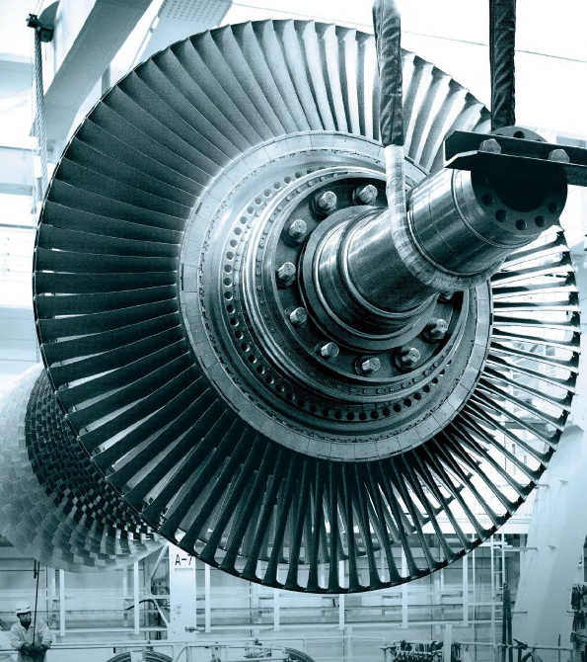

Università degli Studi di Napoli Federico II
Scuola Politecnica e delle Scienze di Base
Dipartimento di Ingegneria Industriale
Corso di Laurea in Ingegneria Meccanica
Classe di laurea L 09
Elaborato di laurea in
Tecnologia meccanica
Superalloys and casting process
for ultra-high temperature gas turbines
Relatore:
Ch.mo Prof. Ing. Antonio Formisano
Candidato:
Salvatore Palumbo
N47/7322
ANNO ACCADEMICO 2023/2024

Slide 2
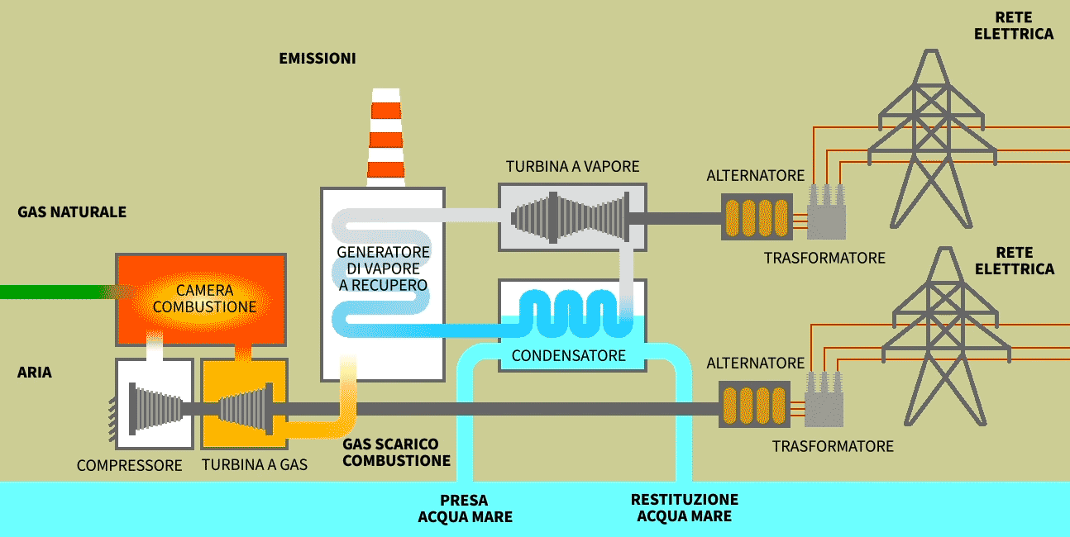
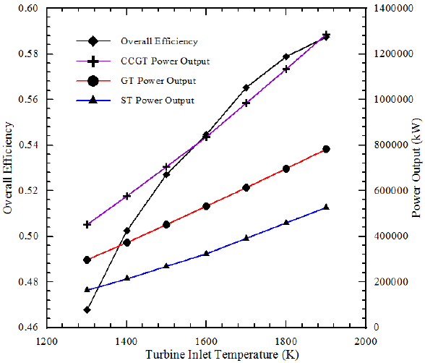
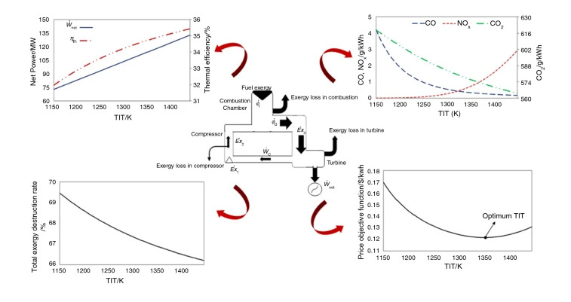
Why increasing TIT?

Slide 3
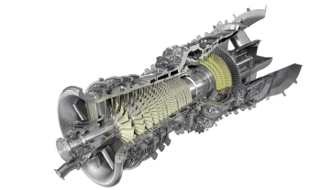
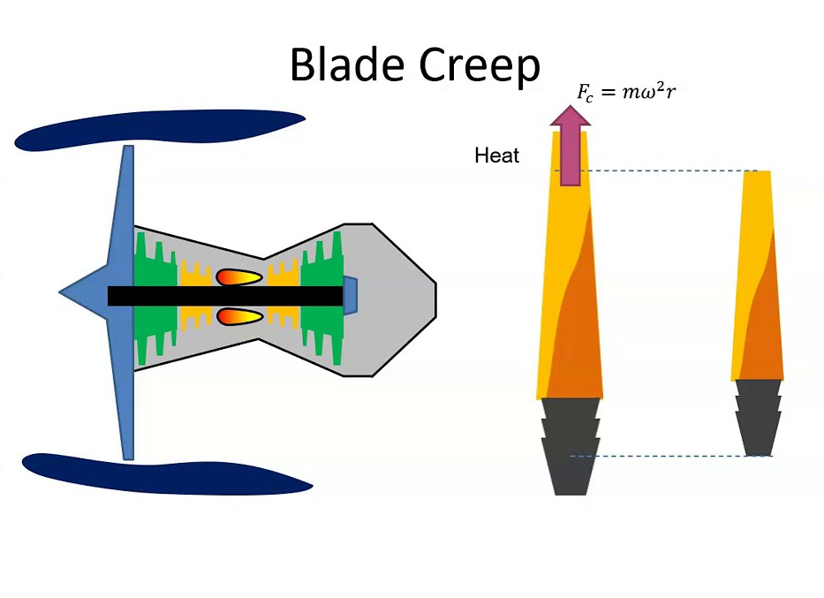
Mitsubishi Heavy Industries (MHI) project
High-performance compressors with improved boundary layer control to increase pressure ratio and efficiency.
Lean premix combustors with reduced NOx emissions achieved through improved flame position evaluation using optical measurement and large-scale unsteady numerical simulation.
High-performance turbines with optimized exhaust diffusers to improve efficiency by reducing turbine blade exit velocity.
Advanced thermal barrier coatings (TBC) for high-temperature components with improved thermal conductivity and high-temperature stability.
Welding repair technology for single-crystal turbine blades using Laser Metal Deposition (LMD).
Additive manufacturing for complex cooling structures in hot parts to reduce cooling air volume.
Super heat-resistant materials for turbine blades with excellent creep strength and dwell thermo-mechanical fatigue strength.
Casting process simulations for directionally solidified and single crystal blades to predict casting defects and optimize casting processes.
Wireless power supply technology for high-speed blade vibration measurement eliminating the need for battery changes.
Blade internal surface defect detection technology using a matrix array UT probe for improved inspection of cooling passages.
Under patent!!
Structural problem!!

Slide 4
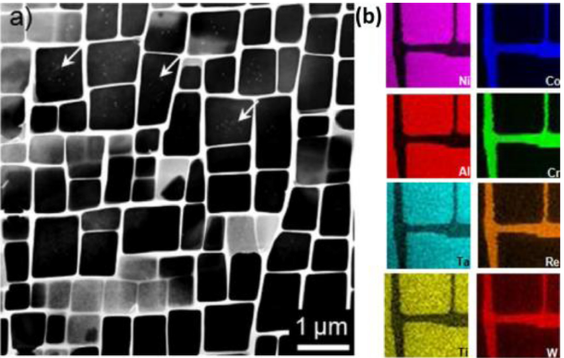
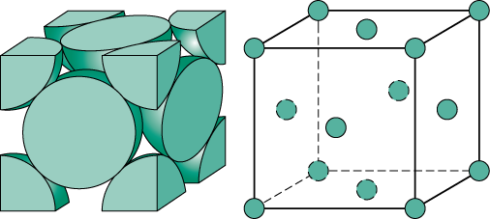
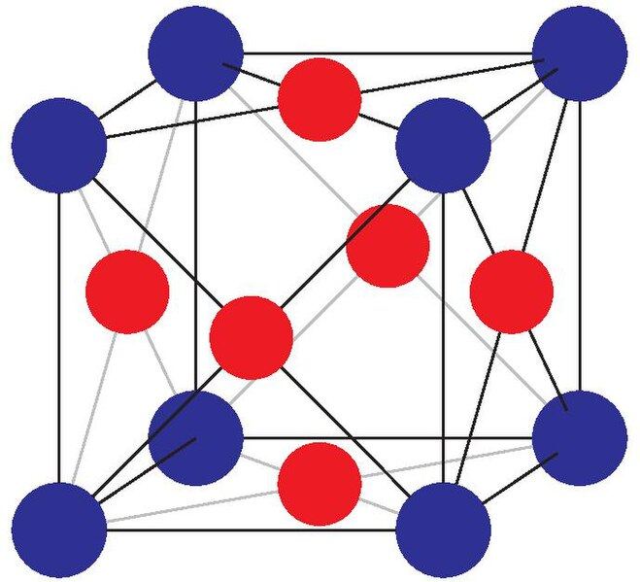
Ni-based superalloy microstructure and importance of volume fraction
Single Crystal supealloys: a key factor of the creep strength
65%-70% in γ'
γ
If more than this, degradation of cuboids at high temperature!!
FCC structure
γ'
FCC-L1_2 structure (ordered)

Slide 5
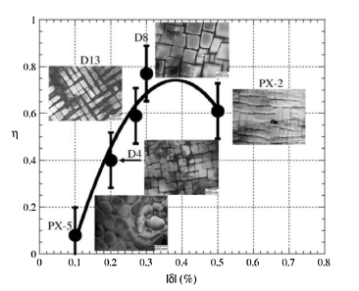

Lattice misfit:
a parameter to manage the γ/γ' interfacial coherency
Closely affect creep properties!!

Slide 6
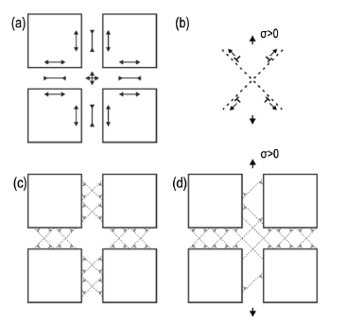
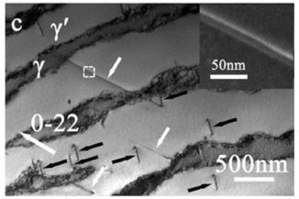

Dislocation motion: a way to understand creep strength of Ni-based superalloy
Forming an APB within an excisting γ ‘ crystal is the only way dislocation have to pass through this phase.
APB = ANTI-PHASE BOUNDARIES
This is the reason why interfacial coherency enanches creep strength!
Schematic illustrations of dislocation movements in the γ channels
Diffusion of atoms and vacancies!!
Illustrations of dislocation motion in γ ‘ phase with forming APBs.

Slide 7
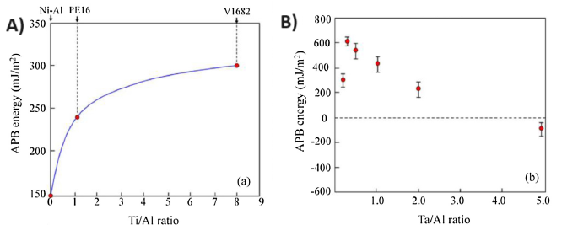
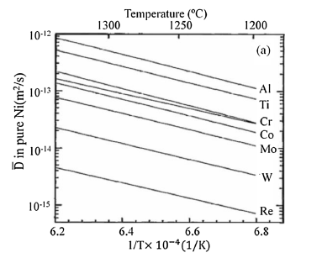

In light of the key factors discussed, which specific alloying elements are crucial for achieving the exceptional strength exhibited by this superalloy?
Effects of Ti and Ta on APB energy of Ni-SXs. The effects of Ti/Al ratios (a) and Ta/Al ratios (b) on APB energy in Ni-Al-X systems
Diffusion coefficients of some strengthening elements in Ni
γ phase is a solid solution
High %Co reduces the energy of dislocations in γ phase
r_Ti, r_Ta > r_Co, r_Cr, etc..
a_γ’ > a_γ
$δ$>0
Why Al, Ti, Ta in particular? Larger than Ni. It allows to have L1_2 structure (ordered)

Slide 8
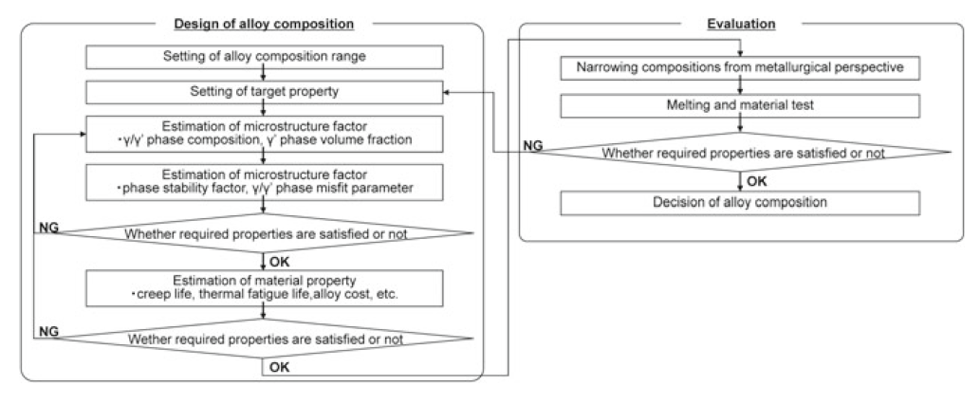
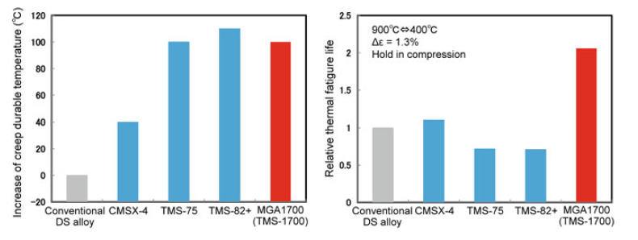
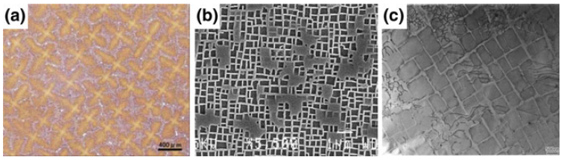
MGA1700: the result of joint research between NIMS and MHI
NIMS = National Institute for Materials Science
NIMS alloy design program
200 mm x 200 mm x 20 mm specimens
Results of testing on different composition

Slide 9
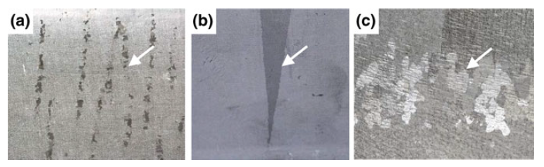
Typical casting defects in the SC superalloy
a) freckle, b) stray grain, and c) re-crystallization

Slide 10
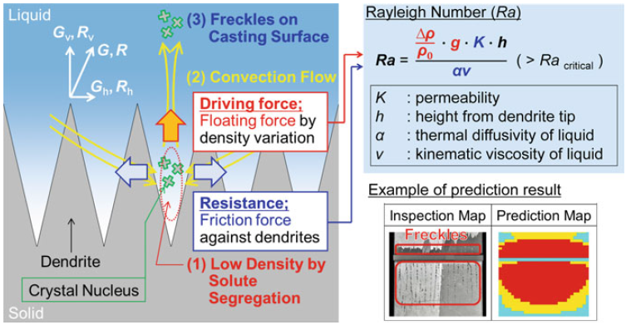
Freckle generation
Basic mechanism and an example of prediction result of freckle generation

Slide 11
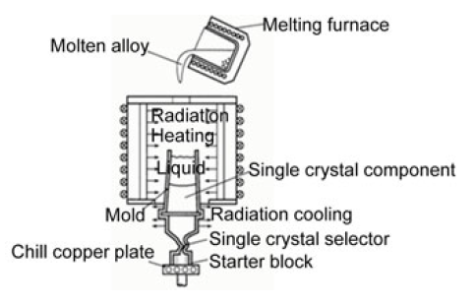
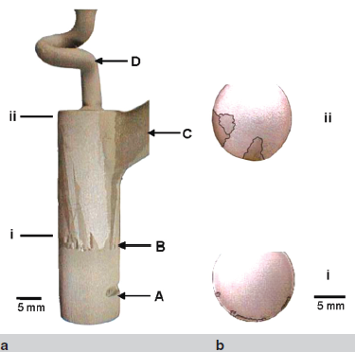
Casting process and stray grain
The seed and helical selector section of a turbine blade casting macro etched to highlight the stray grains
Solidification speed and thermal gradient to predict stray grain!

Slide 12
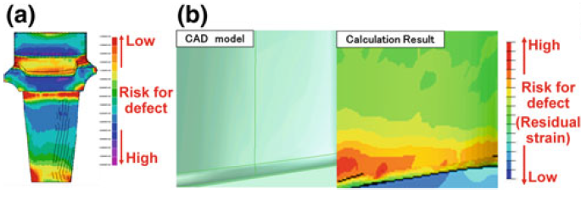
Stray grain and re-crystallization
Predicted results of a) stray grain, b) re-crystallization

