Slide 1


Slide 2
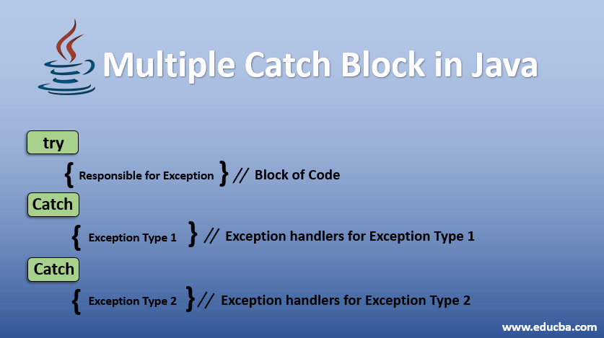

Slide 3
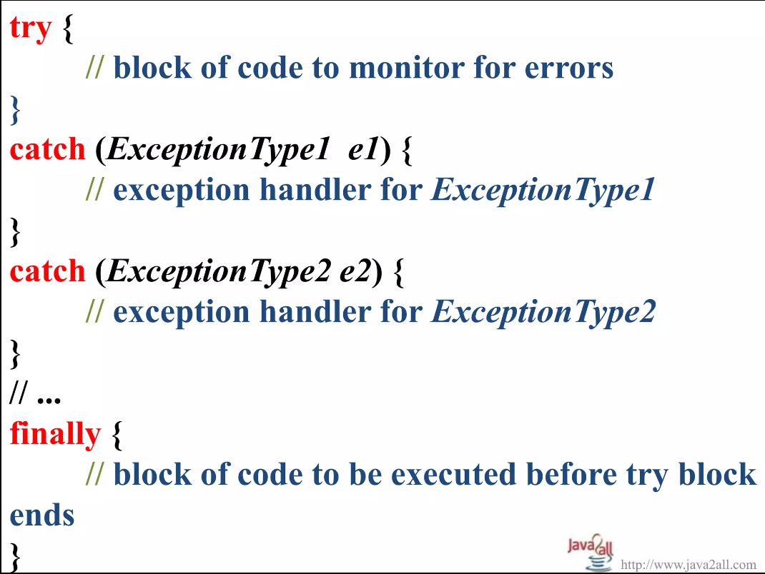

Slide 4
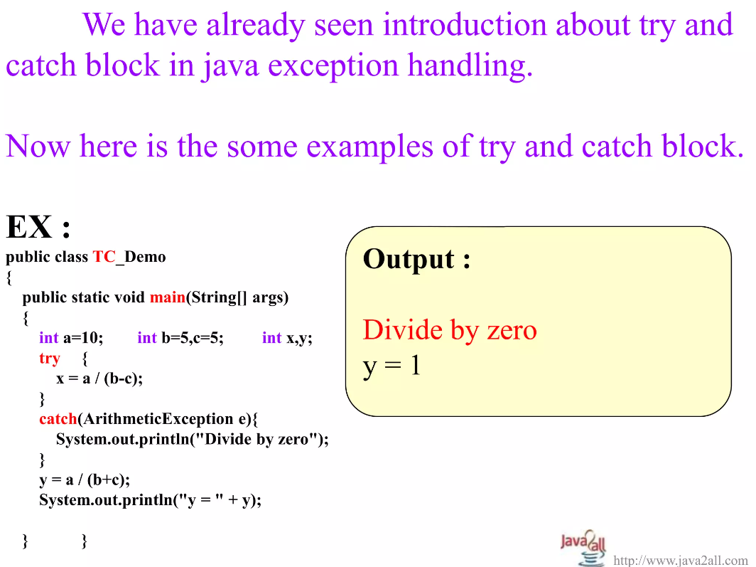

Slide 5
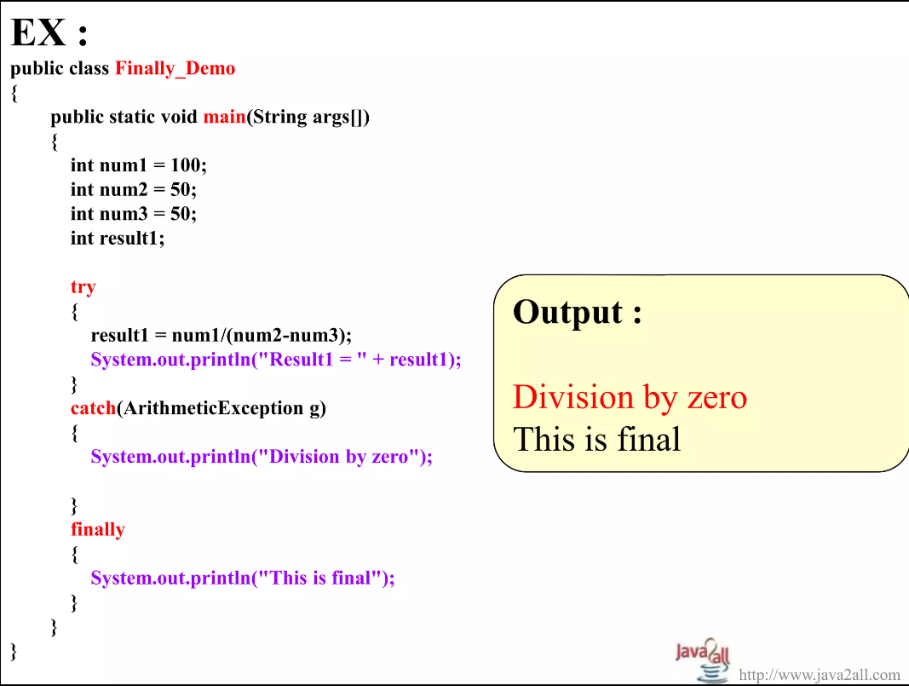

Slide 6
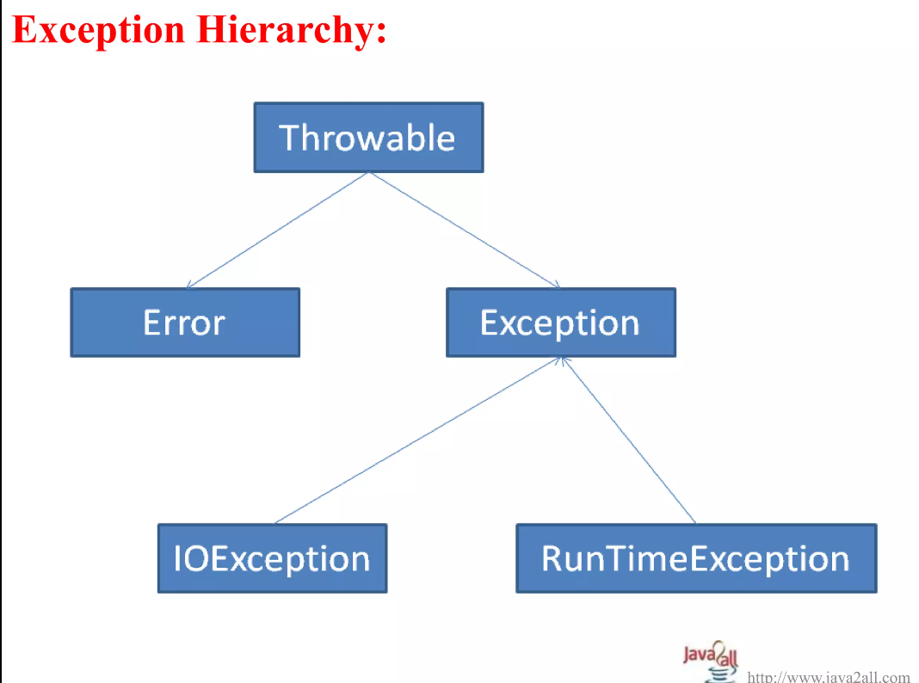

Slide 7
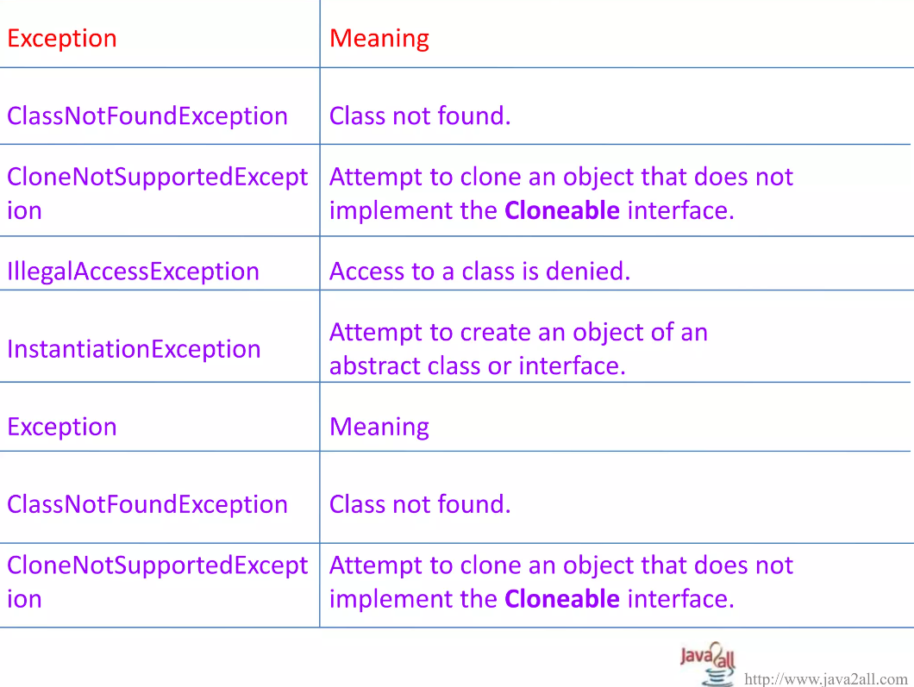

Slide 8
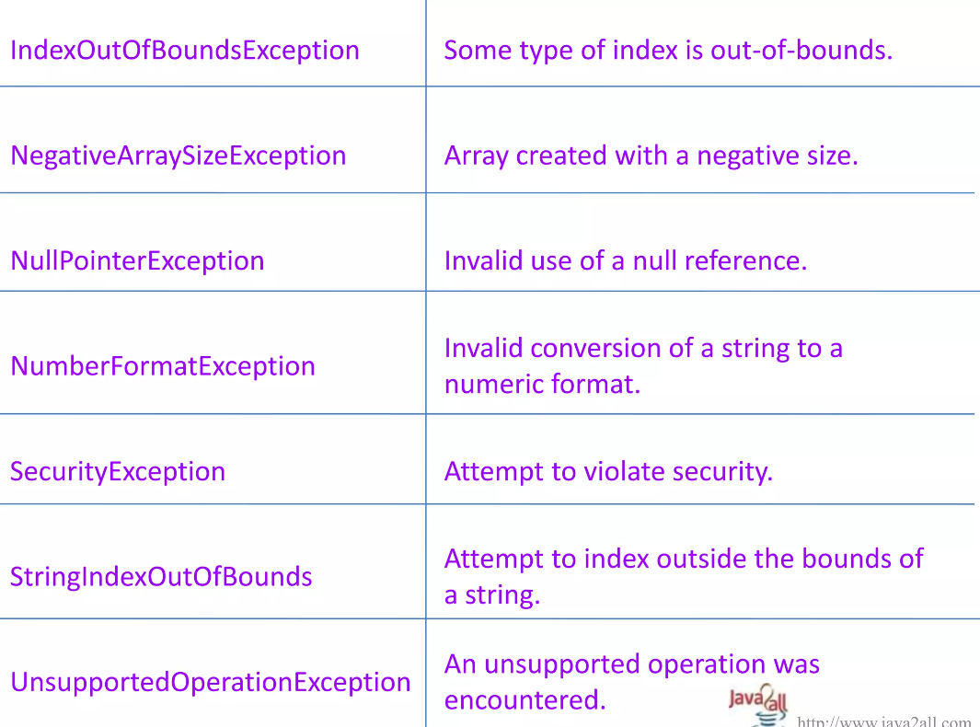

Slide 9
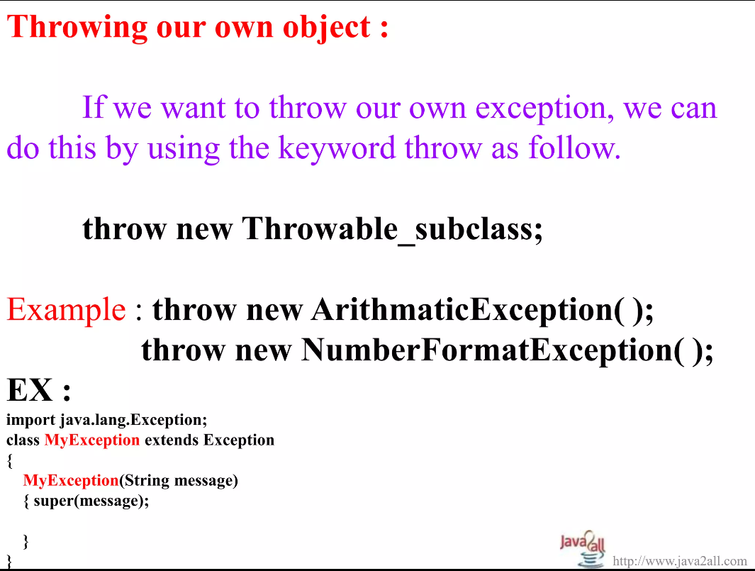

Slide 10
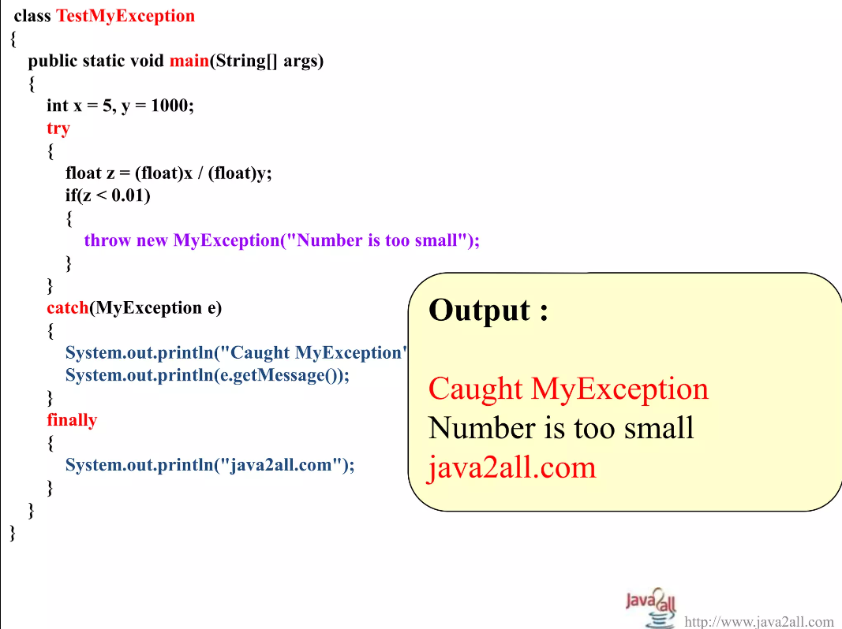

Slide 11
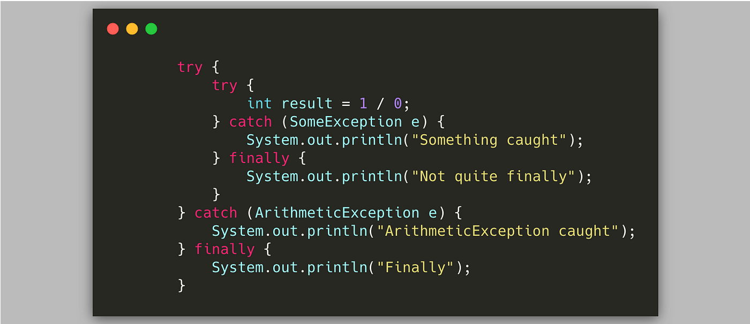

Slide 12
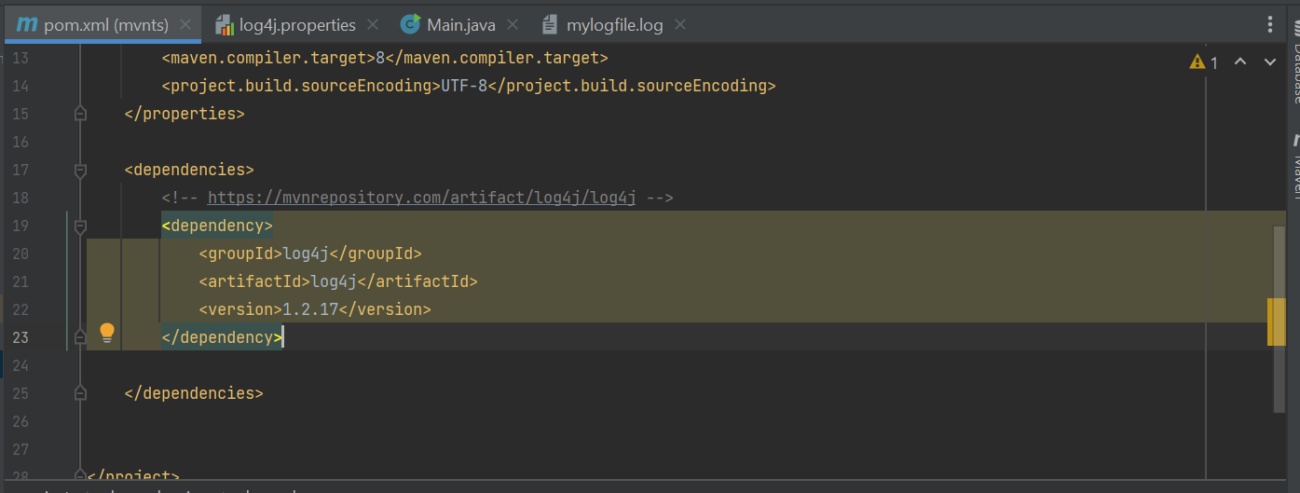

Slide 13
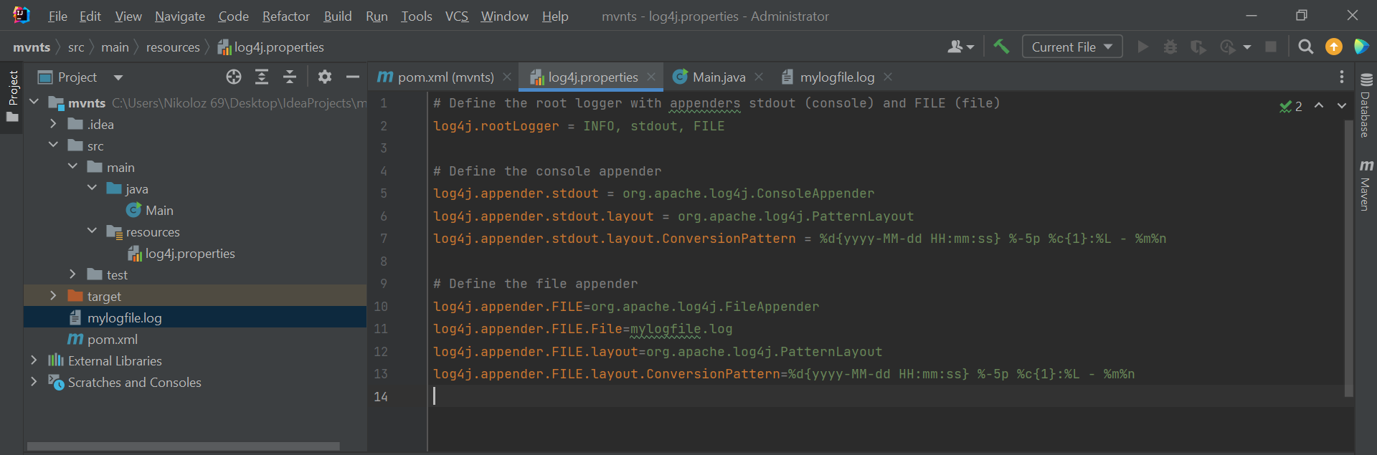

Slide 14
# Define the root logger with appenders stdout (console) and FILE (file) log4j.rootLogger = INFO, stdout, FILE # Define the console appender log4j.appender.stdout = org.apache.log4j.ConsoleAppender log4j.appender.stdout.layout = org.apache.log4j.PatternLayout log4j.appender.stdout.layout.ConversionPattern = %d{yyyy-MM-dd HH:mm:ss} %-5p %c{1}:%L - %m%n # Define the file appender log4j.appender.FILE=org.apache.log4j.FileAppender log4j.appender.FILE.File=mylogfile.log log4j.appender.FILE.layout=org.apache.log4j.PatternLayout log4j.appender.FILE.layout.ConversionPattern=%d{yyyy-MM-dd HH:mm:ss} %-5p %c{1}:%L - %m%n

Slide 15
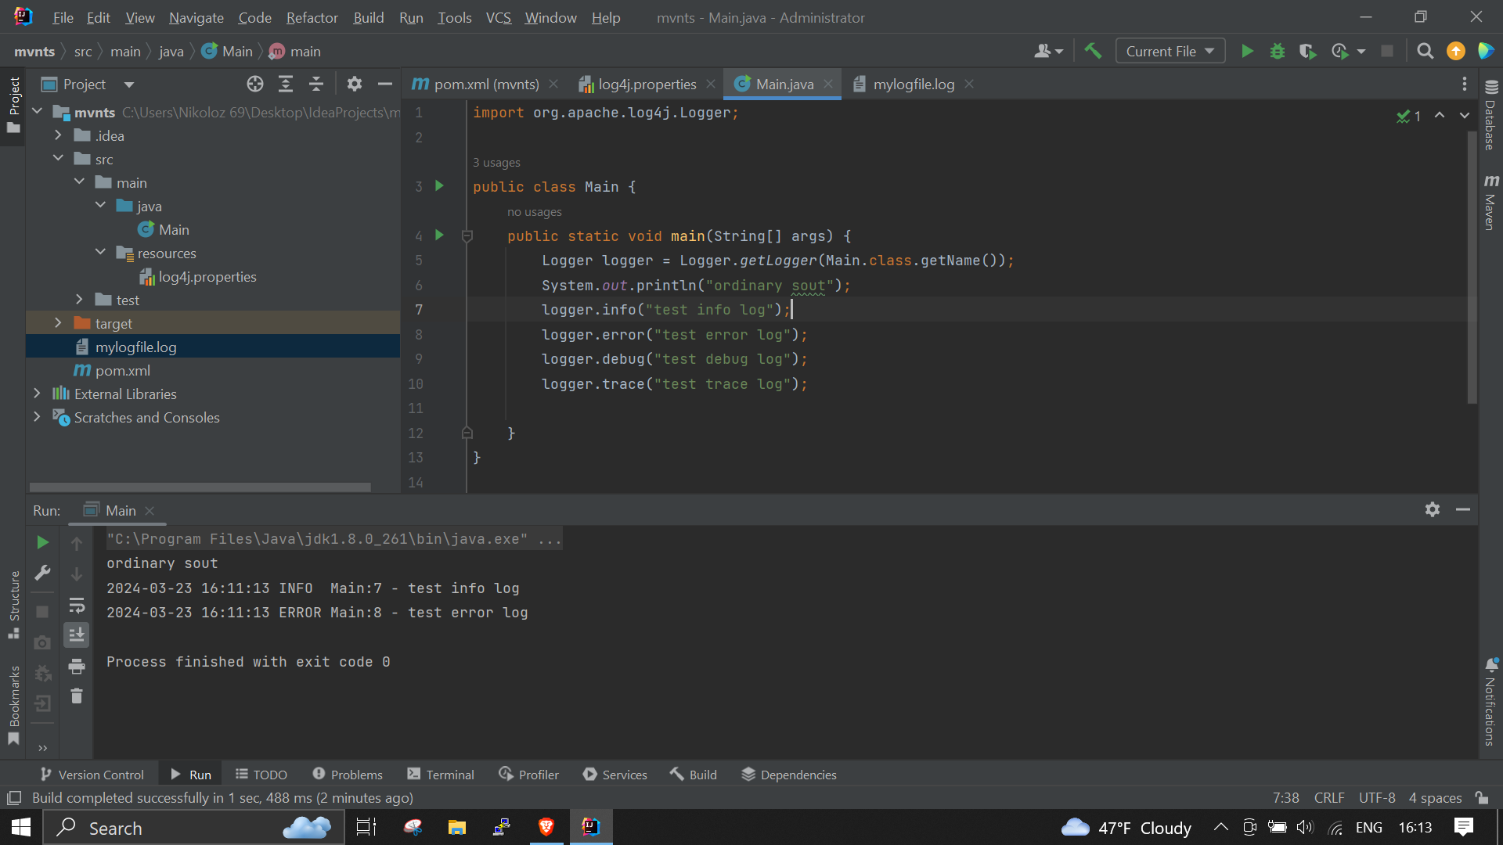

Slide 16
