Slide 1
Java Basics - May 2014 - Teamwork TEAM "KALARBA"
The team members:
Lyubomir Korukov (sportsman)
Ivaylo Iliev (Ivaylo.Il)
Stanislav Dimitrov (StanDimitroff)
Desislav Delchev (Desso)

Slide 2
Project: Creating a Memory Cards Game
Purpose: to make a Java-based game and to work as a team
Created a memory cards game and used the following tool and technologies:
Java 8
Eclipse SDK
Java GUI libraries: Swing , AWT
GitHub and Pastebin
How to play the game:
The object of the game is to guess all matching pairs of pictures.
The player turns over 2 cards and if they match they stay face up. If they
do not match they are turned face down again and the player can try again.
The maximum score is 80 points – 10 points per pair. The goal is to win the
game with as less attempts as you can.

Slide 3
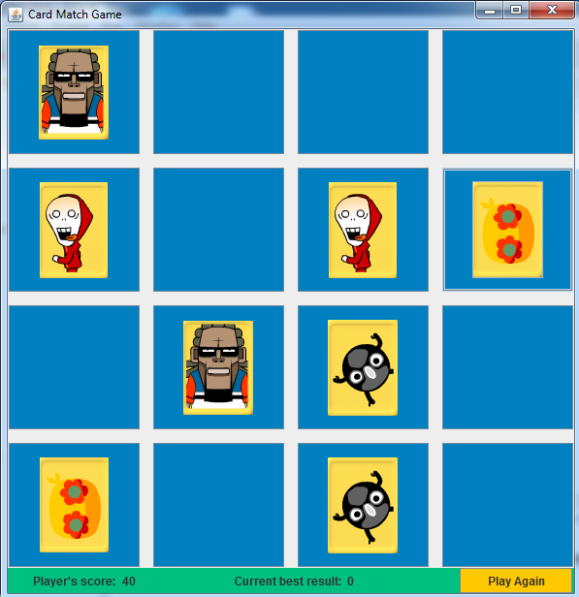
Screen capture

Slide 4
Everyone contributed
Lyubomir Korukov
Ivaylo Iliev
Stanislav Dimitrov
Desislav Delchev

