Slide 1
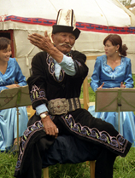
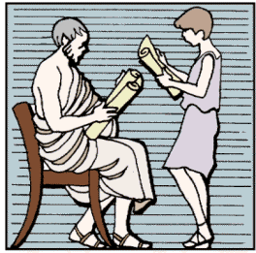


Delivery / performance
logic for assembled
instances / variations
XML
Oral Poetry
Rhetorical
Discourse
Topic-based
Tech Comm
Conversational
AI
Assembly logic for
instances / variations
c
c
c
c
Instances / variations
Of “Types” / “Themes”
b
b
b
b
a
a
a
a
“Types” / “Themes”

Slide 2
XML
Oral Poetry
Rhetorical
Discourse
Topic-based
Tech Comm
Conversational
AI
c
c
c
c
b
b
b
b
a
a
a
a

