Slide 1


GENERAL CONTEXT
Chapter-1
LINK
IMMEDIATE CONTEXT
Chapter-2
Reader
LINK
LINK
LINK
LINK
Chapter-3
LINK

Slide 2
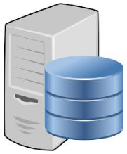
Feature Domain
BROWSE CONTEXT
CSH
CONTEXT
SEARCH
CONTEXT
METADATA
CONTEXT

