Slide 1
Organization Name : Thermo Fisher
Problem Statement : Real time mapping of
Epidemic spread
Team Name : Pepehands
Team Leader Name : Harshit Rai
AICTE Code : 1-3508354456

Slide 2
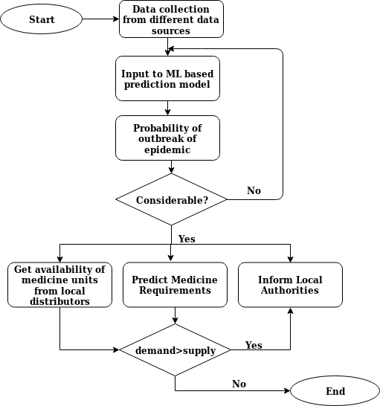
IDEA DESCRIPTION
The application will analyze the historical data of a region and with the help of Machine Learning, it will predict the probability of outbreak of an epidemic.
The major factors which contribute to epidemics are:
Climate
Pollution
Lifestyle of people
Quality of water supply
Sanitation facilities

Slide 3
Data required for prediction of outbreak of an epidemic can be collected from :
Non-Government Organizations (NGOs)
Hospitals & Medical Stores
Weather Department
Pollution Control Board
Laboratories and Research Centres
The Machine Learning model will be trained on the data collected from above mentioned sources for predicting the outbreak of disease.
Systematic data collection techniques and real-time updates will help in predicting contagious disease, sending notifications to respective authorities for prompt response.
Our advanced inventory management tool will maintain the availability of medicines which may be required in a region, where the probability of epidemic outbreak is high as indicated by our epidemic prediction model.

Slide 4





USE CASES
TECHNOLOGY STACK
Can be used as an awareness tool for citizens which gives real-time notifications of epidemic , so that precautionary measures can be taken.
Can be used as a tool to trace the origin and root cause of an epidemic.
Can be used as an alert system which can predict amount of drugs stocks required for the treatment of epidemics.
Java : For developing the Android application.
Android SDK : For developing the Android Application
Tensorflow : For machine learning algorithms.
Amazon Web Services : For hosting the backend of the application.
Python : For creating the api endpoints and for machine learning or deep learning model development.

Slide 5
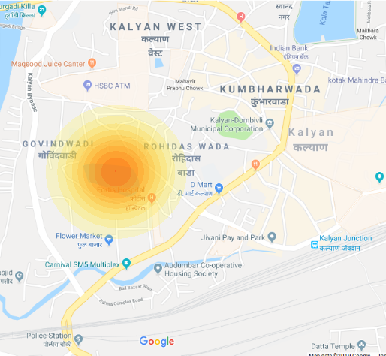
SHOW STOPPERS
Live tracking of epidemics with respect to different regions.
Tracking of medical inventory to counter shortage of medicine in the event of epidemic outbreak.
Proactively predicting epidemic spread by accounting climate change, pollution and other parameters.
The above image represents possible impact of epidemics due to polluted pond.

