Slide 1
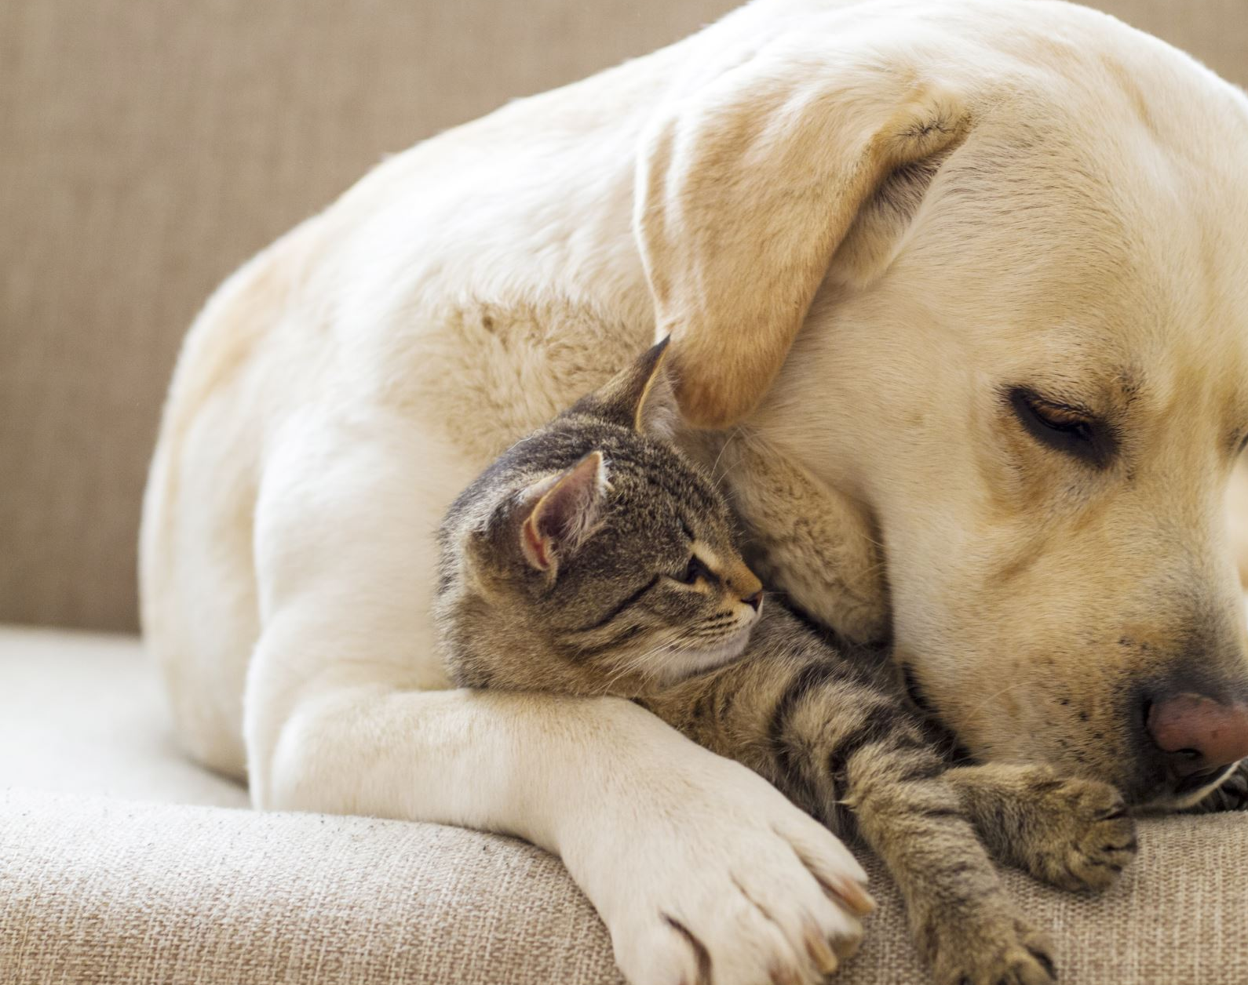
Cat or Dog?
For this project we will use a CNN to determine if an image is of a cat or a dog, build a dashboard to allow a user to input a picture of a cat or dog, and then have our model predict whether the image is a cat or a dog.
Stan Johnson, Brian Haynes, Kelsey Abbey, Toan Nguyen

Slide 2

Tools Used for this Project
keras
TensorFlow – ImageDataGenerator
sklearn

Slide 3
Building our Model
We built and trained our model in Google Colab using an A100 GPU as it was a very resource intensive process
The data was loaded into the Colab session straight from the kaggle API
Using ImageDataGenerator we labeled all the images in the dataset
We then used train-test-split to split our data into training and test sets
After noticing an increase in accuracy from manipulating the different parameters of the model, we decided to let keras-tuner run through the different hyper parameters to fine tune the model

Slide 4
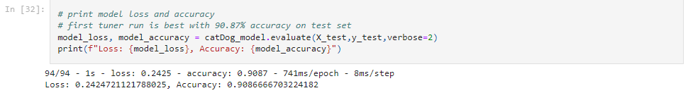
Building our Model: Keras Tuner
We set up data augmentation parameters to make our dataset more generalized
We let keras tuner run different trials using different values for dropout coefficient, filter numbers, number of layers and number of units in each layer
Tuner returned the best model
Accuracy on our test data increased to 90.87%.

Slide 5
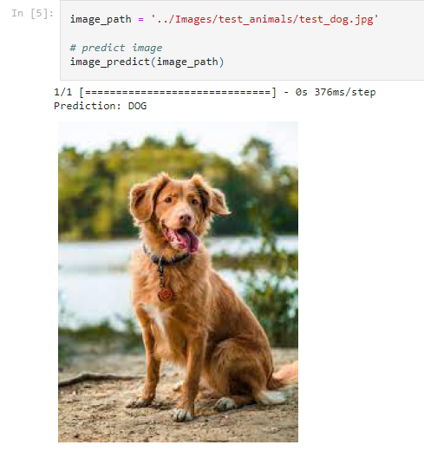
Testing our Model
We tested our model in jupyter notebook
We wrote a function that preprocesses an uploaded image and then runs it through the model to predict whether its an image of a cat or a dog.
We tested the model with images downloaded from google and images of our own pets. All our test images were NOT part of the training or test data used in the previous section.

Slide 6
Deploying our Model
Import necessary tools
Load in the pre-trained model that can predict whether an image contains a cat or a dog
Define where uploaded files will be stored
Create a Flask app instance that will serve as our web application
Configure the app to use our upload folder
Define a function to prepare the uploaded image for the model
The function resizes the image to 150x150, converts it to grayscale, normalizes pixel values, and reshapes it for the model
Create a main page to deal with users’ requests
Inside the index() function: If a user uploads an image (POST request) it takes the uploaded image and saves it in the upload folder. Then it adjusts the image for the model, asks the model if it's a cat or dog and shows the result on the result.html page with the image
Run the app

Slide 7
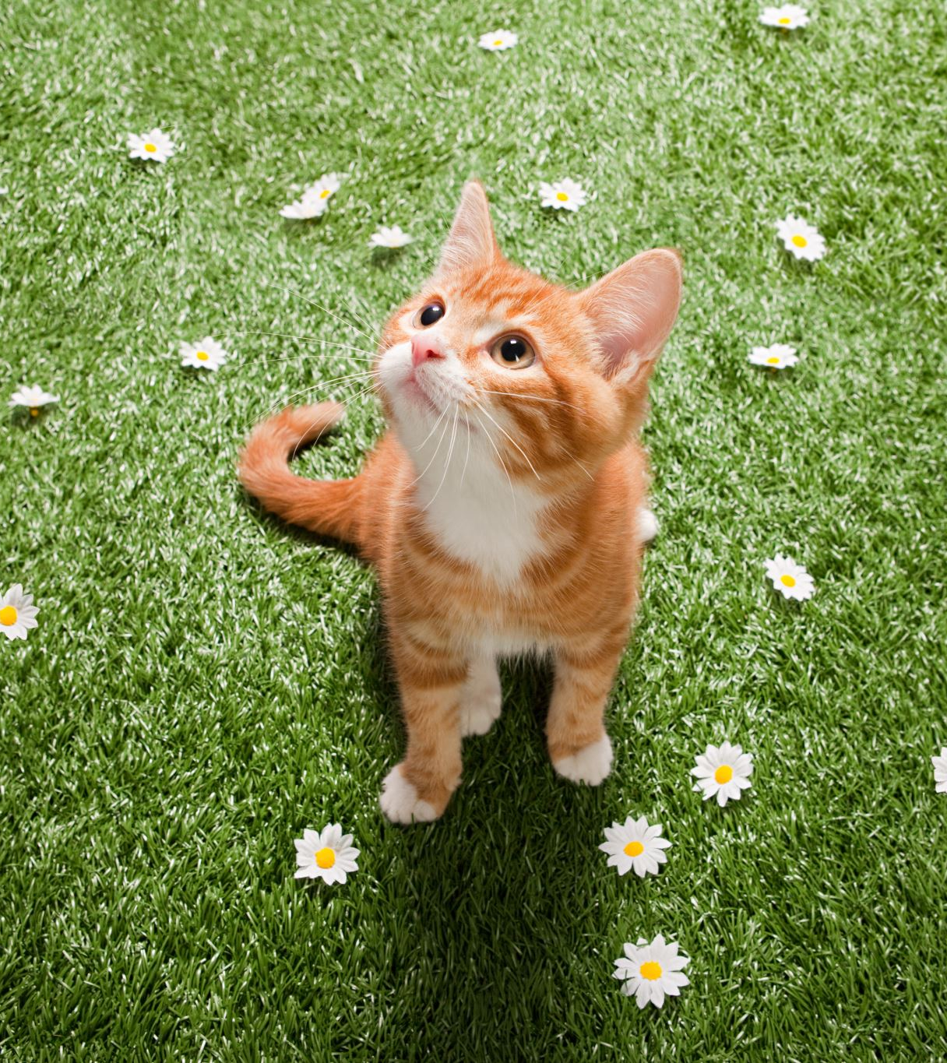
Next Steps
To increase the accuracy of the model, we would want to clean up the images in the data set, i.e. get rid of the images that are not of cats or dogs.
Have the API running in the background

