Slide 1
Healthcare
does the number of hospitals in a city impact home pricing

Slide 2
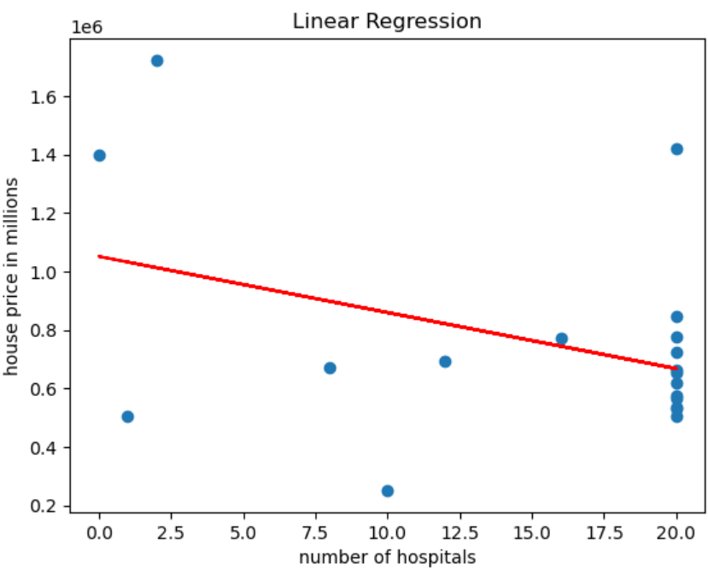
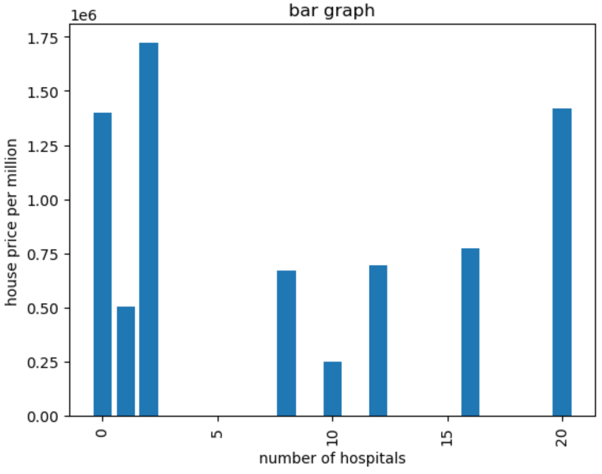
Healthcare
Definition of Healthcare
Radius
R value

