Slide 1
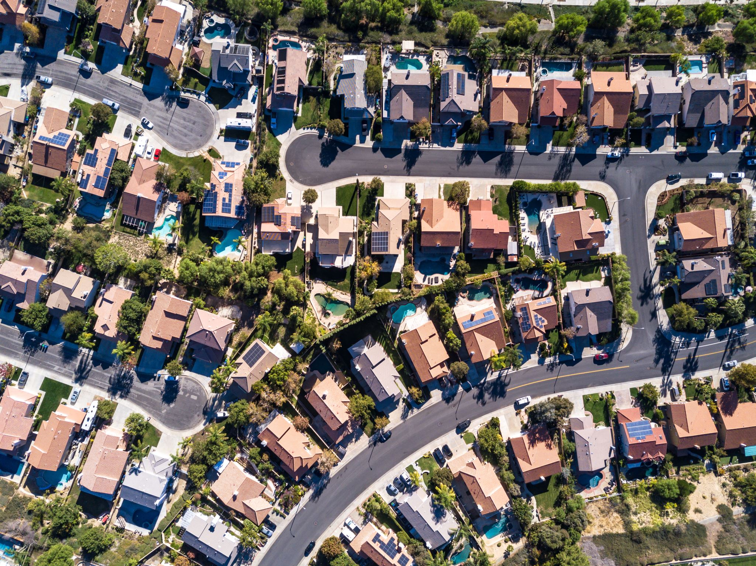
EDA of Factors Affecting the Typical Home Value in Colorado

Slide 2
Summary
The goal of our project was to explore the patterns in the real estate market, mainly home value, regarding different features in the area.
Typical Home Value vs different variables such as proximity to parks, access to healthcare, schools in the area, etc.

Slide 3

Data Collection: Round One
We got our home data from Zillow Research & Data
The data set uses the Zillow Home Value Index (ZHVI) to describe the typical home price at different geographical levels
https://www.zillow.com/research/data/
For our project we analyzed the data at a city level
Notes:
- More info on ZHVI or to use data for yourseld visit Zillow.com

Slide 4
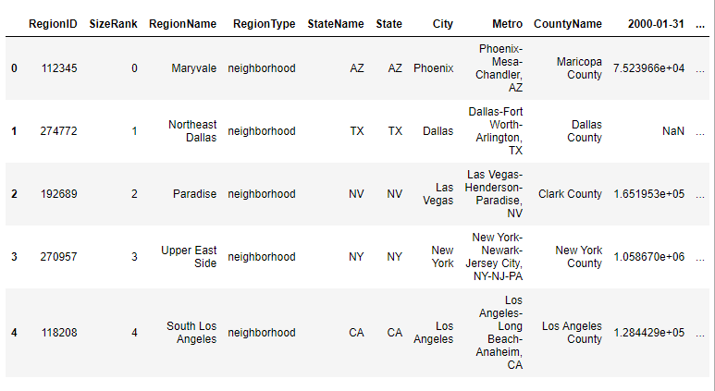
Data Cleanup
Notes:
This is the df after reading in the raw data (csv). Has data for every state at different geographic levels dates start jan 2000 and go until feb 2023

Slide 5


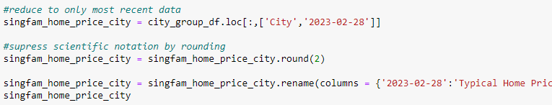
Data Cleanup
Read in csv and reduce to only CO data
Groupby City and use mean()
Get only most recent data and rename column

Slide 6
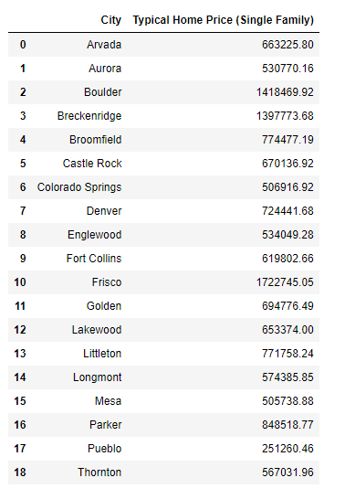
Data Cleanup
Notes:
This is our df after cleaning it up. We grabbed only the most recent entries for Home value for our comparisons. 02/31/23

Slide 7

Data Collection: Round Two
After getting the typical home value for 19 Colorado cities, we used Geoapify to get coordinates for each city
Using the coords for each city, we explored the different categories on the Geoapify Places API
How many of each feature is within x radius from city?
How does this relate to home value?
Notes:
Used for loop and df to get cords for each city.

Slide 8
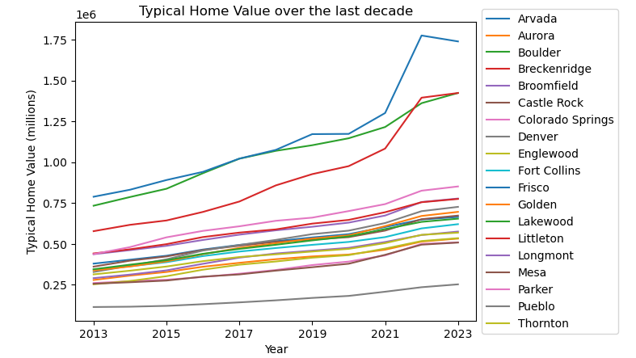
Colorado Cities – Typical Home Value Time Series
Typical Home value in Colorado has trended up over the last decade
The rate at which home values are increasing appears to be increasing since 2020
Notes:
-We should have bought houses 10 years ago.
-All of the CO cities kind of follow the same pattern
-Frisco + Breck are outliers

Slide 9
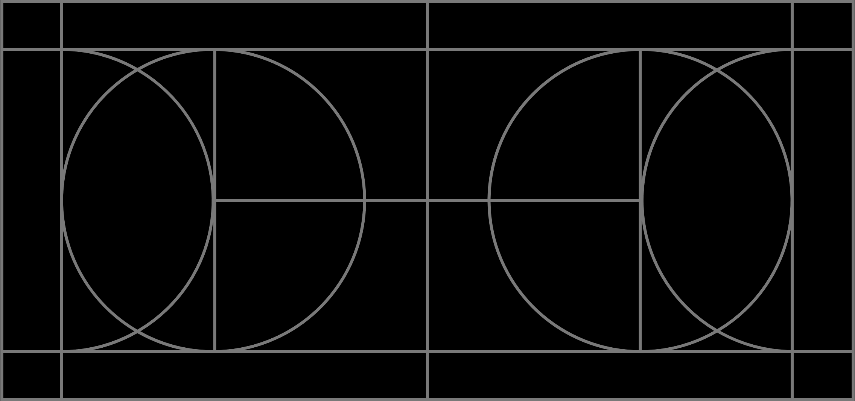
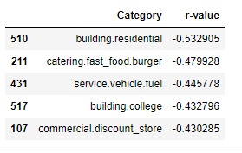
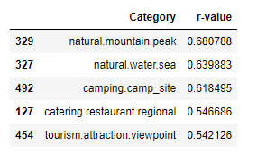
Calculating R-Values
Using a for loop, r-values were calculated for every category on the geoapify places API.
The five strongest positive correlations and the five strongest negative correlations are shown to the right.
Notes:
Used pandas read_html() to get cat list
Sea??
Strongest positive correlations are nature related

Slide 10

Deeper dive into specific categories

Slide 11
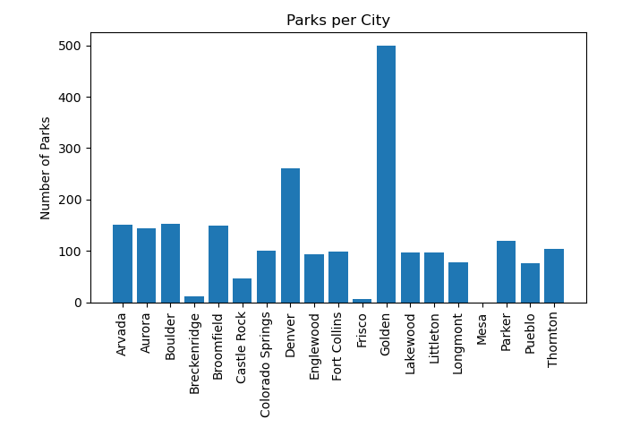
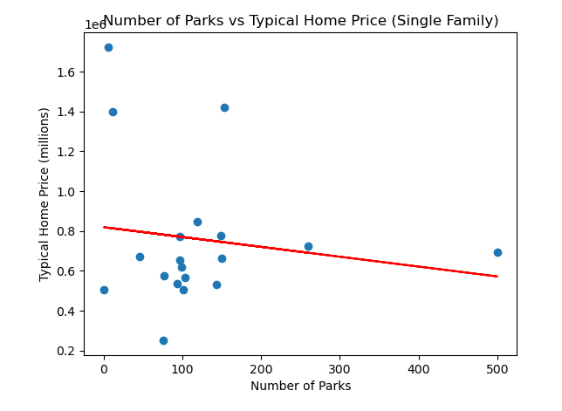
Park Data
Radius – 3 km
Golden has A LOT of parks!?
The number of parks does not seem to be strongly correlated to Typical Home Value with a calculated r-value of -0.15.
Notes:
- Don’t want to go far for a park -why Golden has so many? Deeper look into API results required.

Slide 12
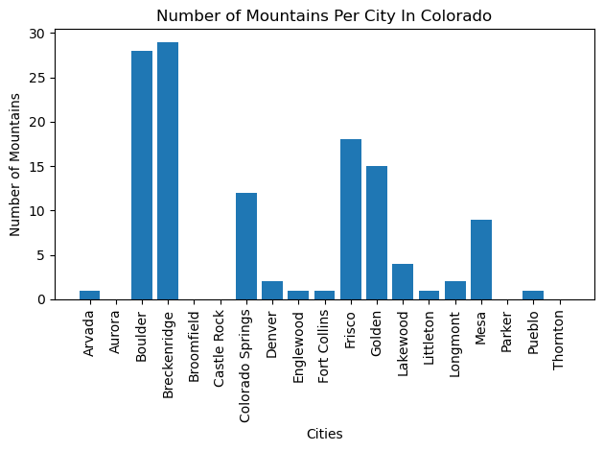
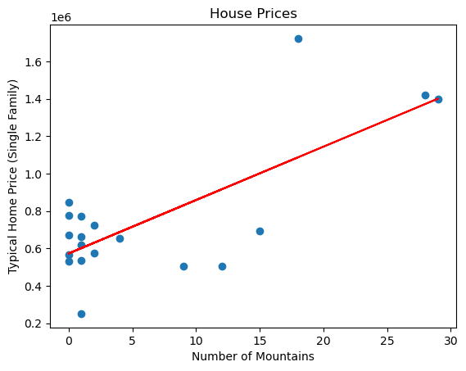
Mountain Data
Wanted to see if having more mountains in a city meant more expensive homes in the city.
Figured out how many mountains are in each city and typical home prices in each city. (Bar Graph)
Compared typical home prices to number of mountains in the city . (Scatter Plot)
Had a radius of 10 km because mountains wouldn’t be right in a city, they would be surrounding the city.
Found that there is a very strong correlation between the number of mountains and the home price. The R value was .76 which means there is a 76% chance that the value of homes increases based on the number of mountains.

Slide 13
Mountains Data
-
-Wanted to see if having more mountains in a city meant more expensive homes in the city.
-Figured out how many mountains are in each city and typical home prices in each city. (Bar Graph)
-Compared typical home prices to number of mountains in the city . (Scatter Plot)
-Had a radius of 10 km because mountains wouldn’t be right in a city, they would be surrounding the city.
-Found that there is a very strong correlation between the number of mountains and the home price. The R value was .76 which means there is a 76% chance that the value of homes increases based on the number of mountains.

Slide 14
Healthcare
does the number of hospitals in a city impact home pricing

Slide 15
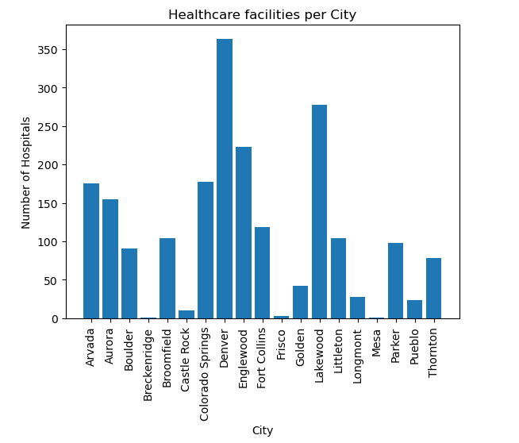
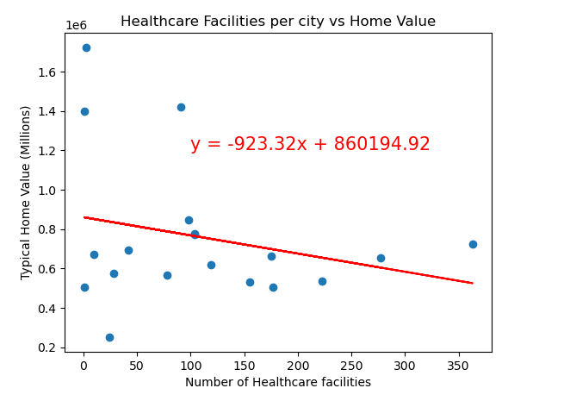
Healthcare Data
Definition of Healthcare
Radius 10km
R value is -0.25

Slide 16
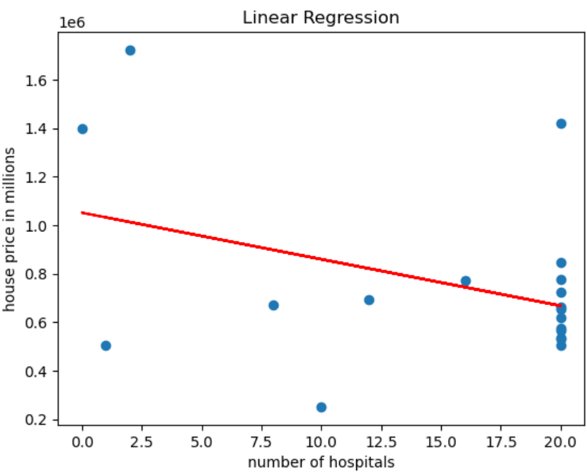
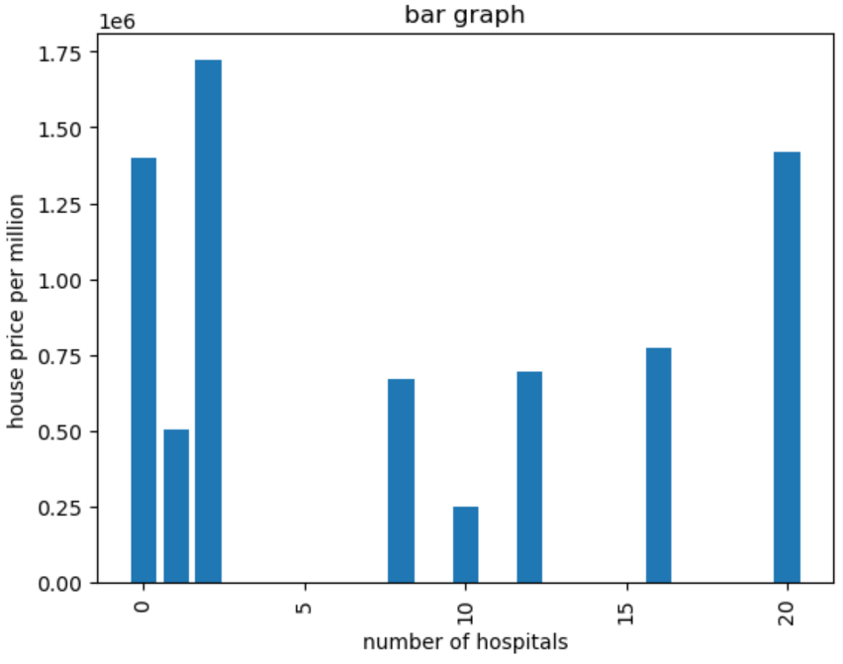
Healthcare
Definition of Healthcare
Radius
R value

Slide 17
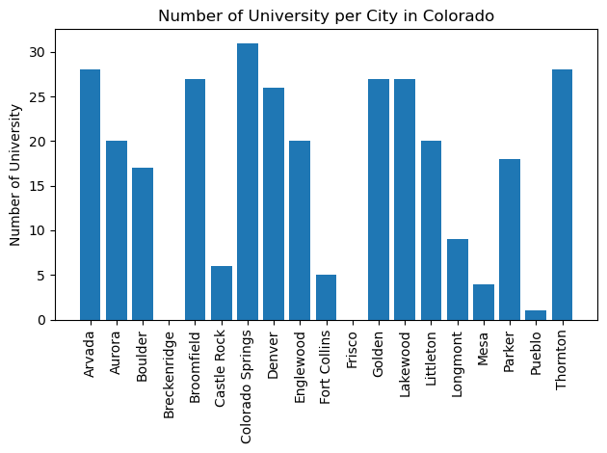
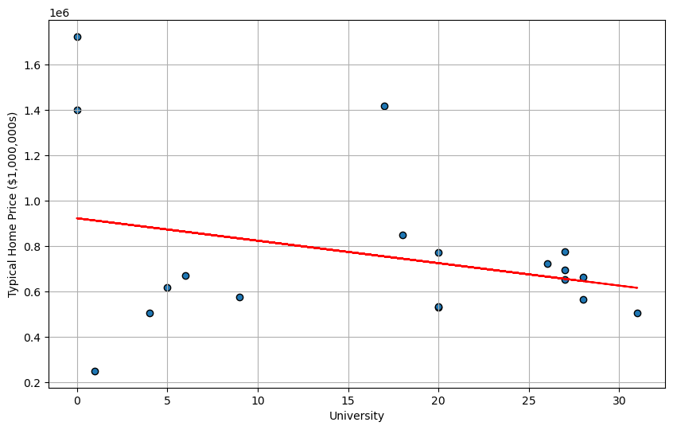

Slide 18
University Data
For my part of this group project, I used Geoapify to see if the presence of University increase home price in the state of Colorado.
Per the bar chart, Colorado Spring has 31 University vs Breckenridge and Frisco with zero.
Based on my finding, a strong demand for a good University nearby can drive property values higher.
I believe there are limitation to this dataset. In future project, I would expand my supported categories to “education.school” instead of limiting it to “education.university”
Also, it would be helpful to identify the homebuyers age, race/ethnicity, marital status and/or education.

Slide 19
For my part of this group project, I used Geoapify to see if the presence of University increase home price in the state of Colorado.
Per the bar chart, Colorado Spring has 31 University vs Breckenridge and Frisco with zero.
Base on my finding, a strong demand for a good University nearby can drive property values higher.
I believe there are limitation to this dataset. In future project, I would expand my supported categories to “education.school” instead of limiting it to “education.university”
Also, it would be helpful to identify the homebuyers age, race/ethnicity, marital status and/or education.

Slide 20
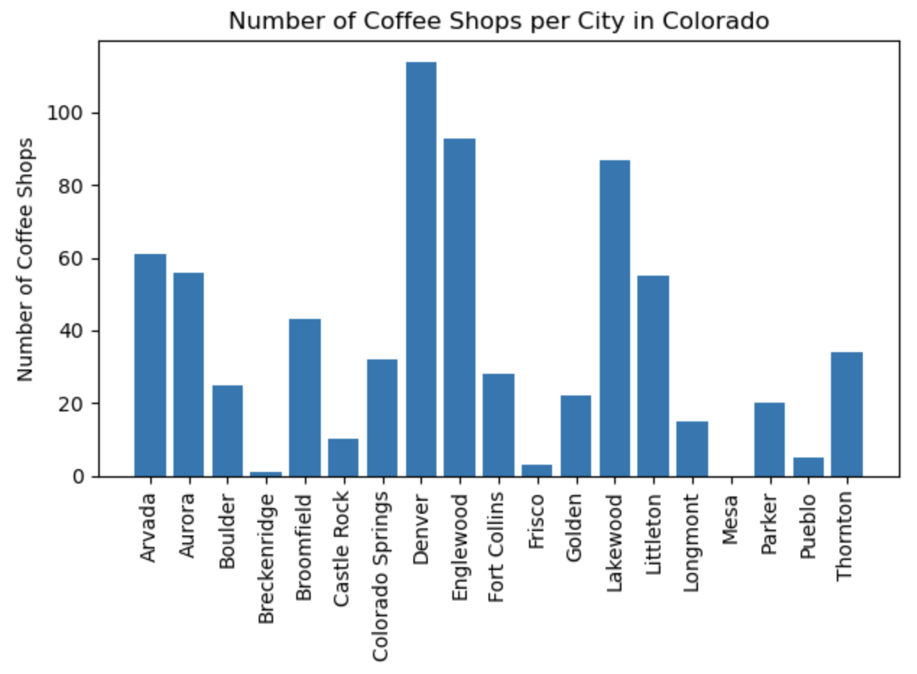
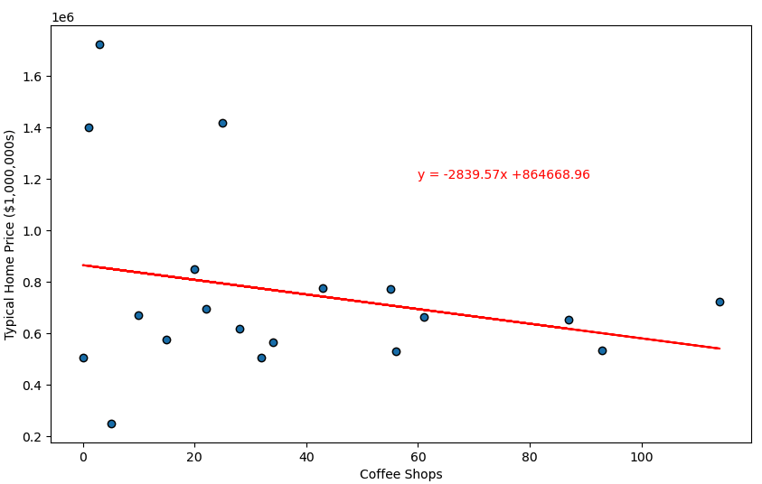
Coffee Shop Data
Radius = 10 km
Using plot_linear_regression, it was found that the r-value is -0.25763. This would indicate that coffee shops are not very strongly correlated to typical single-family home price.

Slide 21

Next Steps
Given more time with this project we would:
Dive deeper into each category and further examine individual results
Only one coffee shop in Breck??
Use population data to better understand how different categories and home value are affected by the population of a city
Explore comparisons at different geographical levels:
Neighborhood level
State level

Slide 22
Acknowledgment
Data on typical home value is from Zillow®
www.Zillow.com/research/data
Our location data is from Geoapify and OpenStreetMap®
https://www.geoapify.com/
https://www.openstreetmap.org/copyright

Slide 23
- Radius = 10 km
- Using plot_linear_regression, it was found that the r-value is -0.25763. This would indicate that coffee shops are not very strongly correlated to typical single-family home price.

