Slide 1
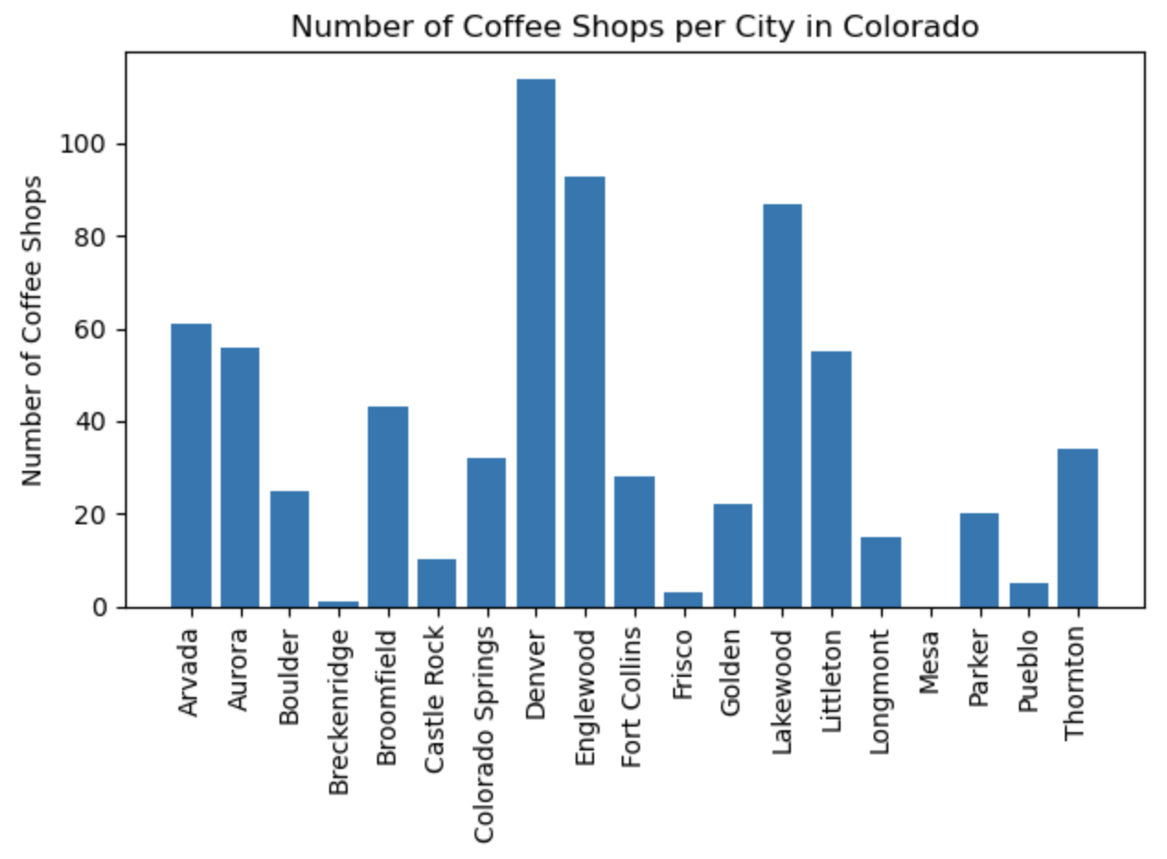
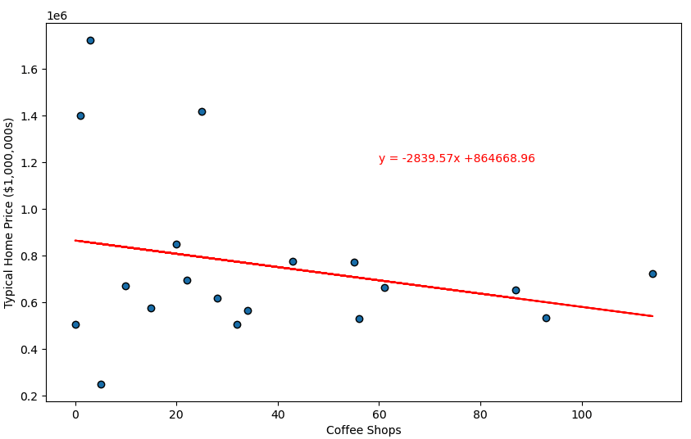
- Radius = 10 km
- Using plot_linear_regression, it was found that the r-value is -0.25763. This would indicate that coffee shops are not very strongly correlated to typical single-family home price.

