Slide 1
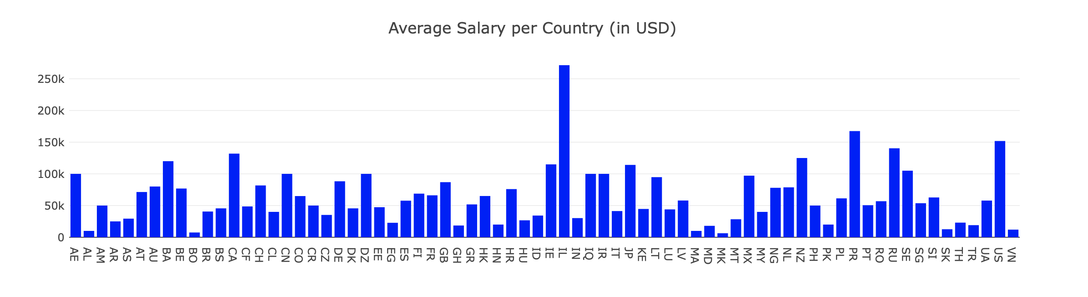
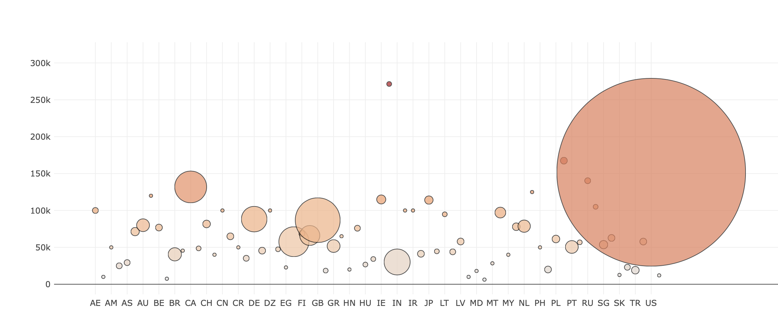
Average Salary per Country
Comparison between data science salaries for all job positions per country
Not all countries have a ton of data
The bottom bubble chart shows average salary per country, adding in the number of data science jobs with reported salaries

