Slide 1

Data Science Salary Dashboard

Slide 2
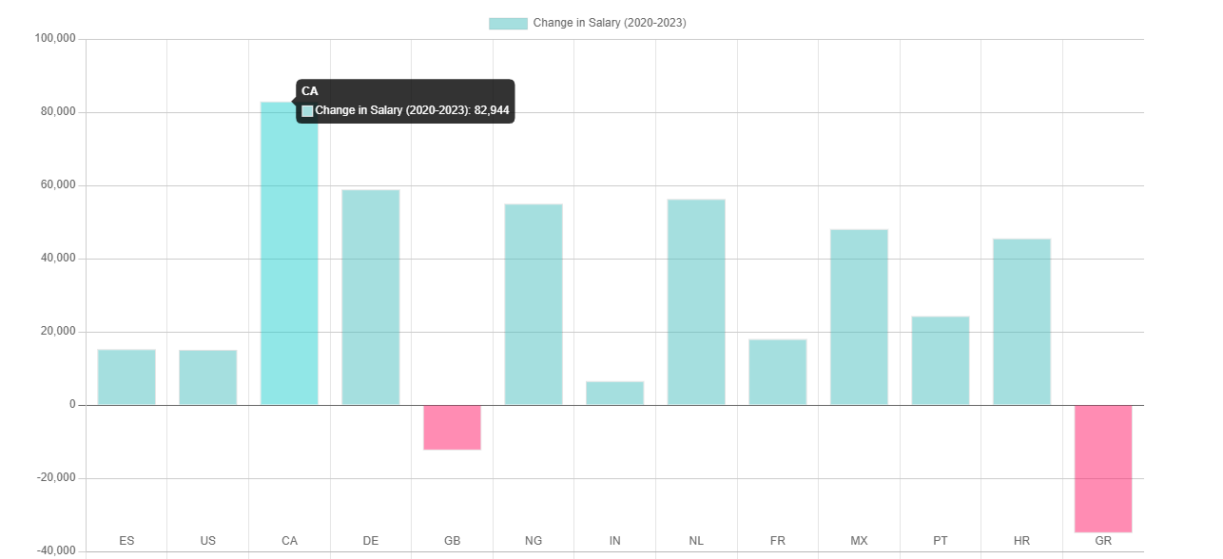
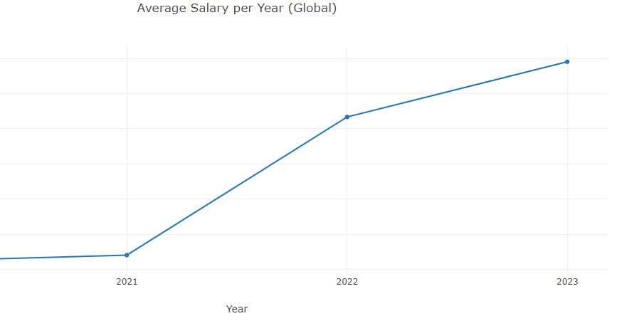
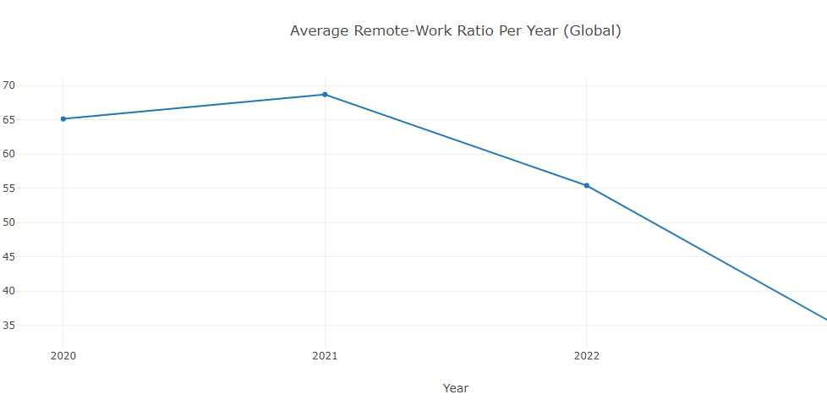
Time Series Analysis
A time series analysis allows us to explore the data over time
Salaries have varied widely by country since 2020
Overall trend
More Money
More commuting

Slide 3
NEXT STEPS and CONSIDERATIONS
Our data set is limited:
Mostly US data
Only for the past 3.5 years
Break the data down further to explore how different experience levels get paid and if they are working more remote or less remote
ADD SOMETHING ELSE HERE*** (OR NOT)

