Slide 1

Project 3
Jennasis Escobar
Stan Johnson
Kelsey Abbey
Brian Haynes
Tyler Nguyen

Slide 2
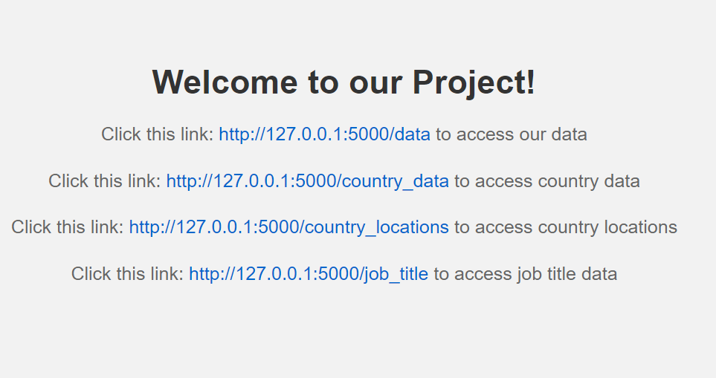
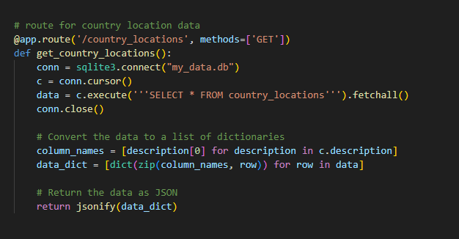
Flask API
The Python file sets up a Flask application which acts as a web server that handles HTTP requests and responses.
Different routes are defined within the Flask application to direct us to specific endpoints. For example, the /home route leads to a home page with links to different sets of data.
Each route connects to an SQLite database, retrieves data using SQL queries and returns it as JSON responses.
The JSON data can be accessed by team members to create their visualizations or perform further analysis.
Our Flask API opens in a webpage when it is run and offers links to each set of data we needed in order to create our visualizations

Slide 3
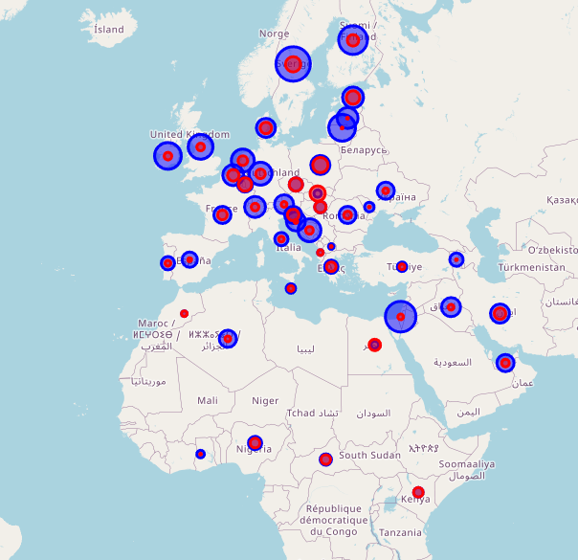
Map
2 APIs
D3.js & Leaflet.js
Data Retrieval
Data Visualization

Slide 4
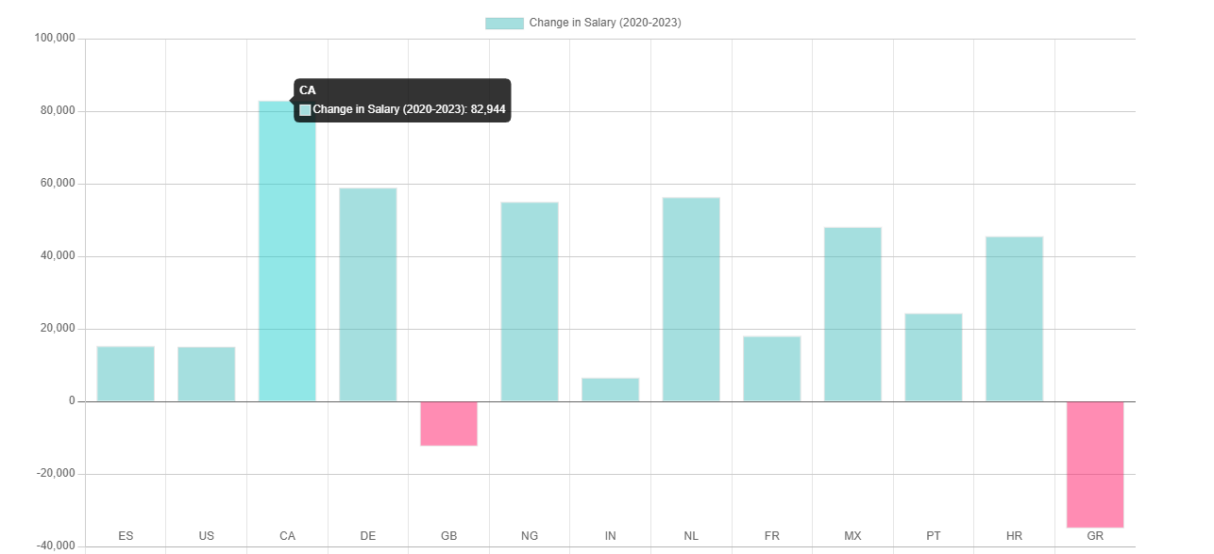
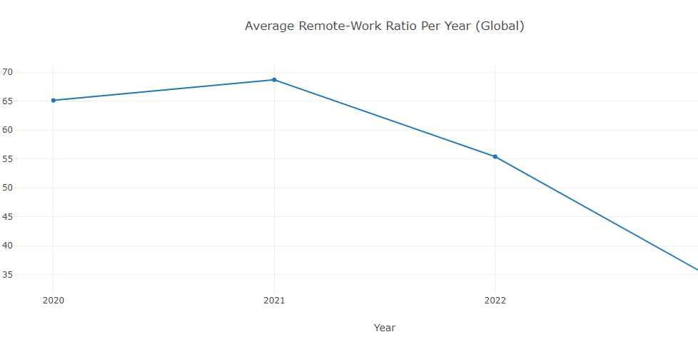
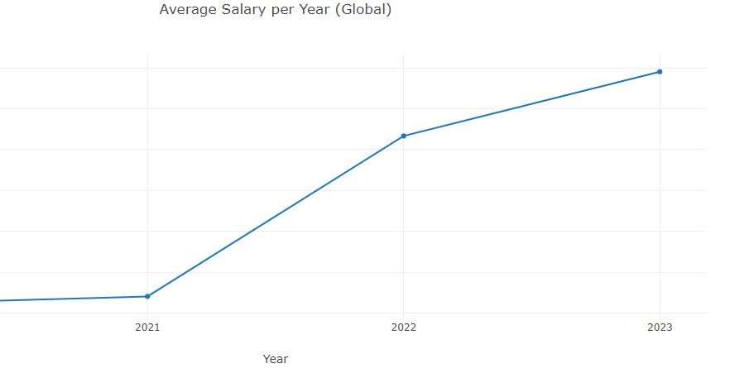
Time Series Analysis
A time series analysis allows us to explore the data over time
Salaries have varied widely by country since 2020
Overall trend
More Money
More commuting

Slide 5
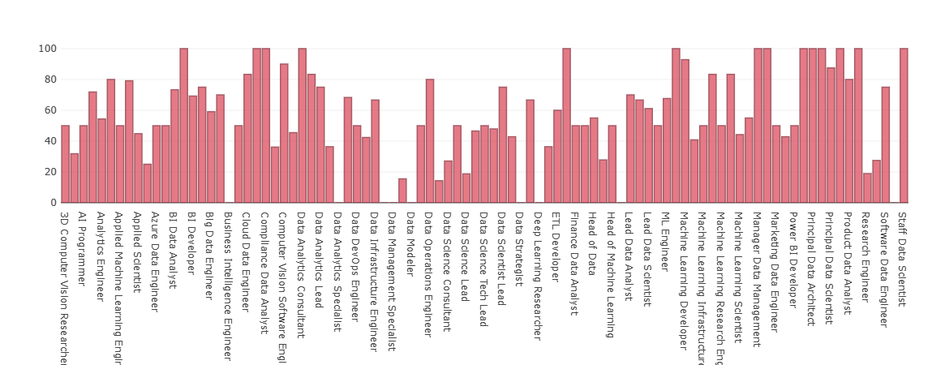
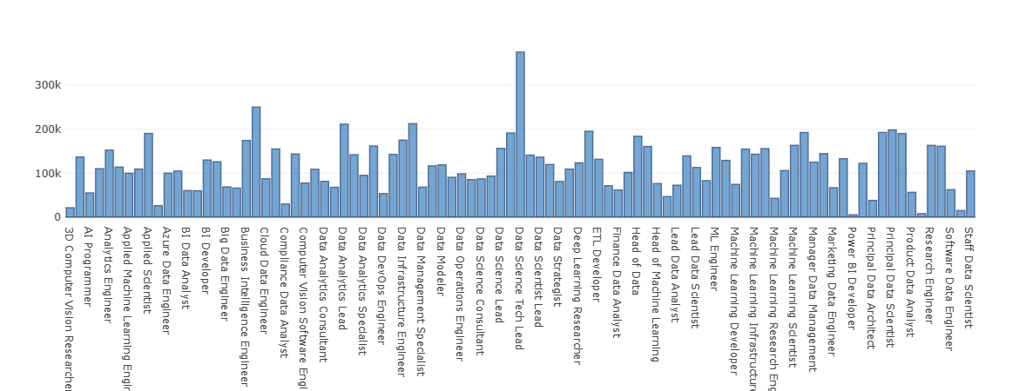
Job title comparison
Base on the chart shown below, Data Science Tech Lead have the highest salary among other job title with $375k and the lowest salary is Power BI Developer with $5409. This visualization show us the the salary for each job.
This visualization show us the job title with the remote work percentage.

Slide 6
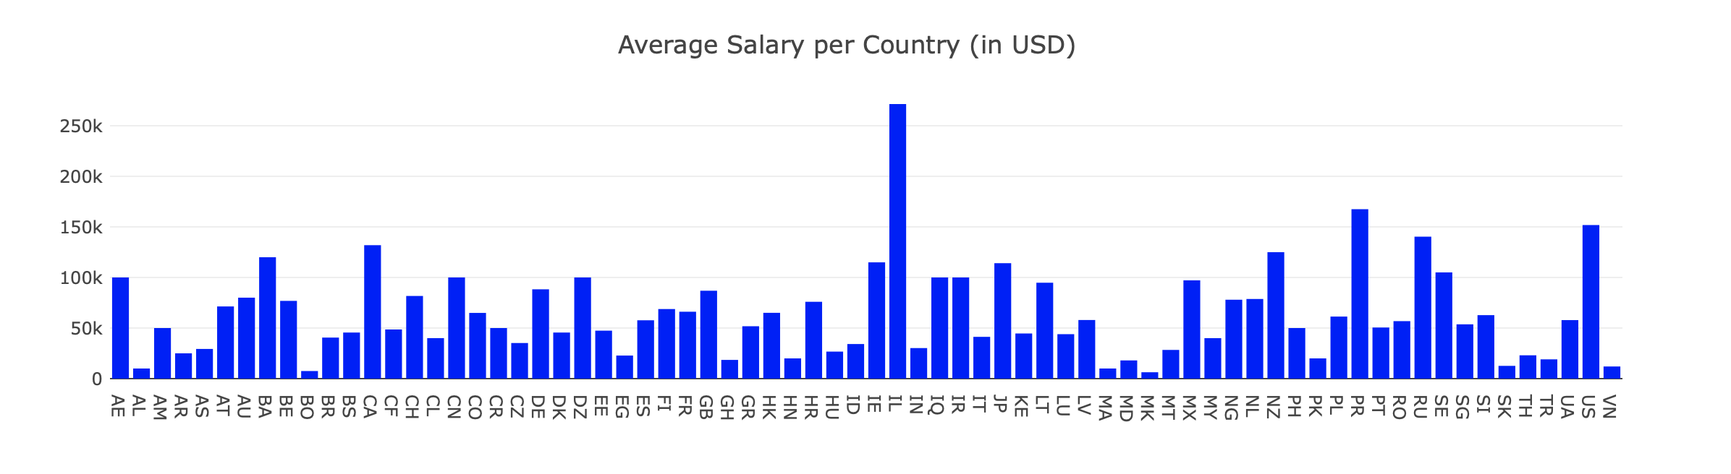
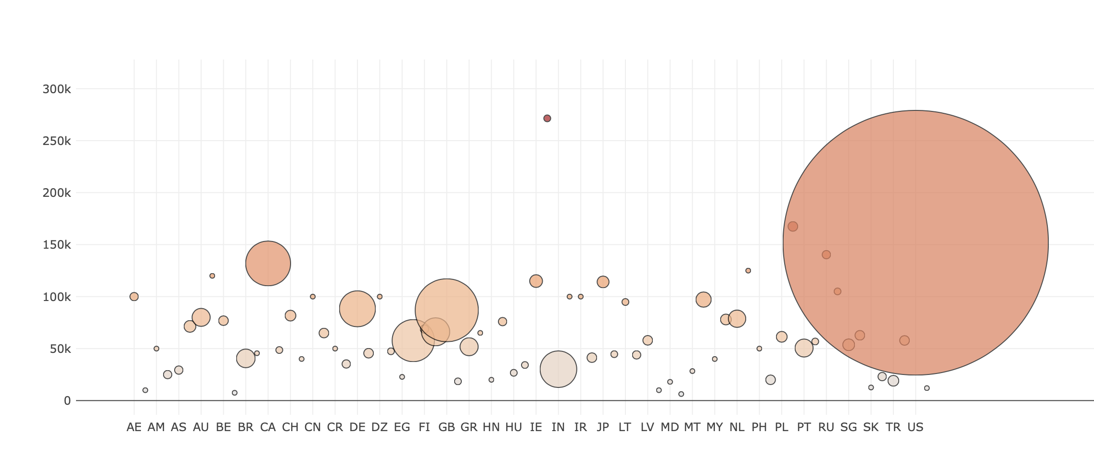
Average Salary per Country
Comparison between data science salaries for all job positions per country
Not all countries have a ton of data
The bottom bubble chart shows average salary per country, adding in the number of data science jobs with reported salaries

Slide 7
NEXT STEPS and CONSIDERATIONS
Our data set is limited:
Mostly US data
Only for the past 3.5 years
Break the data down further to explore how different experience levels get paid and if they are working more remote or less remote

