Slide 1
Statistical Rethinking
1819 StanKorea Study2 Summary
Presenter: Hoyoung Jang
Date: 2019.05.22 (Wed)
Made by Hyunji Moon, Jungwook Im, Hoyoung Jang, Changyeon Park

Slide 2

PRESENTATION CONTENTS
1__ Case Study 1: Is Chimpanzee Sociable?
2__ Case study 2 : Marriage age, rate and Divorce rate
3__ Case study 3 : Oceanic Tool Complexity

Slide 3
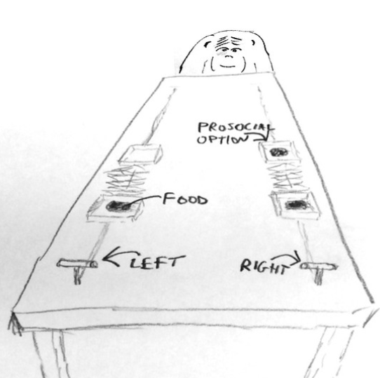
Case Study 1: Is Chimpanzee Sociable?
Ch. 11
Experiment
As in the figure, there is a chimpanzee(chimp A) which has various options.
In the left side there is a food only in chimp A’s side, while in the right both side of plates have food.
There will be two conditions and two options: whether there is a partner(chimp B) or not, and whether the prosocial option(chimp A and B all can eat the food) is in the right or left.
In the given conditions, chimp A should pull one of the lever, and the proportion of pulling left lever will be recorded as the data.
Purpose
We want to see the interaction of one’s handedness and the condition to the outcome(which side of the lever chimp A select).

Slide 4
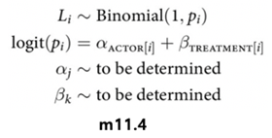
Case Study 1: Is Chimpanzee Sociable?
Ch. 11
Method
There are four possible treatments as the table below:
We will use logit link to calculate the proportion.
 | Prosocial in
 | Right (R) | Left (L)
Partner O (P) | R/P | L/P
Partner X (N) | R/N | L/N
α : Handedness (measurement error)
β : condition of partner

Slide 5
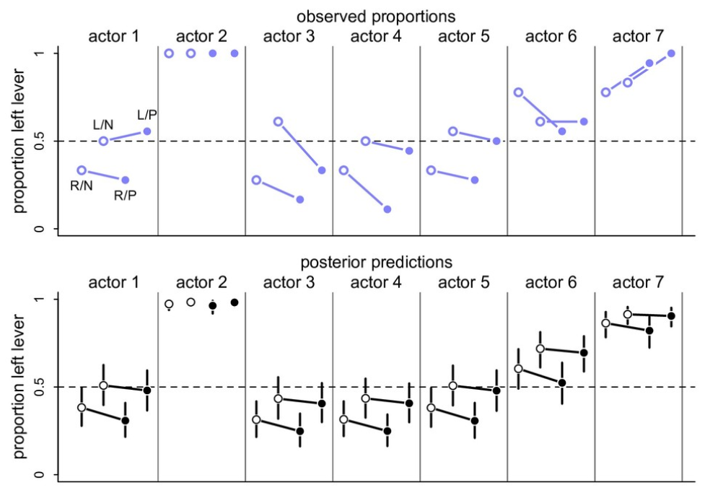
Case Study 1: Is Chimpanzee Sociable?
Ch. 11
Result
Actor 2 shows always left selection : No worth
Actor 1 shows pretty prosocial tendency, but chimps do not respond always in the same way. That doesn’t mean that chimps are bull shit asocial assholes but their selections are not much affected by partners but by their handedness.
In the posterior distribution, such tendency becomes stronger that the conditions are not that much effective; just their handedness control them.
Raw data
Posterior distribution

Slide 6
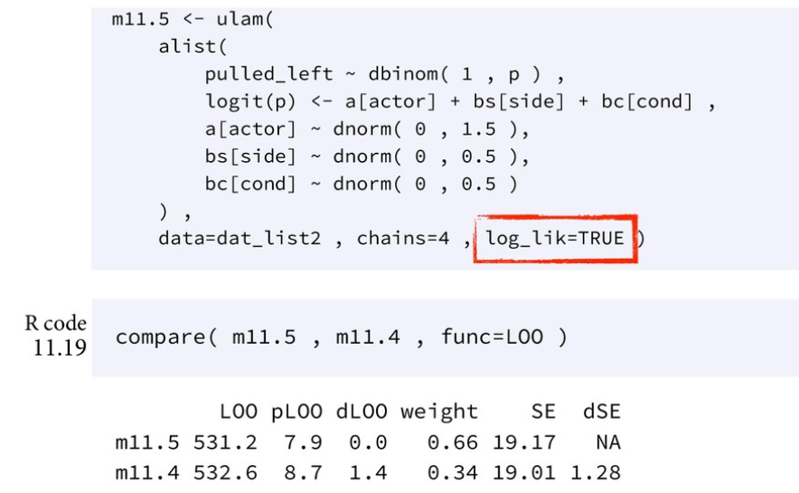

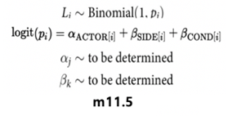
Case Study 1: Is Chimpanzee Sociable?
Ch. 11
Result
To make the point clearer, the experiment result was compared with no-interaction of handedness and treatments model.
As seen in the dLOO value, which corresponds to WAIC, there’s almost NO interaction between handedness and treatments.
All the parameters are separated with no interaction.

Slide 7
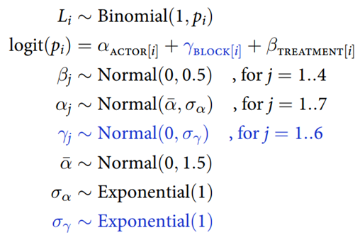


Case Study 1: Is Chimpanzee Sociable?
Ch. 13
5. New method
Experiments are done for six days.
We add varying intercepts term to our model.
m13.6
Notes:
Varying intercept : 날짜에 대한 영향

Slide 8
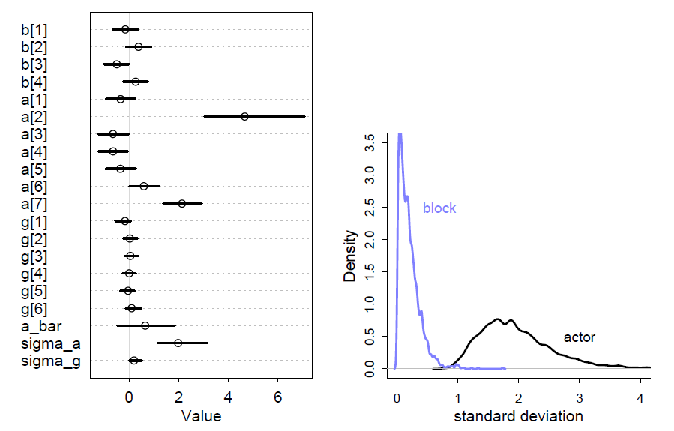

Case Study 1: Is Chimpanzee Sociable?
Ch. 13
6. New result
Estimated variation among actors is a lot larger than the estimated variation among blocks.
This means the chimpanzees vary, but the blocks are all the same.
Posterior mean & interval
Posterior sd of $α$, $γ$

Slide 9
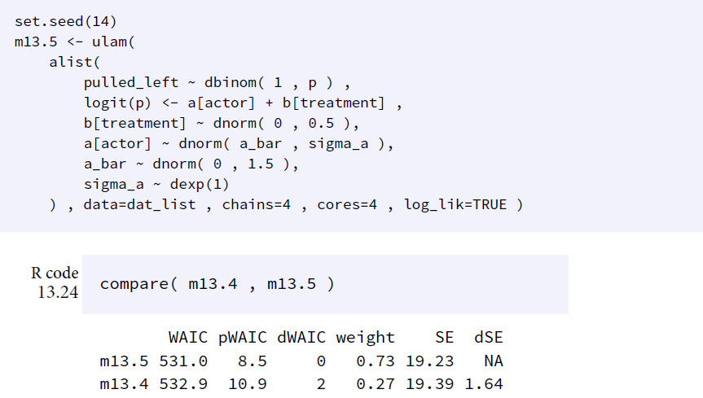
Case Study 1: Is Chimpanzee Sociable?
Ch. 13
6. New result
As seen in pWAIC value, we added 7 more parameters but only about 2.5 more parameters are effective.
Incorporating block intercept terms has no benefits.

Slide 10
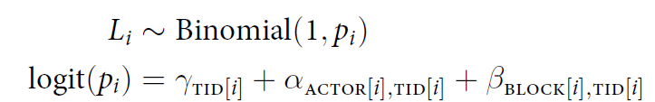



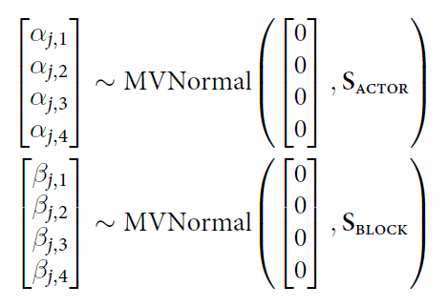
Case Study 1: Is Chimpanzee Sociable?
Ch. 14
7. Another new method
Cross-classified varying slope model
– each actor in each treatment, each block in each treatment
We use matrix representation.
m14.2
Notes:
행렬식 구성

Slide 11
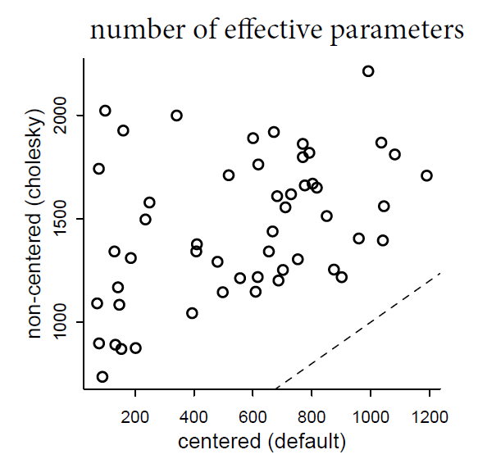
Case Study 1: Is Chimpanzee Sociable?
Ch. 14
8. Another new result
Both models arrive at equivalent inferences
But the non-centered version samples much more efficiently.
Distributions of effective samples(n_eff)

Slide 12
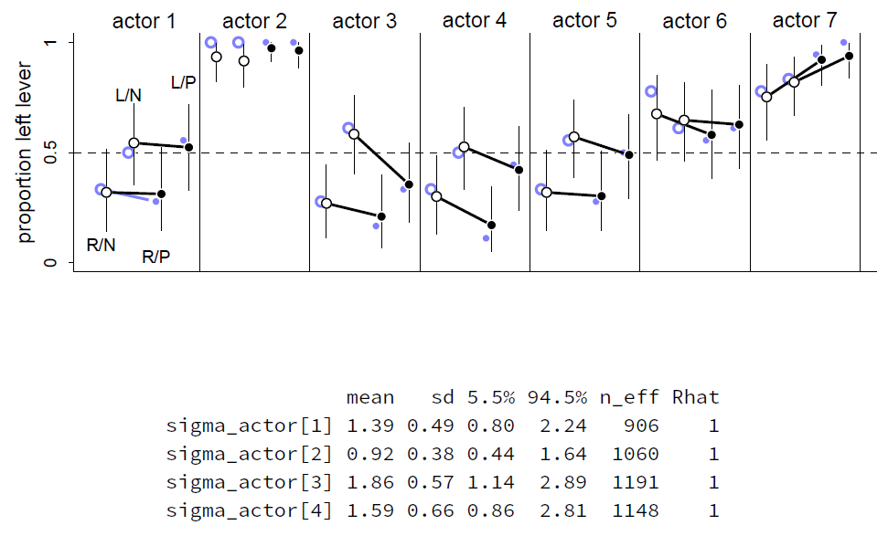
Case Study 1: Is Chimpanzee Sociable?
Ch. 14
8. Another new result
Black lines are posterior predictions and blue lines are the raw data for m14.3.
The most obvious difference from earlier is that the model accommodates a lot more variation among individuals.

Slide 13
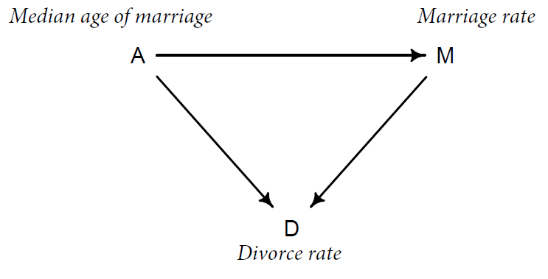
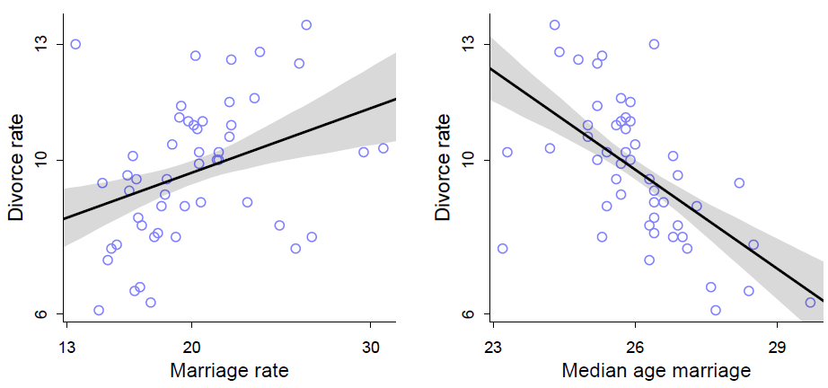
Case study 2 : Marriage age, rate and Divorce rate
Ch. 5
Experiment
As in the figure below, the association between marriage rate (M), divorce rate (D) and median age of marriage (A) are searched. The multiple regression will be used to know the genuine correlation and causation between the predictors.
Purpose
Although the M, A and D have the association as in the chart, it cannot say the real correlation between them. Spurious correlation can be hidden, hindering the correct causal inference. We will search for 1) the value of a predictor, once we know the other predictors
2) how each predictor is associated with outcome, once we know all the other predictors

Slide 14
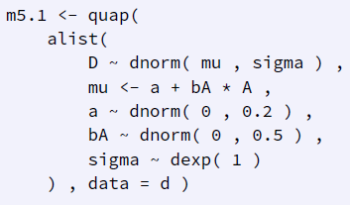
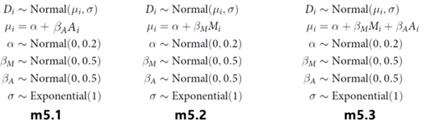
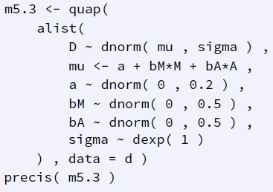
Case study 2 : Marriage age, rate and Divorce rate
Ch. 5
Method – Multiple regression
As seen in the DAG, A, M, D are associated while we cannot know the genuine correlation between them since whether the path M→D is closed or not does not effect on the result.
For achieving the purpose, we will make three models as in the code; m5.1, 5.2, 5.3 each indicates the code assuming that divorce rate is correlated with median age of marriage only, marriage rate only and both. The last one is multiple regression, using two or more variables to predict posterior.
The posterior predictions will then be plotted in three other ways : predictor residual plots, counterfactual plots and posterior prediction plots.

Slide 15
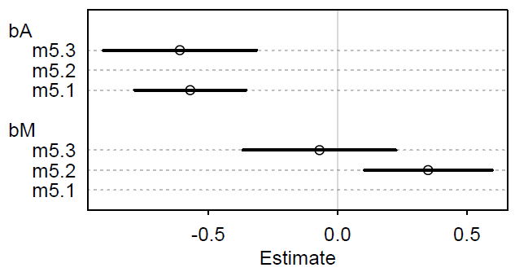
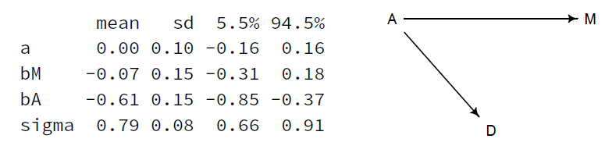
Case study 2 : Marriage age, rate and Divorce rate
Ch. 5
Result
As seen in the chart, the β_{A}, slope of the marriage age, shows negative posterior distribution both in m5.1 and 5.3 while the β_{M}, slope of the marriage rate, moves to the zero in multiple regression compared to the single regression.
Such shift indicates that the marriage rate cannot be the direct common cause of the divorce rate. The DAG should be modified as in the bottom; no direct causal relationship between M and D. They are just associated through median marriage age.
This is why the multiple regression is useful; it can show us the genuine causal relationship between predictors and posterior.
Once we know the A, M has little value to produce the posterior distribution. In contrast, A is still valuable in case where we know the M to get D.

Slide 16
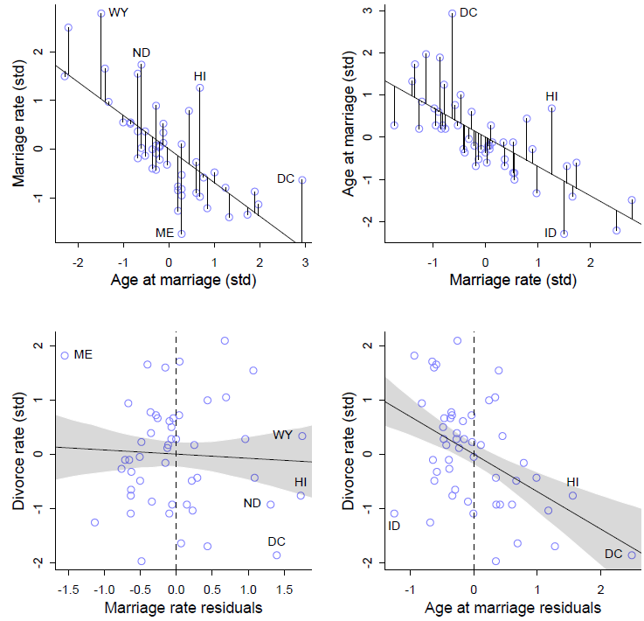
Case study 2 : Marriage age, rate and Divorce rate
Ch. 5
Posterior Predictions Plotting
We have lots of options to plot the posterior predictions, so we will introduce 3 representative methods : predictor residual, counterfactual and posterior prediction plots.
The graph beside shows predictor residual plots. Regressing the predictor on other predictors, we can calculate the residual of the predictor and regress outcome on residuals.
The regression of the marriage rate residuals to divorce rate shows no association while the age residuals show clear negative relationship with divorce rate.
Predictor residual plots are very intuitive to evaluate the predictors, but analyzing residuals will essentially lay the wrong answer.

Slide 17
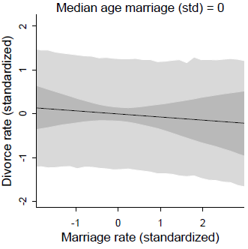
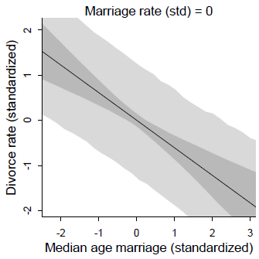
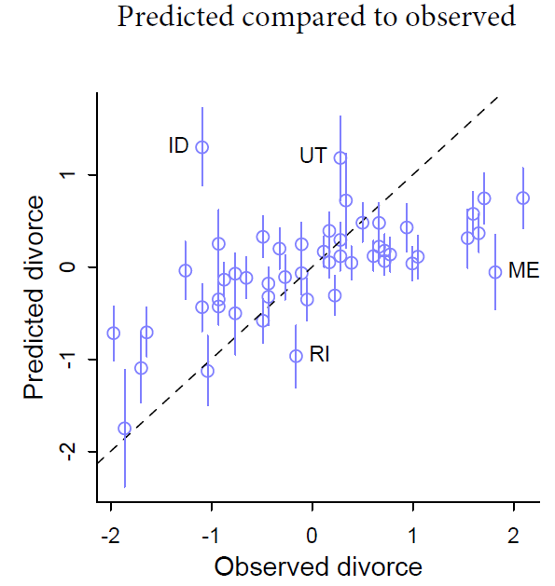
Case study 2 : Marriage age, rate and Divorce rate
Ch. 5
Posterior Predictions Plotting
The counterfactual plots hold other predictors constant and regress one predictor to the outcome. It is very useful for understanding the models, but does not give us the causal inference. It is plotted on the top.
The posterior prediction plots are somewhat different with the models before. It compares the posterior distribution of outcome from predictors with raw data, checking the model’s accuracy. It is useful to find model failures. As the slope of the graph downside goes to unity, the model fits well.

Slide 18
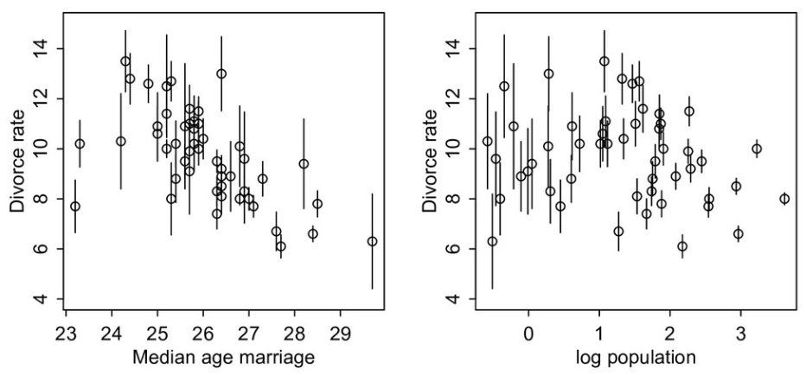
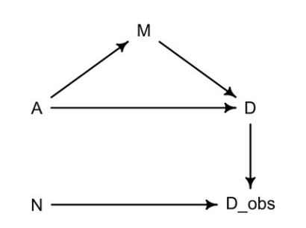
Case study 2 : Marriage age, rate and Divorce rate
Ch. 15
Relationship between divorce rate, marriage rate and median marriage age for each states
As for the small state, the standard deviation(line segment) increases due to lack of evidence
Considering the measurement error, we have to add the D_obs which states the observed divorce rate, connected with the population size of state(N) and the unknown true divorce rate D in the DAG.

Slide 19
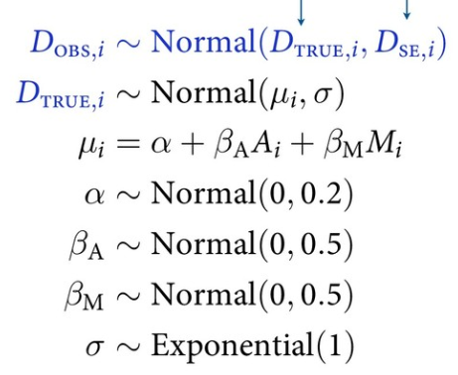
Case study 2 : Marriage age, rate and Divorce rate
Ch. 15
Keep the D_{TRUE, i} for unknown parameter, and assuming that the observed divorce rate (D_{OBS, i}) follows the normal distribution having D_{TRUE} as mean value.
D_{SE} is the standard error of observation, inversely proportional to the size of population.
A : median marriage age M : Marriage rate
m15.1

Slide 20
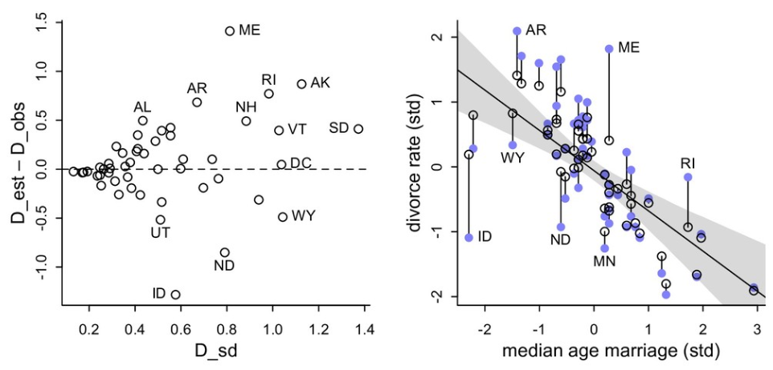
Case study 2 : Marriage age, rate and Divorce rate
Ch. 15
As in the result plot, the shrinkage happens to the regression model. (blue circle : observed data; open circle : posterior of true data)
The range of shrinkage has the tendency that as the standard deviation of the divorce rate(or the median age) increases, the shrinkage becomes more extreme.
Such tendency comes from the population of state: with lots of evidence, like in California, the observed rate and estimated rate has small difference while the small states like ID or ND in the figure shrinkages far more because of lack of evidence.

Slide 21
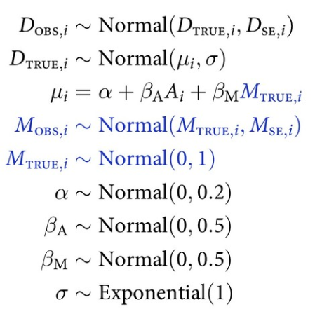
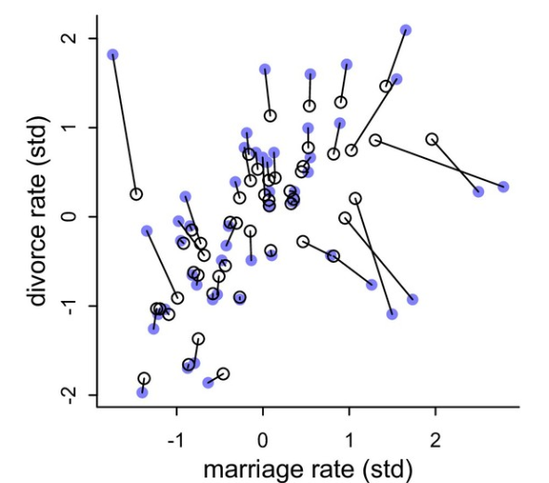
Case study 2 : Marriage age, rate and Divorce rate
Ch. 15
With just the same approach, the error on predictor can also be expressed in Stan code. Let’s consider the error in marriage rate.
As seen in the figure in bottom, the shrinkage also happens but in both horizontal and vertical direction. The point is that, although the fact that the low standard deviation makes lower shrinkage is still valid, the shrinkage rate of divorce rate and marriage rate is different.
Divorce rate shrinks more, because the marriage rate is not strongly associated with the outcome(divorce rate). Although it is the predictor and connected with the outcome in DAG, the low shrinkage means the marriage rate does not give much information through regression.
Also the model is not perfect because in this case the interaction and association between age and marriage rate is neglected.
m15.2

Slide 22
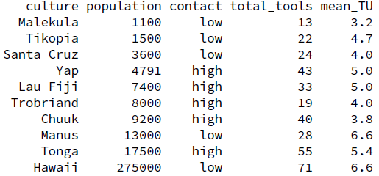
Case study 3 : Oceanic Tool Complexity
Ch. 11
Experiment
As seen in the chart, the population, contact to other islands and continents, the number of tools are searched.
Purpose
1) We want to see the relationship between the complexity of toolkit and the magnitude of population(log of population).
2) We want to see whether the contact with other islands moderates impact. If the island has high contact rate, it can possess lots of tools despite of small population size.

Slide 23
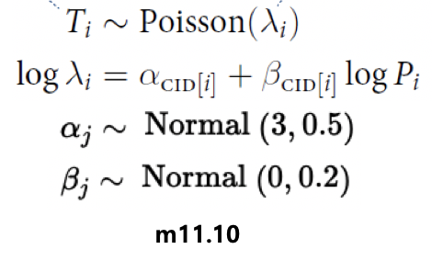
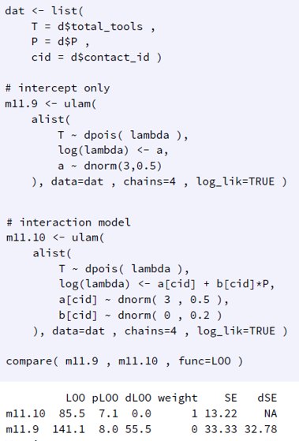
Case study 3 : Oceanic Tool Complexity
Ch. 11
Method : Poisson GLM
The tool complexity is modeled with Poisson GLM, one of the counting distribution models, which is very handy since the rate for each trial is very low although the maximum count value is unknown.
T_{i}, λ_{i}, P_{i} each means the total number of tools, expected tool numbers and population size for case i. α_{CID} and β_{CID} each indicates the intercept and slope of the model with the CID meaning contact ID. Remember that our final purpose is to check the relationship between the number of tools and population magnitude.
The code below indicates that the model with both intercept and slope shows lower pLOO, indicating less overfitting. We will use m11.10 model from now on.

Slide 24
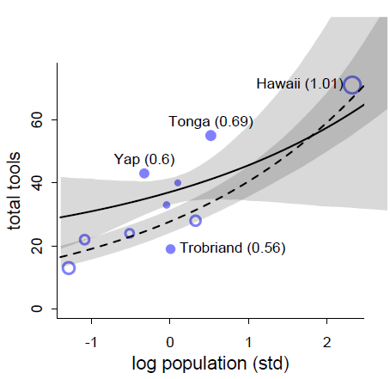
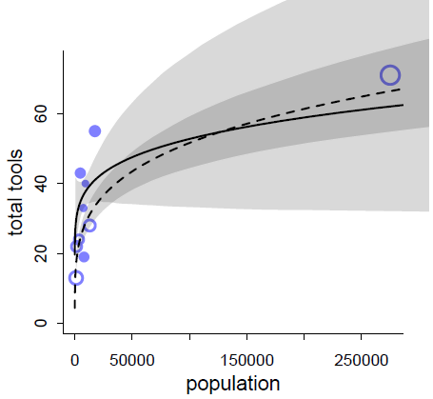
Case study 3 : Oceanic Tool Complexity
Ch. 11
Result
The chart upper left shows the relationship between log population and total tools, which we want at first. The bottom one represents it with the real population number.
The solid line and filled circle show the high-contact islands while the dashed ones show low-contact islands.
There are two main flaws in the graph based on statistical model: - The lines do not pass the origin. Zero population should indicate zero tools. - As higher the population, low-contact islands have more tools than high-contact islands. In common sense, there should be explicit difference. Such flaws come from the outfitting case of Hawaii: it has too many population but geographically has low contact.
The listed errors show the limitation of statistical model, emphasizing the necessity of introducing scientific model instead.

Slide 25

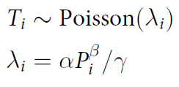
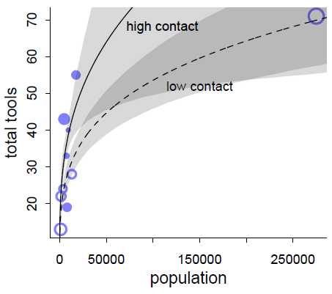
Case study 3 : Oceanic Tool Complexity
Ch.11
Result - Improved
The introduced scientific model is about the rate of number of tools change with time. α and β each shows the innovation rate and diminishing return. As the population increase, the ΔT should increase. But economically as the population reaches to certain level, the saturation effect occur and each additional person contributes less to the tool increase. That’s the diminishing return effect. γ indicates the loss rate, showing that as the tool number increases, the loss rate also increases.
At the steady state, the λ_{i} is determined as left, which did not include any ad hoc link functions. With the new scientific model, the bottom left lines are drawn. Since the values are scientifically derived, the two flaws in the statistical models are clearly solved. It passes origin and shows clear difference.
As the result, although it contains some flaws too, scientific model can be more useful than statistical model in some case where some outliners exist in the data.

Slide 26
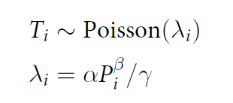
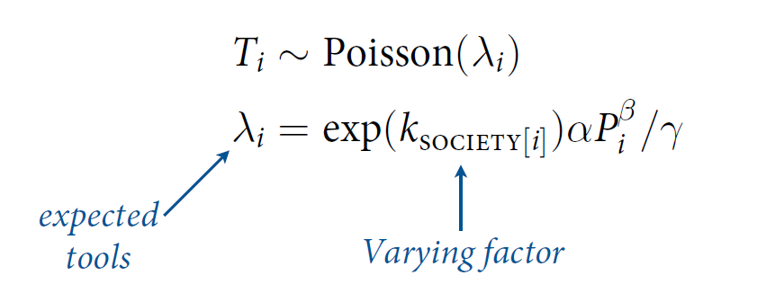
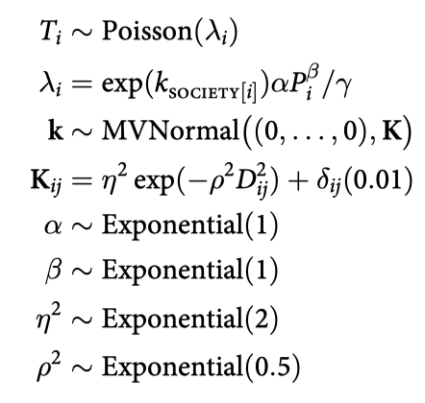
Case study 3 : Oceanic Tool Complexity
Ch.14
5. New method
We added varying intercepts term to our model.
Varying intercepts are estimated in light of geographic distance. Not distinct category membership like in typical varying intercepts but as a form of correlation matrix.
m14.7

Slide 27
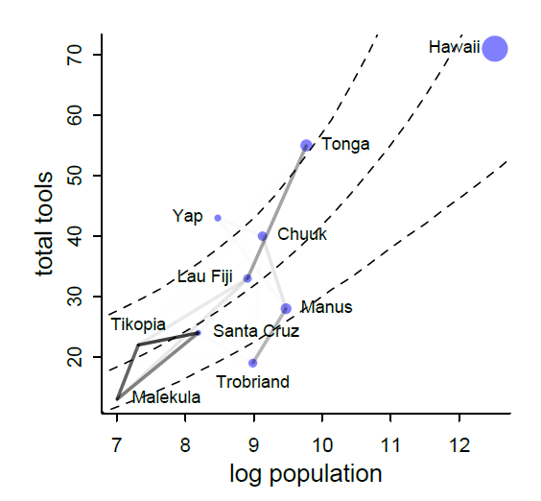
Case study 3 : Oceanic Tool Complexity
Ch.14
New result
Graph on the left shows the results. The size of each dots indicate population of the island. Darker lines indicate stronger correlations, with pure white being zero correlation and pure black 100% correlation.
Looking at the correlations among Malekula, Tikopia, and Santa Cruz describe the fact that they are below the expected number of tools for their populations. All three societies lying below the expectation and being so close, is consistent with spatial covariance.
Tonga has more tools than expected for its population, and its proximity to Fiji counteracts some of the tug Fiji’s smaller neighbors—Malekula, Tikopia, and Santa Cruz—exert on it. So the model seems to think Fiji would have fewer tools, if it weren’t for Tonga.
Of course the correlations that this model describes by geographic distance may be the of other, unmeasured commonalities between geographically close societies.

Slide 28
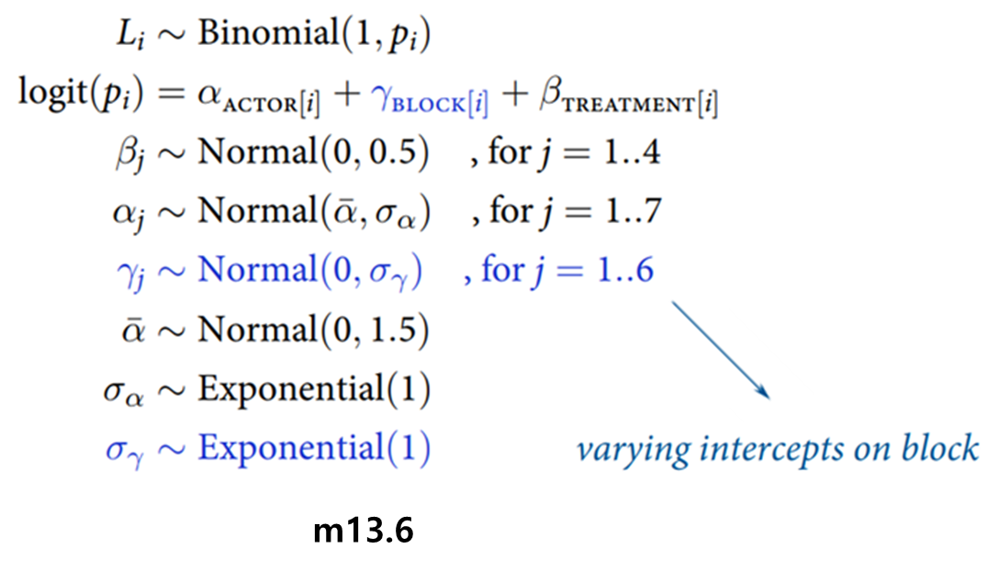
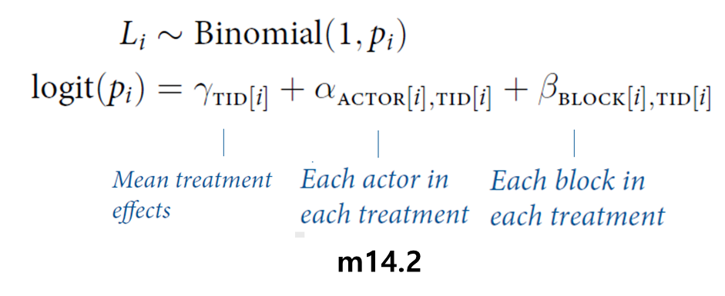
Appendix : Model Codes
Chimpanzee models

Slide 29
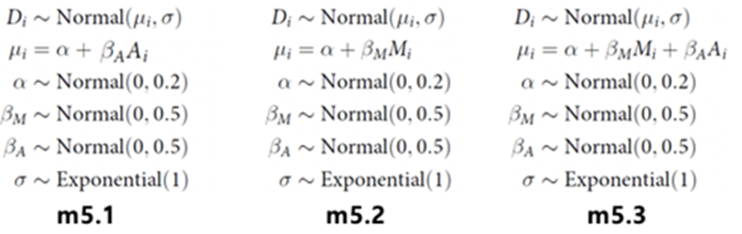
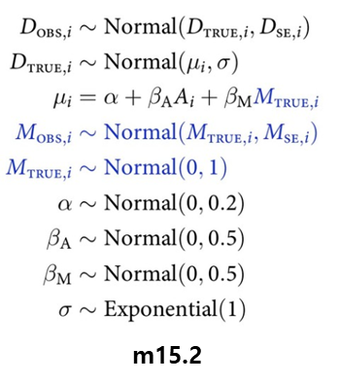
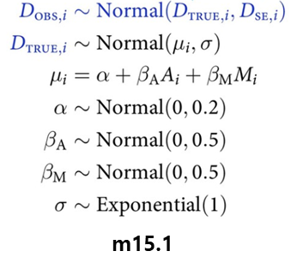
Appendix : Model Codes
Divorce rate models

Slide 30
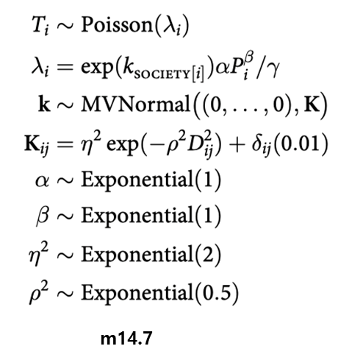
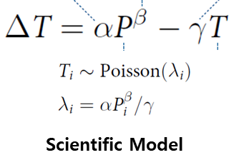
Appendix : Model Codes
Oceanic Tool models

Slide 31

Thank You
StanKorea

