Slide 1
OOP Project3
Pokémon

Slide 2

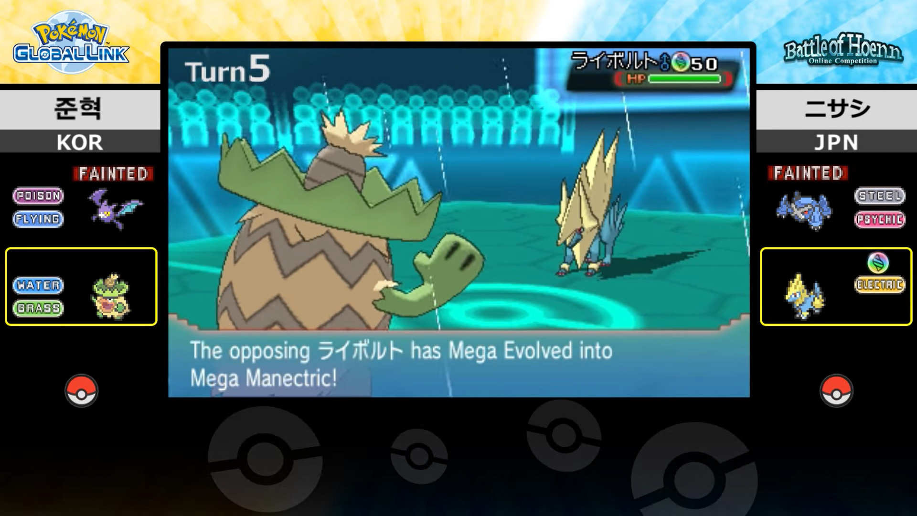
What is Pokémon?
https://play.pokemonshowdown.com/
https://www.youtube.com/watch?v=AsFKC4F4wEo&ab_channel=TheOfficialPok%C3%A9monYouTubechannel

Slide 3
Goal
Create a Pokémon 3 vs 3 battle game!
Learn how to use OOP skills in a system.

Slide 4
Flowchart
Each turn will follow the following flow:
The detailed Damage Calc is following:
Battle
Use a move
First Pokémon Damage Calc*
Second Pokémon Damage Calc*
B&P*
Swap / Use a potion
*: Check for fainting after this move
Damage Calc
Type Effectiveness
Critical Hit
Additional Effect
Fainting?
Additional Effect (Status Move)

Slide 5

Pokémon
Name Charizard
Type Fire & Flying
Stat
HP 185
Attack (Atk) 149
Defense (Def) 143
Special Attack (Sp.Atk) 177
Special Defense (Sp.Def) 150
Speed 167

Slide 6

Who first?
Speed 167
Move First
Speed 143

Slide 7
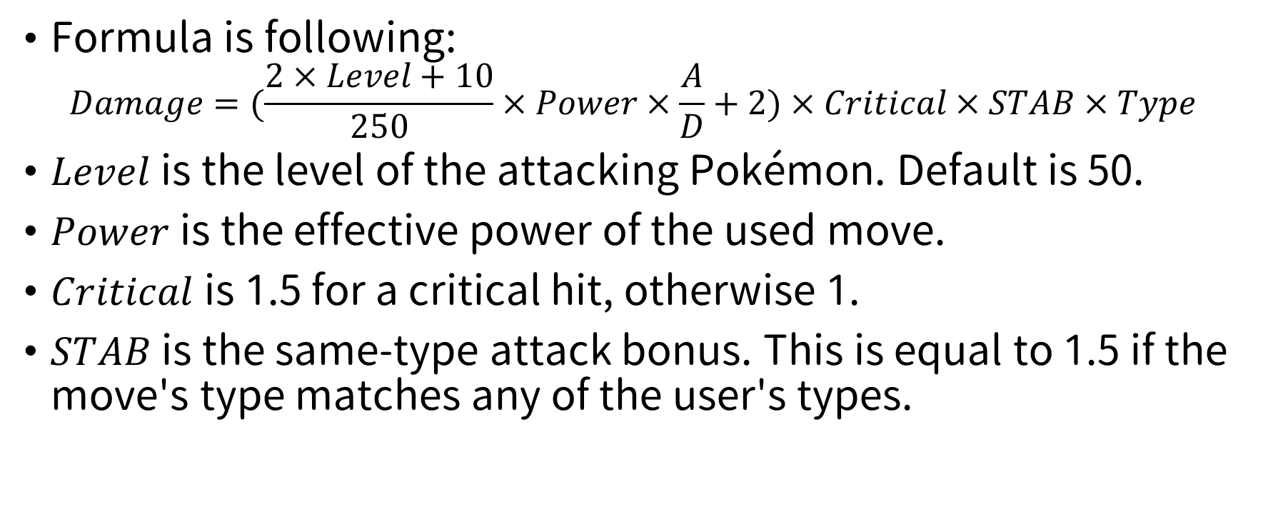
Damage calculation
Formula is following:
$$Damage=(\frac{2×Level+10}{250}×Power×\frac{A}{D}+2)×Critical×STAB×Type$$
$Level$ is the level of the attacking Pokémon. Default is 50.
$Power$is the effective power of the used move.
$Critical$ is 1.5 for a critical hit, otherwise 1.
$STAB$ is the same-type attack bonus. This is equal to 1.5 if the move's type matches any of the user's types.

Slide 8
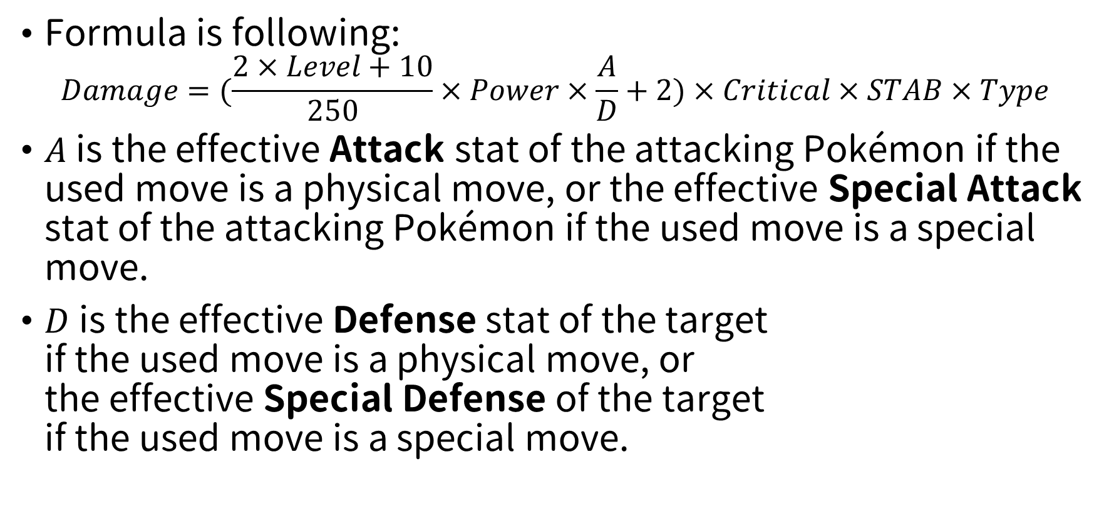
Damage calculation
Formula is following:
$$Damage=(\frac{2×Level+10}{250}×Power×\frac{A}{D}+2)×Critical×STAB×Type$$
$A$is the effective Attack stat of the attacking Pokémon if the used move is a physical move, or the effective Special Attack stat of the attacking Pokémon if the used move is a special move.
$D$is the effective Defense stat of the target if the used move is a physical move, or the effective Special Defense of the target if the used move is a special move.
Damage categories
Physical
Special
Status

Slide 9
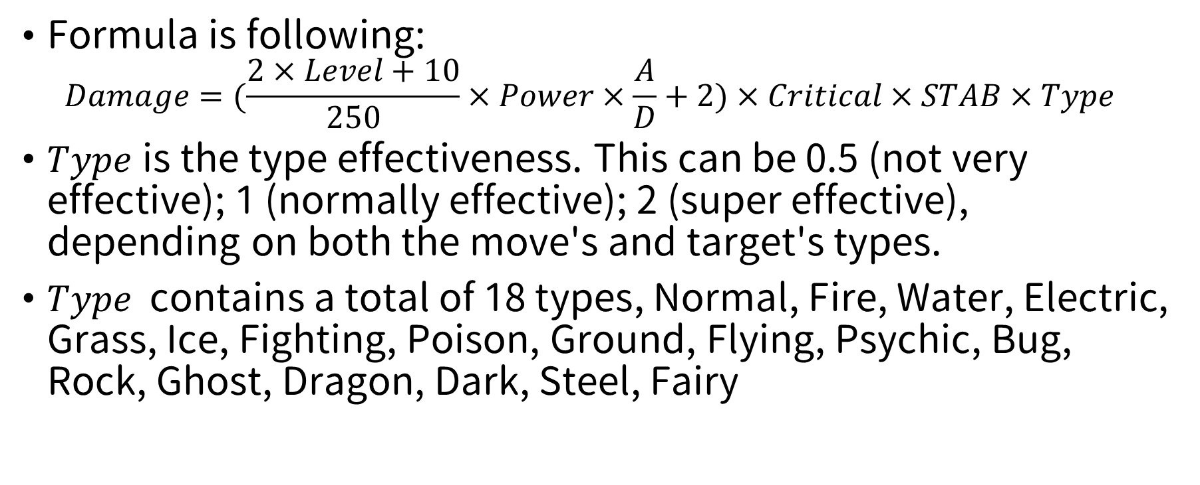
Damage calculation
Formula is following:
$$Damage=(\frac{2×Level+10}{250}×Power×\frac{A}{D}+2)×Critical×STAB×Type$$
$Type$ is the type effectiveness. This can be 0.5 (not very effective); 1 (normally effective); 2 (super effective), depending on both the move's and target's types.
$Type$contains a total of 18 types, Normal, Fire, Water, Electric, Grass, Ice, Fighting, Poison, Ground, Flying, Psychic, Bug, Rock, Ghost, Dragon, Dark, Steel, Fairy
Notes:
url: https://bulbapedia.bulbagarden.net/wiki/Damage

Slide 10
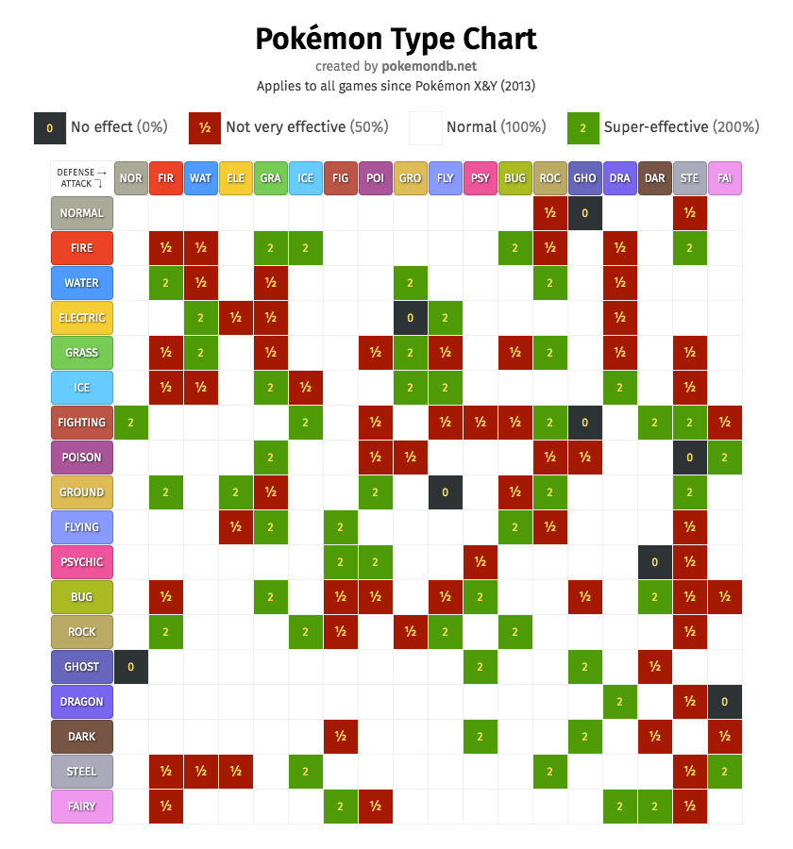
Type effectiveness
Types are properties applied to Pokémon and their moves, which affect the power of moves in battles.
For example, using a Fire-type move will cause double damage to a Steel-type Pokémon, and using an Electric-type move will do no damage to a Ground-type Pokémon

Slide 11
Type effectiveness
Some Pokémon have two types, for example, Charizard are Fire-type and Flying-type Pokémon, which is called dual-type
Using Grass-type moves will cause 4 times the damage of Water-type and Ground-type dual-type Pokémon.

Slide 12
Type effectiveness
When in state Type Effectiveness, output according to the following rules:
When the effect is greater than or equal to twice, output: It's super effective!
When the effect is less than or equal to 1/2 times, output: It's not very effective...
When the effect does no damage, output: It's not effective!

Slide 13
Status move
The status move category includes several moves that do not directly inflict damage, unlike physical and special moves.
For instance, PoisonPowder is a status move: [Turn 2] Venusaur used PoisonPowder! [Turn 2] The opposing Blastoise was poisoned!
Damage categories
Physical
Special
Status

Slide 14
Accuracy
Accuracy is a property of moves that, in conjunction with the user's in-battle accuracy stat and the target's evasion stat, determines how likely a move is to hit.
100% Accuracy rate in Test Mode
When the target is not hit, output: <Pokémon> avoided the attack!

Slide 15
Critical hit
A critical hit is a (generally) random event that multiplies the damage of a damage-dealing move.
0% in Test Mode
When stated at Critical Hit, output: A critical hit!
Notes:
url: https://youtu.be/5zG4Qb30HqU?t=766

Slide 16
Turn
You should output the number of turns before all output.
For examples: [Turn 1] Venusaur used VineWhip! [Turn 7] You used a Hyper Potion! [Turn 13] You win

Slide 17
<Pokémon>
In order to distinguish the player's Pokémon from the opponent's, <Pokémon> outputs the name of the player's Pokémon, and the opponent needs to output “The opposing Pokémon”
For examples: [Turn 2] Venusaur used VineWhip! [Turn 3] The opposing Blastoise used AquaTail!

Slide 18
PP (Power Point)
PP, short for Power Point, is the energy that a Pokémon requires in order to perform a move.
It costs 1 PP to use a move, so the PP a move has remaining is essentially equivalent to the number of times that move can be used.
Regardless of whether the move is used successfully or not, when the round ends, PP will cost 1.
The PP of each Pokémon is calculated independently.
When Pokémon uses a move, output: <Pokémon> used <Move>!

Slide 19
Status condition
Paralysis
Burn
Poison
Even if it is swapped, the Pokémon's state will remain but not be damaged.
Notes:
url: https://bulbapedia.bulbagarden.net/wiki/Status_condition

Slide 20
Paralysis
The paralysis condition (PAR) reduces 50% the Pokémon’s Speed stat and causes it to have a 25% chance of being unable to use a move.
When stated at Additional Effect, output: <Pokémon> is paralyzed, so it may be unable to move!
When using a move in a paralyzed state, output: <Pokémon> is paralyzed! It can't move!
Notes:
url: https://bulbapedia.bulbagarden.net/wiki/Cheri_Berry

Slide 21
Burn
The burn condition (BRN) inflicts damage equal to 1/16 of its maximum HP every turn
When stated at Additional Effect, output: <Pokémon> was burned!
When stated at B&P, output: <Pokémon> is hurt by its burn!
Notes:
Heal Bell: https://bulbapedia.bulbagarden.net/wiki/Heal_Bell_(move)#:~:text=Heal%20Bell%20cures%20the%20user,Ability%20Soundproof%2C%20including%20inactive%20Pok%C3%A9mon.
Aromatherapy: https://bulbapedia.bulbagarden.net/wiki/Aromatherapy_(move)

Slide 22
Poison
The poison condition (PSN) inflicts damage equal to 1/16 of its maximum HP every turn.
When stated at Additional Effect, output: <Pokémon> was poisoned!
When stated at B&P, output: <Pokémon> is hurt by its poisoning!
Notes:
https://youtu.be/i45aGNSvpZ4?t=7443

Slide 23




Potion
Potion heals the Pokémon by 20 HP.
Super Potion heals the Pokémon by 60 HP.
Hyper Potion heals the Pokémon by 120 HP.
Max Potion heals the Pokémon to its full HP.
Potion
Super Potion
Hyper Potion
Max Potion

Slide 24
Potion
Any potion must be used before the opponent's moves, and the player cannot make moves in this round.
The usage of any potion must be faster than the opponent.
When the player uses any potion, output: You used a <Potion>! <Pokémon> had its HP restored.
Potion
Super Potion
Hyper Potion
Max Potion

Slide 25
Swap Pokémon
Before making a move, you can choose to swap Pokémon into the battle.
The speed of swapping must be faster than the opponent.
When swapping a Pokémon, output: <Pokémon>, switch out! Come back! Go! <Pokémon>!

Slide 26
Fainting
Fainting is a status condition in which a Pokémon is no longer able to battle.
A Pokémon is considered fainted when its HP is less than 0.
When a player's Pokémon faints, the player must swap an unfainted Pokémon into the battle. After the player swaps a fainted Pokémon, output: Go! <Pokémon>!

Slide 27
Victory or defeat
During a battle, if all Pokémon in a Trainer's party have fainted, the Trainer loses that battle.
When the opponent loses the battle, output: You win
When the player loses the battle, output: You lose

Slide 28
Grading
Basic requirements 80%
Load data (Pokémon, moves, and game) 10%
Output 10%
3 vs 3 game 10%
PP (Power Point) 10%
Status condition (Paralysis, Burn, and Poison) 10%
Physical or special move 5%
Speed (who go first) 5%
Type effectiveness 5%
Swap Pokémon 5%

Slide 29
Grading
Basic requirements (Cont.) 80%
Potion 5%
Victory or defeat 5%
Extra functions 40% (Maximum)
GUI 15%
Accuracy 5%
Critical hit 5%
Audio 5%
RPG 10%
Others 3% (per each)

Slide 30
Load data
Pokémon data
Move data
Game data
Test Case

Slide 31
Pokémon data format
You need to implement loading the file that stores all the Pokémon information.
<Pokémon> is the name of Pokémon, and Tn means how many types it is.
Input:
<Pokémon>
Tn Type Type
HP Atk Def Sp.Atk Sp.Def Speed
Sample Input: PokemonLib.txt
Venusaur
2 Grass Poison
187 147 148 167 167 145
Charizard
2 Fire Flying
185 149 143 177 150 167
Blastoise
1 Water
186 148 167 150 172 143

Slide 32
Move data format
You need to implement loading the file that stores all the move information.
Move is the name of the move, and P/Sp/St means the move is physical, special, or status.
Input:
Move Type P/Sp/St power accuracy PP <Con>
Sample Input: MoveLib.txt
DragonClaw Dragon Physical 80 100 15
Ember Fire Special 40 100 25
DragonBreath Dragon Special 60 100 20 PAR
AirSlash Flying Physical 75 95 15
Flamethrower Fire Special 90 100 15 BRN
FlashCannon Steel Special 80 100 10
WaterGun Water Special 40 100 25
WaterPulse Water Special 60 100 20
AquaTail Water Physical 90 90 10
PoisonPowder Poison Status 0 75 35 PSN
SeedBomb Grass Physical 80 100 15
VineWhip Grass Physical 45 100 25
SolarBeam Grass Special 120 100 10
Damage categories
Physical
Special
Status

Slide 33
Move data format
power is an integer.
accuracy is an integer between 0~100.
PP is an integer.
<Con> is an additional effect, which can be PAR, BRN, or PSN.
Input:
Move Type P/Sp/St power accuracy PP <Con>
Sample Input: MoveLib.txt
DragonClaw Dragon Physical 80 100 15
Ember Fire Special 40 100 25
DragonBreath Dragon Special 60 100 20 PAR
AirSlash Flying Physical 75 95 15
Flamethrower Fire Special 90 100 15 BRN
FlashCannon Steel Special 80 100 10
WaterGun Water Special 40 100 25
WaterPulse Water Special 60 100 20
AquaTail Water Physical 90 90 10
PoisonPowder Poison Status 0 75 35 PSN
SeedBomb Grass Physical 80 100 15
VineWhip Grass Physical 45 100 25
SolarBeam Grass Special 120 100 10

Slide 34

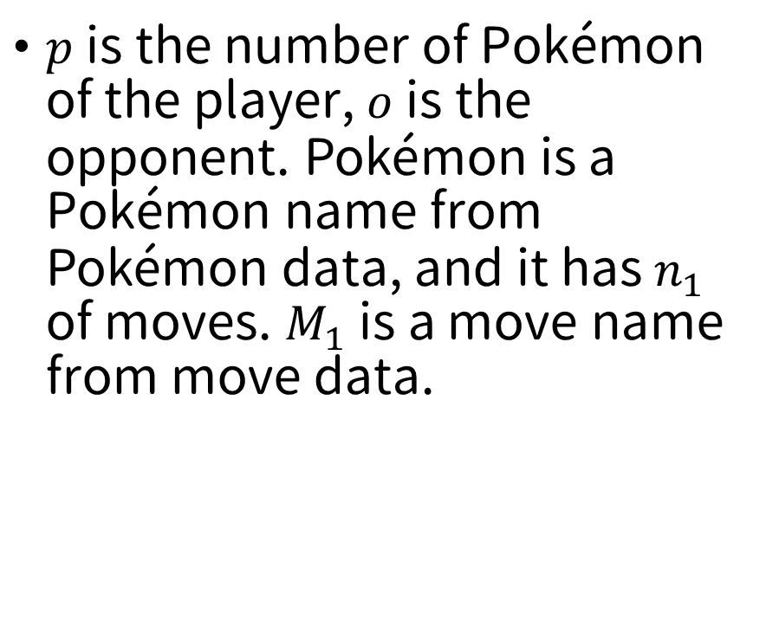
Game data format
$p$ is the number of Pokémon of the player, $o$ is the opponent. $\text{Pok}\text{é}\text{mon}$ is a Pokémon name from $\text{Pok}\text{é}\text{mon}$ data, and it has $n_{1}$ of moves. $M_{1}$ is a move name from move data.
Input:
$$p$$
$${\text{Pok}\text{é}\text{mon}}_{1} n_{1}$$
$$M_{1}…M_{n_{1}}$$
$$…$$
$${\text{Pok}\text{é}\text{mon}}_{p} n_{p}$$
$$M_{1}…M_{n_{p}}$$
$$o$$
$${\text{Pok}\text{é}\text{mon}}_{1} n_{1}$$
$$M_{1}…M_{n_{1}}$$
$$…$$
$${\text{Pok}\text{é}\text{mon}}_{p} n_{o}$$
$$M_{1}…M_{n_{o}}$$

Slide 35
Game data format
You need to implement loading the file that stores the information about this battle.
Sample Input: GameData.txt
3
Venusaur 4
PoisonPowder VineWhip SeedBomb SolarBeam
Charizard 4
Ember Flamethrower DragonBreath AirSlash
Blastoise 4
FlashCannon WaterGun WaterPulse AquaTail
3
Blastoise 4
FlashCannon WaterGun WaterPulse AquaTail
Charizard 4
DragonClaw Flamethrower DragonBreath AirSlash
Venusaur 4
PoisonPowder VineWhip SeedBomb SolarBeam

Slide 36
Test Case format
You need to implement a function that can read the command file
PokemonLib.txt is Pokémon data, MoveLib.txt is Move data, and GameData.txt is Game data
Test means Test Mode.
Sample Input: case.txt
PokemonLib.txt
MoveLib.txt
GameData.txt
Test
Battle
VineWhip
WaterGun
Battle
PoisonPowder
FlashCannon
Bag
Potion
Venusaur
WaterPulse
Status
Check
Pokemon
Blastoise
FlashCannon
Status
Run

Slide 37
Command
Battle The next line is a name of the player’s Pokémon move, followed by the opponent’s.
Bag The next line is the name of the potion, followed by the name of the player’s Pokémon. Of course, followed by the name of the opponent's move.
Pokemon The next line is the name of the player’s Pokémon, followed by the opponent’s move.

Slide 38
Command
Status Pokémon hp PAR BRN PSN Pokémon hp PAR BRN PSN For example: Venusaur 175 Blastoise 129 Venusaur 142 Blastoise 118 PSN
Check Output the moves and PP of the current player's Pokémon. For example: PoisonPowder 33 VineWhip 24 SeedBomb 15 SolarBeam 10
Run Exit application

Slide 39
Command
Test Mode
Set Accuracy 100%
Set no Critical hit
100% paralyzed if the move with paralyzed effect
100% burning if the move with burning effect
100% Poisoned if the move with poisoned effect

Slide 40
Announcement
Due at 6/15
Test case

Slide 41
FAQ
Q: What happens when the type effectiveness is x2 and x0.5?
A: Normal effective.
Q: When a Pokémon faints, whether it is yourself or the opponent, is it unconditional to switch to the second Pokémon?
A: The player must choose a Pokémon that is not fainted, and the opponent is to swap the next Pokémon unconditionally.

Slide 42
FAQ
Q: Is there a limit on the number of potions?
A: No limit.

