Slide 1
Cooking School Blog Website
Group 11: CIL Oguzhan ROOZENDAAL Martijn Temelkov Stanil

Slide 2





Object Mapping
Mongo Driver
POSTMAN
API
ROBO 3T

Slide 3
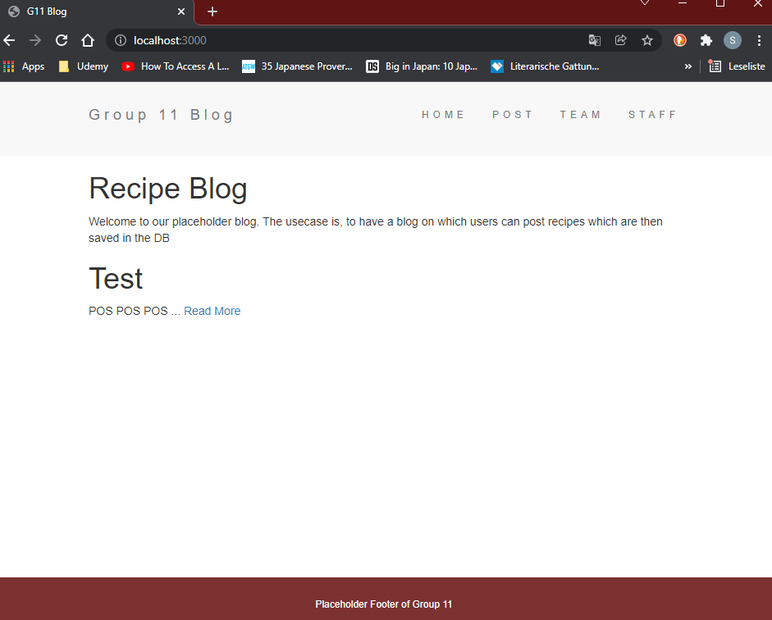

Recipe Blog

Slide 4
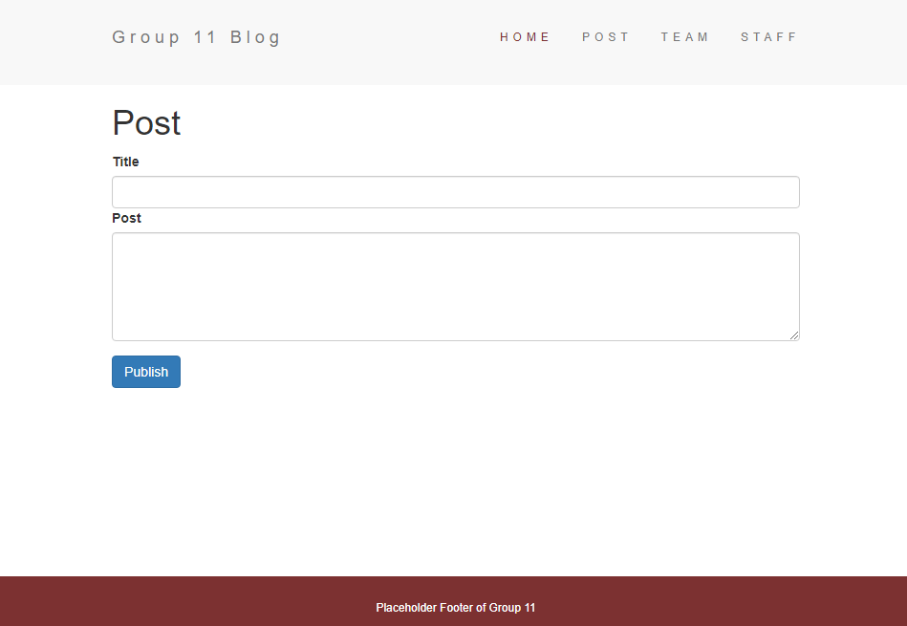
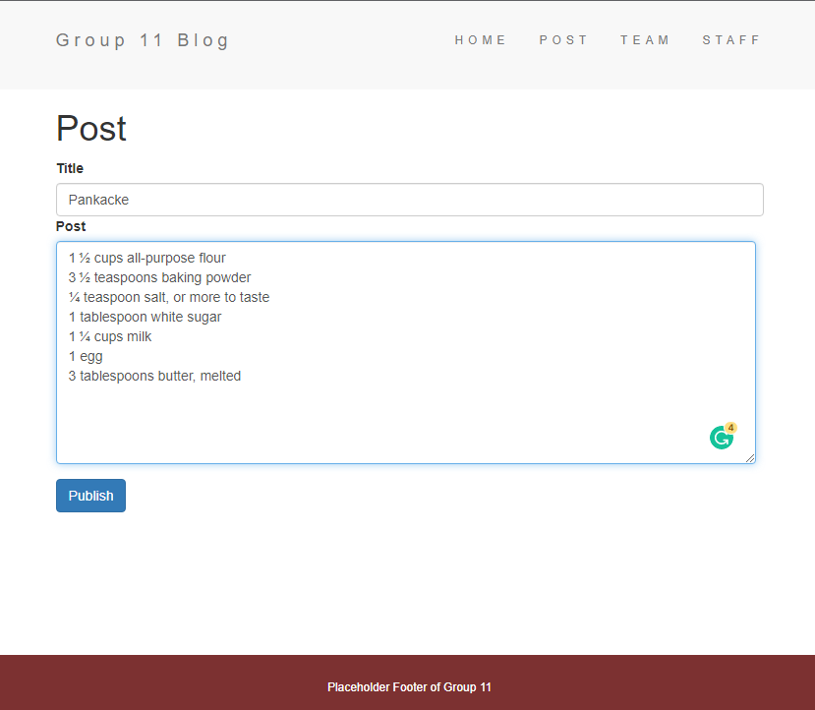
Recipe Blog

Slide 5
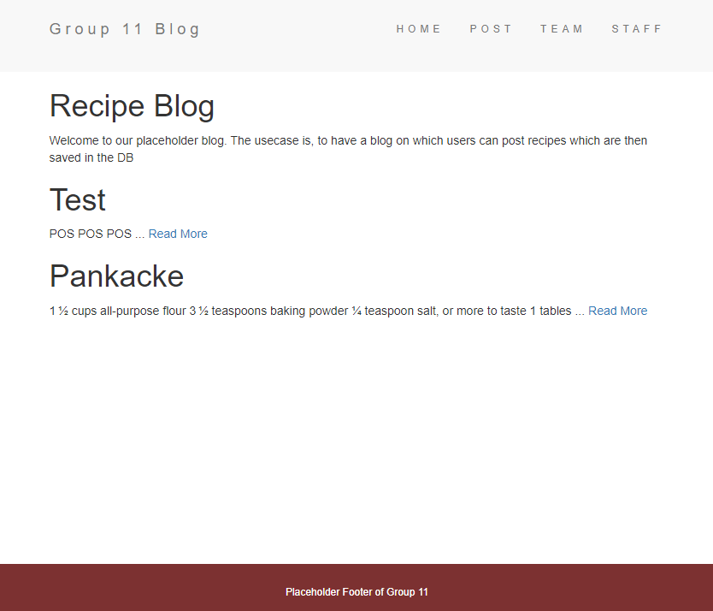
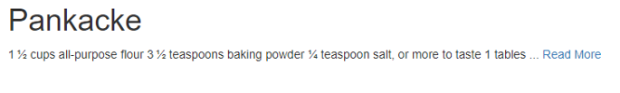

Recipe Blog

Slide 6
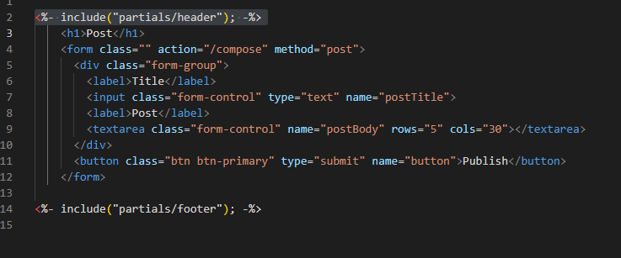
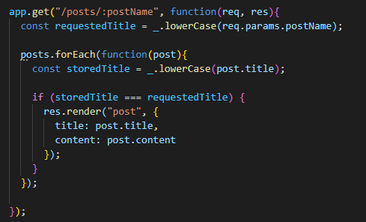
Logic
The Post Ejs
Mongo connection
Feched by the app.js

Slide 7
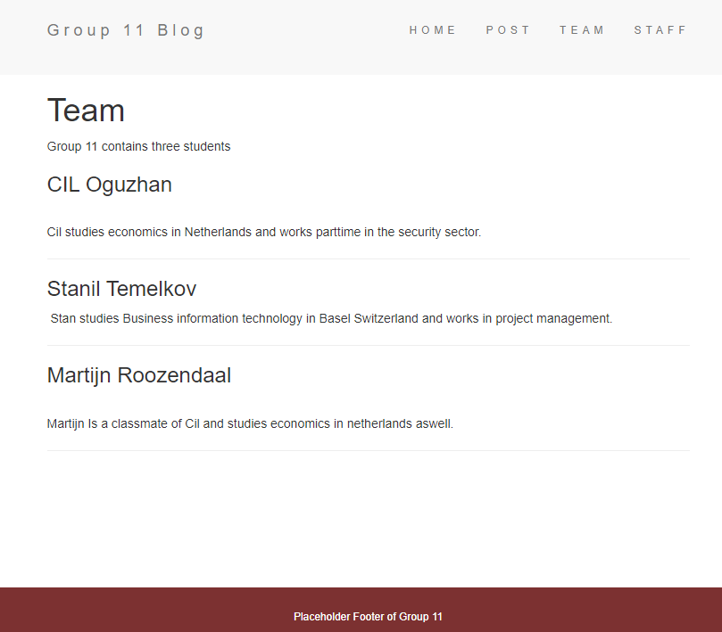
About the Team

Slide 8
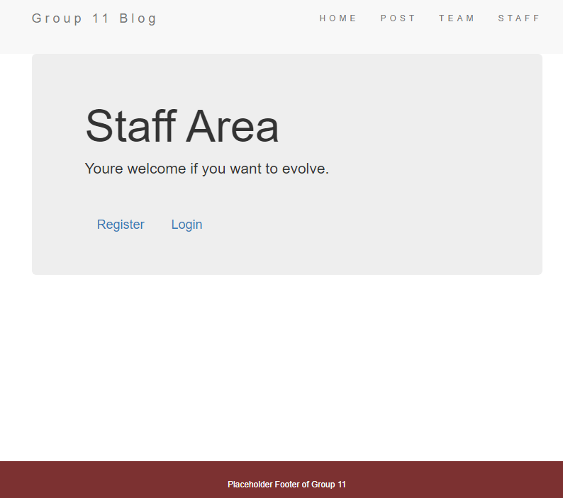
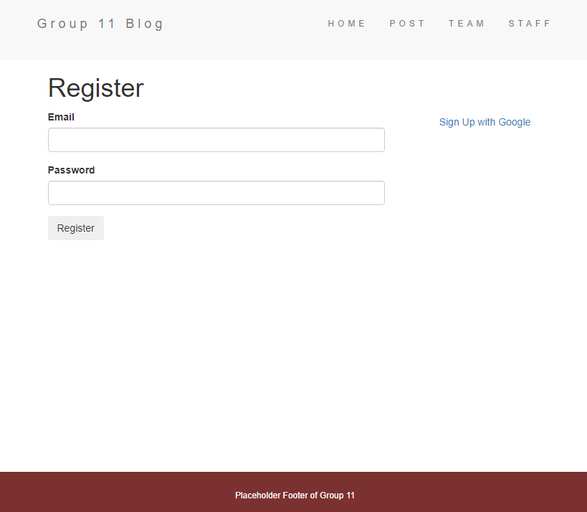
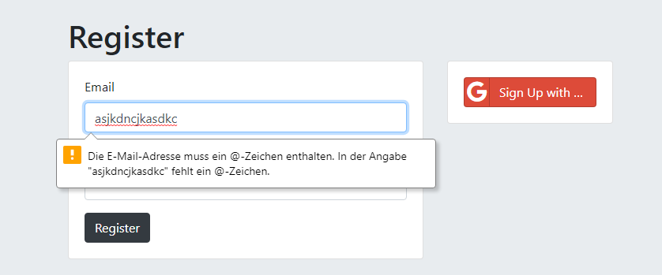
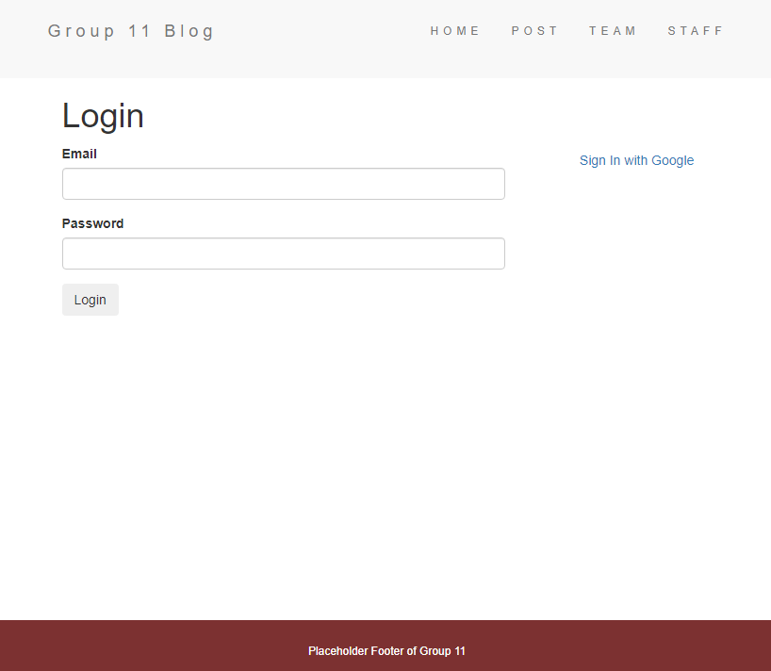
Staff Area

Slide 9
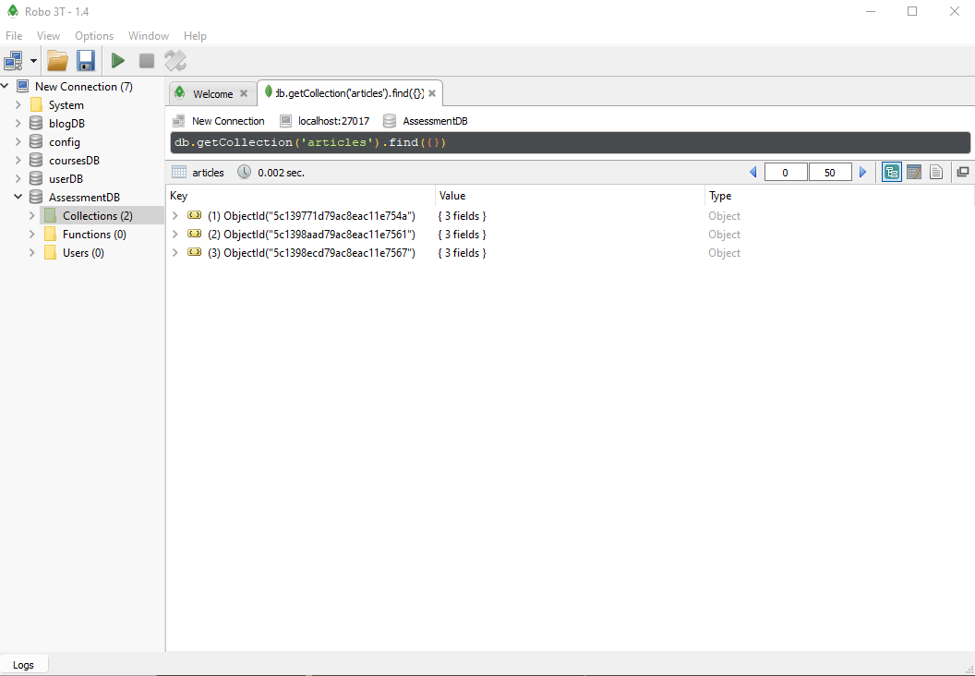
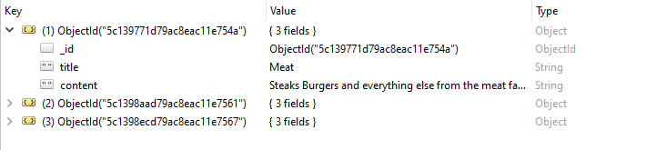
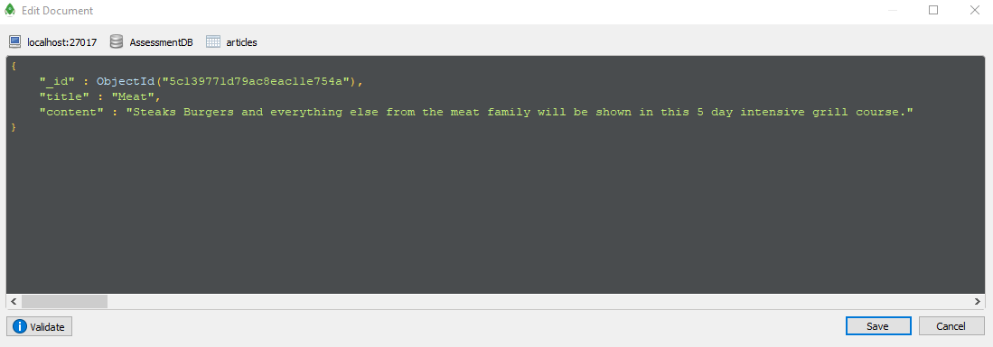
RESTful API with Robo 3T
POSTMAN
Connect API
ROBO 3T

Slide 10
Thank You

