Slide 1

A Theorem for Case Analysis
Fernando Saca
Computer Science / Philosophy
Pepperdine University

Slide 2
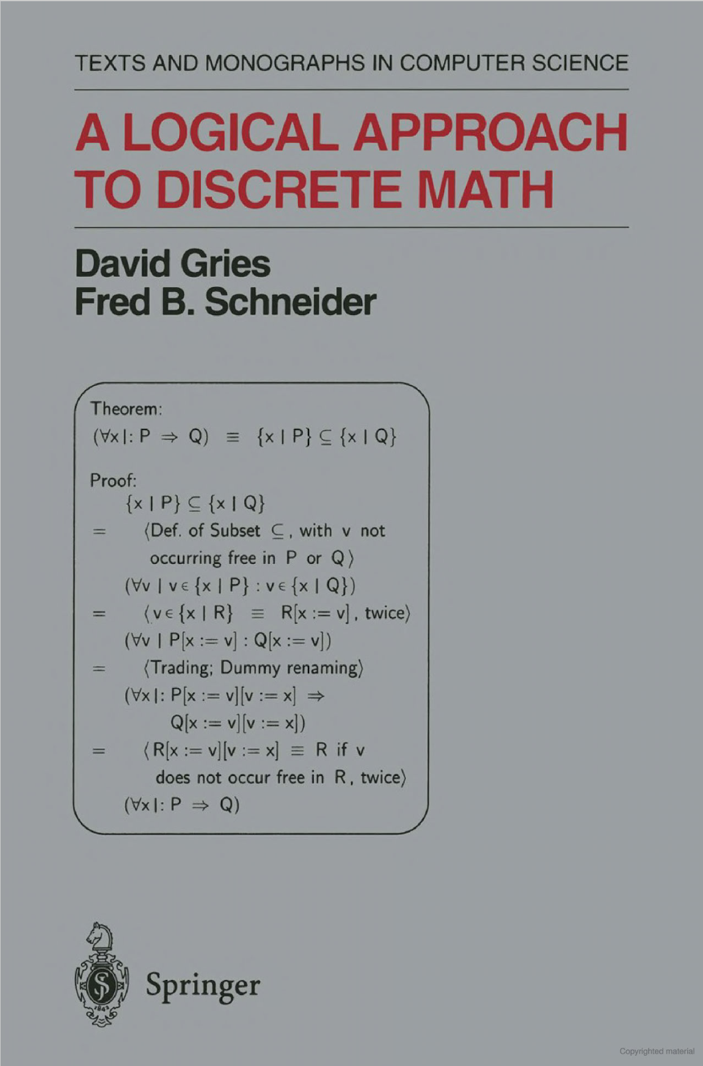
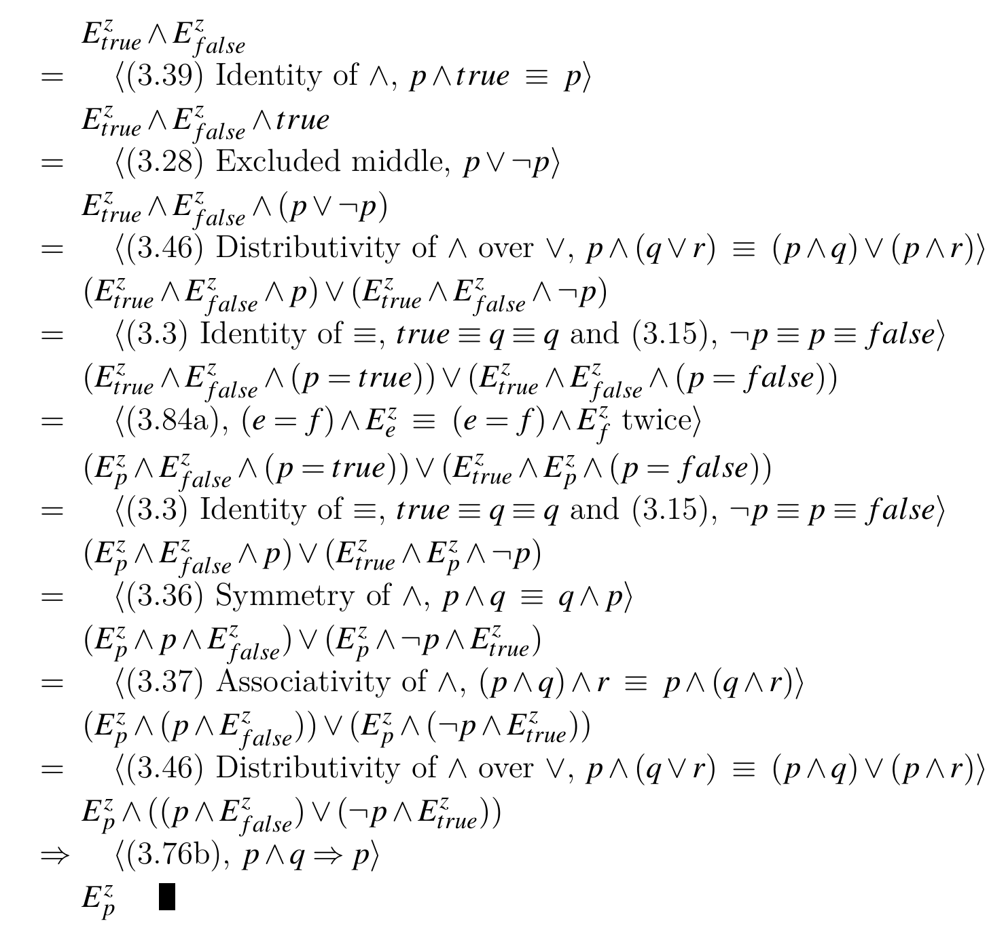
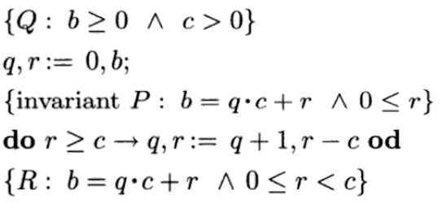

An Overview
Significance
Methodology
Results

Slide 3
Significance
Computer science
English argumentation

Slide 4
Application to Computer Science
Proving program correctness
Specifically, selective and iterative programs
Pain-free theorem verification

Slide 5
Application to English Argumentation
Solving a word problem

Slide 6
methodology
Proof calculi
Hilbert-style

Slide 7
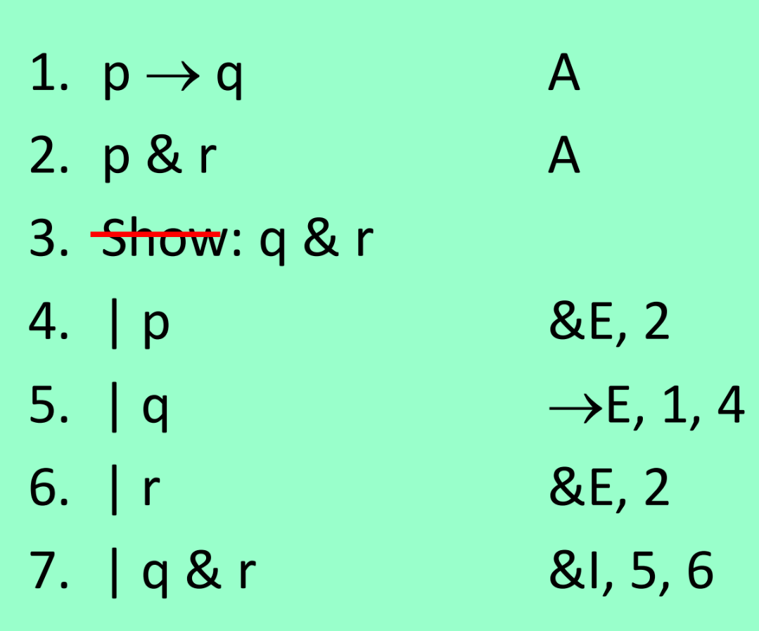
methodology
Proof calculi
Hilbert-style
Natural deduction

Slide 8
methodology
Proof calculi
Hilbert-style
Natural deduction
Equational system

Slide 9
The Equational System
Concerning inference rules and axioms, it is a balance between the other two systems
Cumulative
Neat feature worth mentioning

Slide 11
Results
Proofs
Counterexample of the converse
Implications of these results

Slide 12
Conclusion
Summarize presentation
Restate significance of work

