Slide 1

A Theorem for Case Analysis
Fernando Saca
Computer Science / Philosophy
Pepperdine University

Slide 2
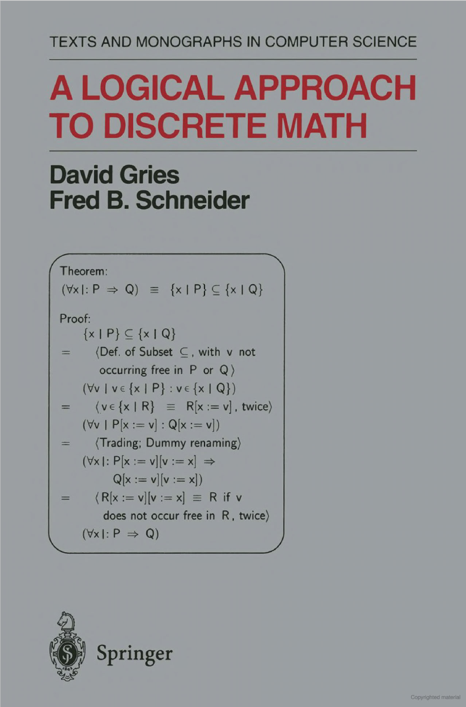
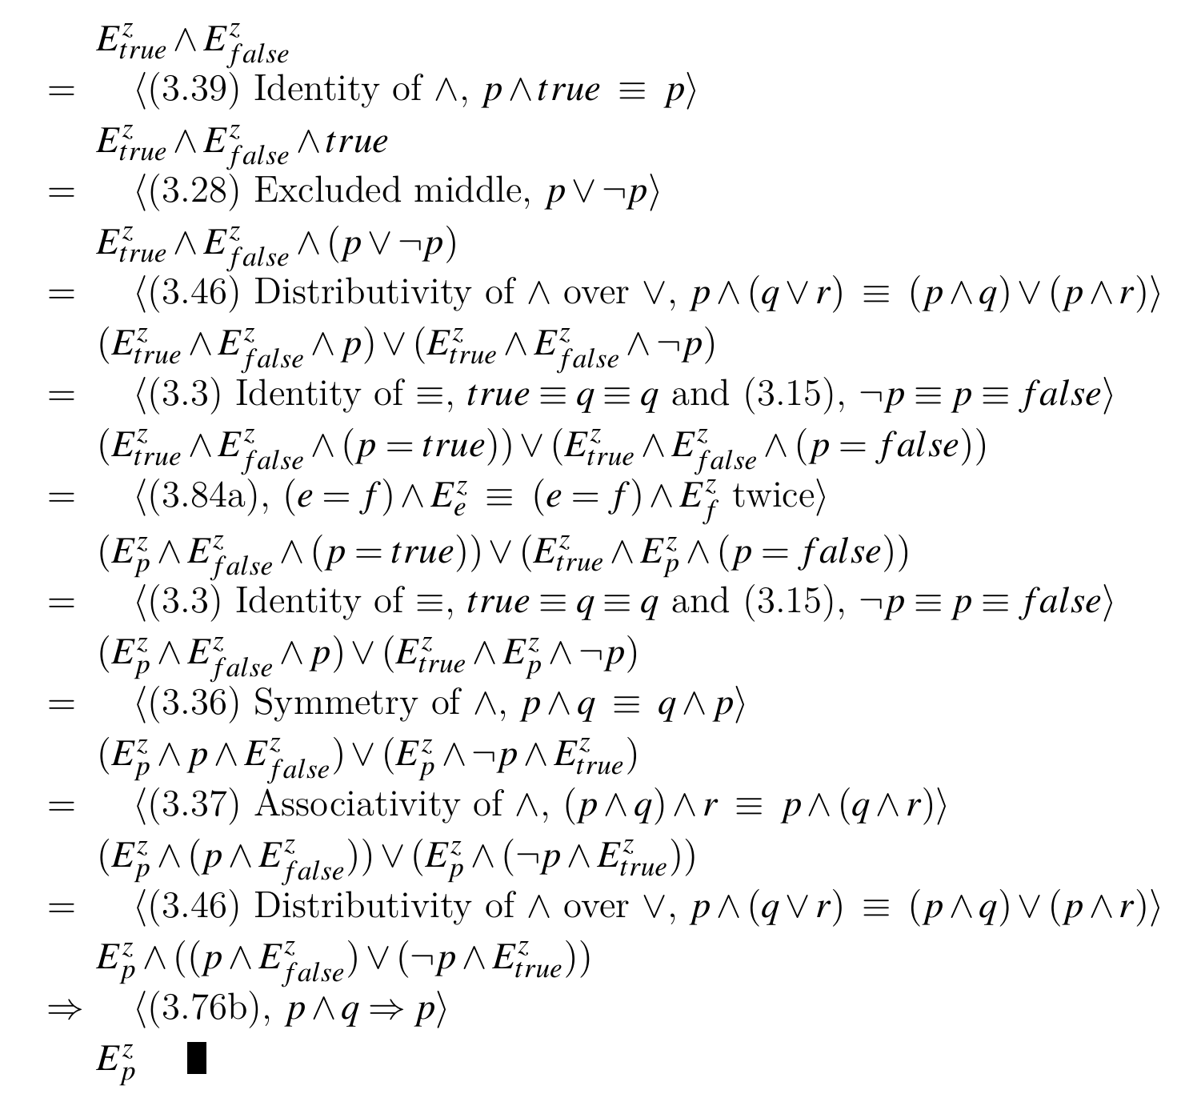
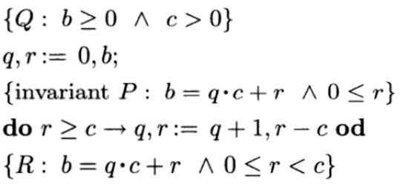

An Overview
Significance
Methodology
Results

Slide 3
Significance
Computer science
English argumentation

Slide 4
Application to Computer Science
Proving program correctness
Specifically, selective and iterative programs
Pain-free theorem verification

Slide 5
Application to English Argumentation
Solving a word problem

Slide 6
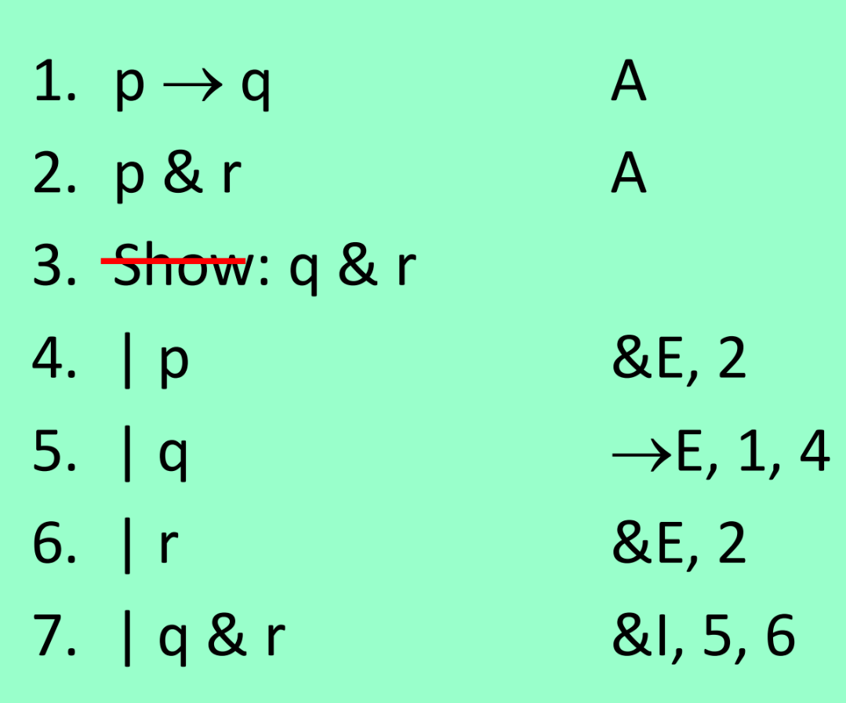
methodology
Proof calculi
Hilbert-style
Natural deduction
Equational system

Slide 8
The Equational System
Concerning inference rules and axioms, it is a balance between the other two systems
Cumulative
Neat feature worth mentioning

Slide 9
Results
Proofs
Counterexample of the converse
Implications of these results

Slide 10
Conclusion
Summarize presentation
Restate significance of work

