Slide 1

A Theorem for Case Analysis
Fernando Saca
Computer Science / Philosophy
Pepperdine University

Slide 2
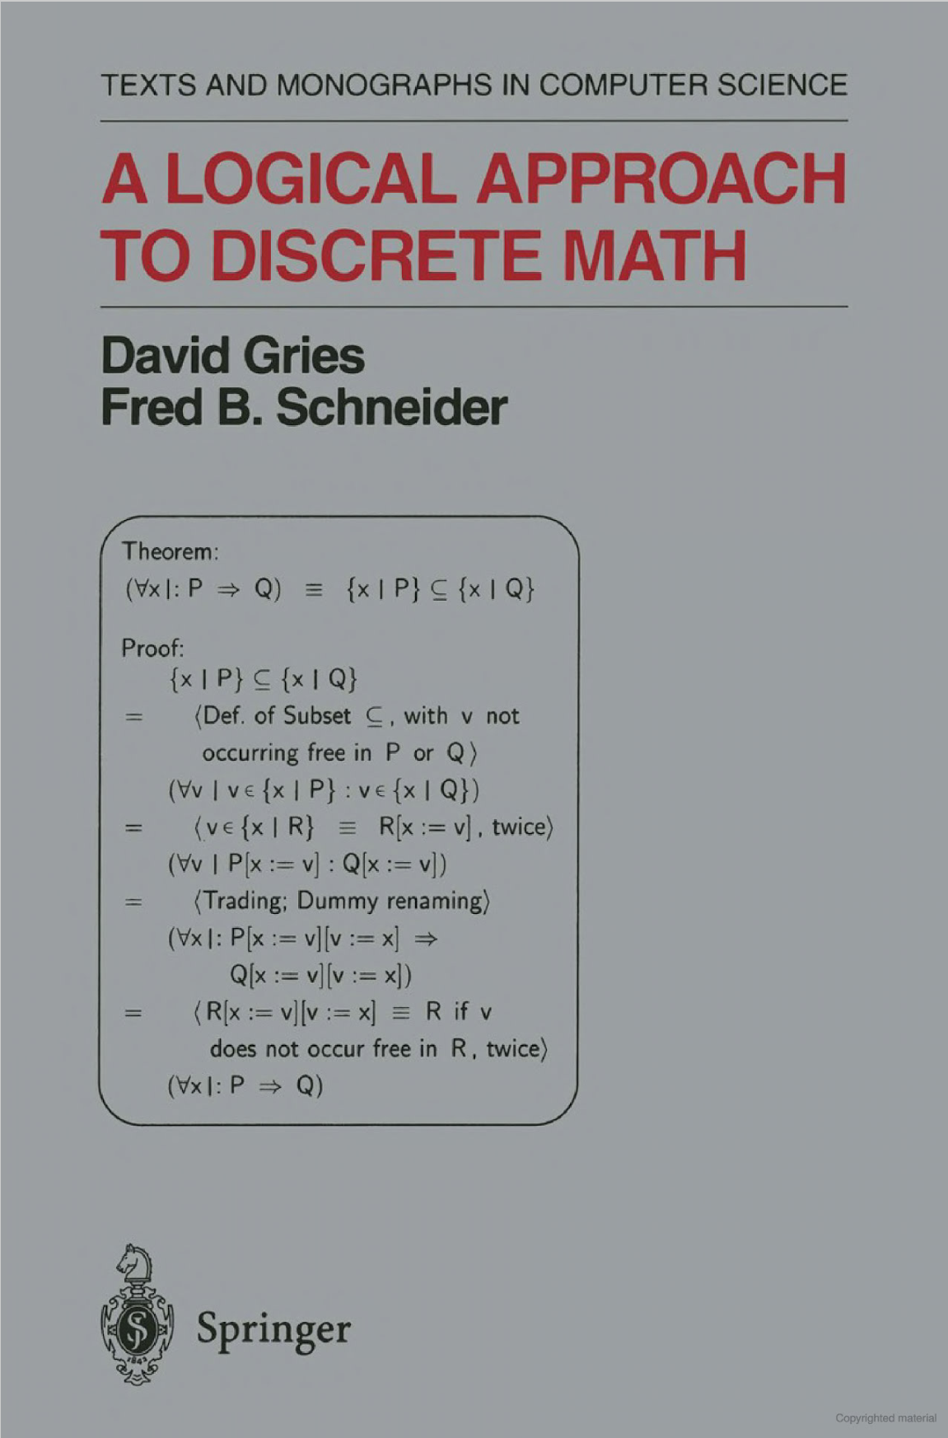
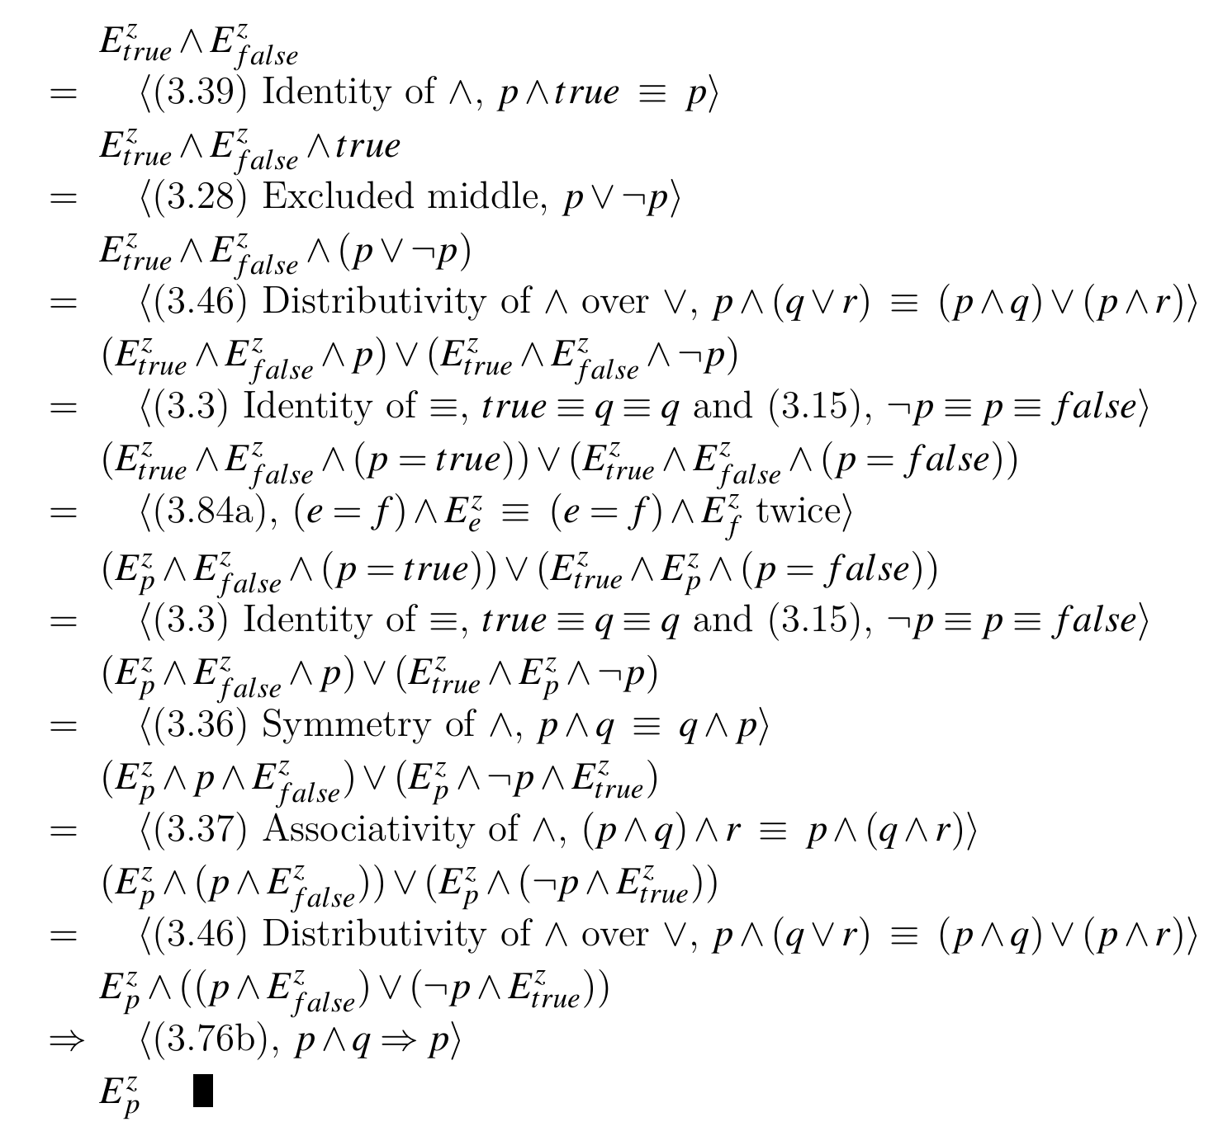
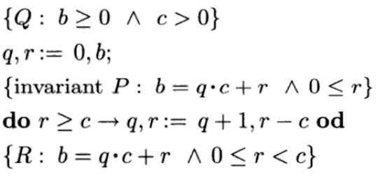

An Overview
Significance
Methodology
Results

Slide 3
Significance
Computer science
In English

Slide 4
Application to Computer Science
Proving program correctness
Specifically, selective and iterative programs
Pain-free theorem verification
Foundation for certain proof techniques

Slide 5
Example in English

Slide 6
Example in English
E: ¬¬z ≡ z
E^{z}_{true}
_{z: “The sky is blue”}
“It is not the case that the sky is not blue.”
≡
“It is the case that the sky is blue.”
E^{z}_{false}
_{z: “The sky is green”}
“It is not the case that the sky is not green.”
≡
“It is the case that the sky is green.”
E^{z}_{p}: ¬¬p ≡ p

Slide 7
methodology
Proof calculi
Hilbert-style

Slide 8
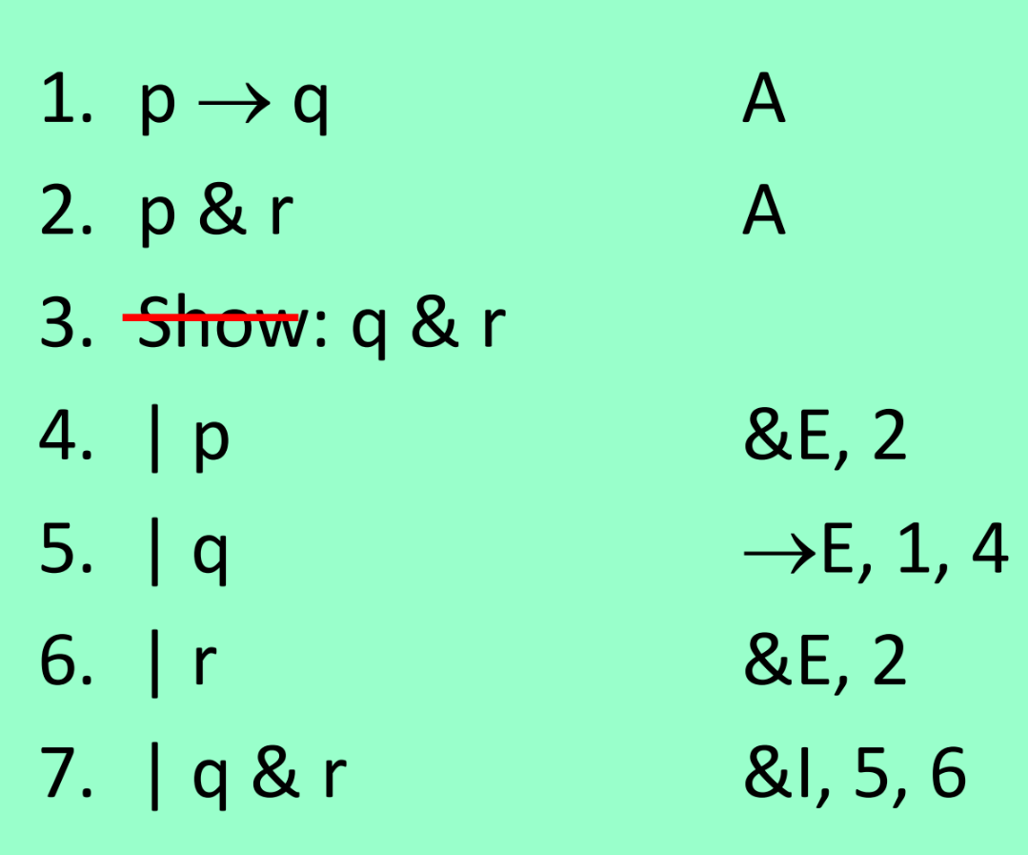
methodology
Proof calculi
Hilbert-style
Natural deduction

Slide 9
methodology
Proof calculi
Hilbert-style
Natural deduction
Equational system

Slide 11
The Equational System
Concerning inference rules and axioms, it is a balance between the other two systems
Cumulative
Neat feature worth mentioning

Slide 12
Results
Proofs
Counterexample of the converse
Implications of these results
Specifically, how they provide a logical basis for case analysis proof techniques

Slide 13
Conclusion
Summarize presentation
Restate significance of work

