Slide 1

A Theorem for Case Analysis
Fernando Saca
J. Stanley Warford, mentor
Computer Science / Philosophy
Pepperdine University

Slide 2
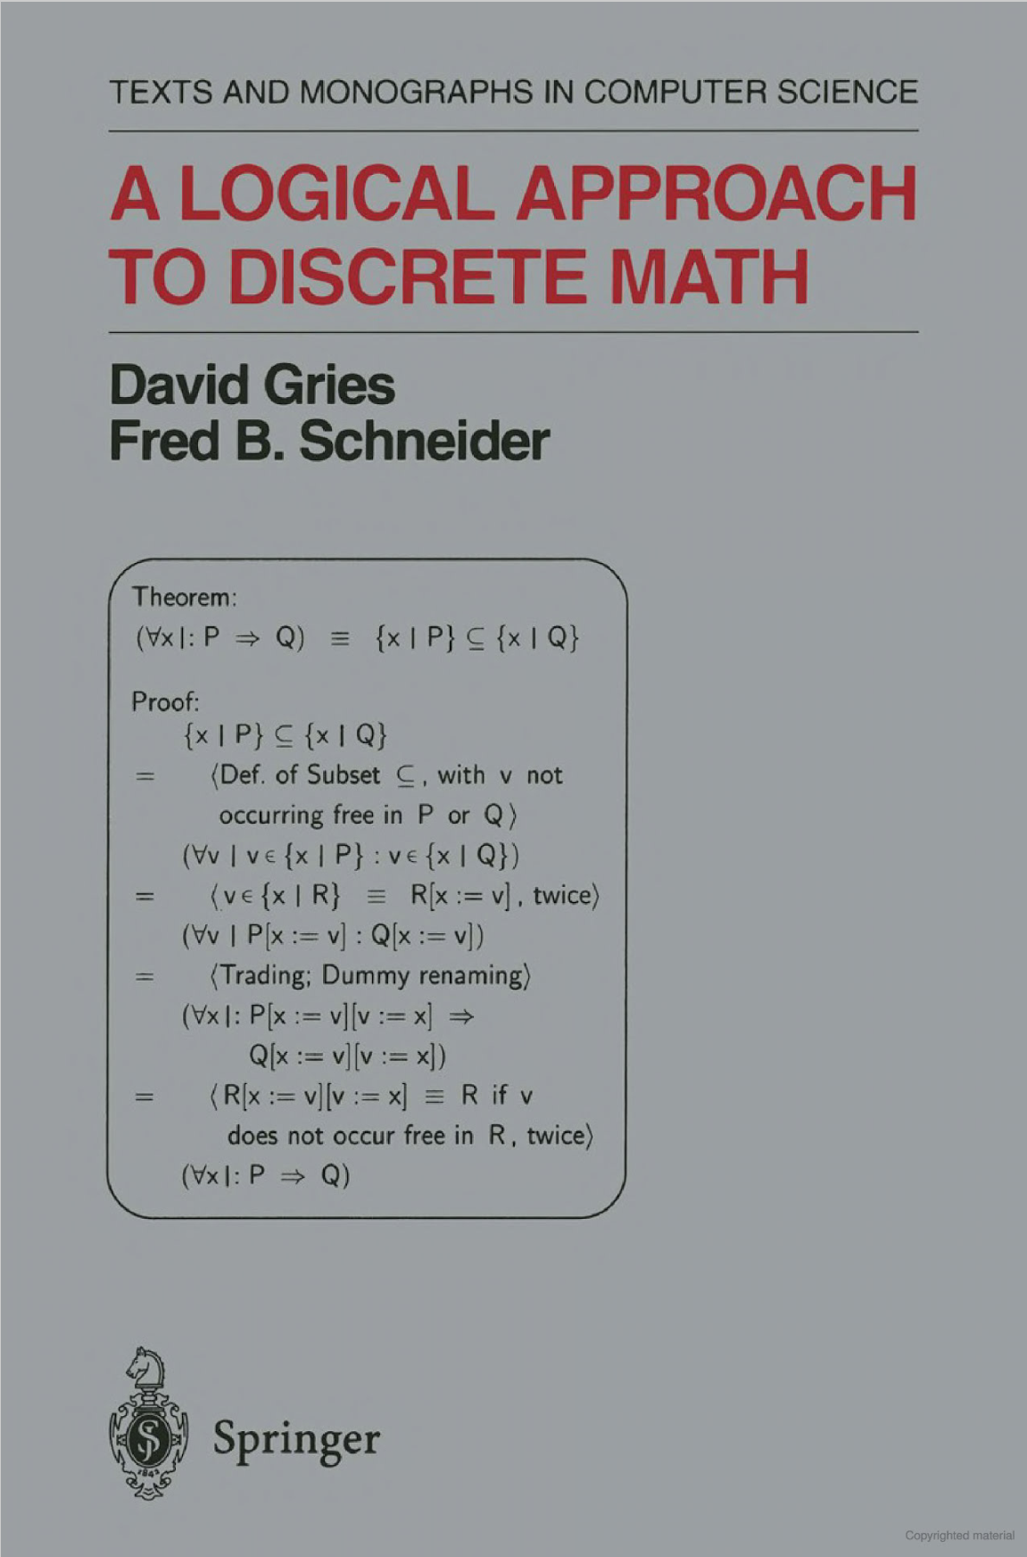
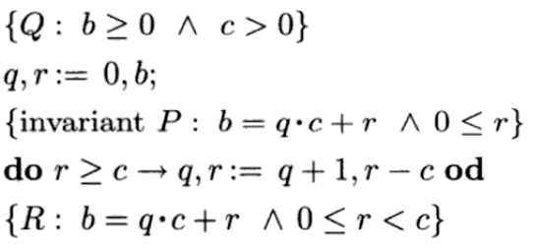

An Overview
Significance
Methodology
Results

Slide 3
Significance
Computer science
In English

Slide 4
Application to Computer Science
Proving program correctness
Specifically, selective and iterative programs
Pain-free theorem verification
Foundation for certain proof techniques

Slide 5
Example in English

Slide 6
Example in English
E: ¬¬z ≡ z
E^{z}_{true}
_{z: “The sky is blue”}
“It is not the case that the sky is not blue.”
≡
“It is the case that the sky is blue.”
E^{z}_{false}
_{z: “The sky is green”}
“It is not the case that the sky is not green.”
≡
“It is the case that the sky is green.”
E^{z}_{p}: ¬¬p ≡ p

Slide 7
Example in English
E: ¬¬z ≡ z
E^{z}_{true}
_{z: “The sky is blue”}
“It is not the case that the sky is not blue.”
≡
“It is the case that the sky is blue.”
⌃
E^{z}_{false}
_{z: “The sky is green”}
“It is not the case that the sky is not green.”
≡
“It is the case that the sky is green.”
E^{z}_{p}: ¬¬p ≡ p

Slide 8
methodology
Proof calculi
Hilbert-style

Slide 9
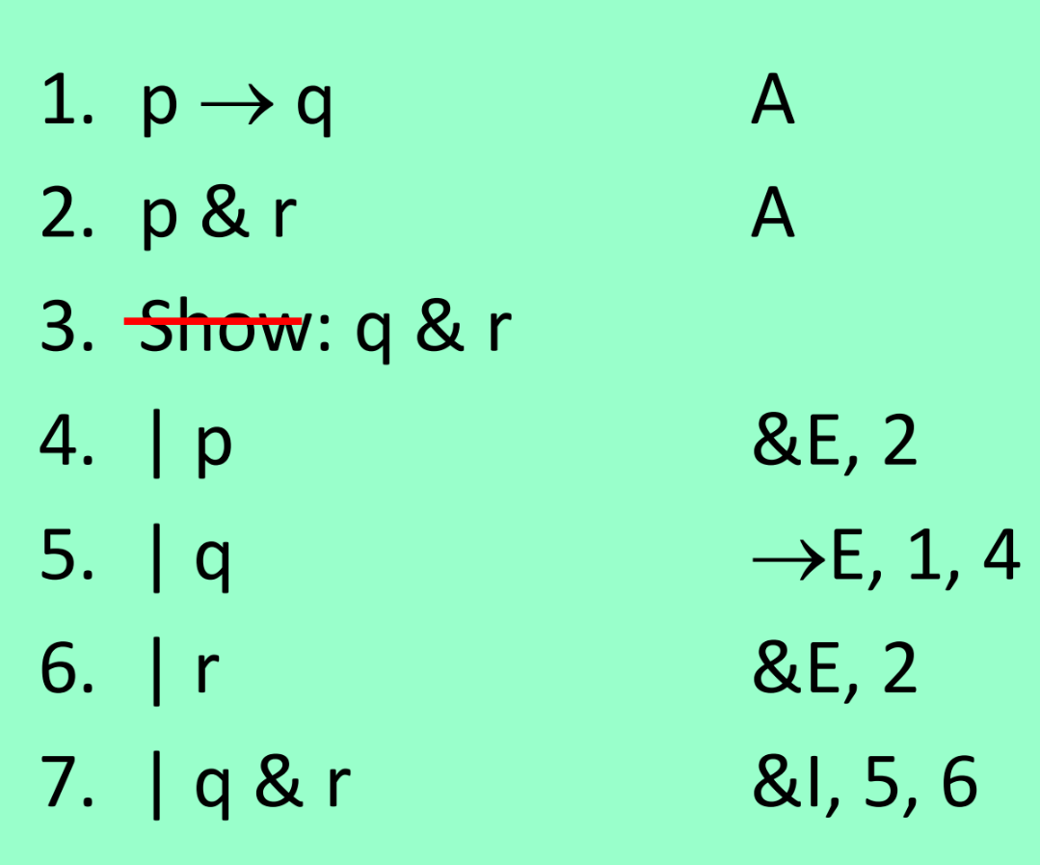
methodology
Proof calculi
Hilbert-style
Natural deduction

Slide 10
methodology
Proof calculi
Hilbert-style
Natural deduction
Equational system

Slide 11
The Equational System
Concerning inference rules and axioms, it is a balance between the other two systems
Cumulative
Neat feature worth mentioning

Slide 13
Results
Proof with Shannon
Proof without Shannon
Counterexample of converse

Slide 14
Results
Proof with Shannon

Slide 15

Results
Proof with Shannon

Slide 16
Results
Proof with Shannon

Slide 17
Results
Proof with Shannon

Slide 18
In conclusion, the equational theorem provides a justification for the case analysis proof technique.
The technique has application to computer science for proving program correctness.

