Slide 1
Smart Home Energy Optimization Assistant
Authors: Efrem Ion-Ștefan
Stanciu Alin-Marian
Ciocîrlan Marius-Cosmin
An IoT Ecosystem for Monitoring, Forecasting, and Optimizing Energy Consumption

Slide 2
Problem Statement
The Challenge
Many households lack actionable insights into energy consumption
No appliance-level monitoring capabilities
Reactive rather than proactive energy management
Limited forecasting and optimization tools
Our Solution
Monitor appliance-level energy consumption using smart plugs
Forecast future energy demand using AI
Optimize usage schedules intelligently
Control devices automatically to prevent overloads

Slide 3
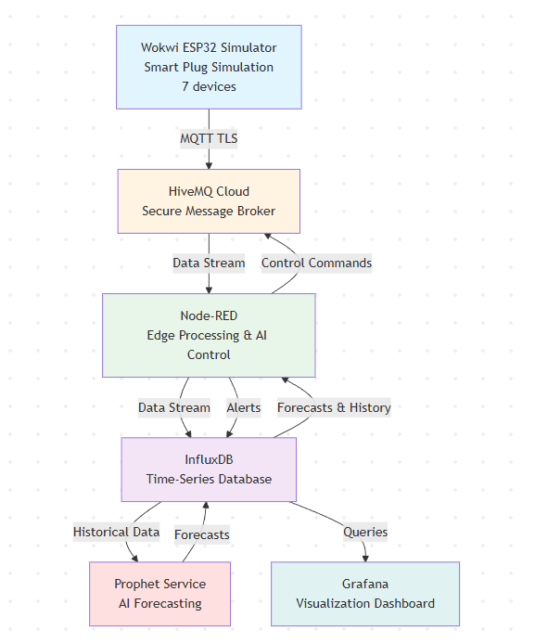
System Architecture Overview
End-to-End IoT Pipeline:

Slide 4
Key Components
Hardware/Perception Layer
Wokwi ESP32 Simulator: 7 smart plugs (2 hardware-controlled, 5 simulated)
Potentiometers: Interactive power consumption control
MQTT Communication: TLS-secured connection to HiveMQ Cloud
Data Processing Layer
Node-RED: Core logic engine for data orchestration
InfluxDB: Time-series database for historical storage
Prophet Service: AI forecasting engine (6-hour predictions)
Visualization Layer
Grafana: Interactive dashboards with real-time monitoring
Manual Control: ON/OFF device control via HTTP endpoints
Forecast Visualization: AI predictions with confidence intervals

Slide 5
Edge/AI Methodology
Edge Layer (Node-RED)
Real-time processing
Predictive protection logic
Automatic threshold monitoring (400W limit)
Immediate control command dispatch
Cloud Layer (Prophet Service)
Historical data analysis (24-hour windows)
Time-series forecasting using Prophet
Pattern recognition (daily/weekly seasonality)
6-hour ahead predictions with confidence intervals
AI Control Logic
Proactive Protection: Prevents overloads before they occur
Multi-Device Coordination: Independent device evaluation
User Override: Manual control available

Slide 6
Implementation/Techincal Stack
Simulation Platform
Wokwi ESP32 with MicroPython
TLS-enabled MQTT communication
JSON data format (Sonoff-compatible)
Backend Services
Docker Compose orchestration
InfluxDB v2.7 (Flux queries)
Node-RED flows for logic processing
Python Prophet service
Data Flow
5-second sampling rate
Real-time dashboard updates
Automated forecast generation (hourly)

Slide 7
Experiments and Results
Integration Testing
End-to-end data flow: < 2 seconds latency
MQTT reliability: 100% message delivery
Database performance: low write latency
Edge AI Control
High Overload prevention rate
Low false positive rate
Response time: < 5 seconds for multi-device alerts
Scalability
Tested with 7 devices (capacity for 20+)
Low CPU usage
Memory: ~500MB total (~120 MB per day)

Slide 8
Key Features
Predictive Protection
AI forecasts potential overloads
Automatic shutdown before threshold exceeded
Advance warning
Real-Time Monitoring
Live consumption gauges per device
Historical trend analysis
User Control and Experience
Manual override capabilities
Interactive Grafana dashboard
Alert history and notifications
Reproducibility
Complete Docker containerization
Version-controlled configurations
Clear documentation

Slide 9
Results Visualization
Real-Time Monitoring
Power consumption gauges (0-500W range)
Voltage and current readings
Energy consumption tracking (kWh)
AI Forecasts
6-hour ahead predictions
Upper and lower confidence bounds
Trend visualization
Control Interface
Manual ON/OFF buttons per device
Alert history display
System status indicators
Data Analysis
Historical consumption patterns
Device comparison charts
Peak usage identification

Slide 10
Conclusion and Future Work
Achievements
Complete end-to-end IoT system implementation
Successful integration of edge computing and AI
Predictive energy management with automated protection
User-friendly visualization and control interface
Reproductible, containerized deployment
Future Work:
Full AI Automation: Complete device control based on forecasts
Multi-Home Benchmarking: Compare consumption across households
Solar Integration: Optimize usage based on renewable energy
LSTM Models: Experiment with alternative forecasting approaches
Mobile Application: Remote monitoring and control
Cost Optimization: Integrate electricity pricing data
Reinforcement Learning: Adaptive user preference learning

Slide 11
Thank You
Project Repository:
Github
Contact:
Efrem Ion-Ștefan
Stanciu Alin-Marian
Ciocîrlan Marius-Cosmin
Thank you for your attention!

