Slide 1

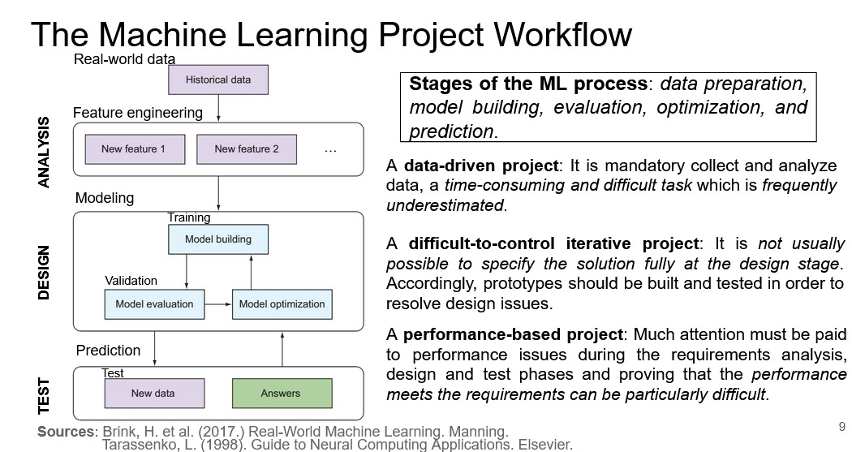
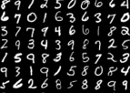
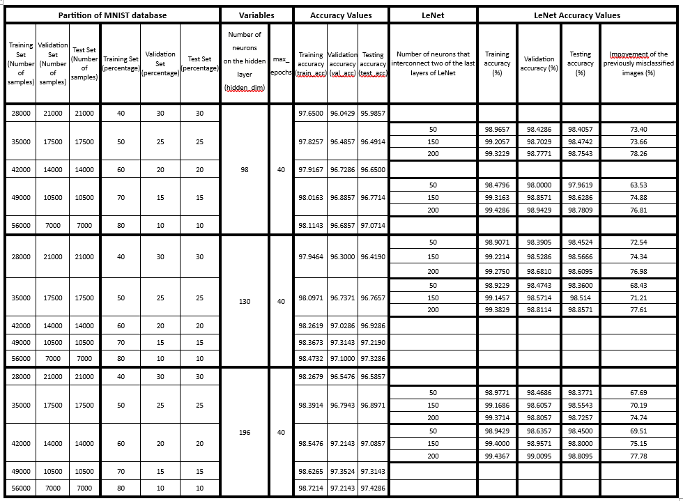
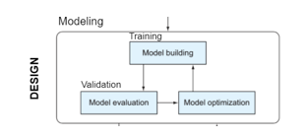
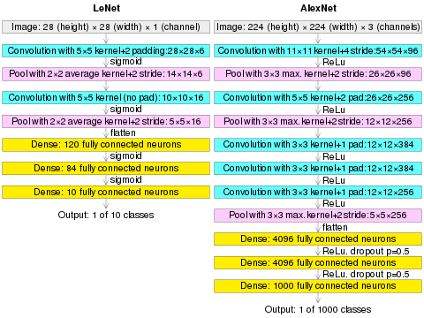
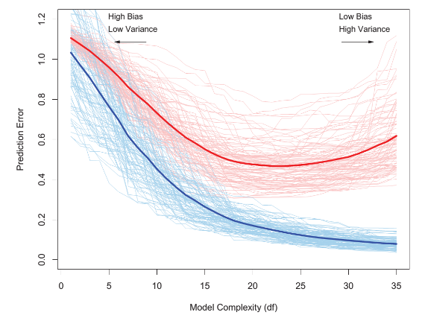
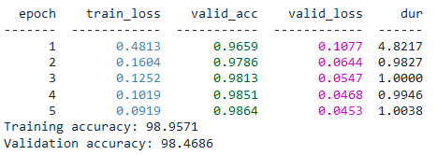
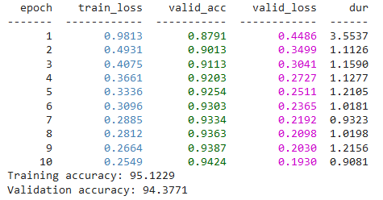
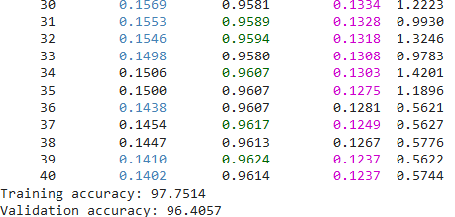
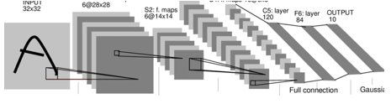
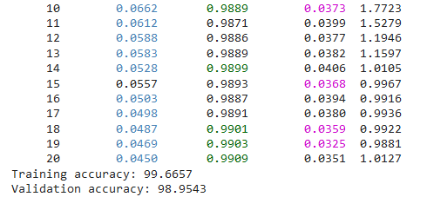
AI HARDWARE
In-focus: DNN Learning Curves
STUDENT: Stanciu Iulia-Cristina
Strategies for the
handwritten digit recognition:
For this exercise there are used two machine learning strategies for digit recognition.
The MNIST database is a 70000 samples set made out of images of 784 pixels. The pixels are being analysed to determine the handwritten digit that can be seen in the picture.
Both algorithms require a well-thought division of the provided date into three categories:
A training set
The training set is usually bigger than the validation set or the test set and it is used to estimate the weights of the neural network
A validation set
The validation set is used is used in the model evaluation part of the training and it is used to optimize the learning rate of the algorithm.
A test set
The test set is used for the final evaluation of the algorithm. The performance of the algorithm is given by the processing of the test set and the comparison between the true answer and the predicted one.
Machine learning workflow and
learning curves:
Modelling is one of the most important stages of the ML workflow.
The modelling part of the process consists of a loop involving the computation of the models, estimating the performance for the training set and a model evaluation which is done by processing the validation set.
Learning curves are the visual representation of how an algorithm learns during the evaluation and validation part of the process. The “learning” refers to the improvement of the accuracy of the algorithm in a given period of time or of repetition of the loop.
LeNet:
LeNet is a convolutional neural network structure proposed by LeCun. It is a simple convolutional neural network, a neural network whose artificial neurons can respond to a part of the surrounding cells in the coverage range and perform well in large-scale image processing.
LeNet-5 was one of the earliest convolutional neural networks.
(In deep learning, a convolutional neural network (CNN, or ConvNet) is a class of artificial neural network (ANN), most commonly applied to analyze visual imagery. CNNs are regularized versions of multilayer perceptrons. Multilayer perceptrons usually mean fully connected networks, that is, each neuron in one layer is connected to all neurons in the next layer.)
LeCun combined a convolutional neural network trained by backpropagation algorithms to read handwritten numbers and successfully applied it in identifying handwritten zip code numbers provided by the US Postal Service.
Analyzing the MNIST dataset with SciKit-Learn and SKORCH and
LeNet Convolutional Network respectively:
For the purpose of this exercise the accuracy of the algorithm and the learning curves are analysed for different values of parameters: division of the dataset into training, validation and test sets (the partition can be seen below), values for the number of neurons on the hidden layer of the first algorithm (values of 98, 130,196), values for number of epochs and number of neurons that interconnect the two last layers of LeNet (tested for values of 50, 150 and 200).
As it can be seen it the table below, having the same number of epochs, the accuracy of the algorithms rises while increasing the number of neurons on the hidden layer. At the same time, a large enough training set further improves the accuracy of the algorithm.
Considering the LeNet algorithm, the bigger the number of neurons that interconnects the last two layers, the better the testing accuracy, giving the best results for 200 neurons: accuracy > 98%.
Accuracy values of the algorithms for different learning parameters
Observation!
For the LeNet algorithm the number of epochs was initially set to 10.
The evolution of the learning curve can be seen by modifying the number of epochs. An example of the leaning process can be seen below. The bigger the number of epochs (until a point), the better the accuracy.
SciKit-Learn
with 10 epochs
=> Final validation accuracy of 94.38%
SciKit-Learn
with 40 epochs
=> Final validation accuracy of 96.41%
LeNet with 5 epochs
=> Final validation accuracy of 98.47%
LeNet-5 consists of seven layers. In addition to input, every other layer can train parameters. Every convolutional layer includes three parts: convolution, pooling, and nonlinear activation functions.
REFERENCES
[1] LeCun, Y., Bottou, L., Bengio, Y., Haffner, P. (1998).
“Gradient-based learning applied to document
recognition."
[2] LeCun, Y.; Boser, B.; Denker, J. S.; Henderson, D.; Howard, R. E.; Hubbard, W.; Jackel, L. D. (December 1989). "Backpropagation Applied to Handwritten Zip Code Recognition". Neural Computation.
[3] Goodfellow, I., Bengio, Y., Courville, A. (2016). Deep Learning. The MIT Press.
[4] Hastie et al. (2008). The Elements of Statistical Learning, Second Edition (corrected 12th printing). Springer.
LeNet with 20 epochs
=> Final validation accuracy of 98.95%

