Slide 1
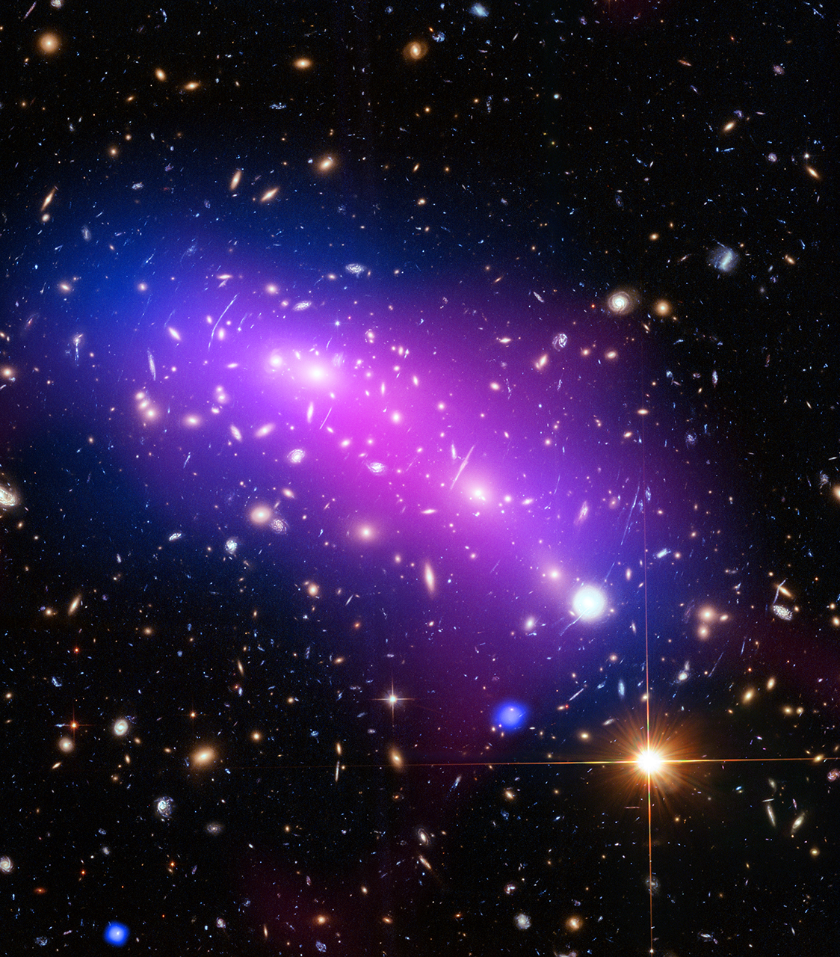
Small Steps Towards Reproducible Data Analyses
Mark C. Adkins York University

