Slide 1
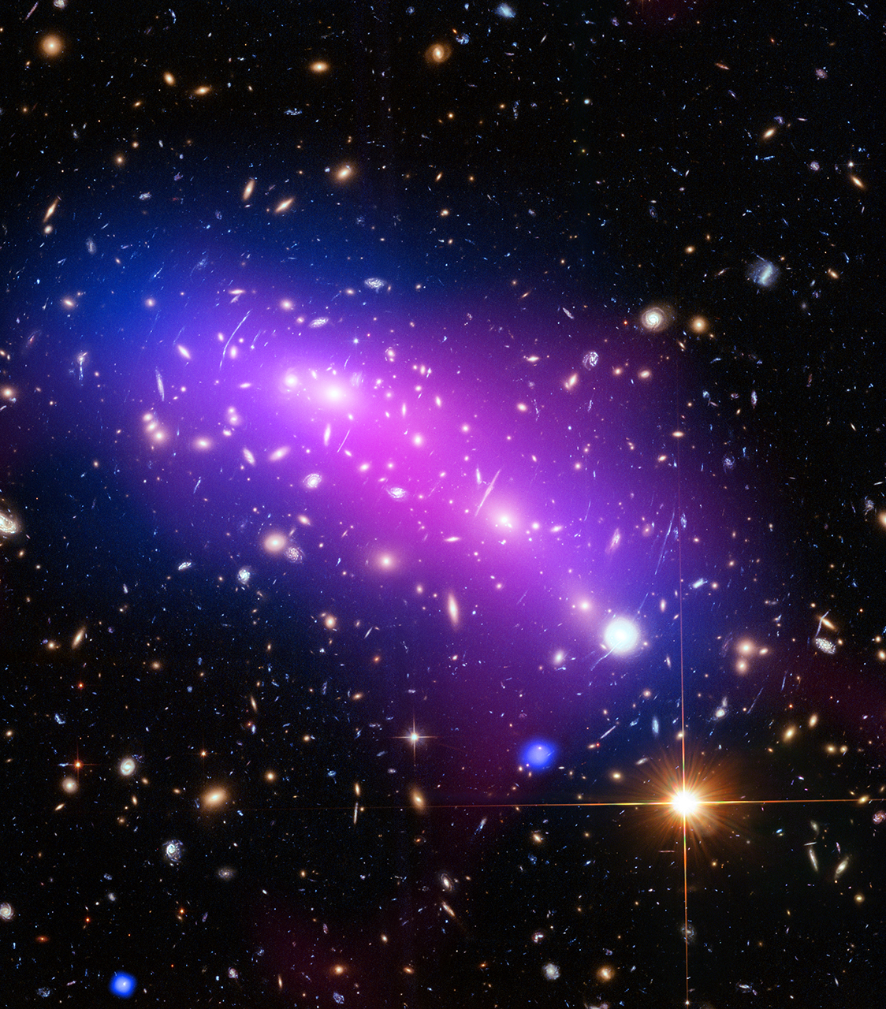
Small Steps Towards Reproducible Data Analyses
Section 2: Tidy Data
Mark C. Adkins York University

