Slide 1
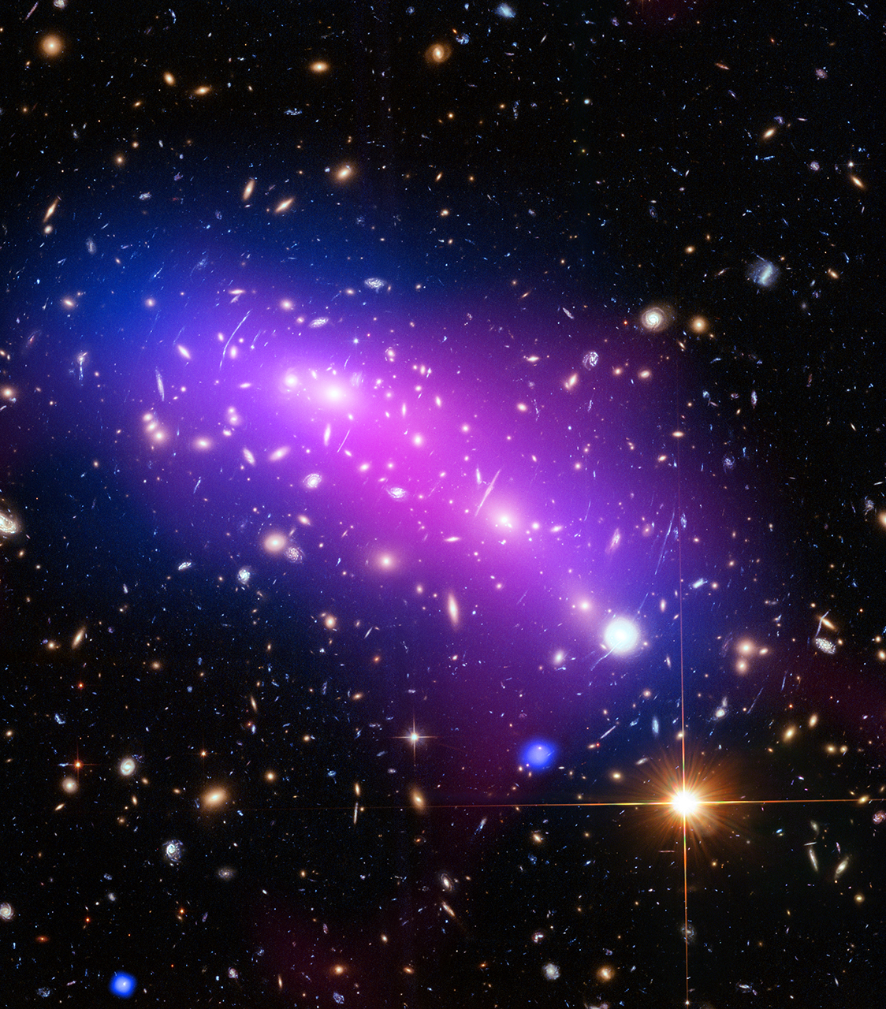
Better Data Cleaning using R and the Tidyverse
Section 2: Tidy Data
Mark C. Adkins York University

