Slide 1
Predictors of problem gambling among seniors in Ontario
Jolynn Pek, Bonnie Armstrong, Mark Adkins,
Jessica K. Flake, & Julia Spaniol

Slide 2
Outline
Background
Purpose of Research
Methods
Results/Discussion

Slide 3
background
Seniors constitute the fastest-growing segment of society. (Statistics Canada, 2012)
Significant proportion experiencing gambling-related problems. (Petry, 2002)
Lifecycle events (e.g., partner loss or cognitive decline) may make seniors vulnerable to poor choices and problem gambling. (Munro et al., 2003)
Initially analyzed by McCready et al. (2014).
Focused on descriptive statistics for demographic and gambling-related variables.
Exploring predictors of problem gambling.
The dataset provided a rich opportunity for further exploration.

Slide 4
background
Seniors constitute the fastest-growing segment of society. (Statistics Canada, 2012)
Significant proportion experiencing gambling-related problems. (Petry, 2002)
Lifecycle events (e.g., partner loss or cognitive decline) may make seniors vulnerable to poor choices and problem gambling. (Munro et al., 2003)
Initially analyzed by McCready et al. (2014).
Focused on descriptive statistics for demographic and gambling-related variables.
Exploring predictors of problem gambling.
The dataset provided a rich opportunity for further exploration.

Slide 5
background
Seniors constitute the fastest-growing segment of society. (Statistics Canada, 2012)
Significant proportion experiencing gambling-related problems. (Petry, 2002)
Lifecycle events (e.g., partner loss or cognitive decline) may make seniors vulnerable to poor choices and problem gambling. (Munro et al., 2003)
Initially analyzed by McCready et al. (2014).
Focused on descriptive statistics for demographic and gambling-related variables.
Exploring predictors of problem gambling.
The dataset provided a rich opportunity for further exploration.

Slide 6
background
Seniors constitute the fastest-growing segment of society. (Statistics Canada, 2012)
Significant proportion experiencing gambling-related problems. (Petry, 2002)
Lifecycle events (e.g., partner loss or cognitive decline) may make seniors vulnerable to poor choices and problem gambling. (Munro et al., 2003)
Initially analyzed by McCready et al. (2014).
Focused on descriptive statistics for demographic and gambling-related variables.
Exploring predictors of problem gambling.
The dataset provided a rich opportunity for further exploration.

Slide 7

Ontario Seniors gambling data
Gambling Research Exchange Ontario (GREO)
Exit interviews gathered at 7 casinos around Ontario in 2013.
Seniors (aged 55+) were randomly selected to participate in an interview upon exiting the casino.
142 variables collected; we focused on a subset of 15 variables.

Slide 8
Purpose of research
Explore conditional effects of the following on problem gambling:
Person-level variables;
Environmental variables;
Gambling related behaviours;
Person-by-environment interactions.

Slide 9
Covariates
Age
Marital status
Employment status
Ethnicity

Slide 10
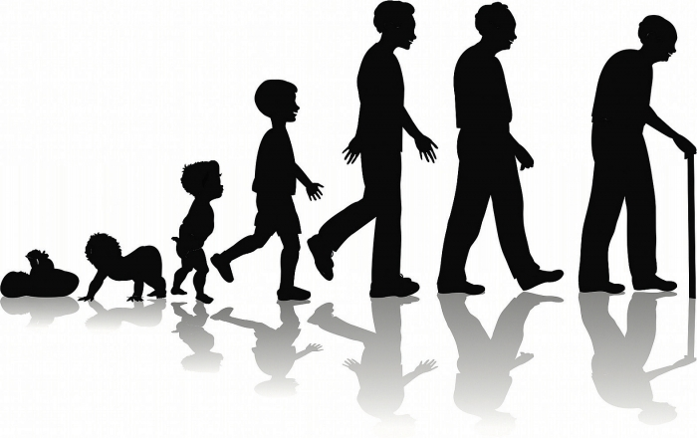
Covariates
Age (55-74 vs. 75+)
Marital status
Employment status
Ethnicity

Slide 11

Covariates
Age
Marital status (married or equivalent)
Employment status
Ethnicity

Slide 12

Covariates
Age
Marital status
Employment status (formally employed vs. not)
Ethnicity

Slide 13

Covariates
Age
Marital status
Employment status
Ethnicity
8 categories (white, black, Canadian etc.)
27 unique combinations
Born in Canada as a simplification.

Slide 14
Person-level
Belief about the benefit or harm gambling has for society
Opinion on legalization of gambling activities
Approach gambling motives
Escape or forget worries
Helps negative feelings
To fill time or relieve boredom

Slide 15

Person-level
Belief about the benefit or harm gambling has for society
Opinion on legalization of gambling activities
Approach gambling motives
Escape or forget worries
Helps negative feelings
To fill time or relieve boredom

Slide 16

Person-level
Belief about the benefit or harm gambling has for society
Opinion on legalization of gambling activities
Approach gambling motives
Escape or forget worries
Helps negative feelings
To fill time or relieve boredom

Slide 17
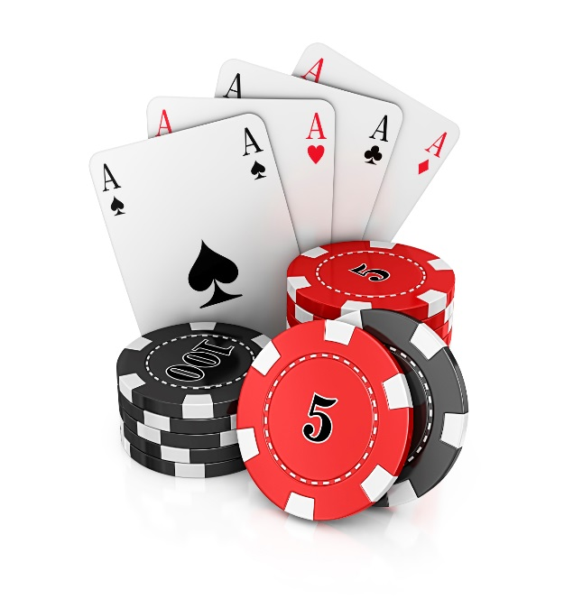

Person-level
Belief about the benefit or harm gambling has for society
Opinion on legalization of gambling activities
Approach gambling motives (count of 7 motives)
Escape or forget worries
Helps negative feelings
To fill time or relieve boredom

Slide 18

Person-level
Belief about the benefit or harm gambling has for society
Opinion on legalization of gambling activities
Approach gambling motives (count of 7 motives)
Escape or forget worries
Helps negative feelings
To fill time or relieve boredom

Slide 19
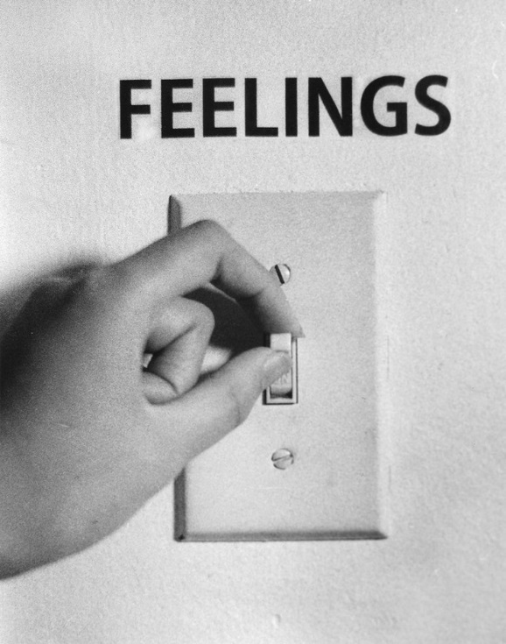
Person-level
Belief about the benefit or harm gambling has for society
Opinion on legalization of gambling activities
Approach gambling motives (count of 7 motives)
Escape or forget worries
Helps negative feelings (anxious, nervous, or depressed)
To fill time or relieve boredom

Slide 20
Person-level
Belief about the benefit or harm gambling has for society
Opinion on legalization of gambling activities
Approach gambling motives (count of 7 motives)
Escape or forget worries
Helps negative feelings (anxious, nervous, or depressed)
To fill time or relieve boredom

Slide 21


Environmental-level
Come alone versus come with family and/or friends

Slide 22
Gambling-related variables
Playing slots/EGMs monthly or more often
Spending at least $1000 annual on gambling

Slide 23
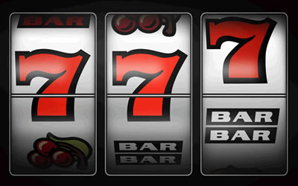
Gambling-related variables
Playing slots/EGMs monthly or more often
Spending at least $1000 annual on gambling

Slide 24
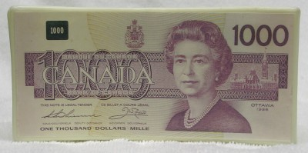
Gambling-related variables
Playing slots/EGMs monthly or more often
Spending at least $1000 annually on gambling

Slide 25
Dependent variable
Problem Gambling Severity Index (PGSI) (Ferris & Wynne, 2001)
Van der Maas et al. (in review) defined problems gamblers as scoring a 9 or higher.

Slide 26

Analyses
PGSI was modeled using logistic regression:
Probability of being a problem gambler vs. not.

Slide 27
Results
Seniors who were married (or equivalent) were half as likely to be problem gamblers. OR = 0.50, 95% CI = [0.27, 0.91]

Slide 28
Results
Seniors who were formally employed were more than 3 times less likely to be problem gamblers. OR = 3.33, 95% CI = [1.74, 6.40]

Slide 29
Results
Seniors who thought that gambling had equal harm and benefits vs. seniors who though that gambling had more harms were more than 5 times more likely to be problem gamblers. OR = 5.13, 95% CI = [2.60, 10.10]
Seniors who thought that gambling had more benefits than harm vs. more| harm than benefits were more than 19 times more likely to be problem gamblers. OR = 19.23, 95% CI = [4.31, 90.01]

Slide 30
Results
Seniors who endorsed using gambling to escape or forget about worries were more than 3 times more likely to be problem gamblers. OR = 3.16, 95% CI = [1.56, 6.40]

Slide 31
Results
Seniors who endorsed the motive that gambling helps when they were feeling anxious, nervous, or depressed were also more than 3 times more likely to be problem gamblers. OR = 3.26, 95% CI = [1.42, 7.98]

Slide 32
Results
Seniors who played slots/EGMs monthly or more often vs. those who played less frequently were more than 10 times more likely to be problem gamblers. OR = 10.04, 95% CI = [1.22, 75.81]
Seniors who spent at least $1000 annually were more than twice as likely to be problem gamblers. OR = 2.18, 95% CI = [1.19, 3.99]

Slide 33
But what does it all mean?
Overall, one distinct contribution was the examination of conditional effects of person-level and environmental variables.
No significant person X environment effects.
Though not covered here, the three outcomes failed to show one distinct demographic profile of at-risk seniors.
Can help inform:
Ontario Lottery and Gaming Corporation (OLG);
Policy makers;
Future research.

Slide 34
Limitations
Missingness
Females vs. males: OR 1.70, 95% CI [1.42, 2.05]
Age (75+) vs. young-old OR 1.32, 95% CI [1.08, 1.62]
Primary analysis used listwise deletion. (N=1401 vs. N=2301)
Problems generalizing results to females and seniors over the age of 75.
Exploratory aspects, specifically the data-driven approach, can make it difficult to interpret results along theoretical lines.

Slide 35
questions
?

Slide 36
Additional slides

Slide 37
Table 3.7: Effects on gambling at slot machines and EGMs monthly or more often versus less often.
Parameter | log-odds | S.E. | X²(df = 1) | p-value | OR | OR 95% CI
Intercept | 1.40 | 0.15 | 81.70 | <.001*
Old-old vs. young-old | 0.31 | 0.14 | 5.25 | .022* | 1.36 | [1.05, 1.78]
Female vs. Male | -0.40 | 0.12 | 11.19 | .001* | 0.67 | [0.53, 0.85]
Count of approach gambling motives | 0.01 | 0.04 | 0.12 | .726 | 1.01 | [0.94, 1.10]
Escape or forget worries | 0.16 | 0.20 | 0.59 | .443 | 1.17 | [0.79, 1.74]
Helps negative feelingsª | 0.77 | 0.35 | 5.01 | .025* | 2.17 | [1.10, 4.26]
To fill time/boredom | 0.67 | 0.14 | 23.59 | <.001* | 1.96 | [1.49, 2.56]
Proximity 0-10 km vs over 100 km | 0.97 | 0.35 | 7.64 | .006* | 2.64 | [1.33, 5.27]
Proximity 11-25 km vs over 100 km | 0.89 | 0.35 | 6.50 | .011* | 2.44 | [1.23, 4.85]
Proximity 26-50 km vs over 100 km | 0.76 | 0.35 | 4.67 | .031* | 2.14 | [1.07, 4.25]
Proximity 51-100 km vs over 100 km | 0.01 | 0.38 | 0 | .970 | 1.01 | [0.48, 2.14]
Come alone vs. Come with someone | 0.38 | 0.15 | 6.42 | .011* | 1.46 | [1.09, 1.96]
Note. X² = Wald test statistic, df = degrees of freedom, OR = odds ratio, and CI = confidence interval. *p <.05. ªNegative feelings include feeling anxious, nervous, or depressed.

Slide 38
Table 3.8: Effects on gambling expenditure of $1,000 or more per year versus less than $1,000.
Parameter | log-odds | S.E. | X²(df = 1) | p-value | OR | OR 95% CI
Intercept | -1.74 | 0.18 | 91.57 | <.001*
Female vs. Male | -0.21 | 0.10 | 3.98 | .046* | 0.81 | [0.66, 1.00]
All types legal vs. some types legal | -0.27 | 0.11 | 6.66 | .010* | 0.76 | [0.62, 0.94]
All types legal vs. all types illegal | -0.50 | 0.24 | 4.33 | .038* | 0.60 | [0.38, 0.97]
Count of approach gambling motives | 0.11 | 0.03 | 11.77 | .001* | 1.12 | [1.05, 1.20]
Escape or forget worries | 0.33 | 0.16 | 4.19 | .041* | 1.39 | [1.01, 1.90]
Helps negative feelingsª | 0.001 | 0.22 | 0 | .996 | 1.00 | [0.65, 1.55]
To fill time/boredom | 0.50 | 0.11 | 21.36 | <.001* | 1.65 | [1.34, 2.04]
Come with organized group vs. not | -0.79 | 0.26 | 9.25 | .002* | 0.46 | [0.28, 0.76]
Come alone vs. Come with someone | 0.41 | 0.12 | 12.71 | <.001* | 1.51 | [1.20, 1.90]
Play slots/EGMs monthly or more | 1.17 | 0.16 | 51.93 | <.001* | 3.22 | [2.34, 4.42]
Note. X² = Wald test statistic, df = degrees of freedom, OR = odds ratio, and CI = confidence interval. *p <.05. ªNegative feelings include feeling anxious, nervous, or depressed.

Slide 39
Table 3.9: Effects on problem gambling (PGSI total score > 8 versus ≤ 8).
Parameter | log-odds | S.E. | X²(df = 1) | p-value | OR | OR 95% CI
Intercept | -4.93 | 1.08 | 20.67 | <.001*
Old-old vs. young-old | -0.24 | 0.38 | 0.40 | .526 | 0.79 | [0.38, 1.65]
Married vs. nor Married | -0.70 | 0.31 | 5.12 | .024* | 0.50 | [0.27, 0.91]
Employed vs. not Employed | 1.20 | 0.33 | 13.07 | <.001* | 3.33 | [1.74, 6.40]
Born out of vs. Born in Canada | 0.49 | 0.31 | 2.59 | .108 | 1.64 | [0.90, 2.98]
All types legal vs. some types legal | -0.57 | 0.32 | 3.11 | .078 | 0.57 | [0.30, 1.07]
All types legal vs. all types illegal | 0.35 | 0.46 | 0.57 | .451 | 1.42 | [0.57, 3.51]
More harms vs. equal harms and benefits | -1.63 | 0.35 | 22.43 | <.001* | 0.20 | [0.10, 0.38]
More harms vs. less harms | -2.97 | 0.77 | 14.94 | <.001* | 0.05 | [0.01, 0.23]
Count of approach gambling motives | -0.19 | 0.10 | 3.69 | .055 | 0.83 | [0.68, 1.00]
Escape or forget worries | 1.15 | 0.36 | 10.16 | .001* | 3.16 | [1.56, 6.40]
Helps negative feelingsª | 1.21 | 0.44 | 7.55 | .006* | 3.36 | [1.42, 7.98]
To fill time/boredom | -0.15 | 0.31 | 0.22 | .638 | 0.86 | [0.47, 1.59]
Come alone vs. Come with someone | 0.48 | 0.31 | 2.38 | .123 | 1.61 | [0.88, 2.96]
Play slots/EGMs monthly or more | 2.31 | 1.03 | 5.00 | .025* | 10.04 | [1.33, 75.81]
Spend more than $1,000 on gambling | 0.78 | 0.31 | 6.34 | .012* | 2.18 | [1.19, 3.99]
Note. X² = Wald test statistic, df = degrees of freedom, OR = odds ratio, and CI = confidence interval. *p <.05. ªNegative feelings include feeling anxious, nervous, or depressed.

Slide 40
Screening Process
Chi-square tests of independence were used to test marginal effects of each covariate, person-level, and environmental variable per to inclusion in the final model.
Benjamini-Hochberg (1995) procedure was used to control for the false discovery rate.
Missing data analyses was used to determine of missingness of each variable was able to predict gambling-related outcomes.
Sparse responses also precluded some variables from entering the final model.

