Slide 1
Best practices for constructing confidence intervals for the general linear model under nonnormality
Mark Christopher Adkins

Slide 2
outline
Replication crisis
Review General Linear Model
Effect sizes and confidence intervals
Techniques for resolving assumption violations
Empirical example
Monte Carlo simulation
Recommendations
Notes:
Replication crisis
Review General Linear Model
Effect sizes and confidence intervals
Techniques for resolving assumption violations
Empirical example
Monte Carlo simulation
Recommendations

Slide 3
Replication crisis
The failure to replicate research findings has caused concern that many research findings are false Ioannidis, 2005; Open Science Collaboration, 2015
Renewed concerns regarding the dependability of psychological findings has led to a call for methodological reform Strangor & Lemay, 2016; Vazire, 2015
Reporting effect sizes and confidence intervals (CIs) Wilkinson, 1999; Nickerson, 2000; Cumming, 2014
Notes:
Failure to replicate research findings has caused concern that many research findings may be false
These concerns led to a call for methodological reform
Such as reporting ES and CI
CI have great potential for improving methodological practice
Given that ideal conditions tend to be the exception rather than the rule, studying CI performance under non-ideal conditions is a step in the right methodological direction

Slide 4

General linear model
The general linear model (GLM) is a popular modeling framework that can be expressed as: $y_{i}=b_{0}+ b_{1}x_{1i}+…+ b_{k}x_{ki}+ ε_{i}$
Dependent variable
Linear combination of independent variables
Residual

Slide 5
General linear model - Assumptions
Assumptions of the GLM:
Independence of observations
Linear relationship between independent variables and dependent variables
Homogeneity of variance
Normality of model implied residuals

Slide 6
General linear model - Assumptions
Assumptions of the GLM:
Independence of observations
Linear relationship between independent variables and dependent variables
Homogeneity of variance
Normality of model implied residuals

Slide 7
General linear model - effect sizes
Generally, an effect size is a “measure of the magnitude of a phenomenon being studied” Cohen, Cohen, West, Aiken, 2003, p. 47
Focusing on effect sizes is beneficial:
Shifts focus away from dichotomous thinking of the NHST framework
p-values
Can answer questions of practical effect exists
Many different effect sizes within the GLM:
Focus on unstandardized regression coefficients
Notes:
Measure of the magnitude of a phenomenon
P-values:
Holy grail
often do not answer the questions we want
Dance around (see video of the dancing p-values by Geoff Cumming

Slide 8
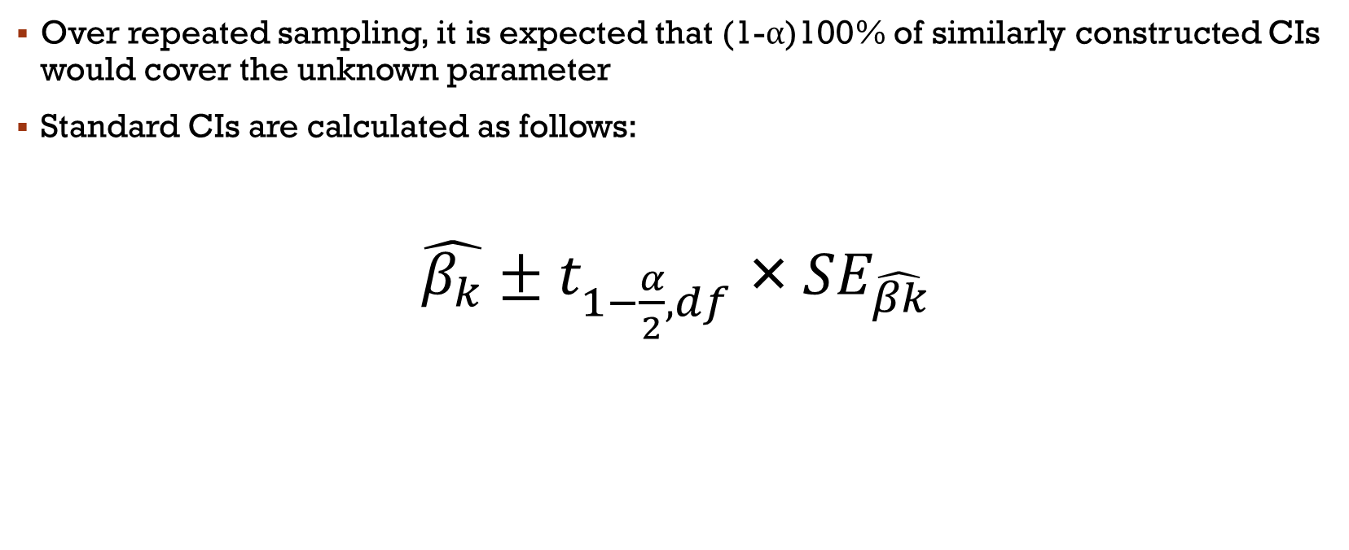
Confidence intervals
Over repeated sampling, it is expected that (1-α)100% of similarly constructed CIs would cover the unknown parameter
Standard CIs are calculated as follows:
$\hat{β_{k}}±t_{1−\frac{α}{2},df} \text{×} {SE}_{\hat{βk}}$
Notes:
Standard CIs are constructing from a theoretical sampling distribution.
CIs:
Provide a set of plausible values for the effect size
An indication of the precision for the point estimate of our effect sizes.

Slide 9
Confidence intervals - properties

Slide 10
Confidence intervals - properties
Coverage:
The proportion of CIs, over repeated sampling, which are expected to contain the population parameter

Slide 11
Confidence intervals - properties
Coverage:
The proportion of CIs, over repeated sampling, which are expected to contain the population parameter
Accuracy:
Relates to the tail probabilities associated with the lower and upper bounds Each tail probability should be approximately equal to α/2 allowing the CIs to capture the central (1- α)100%, while still remaining symmetrical about the parameter estimate.

Slide 12
Confidence intervals - properties
Coverage:
The proportion of CIs, over repeated sampling, which are expected to contain the population parameter
Accuracy:
Relates to the tail probabilities associated with the lower and upper bounds Each tail probability should be approximately equal to α/2 allowing the CIs to capture the central (1- α)100%, while still remaining symmetrical about the parameter estimate.
Efficiency:
Relates to the width of an interval

Slide 13
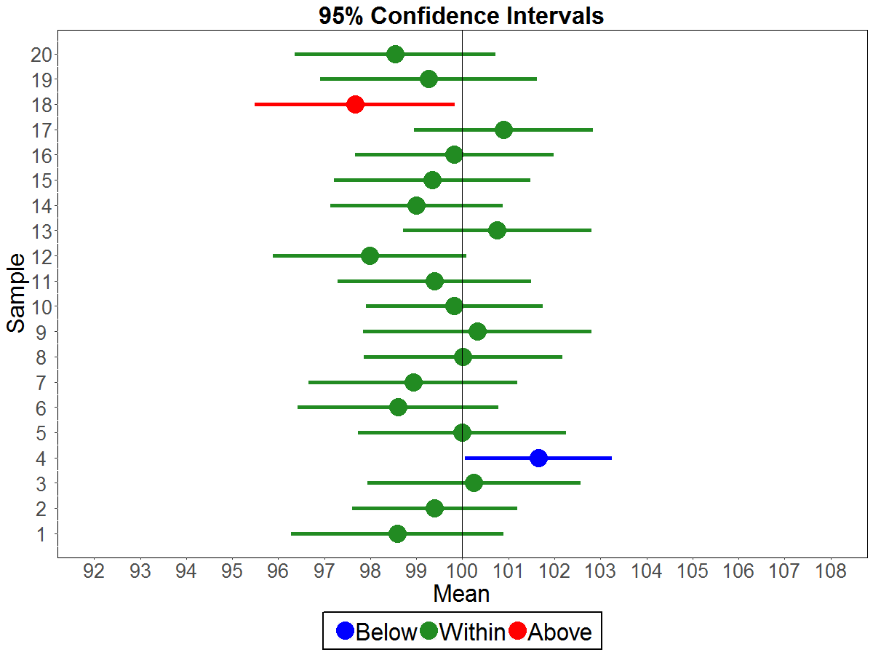
Confidence intervals - properties
μ = 100
σ = 6
n = 30
Notes:
As a way to illustrate these three properties I generated 20 samples and created standard CIs around the sample means.
90% of the CIs captured the true population mean of 100
5% created a CI too low.
5% created a CI too high.
The width of these CIs is how we could measure efficiency.

Slide 14

WHAT’S A RESEARCHER TO DO?

Slide 15

WHAT’S A RESEARCHER TO DO?
Ignore the assumption violation
Rely on the robustness of the GLM to small violations
Rely on the central limit theorem

Slide 16
WHAT’S A RESEARCHER TO DO?
Ignore the assumption violation
Rely on the robustness of the GLM to small violations
Rely on the central limit theorem
Bootstrap resampling techniques
Percentile
Bias-corrected and accelerated

Slide 17
Empirical example
1971 Canadian census data
Random sample of n = 30 occupations were selected
Wage = prestige + education + proportion of women
Average income
Occupational prestige
Years of education
Proportion of women within each occupation

Slide 18
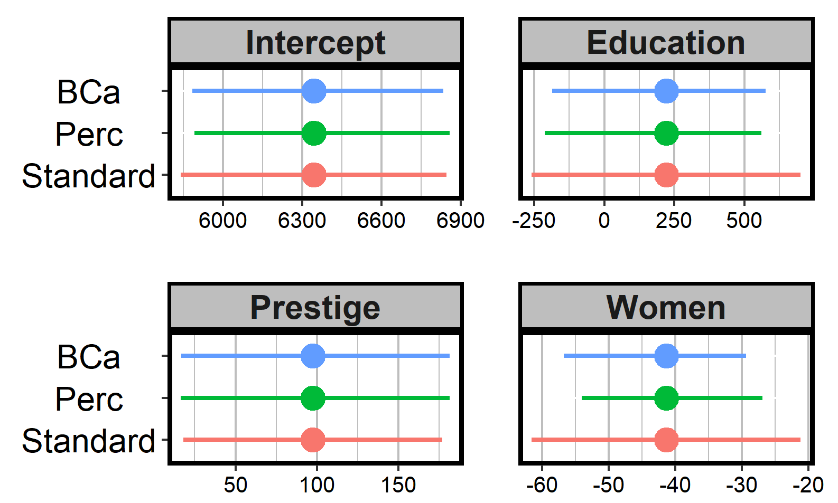
Empirical example - CI Method
Notes:
The CIs for the coefficient estimates after performing a logarithmic transformation are omitted from these charts due to the vastly different scale. Even a back-transformation of these CIs were not near these other methods.

Slide 19
Monte Carlo simulation
Factors:
Sample size
Number of independent variables
Degree of multicollinearity
Non-normal error distributions
Technique to accommodate for assumption violations
Notes:
In addition to the main simulation, and one-off condition comparing an idealized condition using a large sample size, normally-distributed errors, only 2 predictors and low multi-collinearity condition was used to compare the effect of log transforming the DV had on the CIs. It was set up to mimic the model selection process which an applied researcher could follow. That is, if the distribution of the model-implied residuals could be normalized by a logarithmic transformation then it would be applied. Given that the simulation used known parameters it was quickly determined that

Slide 20
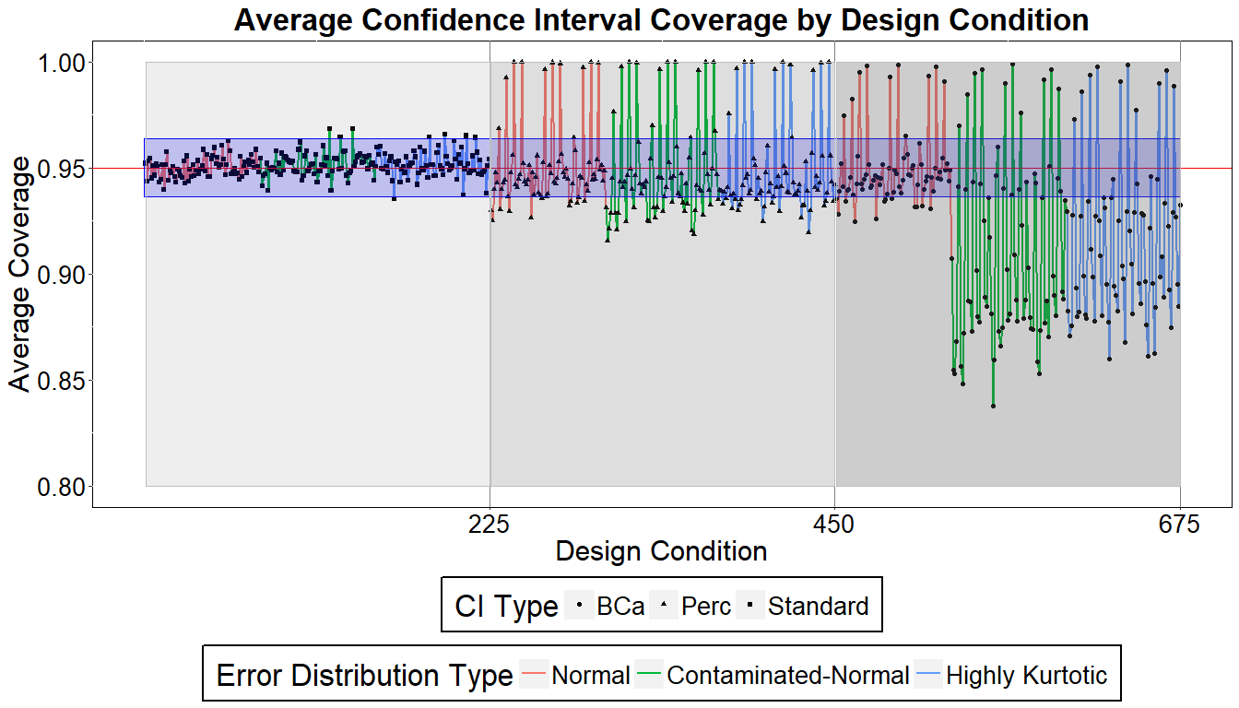
Monte Carlo simulation - Results
Notes:
X-axis is the design condition number
Y-axis is the average coverage for all regression coefficients within every given model.
The first pane is the standard CIs
The second pane is the percentile boostrapped CIs
The third pane is the Bca bootstrapped CIs.
There is a 95% confidence band indiating the proportion of coverage expected given 1000
Each of the three colors indicates the three error distributions examined.
The spikes near 100% coverage are for the n=10 sample sizes. The standard error is s large that the width of the CIs is many times larger that those for larger sample sizes which allow them to envelop the simulation parameters.
I won’t discuss the upper and lower tail proportions as then were largely identical indicating symmetry.

Slide 21
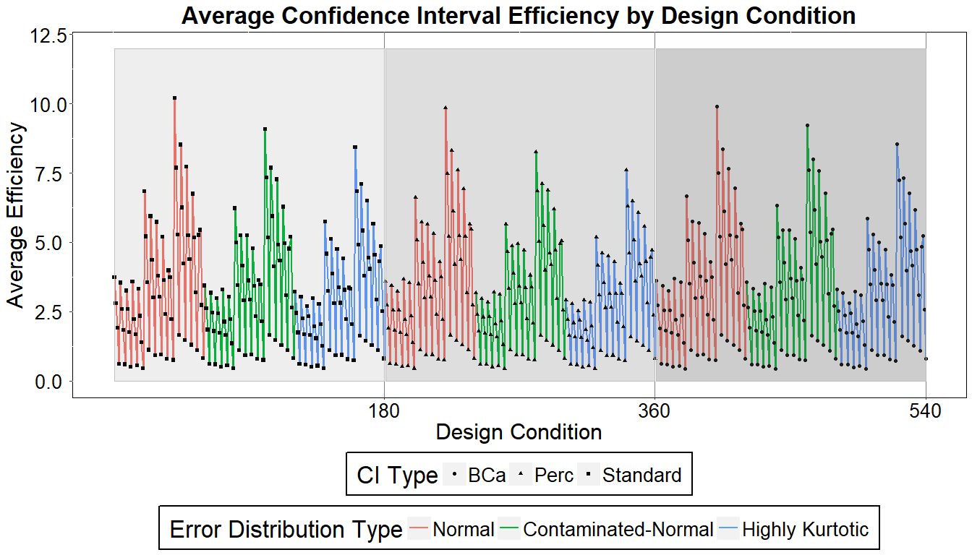
Monte Carlo simulation - Results

Slide 22
Recommendations
Sample size |  | N = 30 |  |  |  |  | N = 50 |  |  |  |  | N = 100 |  |  |  |  | N = 1000
Number of IVs |  | 2 | 3 | 4 | 5 | 6 | 2 | 3 | 4 | 5 | 6 | 2 | 3 | 4 | 5 | 6 | 2 | 3 | 4 | 5 | 6
Error Dist. | Multi
Normal | 3
 | 6
 | 9
Contaminated-Normal | 3
 | 6
 | 9
Highly Kurtotic | 3
 | 6
 | 9
Legend
Standard Only
Standard 5% Better
Percentile Only
Percentile 5% Better
Notes:
Using only methods that maintained proper coverage, I’ve put together an illustration which showcases the methods with the best relative efficiency across all 180 design conditions. I want to highlight a few things.
When the errors were sampled from a normal distribution, all of the methods had comparable coverage and efficiencies. It is recommended that the less computationally intensive standard method be used.
At samples sizes of 100 and 1000 the standard method is generally recommended.
At sample sizes for 30 and 50, as the error distribution deviates further from normal, the percentile bootstrap CIs starts to systematically outperform the other methods.
As a final note regarding the simulation results. A single one-off simulation condition

Slide 23
Conclusion
Notes:
Using only methods that maintained proper coverage, I’ve put together an illustration which showcases the methods with the best relative efficiency across all 180 design conditions. I want to highlight a few things.
When the errors were sampled from a normal distribution, all of the methods had comparable coverage and efficiencies. It is recommended that the less computationally intensive standard method be used.
At samples sizes of 100 and 1000 the standard method is generally recommended.
At sample sizes for 30 and 50, as the error distribution deviates further from normal, the percentile bootstrap CIs starts to systematically outperform the other methods.

Slide 24
questions

Slide 25
Monte Carlo simulation
Compare the relative performance of CIs under a variety of data conditions Dudgeon, 2016
Factors:
Sample size:
10, 30, 50, 100, 1000
Number of predictors:
2, 3, 4, 5, and 6 normally distributed
Multicollinearity
Kappa = 3, 6, and 9
Distribution of residuals:
Normal
Contaminated-normal (skewness = 0 & kurtosis = 22.73)
Highly kurtotic (skewness = 0 & kurtosis = 102.62)

Slide 26
Empirical example – education
CI Type | Lower Bound | Upper Bound
Standard | -259.49 | 699.95
Log-transformed DV | -0.038 | 0.094
Percentile Bootstrap | -213.10 | 561.17
Bca Bootstrap | -186.02 | 574.92

Slide 27
Empirical example – Prestige
CI Type | Lower Bound | Upper Bound
Standard | 18.13 | 176.74
Log-transformed DV | 0.005 | 0.027
Percentile Bootstrap | 16.59 | 181.33
Bca Bootstrap | 16.62 | 181.47

Slide 28
Empirical example – Women
CI Type | Lower Bound | Upper Bound
Standard | -61.57 | -21.22
Log-transformed DV | -0.01 | -0.0006
Percentile Bootstrap | -54.01 | -26.93
Bca Bootstrap | -56.71 | -29.38

Slide 29

Logarithmic Transformation
${log(y}_{i})=β_{0}+β_{1}x_{1i}+β_{2}x_{2i}+ β_{3}x_{\begin{aligned}3i \\ \end{aligned}}+ ε_{i}$
Average coverage M = 0.94
Average efficiency M = 0.59
$y_{i}={\hat{β}}_{0}+{\hat{β}}_{1}x_{1i}+{\hat{β}}_{2}x_{2i}+ {\hat{β}}_{3}x_{3i}+ {\hat{ε}}_{i}$
Average coverage M = 0.16
Average efficiency M = 58,846.14

