Slide 1
Data thuggery 101: A few tools of the trade

Slide 2
Background
As researchers, we are trained to be critical of the research we consume
We should be both charitable and exacting in our critiques about everything from study design and statistical analyses to the reporting and interpretation of results
In order to progress, science needs both innovation and self-correction, but self-correction does not happen by default (Nosek et. al, 2015; Ioannidis, 2012)

Slide 3
Background
Replicating and reproducing scientific findings is arguably the pinnacle of the self-correcting aspect of the scientific process
Goes hand-in-hand with transparency and open science practices (Nosek et al., 2015)
While theses principles are admirable, there are still roadblocks:
Changing old habits
Deeply entrenched publishing incentives (Nosek, Spies, & Motyl, 2012)

Slide 4
Background
What can we do while we wait for science to “catch up”?
Are there tools we can use to improve our critiques of existing literature or aid our own review process?
Can these tools be used to improve the quality of our own research?

Slide 5
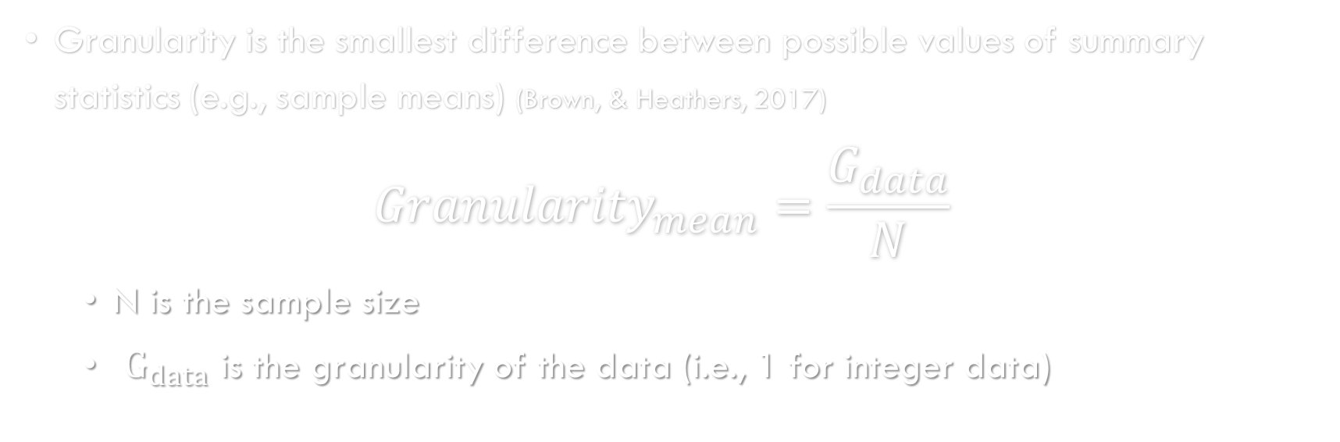
GRIM: Granularity-Related Inconsistency of Means
Granularity is the smallest difference between possible values of summary statistics (e.g., sample means) (Brown, & Heathers, 2017) ${Granularity}_{mean}=\frac{G_{data}}{N}$
N is the sample size
$G_{data}$ is the granularity of the data (i.e., 1 for integer data)
Notes:
$$\frac{G_{data}}{N∗L}>{10}^{−D}$$

Slide 6
GRIMMER: GRIM Mapped to Error Repeats
The GRIMMER test extends the logic of the GRIM test, but it relies on a few additional factors (Anaya, 2016)
In brief rather than a valid summary statistic being a multiple of the granularity of that statistics, it tends to follow a pattern
Deviations from this pattern are considered inconsistencies
Notes:
Relies on 4 factors:
Sample size
Granularity of the data
Degree of precision
Magnitude of the statistic

Slide 7
GRIM and GRIMMER
n = 10
Any means which fall in the white-space (e.g., the red box) are inconsistent
Any SD which fall between points on the red line are inconsistent

Slide 8
GRIM and GRIMMER
These tools can be helpful to editors, reviewers, and researchers for checking manuscripts at any stage of the publication process for inconsistencies
It is important to remember that inconsistencies can arise for many reasons
Typos
Improper sample sizes due to attrition
Rounding errors

Slide 9
GRIM and GRIMMER
While these tests can be helpful for detecting inconsistencies, as consumers of research we might be better served with the actual distribution of a sample
For a variety of reasons, getting access to data can be difficult at best
May be sensitive, protected, or proprietary
May require further ethical or institutional permission
May require much labor to make it externally interpretable
May no longer be available

Slide 10
Understanding Discrete Sample Data Beyond Basic Descriptive Statistics
When trying to understand data, we need to keep in mind the mechanisms that gave rise to the data observed
Understanding how the data was collected and operationalized can go a long way to aiding our understanding of statistical results
Often, we want to know a little bit more about how subjects responded beyond the basic descriptive statistics

Slide 11
SPRITE: Sample Parameter Reconstruction via Iterative TEchniques
The authors of SPRITE describe it as a “random walk through the possible data distributions in search of the correct SD” (Heathers, et. al, 2018)
Creates plausible samples using basic descriptive statistics of discrete data (mean, SD, lower and upper bounds)
A random distribution which matches the sample mean are first generated, and an iterative process of randomly selecting pairs of data points are shifted in the direction to approach the desired SD

Slide 12


SPRITE, GRIM and GRIMMER
Mean/SD pairs on the edges of this “umbrella” plot are possible, but unlikely sample distributions
Using upper and lower bound can also detect other inconsistencies

Slide 13
SPRITE: A Quick Example
Example: Likert-type item ranging from 1 “Strongly disagree” to 5 “Strongly agree” M = 3.20 SD = 1.00 n = 30
While the mean/SD pair are can be checked with GRIM/GRIMMER, what information could be glean to help us understand the sample composition?

Slide 14
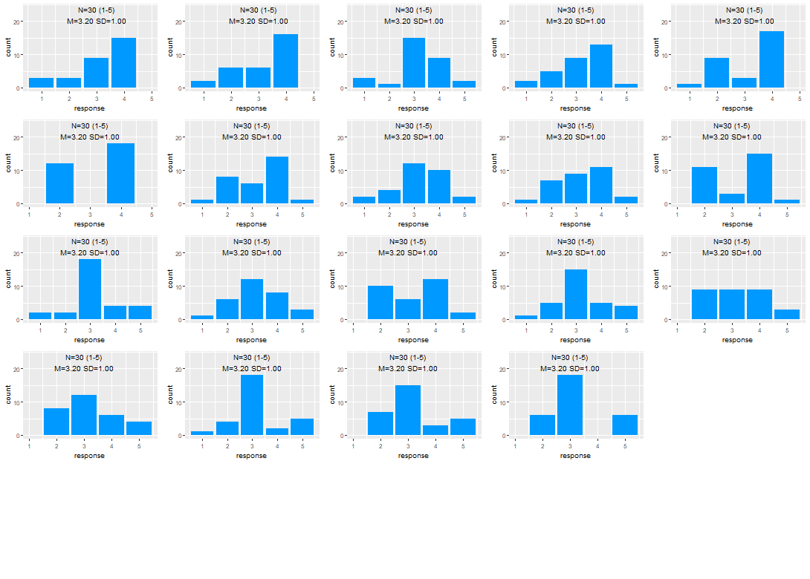
SPRITE: A Quick Example
I requested 25 solutions, but SPRITE find 19 possible sample distributions
Patterns could emerge from the solutions found
No solution had many extreme values (1 or 5)

Slide 15
SPRITE: A Worked Example
This example came from a retracted article from the Food and Brand Lab at Cornell, “Attractive names sustain increased vegetable intake in schools” (Wansink et al., 2012)
Through the use of GRIM and GRIMMER, many inconsistencies were found the article issued a correction and then later the paper was retracted
This example uses descriptive statistics regarding the average number of carrots taken by school children

Slide 16
SPRITE: A Worked Example

Slide 17
SPRITE: A Worked Example
Using the descriptive stats from the number of carrots eaten in the “X-ray vision Carrots” condition, M = 11.3, SD = 16.3, and n = 32
GRIM and GRIMMER found no inconsistencies with these summary statistics
So I used SPRITE to play around and take a peak at some plausible distributions
SPRITE needed some additional constraints
Lower bound of 0
Upper bound started at 20 and incremented upward until a solution was found

Slide 18
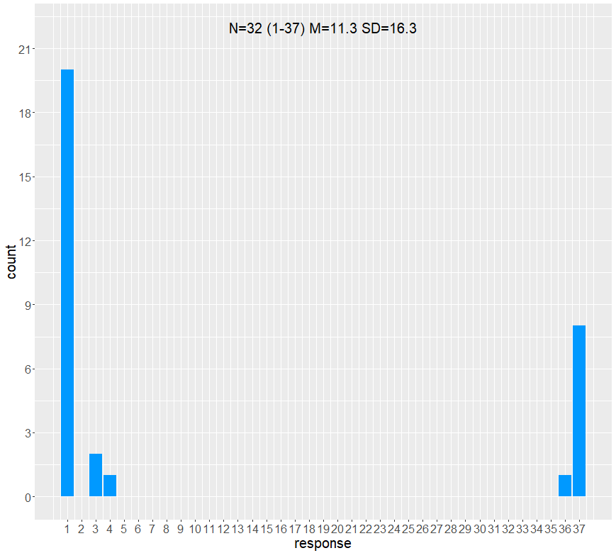
SPRITE: A Worked Example
This is the first possible sample distribution SPRITE found using an upper bound of 37 carrots
20 children “ate” 1 carrot
8 children “ate” 37!

Slide 19
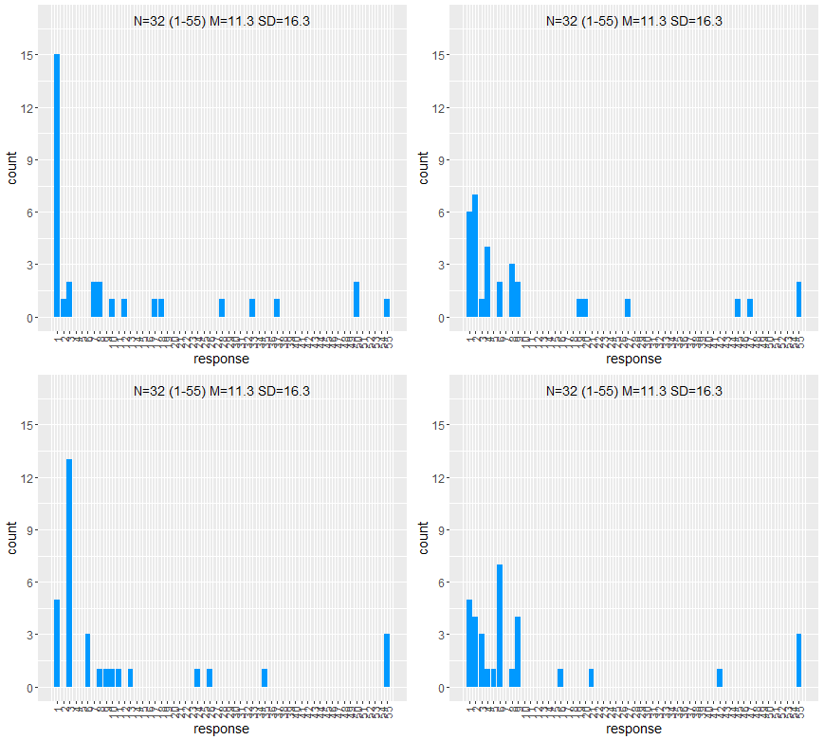
SPRITE: A Worked Example
After moving the upper bound to 55 carrots, the distribution start to look like one might expect
Many children taking small numbers of carrots
But this still requires 1-3 children to load up

Slide 20
SPRITE: A Worked Example 2.0
This next example was taken from the “Many Labs 2” replication study (Klein et al., 2018)
I was curious if subjects in the original study responded similarly to the aggregate sample collected in the replication study
I found a study with SPRITEable data (Likert-type with known constraints) and started to explore

Slide 21
SPRITE: A Worked Example 2.0
Original Study
Replication Study
 | Consumer | Control
Mean | 4.08 | 5.33
SD | 1.56 | 1.30
Sample Size | 38/39 | 38/39
 | Consumer | Control
Mean | 3.92 | 4.10
SD | 1.44 | 1.45
Sample Size | 3304 | 3304
(Bauer, Wilkie, Kim & Bodenhausen, 2012)
(Klein et al., 2018)

Slide 22
SPRITE: A Worked Example 2.0
Original Study
Replication Study
 | Consumer | Control
Mean | 4.08 | 5.33
SD | 1.56 | 1.30
Sample Size | 39 | 38
 | Consumer | Control
Mean | 3.92 | 4.10
SD | 1.44 | 1.45
Sample Size | 3304 | 3304
No solutions exist for the consumer
condition with a sample size of 38

Slide 23
SPRITE: A Worked Example 2.0
Original Study
Replication Study
 | Consumer | Control
Mean | 4.08 | 5.33
SD | 1.56 | 1.30
Sample Size | 39 | 38
 | Consumer | Control
Mean | 3.92 | 4.10
SD | 1.44 | 1.45
Sample Size | 3304 | 3304
No solutions exist for the consumer
condition with a sample size of 38

Slide 24
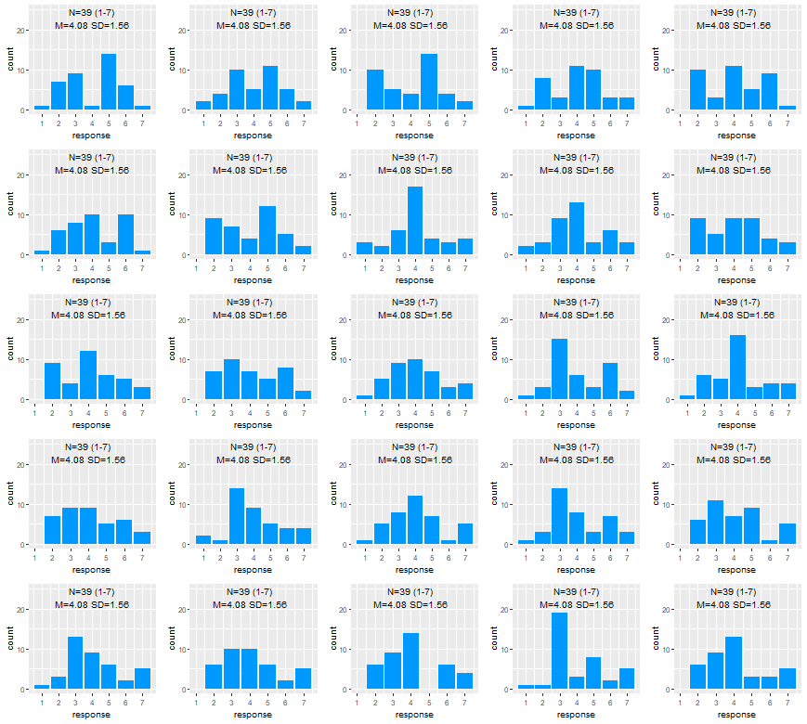
SPRITE: A Worked Example 2.0

Slide 25
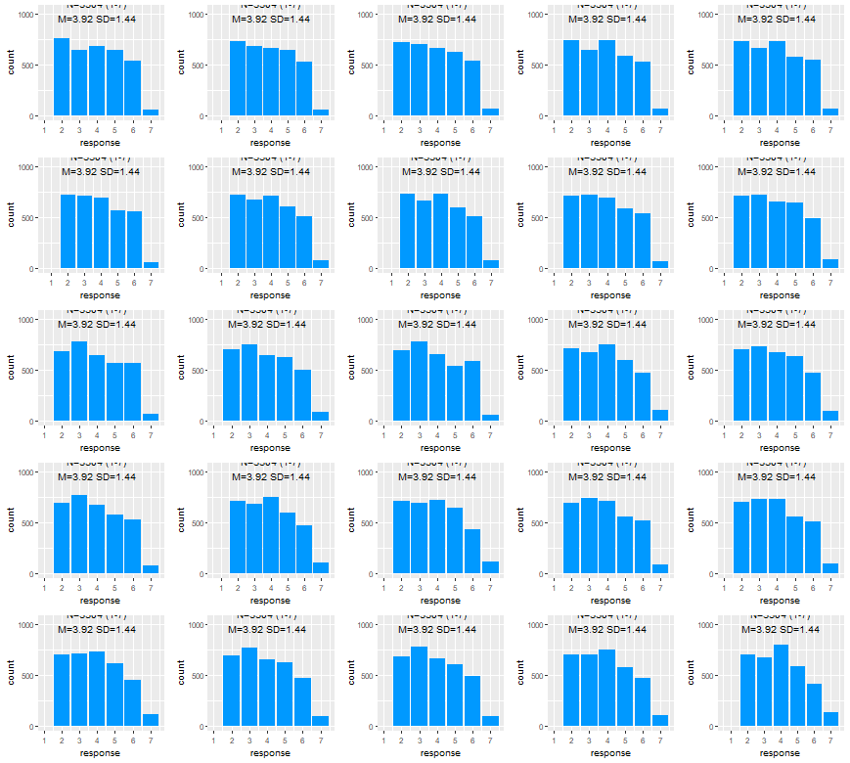
SPRITE: A Worked Example 2.0

Slide 26
SPRITE: Caveats
The authors of SPRITE are quite careful to point out that not all solution are necessarily identified
Probability statements cannot not be made about any specific sample distribution
Only patterns of observation are of more importance than any single distribution
A complete solution set of all possible samples can be found using the “Complete recovery of values in diophantine systems” or CORVIDS method (Wilner et al., 2018)

Slide 27
Take Home Message
Nothing will replace open science practices (transparency, etc.), but when sample data is not available there are tools which can help us gain a deeper understanding using only the basic descriptive statistics available
While these tools can help detect inconsistencies in existing literature, they can be quickly and easily applied to our work to improve reporting accuracy

Slide 28
Questions?

Slide 29
References
Anaya, J. (2016). The GRIMMER test: A method for testing the validity of reported measures of variability. Peerj preprints, 4, e2400v1.
Bauer, m. A., Wilkie, J. E., Kim, J. K., & Bodenhausen, G. V. (2012). Cuing consumerism: situational materialism undermines personal and social well-being. Psychological science, 23(5), 517-523.
Brown, n. J., & Heathers, J. A. (2017). The GRIM test: A simple technique detects numerous anomalies in the reporting of results in psychology. Social psychological and personality science, 8(4), 363-369.
Heathers, j. A., Anaya, J., Van der zee, T., & Brown, N. J. (2018). Recovering data from summary statistics: sample parameter reconstruction via iterative techniques (SPRITE) (no. E26968v1). Peerj preprints.
Ioannidis, j. P. (2012). Why science is not necessarily self-correcting. Perspectives on psychological science, 7(6), 645-654.

Slide 30
References
Klein, r. A., Vianello, M., Hasselman, F., Adams, B. G., Adams jr, R. B., Alper, S., ... & Batra, r. (2018). Many labs 2: investigating variation in replicability across samples and settings. Advances in methods and practices in psychological science, 1(4), 443-490.
Nosek, b. A., Spies, J. R., & Motyl, M. (2012). Scientific utopia: II. Restructuring incentives and practices to promote truth over publishability. Perspectives on psychological science, 7(6), 615-631.
Nosek, b. A., Alter, G., Banks, G. C., Borsboom, D., Bowman, S. D., Breckler, S. J., ... & Contestabile, m. (2015). Promoting an open research culture. Science, 348(6242), 1422-1425.
Wilner, S., Wood, K., & Simons, D. J. (2018). Complete recovery of values in Diophantine systems (CORVIDS).

