Slide 1
Little Steps: A Primer on Open Science Practices

Slide 2
Open Science Definition
“Open Science is a collection of actions designed to make scientific processes more transparent and results more accessible. Its goal is to build a more replicable and robust science; it does so using new technologies, altering incentives, and changing attitudes.”

Slide 3
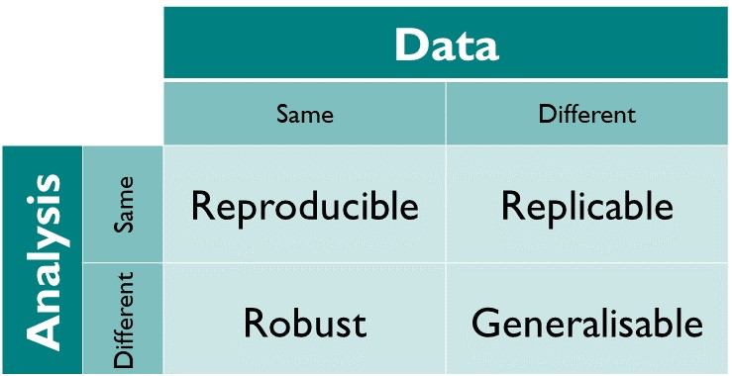
Open Science Definition

Slide 4
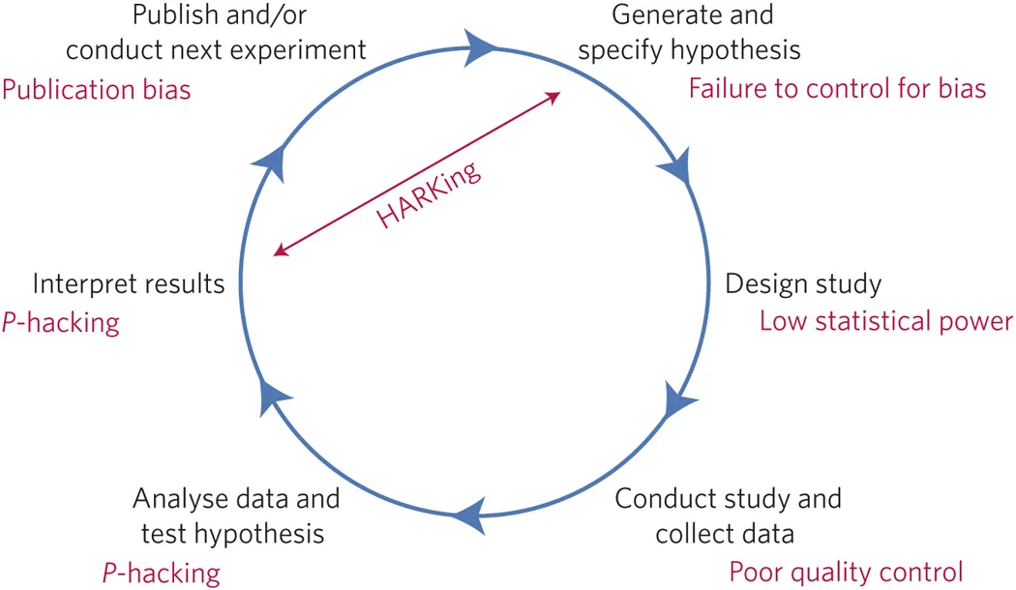
Open Science Why We need it

Slide 5
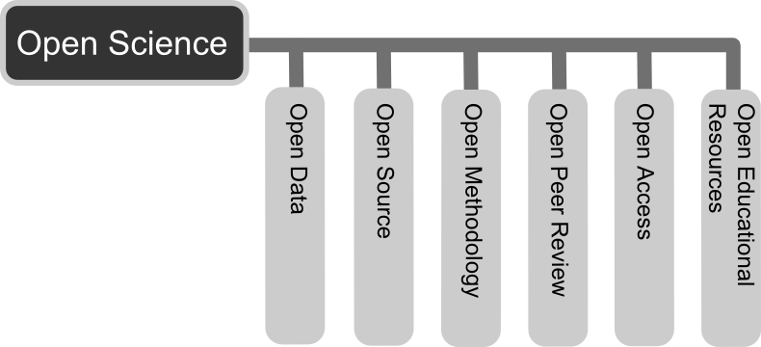
Open Science AKA Science
When will “open science” become simply science?
Open data
Open source
Open methodology
Open peer review
Open Access
Open educational resources

Slide 6
Open Science AKA Science
When will “open science” become simply science?
Open data
Open source
Open methodology
Open peer review
Open Access
Open educational resources

Slide 7
Open Science Open Data
As open as possible, as closed as necessary

Slide 8
Open Science Open Data
As open as possible, as closed as necessary
Open data:
Allows for reproduction of analyses
Secondary analyses
Transparency

Slide 9
Open Science Open Data
As open as possible, as closed as necessary
Open data:
Creates the potential for identifying subjects (even with anonymizing the data)
Notes:
Google data story

Slide 10
Open Science Open Data
As open as possible, as closed as necessary
Open data:
Creates the potential for identifying subjects (even with anonymizing the data)
Solution:
Release synthesized data

Slide 11
Open Science Open Data
Everybody needs data that are:
Discoverable by humans and machines
Retrievable and structured in standard format(s)
Self-described so that third parties can make sense of it

Slide 12
Open Science Findable
Repositories
Stable location (rather than a personal website)

Slide 13
Open Science Findable
Repositories
Stable location (rather than a personal website)
Searchable (for researchers and machines)
Notes:
Google data story

Slide 14
Open Science Findable
Repositories
Stable location (rather than a personal website)
Searchable (for researchers and machines)
DOI (digital object identifier)
Makes the data citable
Makes it easier to determine how many secondary analyses use the same data
Notes:
Google data story

Slide 15
Open Science Discoverable
Repositories
Registry of Research Data Repositories
https://www.re3data.org/
Open Science Framework
https://osf.io/
Dataverse (York has an account)
https://dataverse.org/
Notes:
Google data story

Slide 16
Open Science Accessible & Interoperable
Retrievable and structured in standard format(s)
Open access repositories
Standard file formats that are not tied to proprietary software (e.g., CSV)
Renders the data useless unless interested parties have access to the same software
Notes:
Google data story

Slide 17
Open Science Reusable
Self-described so that third parties can make sense of it
This is becoming a larger problem than originally anticipated
Researchers are making data available, but without sufficient documentation to make it reusable
It is possible to publish “data” papers (covering data collection procedures and protocols)
Notes:
Google data story

Slide 18
Open Science R TIP
If you are using R there is a handy package called codebook
Given a data.frame, the package has functions which can generate metadata and descriptives
It can also produce formats which allow search engines to find your data and index your metadata
Notes:
Google data story

Slide 19
Open Science FAIR Guidelines
FAIR
Findable
Accessible
Interoperable
Reusable

Slide 20
Open Science FAIR Guidelines
If you are in a particular field/discipline, there are sometimes common formats or guidelines for making data available
https://fairsharing.org/
If a great resource for finding standards for particular journals, or repositories

Slide 21
Open Science Open Source

Slide 22
Open Science Open Source
Open source ties into the notion of interoperability, but it takes it one step further toward reproducibility
Posting script files, code, or syntax

Slide 23
Open Science Open Source
Open source ties into the notion of interoperability, but it takes it one step further toward reproducibility
Posting script files, code, or syntax
In principle this should work, but often our code can depreciate

Slide 24
Open Science R Tip
There are few things we can do to ensure that R code remains functional without manually updating our code
If your code/data are hosted on Github repository, then the holepunch package can help

Slide 25
Open Science R Tip
A less technical alternative for packages available on CRAN, is to use the snapshot service provided by Microsoft via the checkpoint package (from CRAN)
library(checkpoint)
checkpoint(“2019-11-10”)
Notes:
Be sure to use projects
It will create an internal directory and detect the packages necessary to run your scripts

Slide 26
Open Science Open Access
A few things worth mentioning about open access publications
Pre-print servers are a great way to get attention and feedback on your work
You can also plan on publishing your research in OA journals
https://doaj.org/
Notes:
Be sure to use projects
It will create an internal directory and detect the packages necessary to run your scripts

Slide 27
Open Science Oxford Reflections
Notes:
Harry Potter and the gorgeous campus

Slide 28
Open Science Oxford Reflections
Connected with people from across the globe with similar outlook and stage in their career
Inspired me to step up my “open science game”
Rethink my perspective on secondary data analysis

Slide 29
Open Science Oxford Reflections
My experience thus far led me to believe that secondary analyses were of lesser value
A premium is always on novelty

Slide 30
Open Science Oxford Reflections
My experience thus far led me to believe that secondary analyses were of lesser value
A premium is always on novelty
Often, to receive funding required an extensive search for pre-existing data

Slide 31
Open Science Oxford Reflections
My experience thus far led me to believe that secondary analyses were of lesser value
A premium is always on novelty
Often, to receive funding required an extensive search for pre-existing data
Attitude that quality data was the goal for researchers, an article was just the advertisement

Slide 32

Open Science Psychological Science Accelerator

Slide 33
Open Science Oxford Reflections
Since my return from Oxford, I started to think about what other little steps I could take or recommend to other early career researchers (ECRs)

Slide 34
Open Science My 2 Bits
Get on Twitter
There is a vibrant and helpful community at your finger tips

Slide 35
Open Science My 2 Bits
Get on Twitter
Listen to podcasts
There are some amazing podcasts for ECRs, they make the commute better and they often challenge my perspective

Slide 36
Open Science My 2 Bits
Get on Twitter
Listen to podcasts
Read statistics blogs
They can be anything from quick tutorials or they can present a new outlook on topics

Slide 37
Open Science My 2 Bits
Get on Twitter
Listen to podcasts
Read statistics blogs
Create an ORCID account
Makes yourself findable even if you leave your institution

Slide 38
Open Science My 2 Bits
Get on Twitter
Listen to podcasts
Read statistics blogs
Create an ORCID account
Create an OSF account
Free repositories (link with ORCID account)

Slide 39
Open Science My 2 Bits
Get on Twitter
Listen to podcasts
Read statistics blogs
Create an ORCID account
Create an OSF account
SIPS (Society for Improving Psychological Science)
Unconference for ECRs wanting to help change how we do science

Slide 40
Open Science My 2 Bits
Get on Twitter
Listen to podcasts
Read statistics blogs
Create an ORCID account
Create an OSF account
SIPS (Society for Improving Psychological Science)
Join a journal club

Slide 41

Open Science My 2 Bits

Slide 42
Open Science Podcasts
Everything Hertz
ReproducibiliTea
Two Psychologist, Four Beers
Black Goat
Not so Standard Deviations
Quantitude
The R-Podcast

Slide 43
Open Science BLOGS
Bayesian Spectacles
20% Statistician
Simply Statistics
Data Colada
R-Bloggers
Variance Explained
The Hardest Science

Slide 44
Open Science Other Links
Lectures and Workshop from Oxford | Berlin Summer School on Open Science
https://osf.io/6ytne/
Reporting Guidelines
https://www.equator-network.org/reporting-guidelines/
Registration Forms and Templates
https://osf.io/zab38/wiki/home/

