Slide 1
Methods & Processing

Slide 2
differential GPS
satellite
base station
Trimble receiver

Slide 3
Post processing – 2 metods
Trimble Business Center (TBC)
input (.t02)
TBC
output (.csv)
Open Source (OS)
input (.t02)
runpk00 (.tgd)
teqc (.nav,.obs)
RTKLIB (.pos)
python
(UTM,
weighted average)
output (.csv)
base station
data

Slide 4
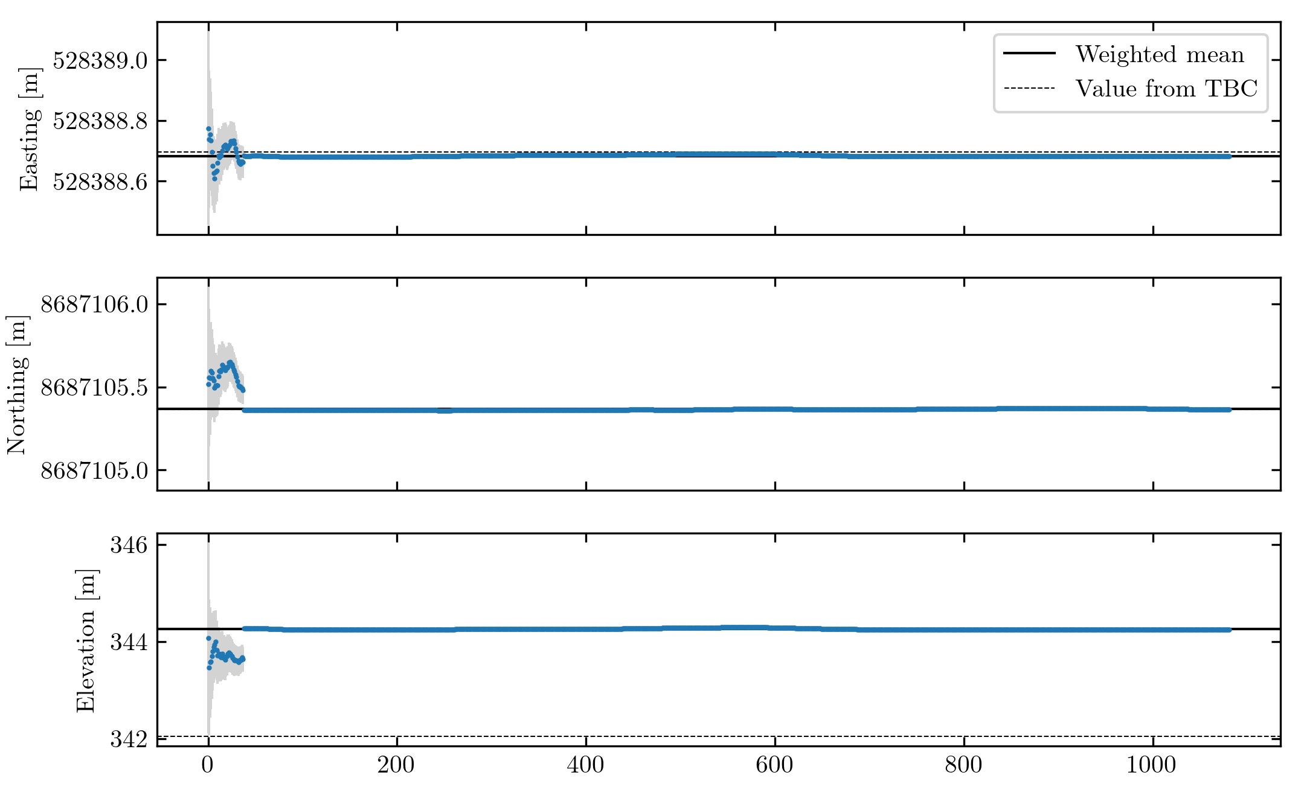
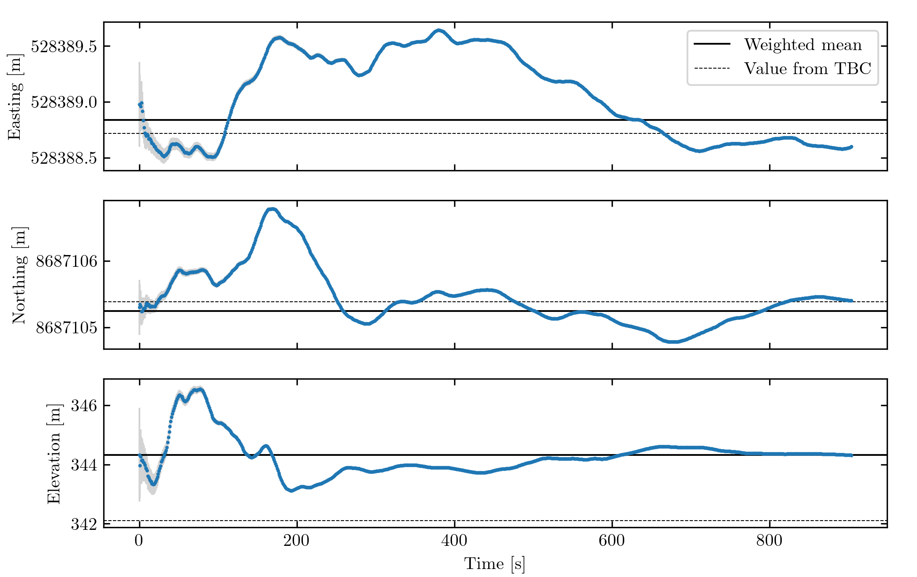
time series: OS

Slide 5
OS as replacement for TBC?
 | Northing [m] | Easting [m] | Elevation [m]
Mean Difference | 0.09 | 0.05 | 0.24
Median Difference | 0.01 | 0.01 | 0.07

Slide 6
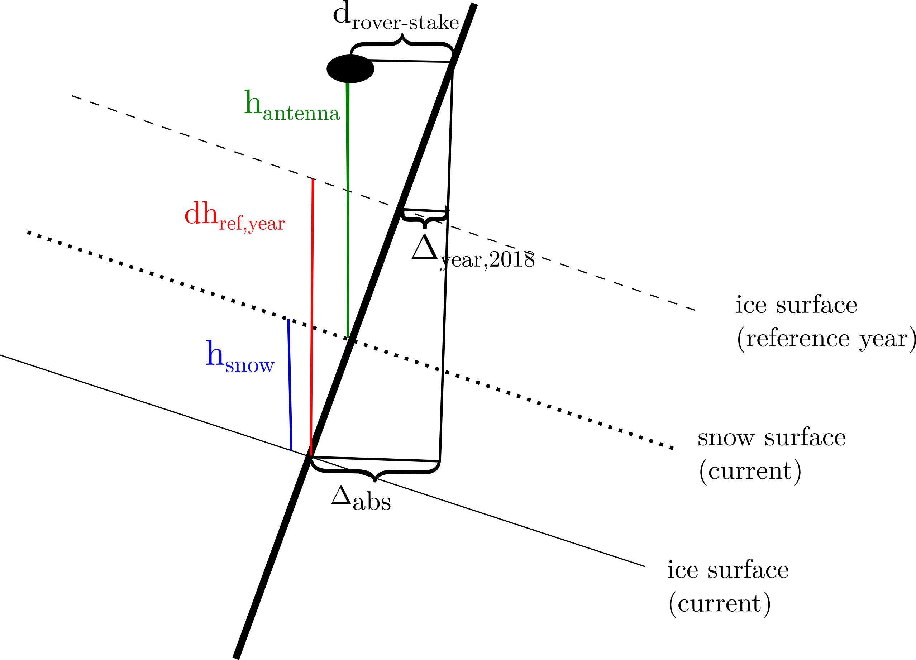
Stake correction

Slide 7
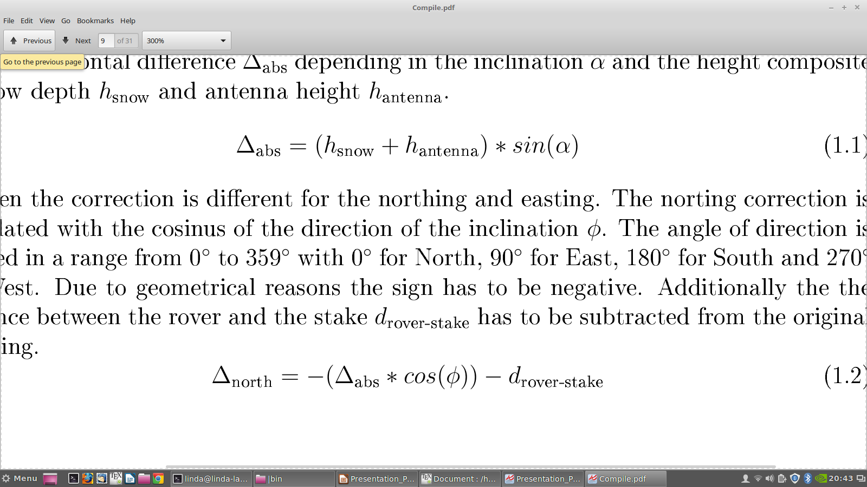
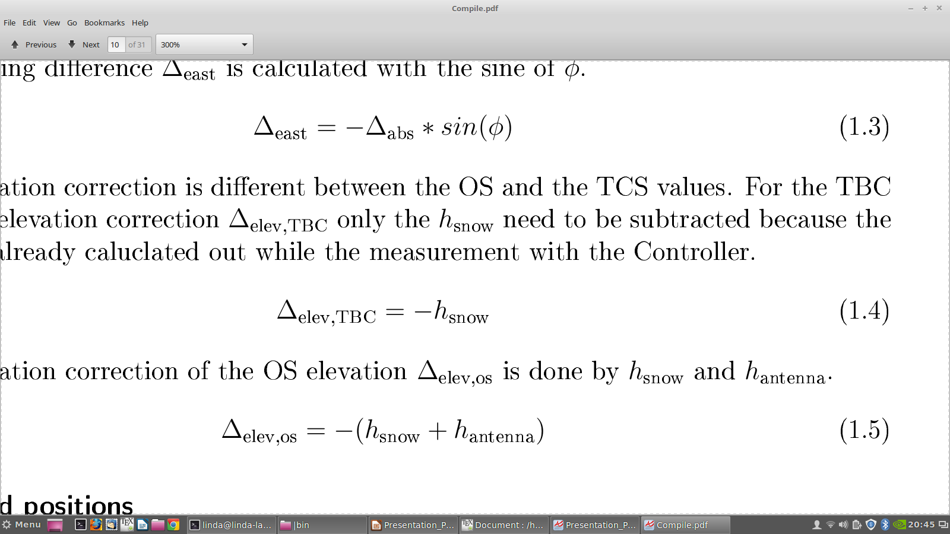
stake correction
horizontal
vertical

Slide 8
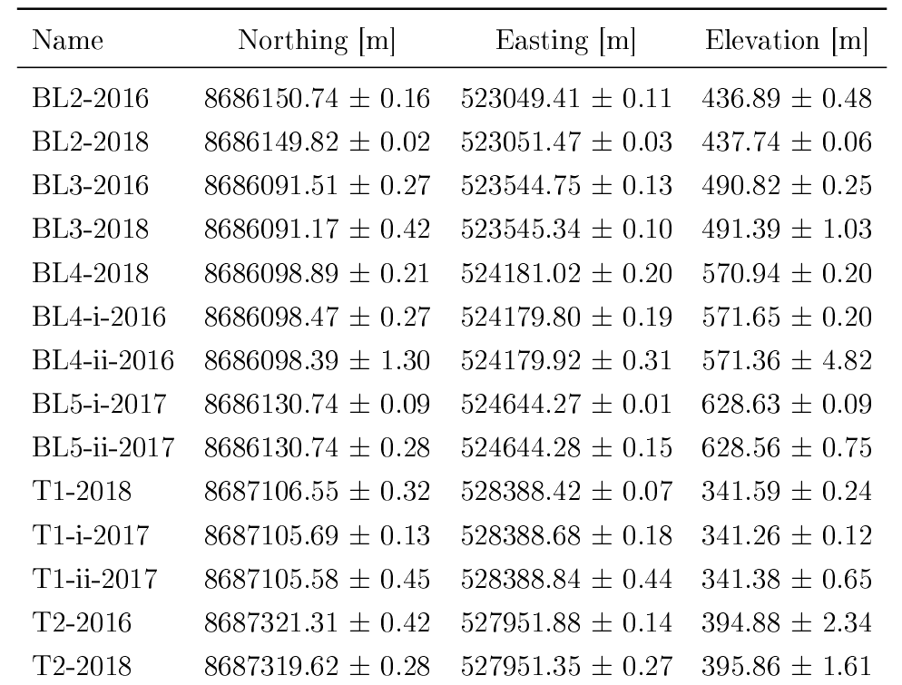
Final stake positions

