Slide 1
Tackling Child and Infant
Mortality in Africa
Ikegbo Stanley

Slide 2
Introduction
In this analysis,the trends were uncovered by investigating the behaviour of mortality rate for infants, children and mothers between 1950 - 2022.
The insights regarding healthcare factors causing mortality rate were derived by comparing the percentage of health insurance coverage with the mean mortality rate (children and mothers) and the percentage of infants immunized across the several african countries

Slide 3
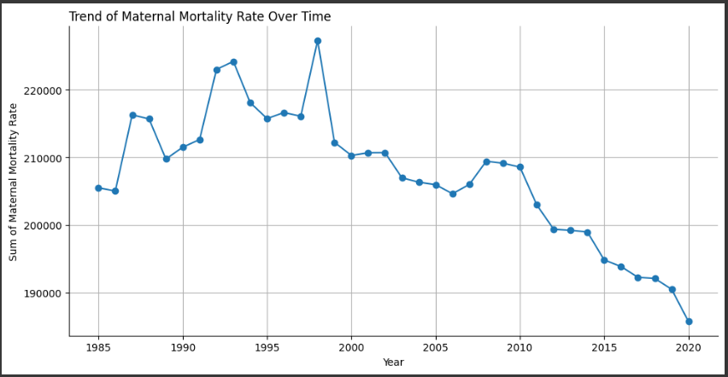
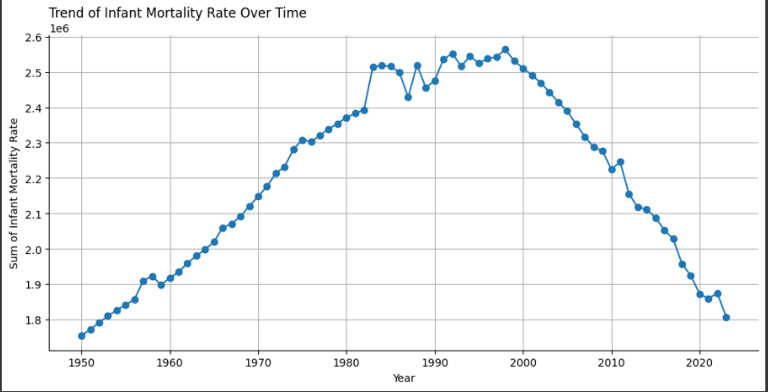
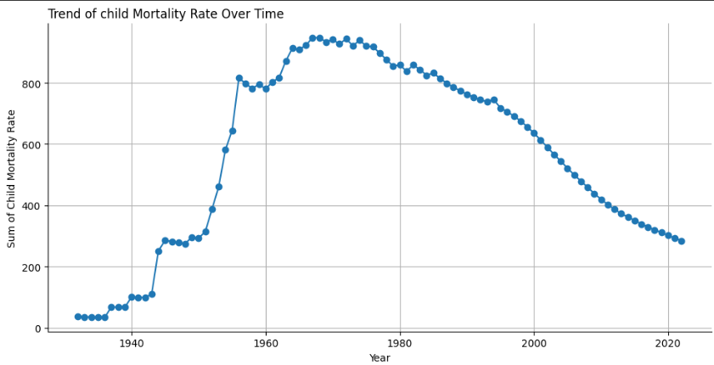
Trend of Maternal Mortality Rate Over Time

Slide 4
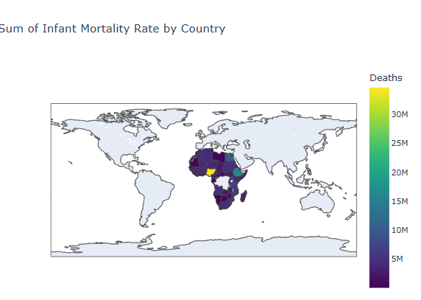
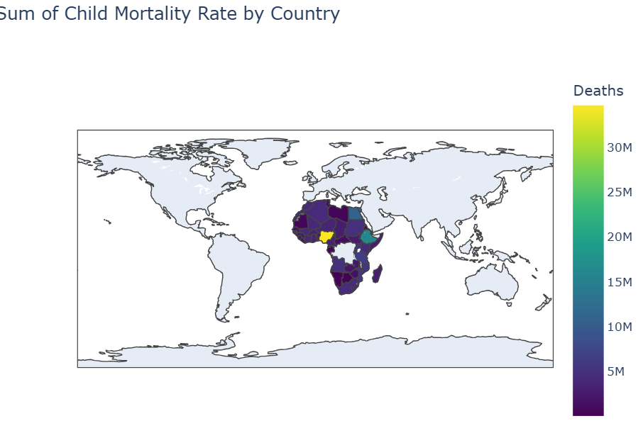
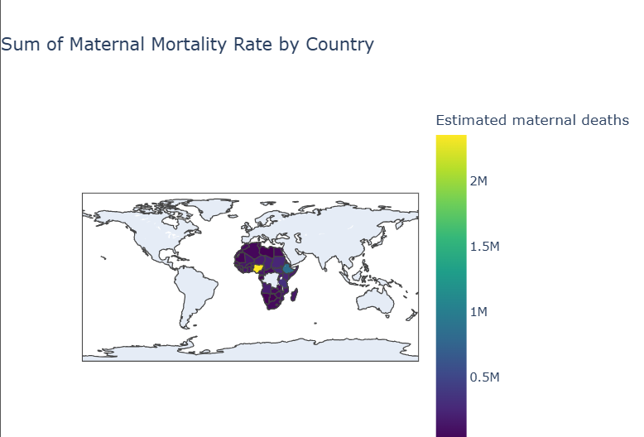
Trend of Maternal Mortality Rate Over Time

Slide 5
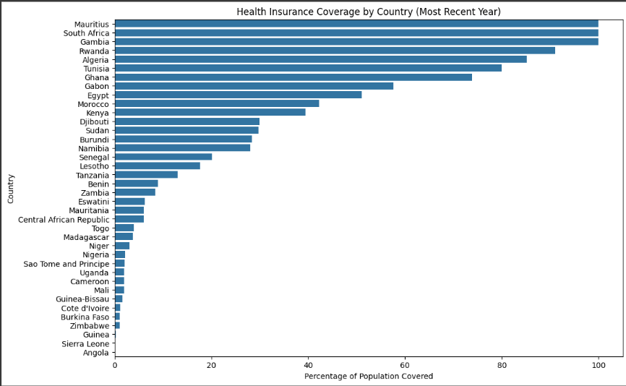
Possible HealthCare Factors contributing to Mortality Rate

Slide 6
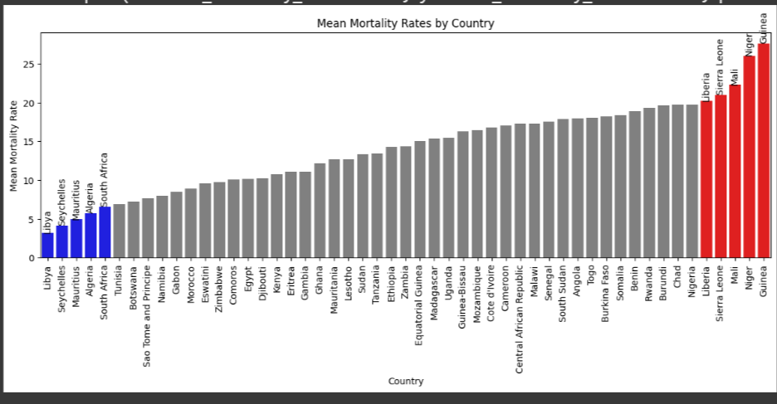

Slide 7
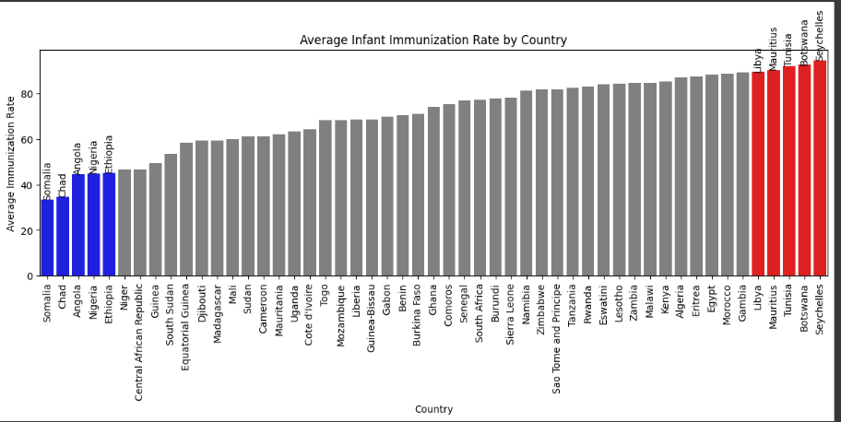

Slide 8
Insights
Mortality rates reduced generally from 1950 - 2022
It is obvious from the previous charts that countries with low percentage of healthcare insurance and infants immunized had high mortality rates, Hence, it can be inferred that
Possible healthcare factors affecting mortality rate includes, percentage of healthcare insurance covered in a country, percentage of infants that were immunized amongst others.

Slide 9
Actionable Recommendations
More healthcare insurance programs should be increased in countries where the percentage coverage of healthcare insurance is low like Mali,Niger and Guinea amongst others.
Infant immunization should be taken seriously, this means that policies and interventions should be put in place to ensure that all infants are immunized. This would reduce the infant mortality rate

Slide 10
Limitations of this Analysis
Socioeconomic and Environmental Factors were not considered, this potentially affects the accuracy of the insights and recommendations given.
Some of the Immunization Tests were dropped while handling missing values because they had large number of missing values, this also means that some useful insights might have been lost
Total births attended to by skilled health workers dataset was not used,this also means that the hypothesis that skilled health workers impact the mortality rate couldn’t be confirmed

