Slide 1
Human MoTrPAC differential analysis
Effect = change from baseline in exercise − change from baseline in resting controls
H0: change in from baseline in exercise and controls = 0 ∀ molecules, timepoints.
MoTrPAC supplies mixed-model effects and raw p-values for differences in fold change. We extract each candidate and reproduce the Benjamini–Hochberg (BH) correction which decreases false discovery rate when running multiple hypotheses tests in parallel.
A BH-adjusted p-value (q) < 0.05 defines a significant change in fold change. BH accounts for all features within each assay and comparison, including 1,417 Olink features for each plasma comparison.
Notes:
Source: MoTrPAC human acute exercise, collection c2.0, analysis package 2.0.8, commit 535b4044e7417413de471104c619120337602b77. https://github.com/MoTrPAC/MotrpacHumanPreSuspensionAnalysis/tree/535b4044e7417413de471104c619120337602b77
The saved notebooks reuse MoTrPAC mixed-model estimates, raw p-values and confidence intervals. No new participant-level model was fitted. BH-adjusted p-values were independently reproduced. Primary comparisons have contrast_type=exercise_with_controls. Effects are source logFC, not absolute concentrations or asserted percentage changes.
Analysis notebooks: /Users/acheron/multiomics-hackathon-2026-track-1/bic/fractalkine_differential_analysis.ipynb and /Users/acheron/multiomics-hackathon-2026-track-1/bic/wars1_differential_analysis.ipynb.
Plasma model: ~ 0 + group_timepoint + BMI + calculatedAge + Sex + (1 | pid). RNA models add assay-specific covariates. BH family: tissue, assay, platform, contrast. Source correction applies separately to each comparison, not jointly across all timepoints.
The study tests responses to a single bout, not adaptation to a training program. Positive effects mean a larger baseline-to-timepoint change than control. The raw p-value assesses H0: the model contrast is zero. BH is a multiple-testing procedure, not another differential model. FDR is an expectation over repetitions, not a posterior probability that an individual hit is false. Pointwise confidence intervals do not include multiplicity correction.

Slide 2
Focusing on Fractalkine and WARS1
Fractalkine / CX3CL1
WARS1: vascular signaling
Human islets: less β-cell death and glucagon secretion, without increased insulin secretion in this study. [1]
Mini-WARS stabilizes endothelial junctions through NRP1 / VE-cadherin and reduces permeability. [4]
T2-WARS binds VE-cadherin and inhibits endothelial migration and new blood-vessel formation. [6]
Rat β-cells: CX3CL1 protects insulin secretion against impairment by the inflammatory cytokine TNFα. [1]
Possible role in immune-cell communication and vascular remodeling. [7]
Olink does not identify which WARS1 form rises after exercise. Could WARS1 modulate Vascular activity after exercise?
[1] Rutti 2014 [4] Gioelli 2022 [6] Tzima 2005 [7] Strömberg 2016. Full references in notes.
Notes:
Purpose: relate the exercise-responsive candidates to independent biological evidence without interpreting the MoTrPAC response as a disease outcome.
[1] Rutti S et al. Fractalkine (CX3CL1), a new factor protecting beta-cells against TNF-alpha. Molecular Metabolism 2014;3:731–741. https://doi.org/10.1016/j.molmet.2014.07.007 ; https://pubmed.ncbi.nlm.nih.gov/25353001/
[2] Nguyen TTT et al. Tryptophan-dependent and -independent secretions of tryptophanyl-tRNA synthetase mediate innate inflammatory responses. Cell Reports 2023;42:111905. https://doi.org/10.1016/j.celrep.2022.111905 ; https://pubmed.ncbi.nlm.nih.gov/36640342/
[3] Sun WX et al. Tryptophanylation of insulin receptor by WARS attenuates insulin signaling. Cellular and Molecular Life Sciences 2024. https://doi.org/10.1007/s00018-023-05082-2 ; https://pubmed.ncbi.nlm.nih.gov/38212570/
[4] Gioelli N et al. Neuropilin 1 and its inhibitory ligand mini-tryptophanyl-tRNA synthetase inversely regulate VE-cadherin turnover and vascular permeability. Nature Communications 2022. https://doi.org/10.1038/s41467-022-31904-1
Evidence details and limits: Rutti et al. exposed human islets to CX3CL1 for 24 hours at 1–50 ng/mL. They reported lower basal human beta-cell apoptosis and lower low-glucose-stimulated glucagon secretion, without increased glucose-stimulated insulin secretion in that study. The TNF-alpha rescue experiments on secretion largely used rat beta cells. These dose and duration conditions cannot be equated with the acute Olink response, which does not establish absolute concentration. Other work reported different insulin-secretory effects (Lee et al., Cell 2013, https://pmc.ncbi.nlm.nih.gov/articles/PMC3717389/), so the slide specifically qualifies the finding as belonging to the Rutti study.
Nguyen et al. demonstrated direct tryptophan-dependent WARS1 secretion and tryptophan-independent release through plasma-membrane-derived vesicles, including extracellular innate immune effects. These were not exercise experiments. WARS1 is the cytoplasmic tryptophanyl-tRNA synthetase, distinct from mitochondrial WARS2.
Sun et al. studied WARS-dependent tryptophanylation of insulin receptor K1209 under excess tryptophan. This reduced insulin-stimulated signaling through IR, AKT and AS160 and reduced glucose uptake. SIRT1 reversed the modification. Substrate availability and the intracellular compartment are essential to this model. The exercise plasma rise does not demonstrate insulin-receptor modification or insulin resistance.
Vascular evidence: Gioelli et al. found that mini-WARS binds NRP1 and inhibits NRP1/VE-cadherin internalization, stabilizing endothelial junctions and reducing histamine-induced permeability in experimental endothelial cells. Tzima et al. found that the proteolytic T2-WARS fragment binds VE-cadherin, inhibits VEGF-induced ERK activation and endothelial migration, and inhibits angiogenesis. Mini-WARS and T2-WARS are distinct molecular forms. The NRP1 mechanism should not be assigned to T2-WARS. These studies did not test exercise plasma. The Olink result does not identify full-length, spliced, cleaved or vesicular WARS1 species.
MoTrPAC results are pinned human c2.0 analysis package 2.0.8, commit 535b4044e7417413de471104c619120337602b77. No glucose-control, islet, endothelial or immune-function endpoint was tested in our differential analysis.
[6] Tzima E et al. VE-cadherin links tRNA synthetase cytokine to anti-angiogenic function. Journal of Biological Chemistry 2005;280:2405–2408. https://doi.org/10.1074/jbc.C400431200 ; https://pubmed.ncbi.nlm.nih.gov/15579907/
Interpretation: vascular signaling is the prioritized follow-up hypothesis because extracellular WARS1 forms have direct experimental vascular actions. MoTrPAC does not establish that this explanation is more likely than other functions. Reduced vessel leakage and inhibition of new vessel growth are different outcomes, and neither implies a uniformly beneficial exercise adaptation. The intracellular insulin-receptor mechanism remains background biology and does not establish a consequence of the plasma response.
[7] Strömberg A et al. CX3CL1—a macrophage chemoattractant induced by a single bout of exercise in human skeletal muscle. American Journal of Physiology-Regulatory, Integrative and Comparative Physiology 2016;310:R297–R304. https://doi.org/10.1152/ajpregu.00236.2015 ; https://pubmed.ncbi.nlm.nih.gov/26632602/
Complementary biology: the human exercise study found increased muscle CX3CL1 with predominantly endothelial localization. Cell experiments supported immune communication and remodeling as possible functions. This is an alternative to, or could coexist with, pancreatic signaling. Neither study establishes which role dominates after exercise. The slide distinguishes the human-islet observations from the rat TNFα experiments.

Slide 3
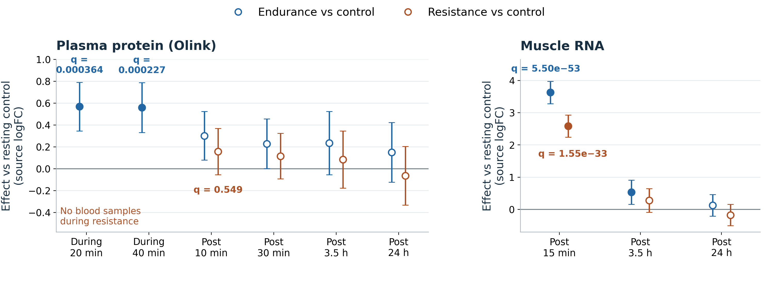
Fractalkine rises during endurance exercise
Resistance: no plasma BH hits after exercise. Muscle RNA rises at 15 min: +2.585, q = 1.55 × 10⁻³³.
During-resistance plasma was not sampled.
Filled: q < 0.05. Hollow: q ≥ 0.05. Bars: pointwise 95% CIs.
Notes:
Source: MoTrPAC human acute exercise, collection c2.0, analysis package 2.0.8, commit 535b4044e7417413de471104c619120337602b77. https://github.com/MoTrPAC/MotrpacHumanPreSuspensionAnalysis/tree/535b4044e7417413de471104c619120337602b77
The saved notebooks reuse MoTrPAC mixed-model estimates, raw p-values and confidence intervals. No new participant-level model was fitted. BH-adjusted p-values were independently reproduced. Primary comparisons have contrast_type=exercise_with_controls. Effects are source logFC, not absolute concentrations or asserted percentage changes.
Sources: /Users/acheron/multiomics-hackathon-2026-track-1/bic/results/fractalkine/cx3cl1_plasma_differential.csv and cx3cl1_tissue_rna_differential.csv. All numerical values are rounded from the CSVs.
Resistance plasma: during-exercise samples are unavailable. Post 10 min effect +0.156882, raw p=0.146200, BH-adjusted p=0.548753. The remaining resistance plasma adjusted p-values are 0.595239 (30 min), 0.962028 (3.5 h), and 0.791810 (24 h). None passes BH. Exactly two of ten primary plasma comparisons pass source BH. The remaining post-exercise plasma contrasts do not. Holm-adjusted p-values across the ten focal plasma comparisons are 0.0000128585 and 0.0000259997. Selection followed exploratory screening, so these sensitivity checks are not independent validation.
Muscle RNA at post 15 min: EE-CON effect +3.626050, q=5.500778e-53. RE-CON effect +2.585393, q=1.554822e-33. There are four of twelve significant muscle/adipose primary RNA comparisons in total. The other two are endurance muscle RNA at 3.5 h (effect +0.536484, q=0.041645) and endurance adipose RNA at 45 min (effect +0.587781, q=0.027316). RNA and protein effect scales must not be pooled.
During-resistance blood was not sampled. Zero of four direct post-exercise EE-RE plasma comparisons pass BH (minimum adjusted p approximately 0.472). An earlier circulating response plus later tissue RNA does not identify the tissue source.

Slide 4
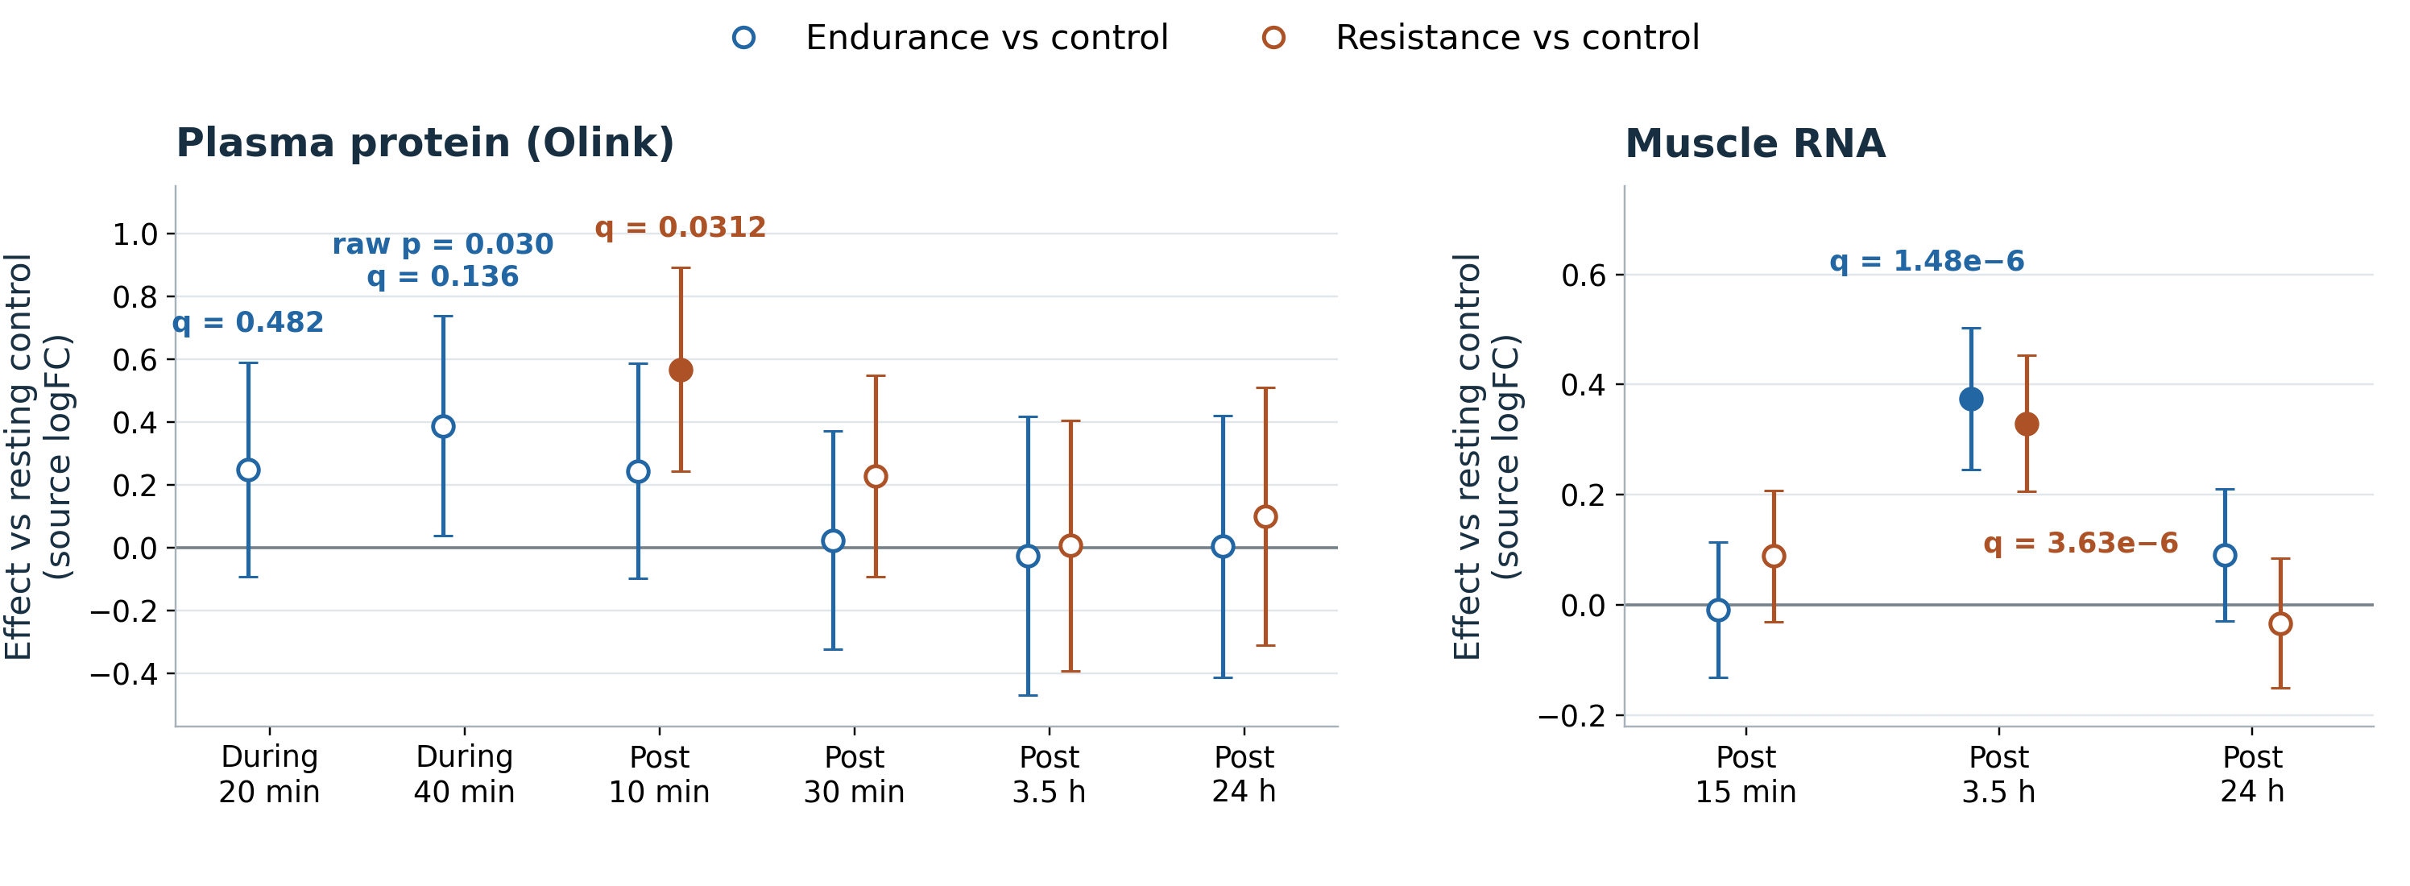
WARS1 rises after resistance exercise
Endurance plasma: q = 0.482 at 20 min and 0.136 at 40 min. Neither passes BH.
Endurance muscle RNA rises at 3.5 h: +0.374, q = 1.48 × 10⁻⁶.
Filled: q < 0.05. Hollow: q ≥ 0.05. Bars: pointwise 95% CIs.
Notes:
Source: MoTrPAC human acute exercise, collection c2.0, analysis package 2.0.8, commit 535b4044e7417413de471104c619120337602b77. https://github.com/MoTrPAC/MotrpacHumanPreSuspensionAnalysis/tree/535b4044e7417413de471104c619120337602b77
The saved notebooks reuse MoTrPAC mixed-model estimates, raw p-values and confidence intervals. No new participant-level model was fitted. BH-adjusted p-values were independently reproduced. Primary comparisons have contrast_type=exercise_with_controls. Effects are source logFC, not absolute concentrations or asserted percentage changes.
Sources: /Users/acheron/multiomics-hackathon-2026-track-1/bic/results/wars1/wars1_primary.csv, wars1_plasma_primary.csv, wars1_direct_EE_RE.csv, wars1_post10_plasma_decomposition.csv and FINDINGS.md.
Endurance plasma at 20 min: effect +0.247576, raw p=0.154284, BH-adjusted p=0.482228. At 40 min: effect +0.387097, raw p=0.030154, BH-adjusted p=0.135725. Neither passes BH. Endurance muscle RNA at 3.5 h: effect +0.374024, q=1.479715e-6. Resistance muscle RNA at 3.5 h: effect +0.329233, q=3.628728e-6. Plasma Olink feature OID21084 maps to WARS1 (aliases WARS/WRS/IFI53), UniProt P23381. The plasma raw p-value is 0.0007337048817773. Its pointwise CI is [0.2417157128, 0.8919410064]. Within resistance, post 10 min vs baseline is +0.370578 (q=0.008118). Control post 10 min vs baseline is -0.196250 (q=0.751245). Their difference gives the primary effect +0.566828.
The plasma response also passes the earlier exploratory pooled BH across 14,170 primary plasma tests (adjusted p=0.040771). This is a sensitivity analysis on the same data. No direct WARS1 contrast passes source BH. No during-resistance samples exist.
Fifty-two primary estimates span available assays, including two muscle phosphosites. Neither the other compartments nor muscle total protein pass primary source BH. A nonsignificant total protein result does not prove absent release. Muscle RNA at 3.5 h cannot establish the origin of a 10 min plasma response. Absolute effects across RNA and protein scales are not directly comparable.

Slide 5
Conceptual hypotheses
Why might release occur during endurance or soon after resistance exercise?
Observed pattern | Conceptual hypotheses
CX3CL1 Plasma rises during endurance exercise (20–40 min) | CX3CL1 pulse during endurance could signal to pancreatic islets, supporting β-cell survival and modulating glucagon during recovery. Repeated pulses might help preserve glucose control. [1]
WARS1 Plasma rises after resistance exercise (10 min) | Mechanical stress from heavy contractions could prompt release of stored WARS1. During recovery, mini-WARS could limit vascular leakage, while T2-WARS could restrain new vessel growth. Some anti-angiogenic behavior could support recovery after exercise. As seen in data, it is a pulse which might make sense in the context of subsequent muscle growth and generation. [4,6,8]
Notes:
Conceptual interpretation: the table proposes possible triggers and adaptive roles. The exercise-mode labels describe where this analysis detected a plasma response. They do not establish mode-specific release, a beneficial effect, or an evolutionary purpose.
Primary CX3CL1 conceptual hypothesis for type 2 diabetes: sustained metabolic demand during endurance exercise could be accompanied by a circulating signal to pancreatic islets. The proposed downstream role is support of β-cell survival and modulation of glucagon during recovery. If repeated exercise pulses have relevant activity, they might contribute to maintaining glucose regulation over time. This is an inference combining the acute MoTrPAC association with separate islet experiments. It is not a demonstrated explanation for the plasma rise or evidence that CX3CL1 prevents diabetes.
Evidence boundary: the human-islet study used prolonged exposure in culture, so it does not establish the activity of an acute exercise pulse. It did not find increased insulin secretion under those conditions. Its TNFα-related insulin-secretion rescue primarily concerns rat β-cells. The hypothesis therefore emphasizes islet survival and glucagon regulation rather than assuming more insulin release. Dose, timing and glucose context need testing. Suppression of glucagon should not be assumed beneficial in every physiological context.
Alternative CX3CL1 interpretation: immune-cell communication and vascular remodeling around exercised muscle remain plausible, based on Strömberg et al. These local roles could coexist with pancreatic signaling, or the plasma rise could reflect spillover without a systemic action. The tissue source, release mechanism and target organ remain unresolved.
Discriminating diabetes experiment, proposed: quantify the exercise-associated CX3CL1 exposure using an orthogonal assay. Apply the measured pulse to human islets under relevant glucose conditions and compare β-cell survival, glucagon and glucose-stimulated insulin secretion with CX3CL1 depletion or CX3CR1 blockade and appropriate controls. Repeated-pulse and longer-term studies would be needed to test the extended hypothesis about glucose regulation. These experiments require new measurements and were not performed here.
WARS1 hypothesis: high-force contractions and associated vascular compression could provide a mechanical-stress context for release of existing WARS1 from stressed cells during early recovery. The proposed link from that stress to WARS1 release is an inference, not an experimentally demonstrated mechanism. Mini-WARS motivates a barrier-stabilization hypothesis, whereas T2-WARS motivates restraint of vessel sprouting. The latter is not equivalent to better perfusion or a beneficial training response. Detecting and identifying the extracellular form is essential. Later muscle RNA induction cannot explain the earlier plasma rise by itself or identify its source.
Mode and timing: neither candidate passed BH in a direct post-exercise EE–RE plasma comparison. A significant exercise-versus-control result in one arm and a nonsignificant result in the other is not evidence of a significant difference between arms. There are no during-resistance samples. A shared response with different timing, clearance changes, concentration changes or cell injury remains possible. WARS1 is a candidate vascular exerkine rather than an established exercise-mediated vascular signal. The claim of novelty requires a systematic literature assessment.
[7] Strömberg A et al. CX3CL1—a macrophage chemoattractant induced by a single bout of exercise in human skeletal muscle. American Journal of Physiology-Regulatory, Integrative and Comparative Physiology 2016;310:R297–R304. https://doi.org/10.1152/ajpregu.00236.2015 ; https://pubmed.ncbi.nlm.nih.gov/26632602/
[8] Muscle contraction-blood flow interactions during upright knee extension exercise in humans. Journal of Applied Physiology 2004. https://doi.org/10.1152/japplphysiol.00219.2004 . Physiological context only: contraction-related intramuscular pressure can restrict flow. This study does not establish WARS1 release or compare its response between exercise modes.
Further rationale, proposed tests and sources follow. These tests have not been performed in this analysis.
These hypotheses and experiments are proposed, not performed. Vascular signaling is the prioritized WARS1 follow-up. Current results do not establish muscle origin, exercise-mode specificity or a beneficial vascular effect.
Observed evidence: CX3CL1 plasma EE-CON at during 20 and 40 min has source BH-adjusted p=0.000364 and 0.000227. WARS1 plasma RE-CON at post 10 min has effect +0.566828, pointwise 95% CI [0.241716,0.891941], adjusted p=0.031163. Muscle WARS1 RNA at post 3.5 h rises in both arms. Our primary source is MoTrPAC c2.0, analysis package 2.0.8, https://github.com/MoTrPAC/MotrpacHumanPreSuspensionAnalysis/tree/535b4044e7417413de471104c619120337602b77 .
Hypothesis 1: an early plasma pulse is compatible with release or cleavage of pre-existing CX3CL1. It cannot be attributed to later measured muscle RNA. Other sources or altered clearance remain possible. An orthogonal quantitative assay, sampling during exercise and soluble-versus-cell-associated measurements would distinguish mechanisms. For the disease hypothesis, an exercise-calibrated human-islet exposure plus CX3CR1 blockade could test a receptor-dependent effect on survival and glucagon. This requires new experiments and measured absolute concentrations.
Hypothesis 2: stored WARS1 may be released rapidly, while the later muscle RNA response could reflect replenishment or an independent stress/translation program. Current summary contrasts cannot measure protein flux or establish that muscle produced the plasma species. Muscle total protein has no primary BH hit. Resolve the circulating form with orthogonal assays and obtain direct cell/tissue release evidence before assigning a myokine source.
Vascular hypothesis and test: compare matched pre/post-exercise plasma under sham depletion, WARS1 depletion and add-back of the molecular form actually detected, at its measured concentration. Mini-WARS motivates testing reduced permeability and preservation of junctional VE-cadherin, with NRP1 dependence. T2-WARS motivates testing reduced VEGF-driven migration or sprouting. These predictions depend on detecting the relevant form. Test both barrier function and sprouting because they are distinct vascular outcomes. If the effect persists after effective specific depletion, or physiological add-back fails to restore it, that would weaken a WARS1-dependent explanation. Include matched resting controls, plasma-volume and cell-injury checks, and assay-specificity and endotoxin controls. Resolving forms and testing function require additional measurements.
Available-data follow-up, proposed: test whether endothelial junction and angiogenesis gene sets change in the available tissue/timepoint differential summaries, alongside translation/stress programs. Use each assay’s measured features as its background and correct across the tested gene sets. Such enrichment is contextual evidence from bulk tissues. It cannot identify the active plasma WARS1 form, prove endothelial cell specificity or establish causality. The current summary data cannot test between-person coupling or mediation.
Exerkine assessment: following Chow et al., an exerkine is a factor released in response to exercise that acts through endocrine, paracrine or autocrine signaling. The exercise-associated circulating WARS1 signal and experimentally established release/signaling outside exercise make it a candidate. This dataset alone does not complete the release-plus-function evidence chain. Its source could be muscle, vascular or immune cells, or another tissue. An exerkine need not be a myokine and its effects need not be uniformly beneficial.
[2] Nguyen TTT et al. Tryptophan-dependent and -independent secretions of tryptophanyl-tRNA synthetase mediate innate inflammatory responses. Cell Reports 2023;42:111905. https://doi.org/10.1016/j.celrep.2022.111905 ; https://pubmed.ncbi.nlm.nih.gov/36640342/
[4] Gioelli N et al. Neuropilin 1 and its inhibitory ligand mini-tryptophanyl-tRNA synthetase inversely regulate VE-cadherin turnover and vascular permeability. Nature Communications 2022. https://doi.org/10.1038/s41467-022-31904-1
[5] Chow LS et al. Exerkines in health, resilience and disease. Nature Reviews Endocrinology 2022;18:273–289. https://doi.org/10.1038/s41574-022-00641-2
[1] Rutti S et al. Fractalkine (CX3CL1), a new factor protecting beta-cells against TNF-alpha. Molecular Metabolism 2014;3:731–741. https://doi.org/10.1016/j.molmet.2014.07.007 ; https://pubmed.ncbi.nlm.nih.gov/25353001/
Neither gene has a significant direct post-exercise endurance-versus-resistance plasma comparison in this analysis. During-resistance samples are unavailable. Nonsignificance does not establish absence or equivalence.
[6] Tzima E et al. VE-cadherin links tRNA synthetase cytokine to anti-angiogenic function. Journal of Biological Chemistry 2005;280:2405–2408. https://doi.org/10.1074/jbc.C400431200 ; https://pubmed.ncbi.nlm.nih.gov/15579907/

