Slide 1
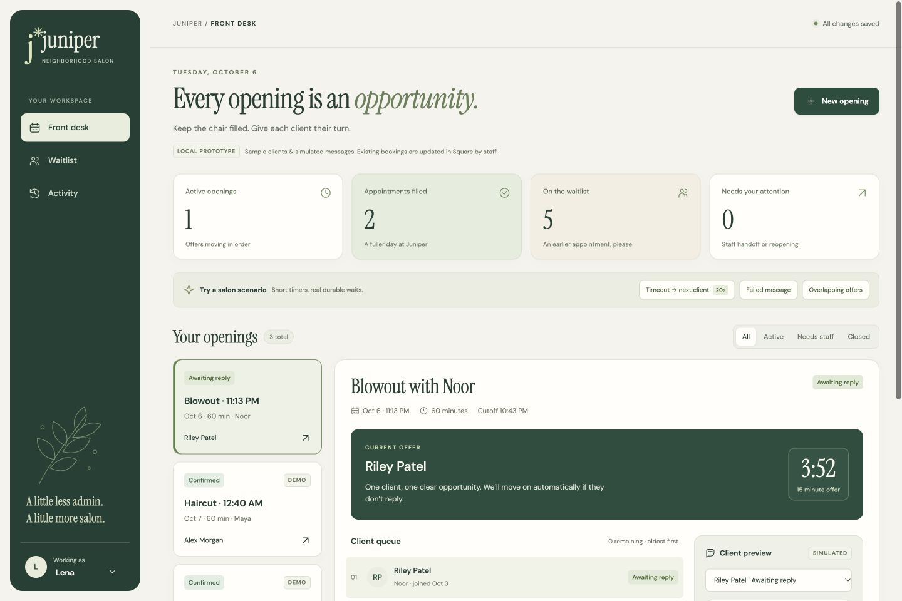
JUNIPER SALON
Filling last-minute openings
Less chasing. Clearer turns.
8–12
last-minute cancellations each week
20–30
clients on the waitlist
Today, spreadsheets and texts make it hard to know who has the next turn.
Lena’s estimates. Website shown with sample clients and simulated messages.
For Lena and Carla • Local prototype
1 / 5
Notes:
Sources: evidence/customer-chat.txt (Lena discovery conversation, turns 15–26), README.md, and the local Juniper Salon prototype. All clients and bookings in screenshots are fictional. Screenshots show actual prototype runs, not production outcomes.
Suggested narration (90 seconds): Lena wants reliable movement to the next eligible person without double-booking. The counts are discovery estimates, not measured performance. The dashboard is a local prototype using a proposed green and ivory visual direction.

Slide 2
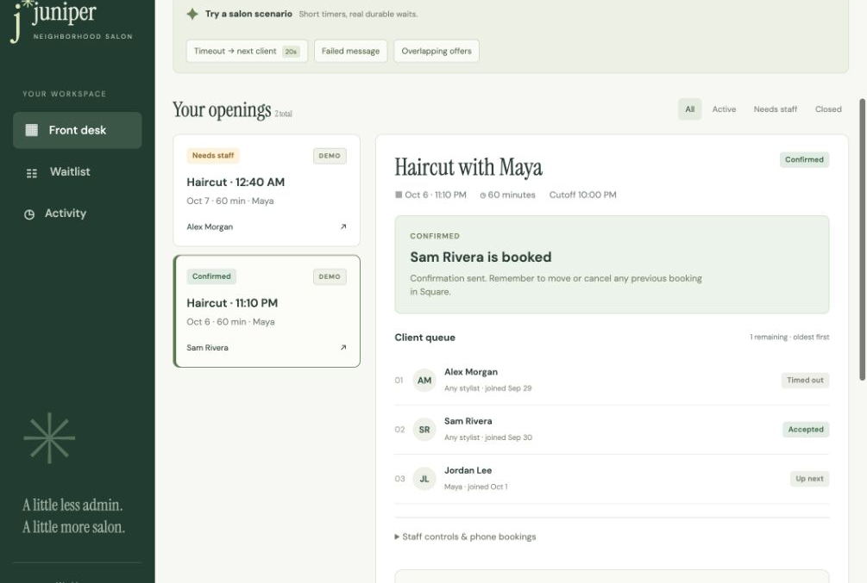
JUNIPER SALON
One client gets a clear turn
01 Match the opening
Service, stylist and availability must fit the whole appointment. Oldest waitlist entry goes first.
02 Wait, then move on
Each client normally gets 15 minutes. A decline or timeout moves to the next person automatically.
03 Confirm one booking
A current “yes” confirms. Late replies cannot take the next client’s turn. Their overlapping offers are withdrawn.
Actual demo: Alex timed out, then Sam accepted.
This scenario uses a shortened 20-second timer.
For Lena and Carla • Local prototype
2 / 5
Notes:
Sources: evidence/customer-chat.txt (Lena discovery conversation, turns 15–26), README.md, and the local Juniper Salon prototype. All clients and bookings in screenshots are fictional. Screenshots show actual prototype runs, not production outcomes.
Suggested narration (2 minutes): Walk through the eligibility rules, oldest-first queue and timed handoff. This screenshot shows the successful scenario Lena requested. The normal response window is 15 minutes, bounded by staff’s cutoff. A repeated yes does not create another booking. Only overlapping offers for the confirmed client are withdrawn.

Slide 3
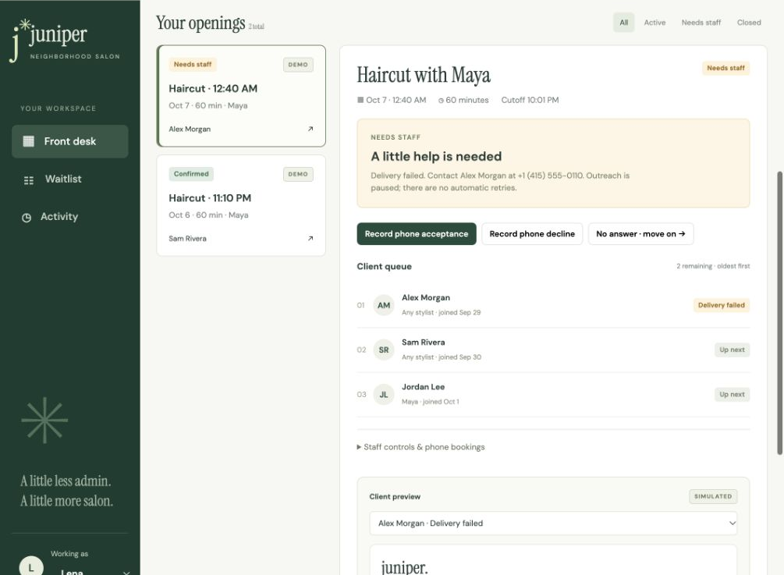
JUNIPER SALON
Staff can see when help is needed
A failed message pauses outreach.
Lena or Carla can see the client and phone number, record a phone response, or explicitly move on. No automatic retries.
The history stays visible.
Staff can stop or fill an opening. A canceled booking needs explicit reopening. The final cutoff closes unresolved openings.
Actual demo: simulated delivery failure and staff controls.
For Lena and Carla • Local prototype
3 / 5
Notes:
Sources: evidence/customer-chat.txt (Lena discovery conversation, turns 15–26), README.md, and the local Juniper Salon prototype. All clients and bookings in screenshots are fictional. Screenshots show actual prototype runs, not production outcomes.
Suggested narration (2 minutes): Explain that failure is visible and intentionally hands control to staff. Staff chooses the phone outcome. Reopening preserves the original queue and skips previously contacted clients. Staff’s cutoff also closes paused openings. Filled by staff, canceled and unfilled remain distinct outcomes.

Slide 4
JUNIPER SALON
What works today, and what is simulated
Working locally
Prototype boundaries
Matching, ordered offers, response deadlines and booking safeguards run in the prototype.
SMS is simulated. Sample clients respond through the on-screen client preview.
Temporal preserves the queue, timers and history when the page closes or the worker restarts.
Square updates stay manual, as Lena requested. Staff still checks external bookings for conflicts.
Staff can review outcomes and act on failures from one dashboard.
No real client portal, secure staff login or public deployment is included.
For Lena and Carla • Local prototype
4 / 5
Notes:
Sources: evidence/customer-chat.txt (Lena discovery conversation, turns 15–26), README.md, and the local Juniper Salon prototype. All clients and bookings in screenshots are fictional. Screenshots show actual prototype runs, not production outcomes.
Suggested narration (2 minutes): Distinguish the real durable workflow from external integrations. Temporal timers and recovery are real. No texts are sent, and the Lena/Carla selector is attribution only, not authentication. Real SMS, secure access and operational checks belong to a later pilot. Square integration was not a discovery requirement.

Slide 5
JUNIPER SALON
A small rehearsal before a live pilot
Proposed next step
Lena and Carla try five sample openings together.
Rehearse the moments that matter
Agree on the pilot’s success checks
A timeout followed by acceptance.
A failed message and phone handoff.
An overlapping offer and a late reply.
Fewer staff checks and texts.
More eligible openings filled.
No conflicting bookings or unclear turns.
After the rehearsal, review the results before adding real SMS and secure access for a supervised pilot. Square changes remain staff work.
For Lena and Carla • Local prototype
5 / 5
Notes:
Sources: evidence/customer-chat.txt (Lena discovery conversation, turns 15–26), README.md, and the local Juniper Salon prototype. All clients and bookings in screenshots are fictional. Screenshots show actual prototype runs, not production outcomes.
Suggested narration (90 seconds): This is a proposed next step, not a customer commitment. Ask Lena and Carla whether these cases represent their day. Record staff effort and filled/unfilled outcomes to establish a baseline. Before any real-client pilot, add SMS integration and authenticated access and agree on operating procedures. No production benefit has been measured yet.

